Slide 1
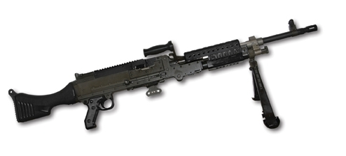
Perform Maintenance on the Machine Gun, 7.62mm, M240B

Slide 2
Terminal Learning Objective
ACTION: Perform Maintenance (PMCS) on the Machine Gun, 7.62mm, M240B.
CONDITION: In a classroom environment, given the requirement to perform maintenance on the M240B Machine Gun. Given TM 9-1005-313-10, TM 9-1005-313-23&P, DA Pamphlet 750-8, DA Form 5988-E, DA Form 5990-E, armorer tool kit, safety equipment, M240B Machine Gun, and linked dummy rounds.
STANDARD: The student will perform maintenance on the M240B Machine Gun in accordance with TM 9-1005-313-10, TM 9-1005-313-23&P, and DA Pamphlet 750-8 finding all deficiencies without losing accountability.

Slide 3

Characteristics, Capabilities & Features, Major Components

Slide 4
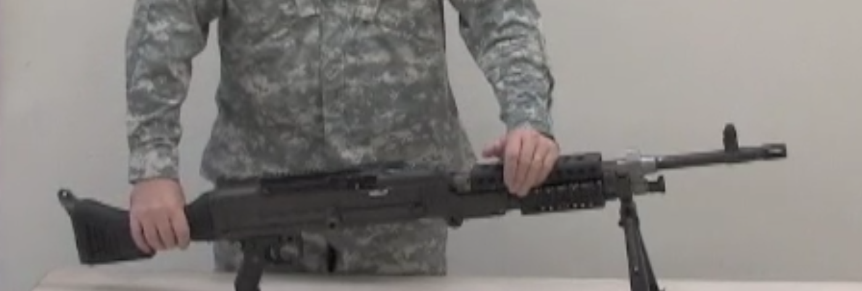
Unload, Clear and Disassemble the M240B

Slide 5
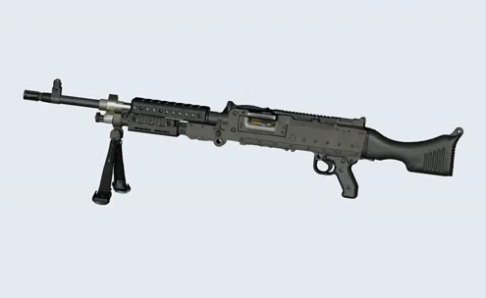
M240B Cycle of Function and Troubleshooting
Feeding
Chambering
Locking
Firing
Unlocking
Extracting
Ejecting
Cocking

Slide 6
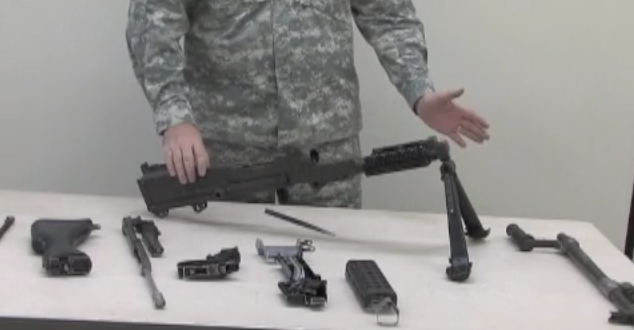
Assemble and Functions Check the M240B

Slide 7
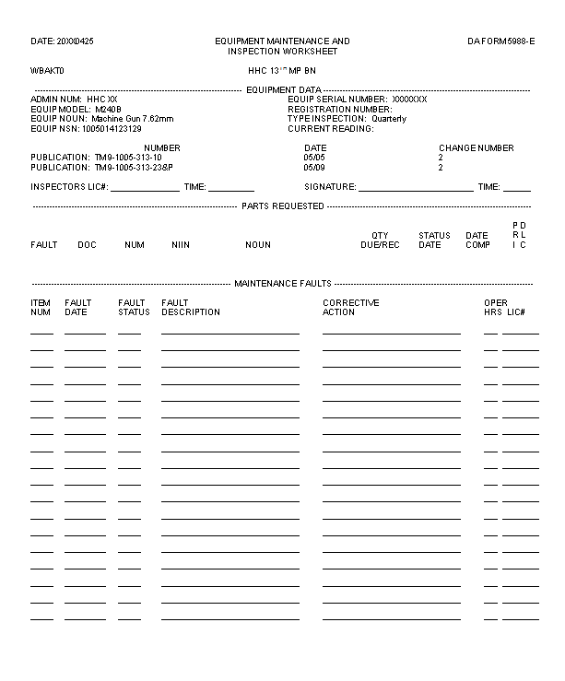
DA Form 5988-E
Student’s Info
9
28 April
X
Cover Assy is bent
DA Form 5990-E (SPT MNT)

Slide 8
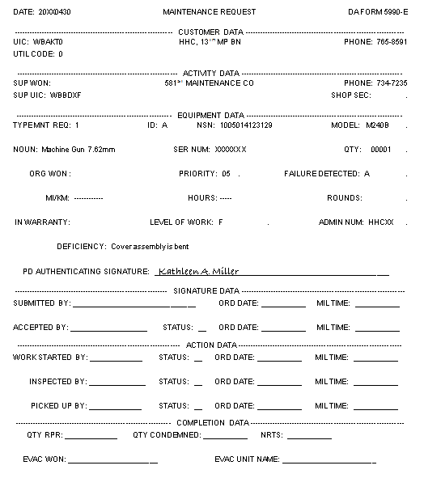
DA Form 5990-E

Slide 9
Summary
Identify the Characteristics, Capabilities and Features, and Major Components of the M240B Machine Gun.
Unload and Clear the M240B Machine Gun.
Disassemble and Troubleshoot the M240B Machine Gun.
Reassemble the M240B Machine Gun.
Perform Safety/Function Check on the M240B Machine Gun.
Perform Maintenance on the M240B Machine Gun.
Complete the DA Form 5988-E on the M240B Machine Gun.
Verify the DA Form 5990-E on the M240B Machine Gun.

