Slide 1
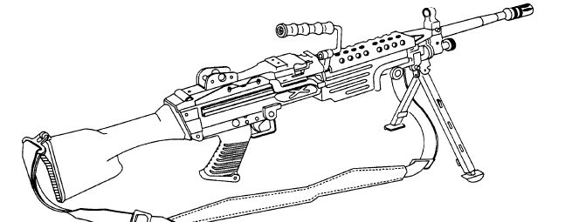
Perform Field Maintenance
on the Machine Gun,
5.56mm, M249

Slide 2
Terminal Learning Objective
ACTION: Perform Field Maintenance on the Machine Gun, 5.56mm, M249.
CONDITION: In a classroom environment given the requirement to perform field maintenance on the M249 SAW. Given TM 9-1005-201-10, TM 9-1005-201-23&P, DA Pam 750-8, blank DA Form 2404, blank DA Form 2407, armorer toolkit, safety equipment, CLP/LSA, pen or pencil, M199A1 dummy rounds, and a M249 SAW.
STANDARD: Perform field maintenance on the M249 Saw in accordance with TM 9-1005-201-10, TM 9-1005-201-23&P and DA Pam 750-8, finding all deficiencies without losing accountability.

Slide 3

Characteristics, Capabilities & Features, Major Components

Slide 4
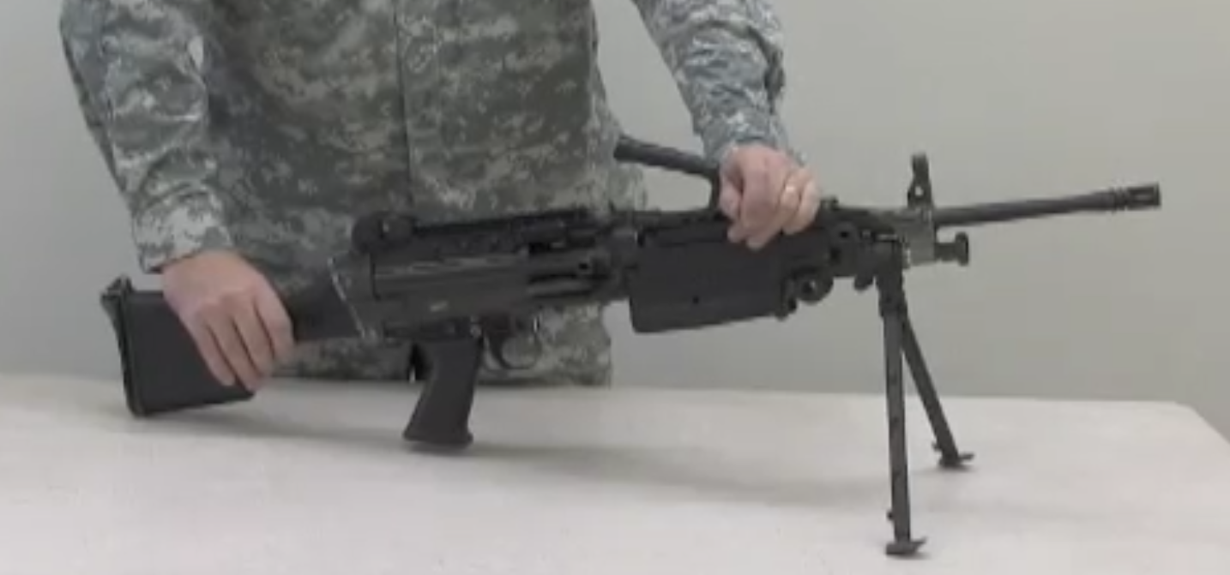
Unload, Clear and Disassemble the M249

Slide 5

Cycle of Function
Feeding
Chambering
Locking
Firing
Unlocking
Extracting
Ejecting
Cocking

Slide 6
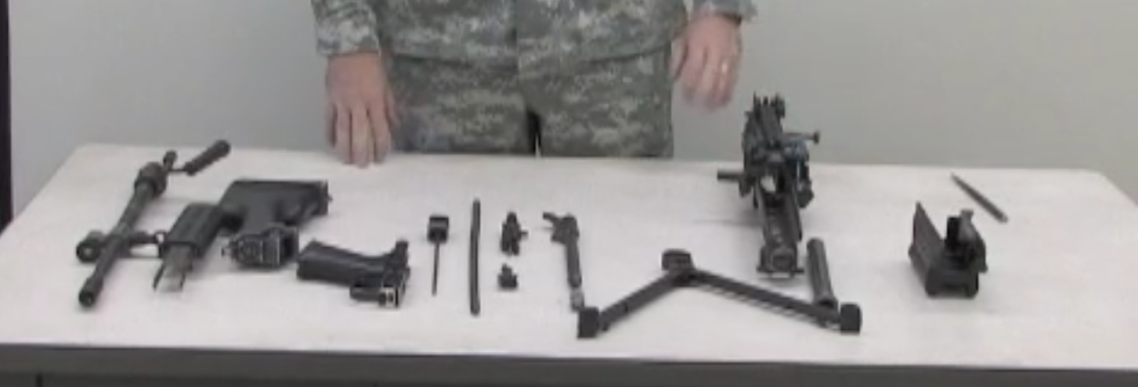
M249 Assembly and Functions Check

Slide 7
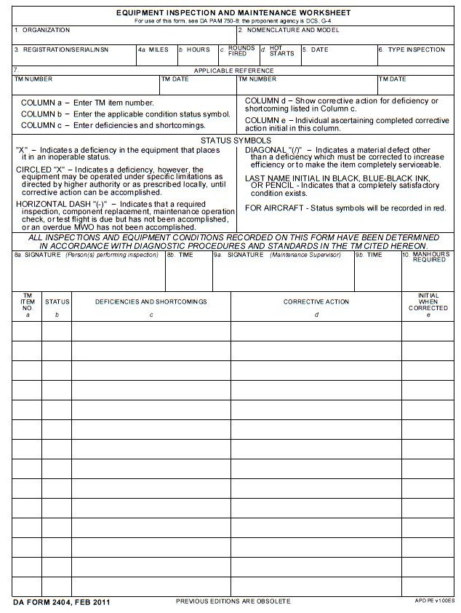
DA Form 2404
HHC, 13th Military Police Battalion
Machine Gun, 5.56mm, M249
84152
28 Feb XX
Quarterly
TM 9-1005-201-23&P W/C 6 14 Dec 90
Student’s Signature
2
/
Gas Collar has chunk missing
1005-01-036-7160
8
X
Piston Rod Bent
DA Form 2407 (SPT MNT)

Slide 8
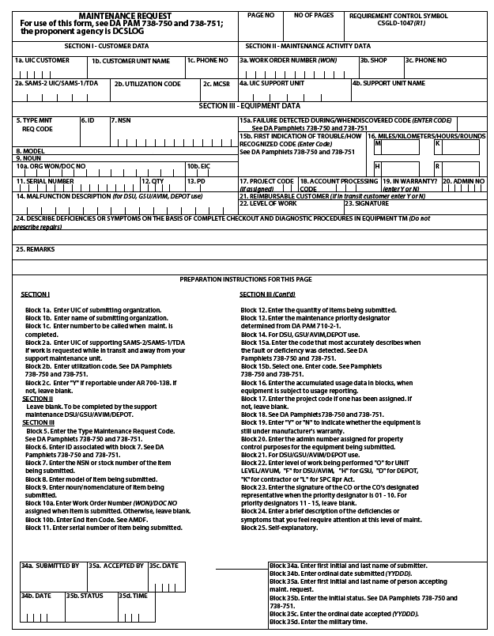
1
1
DA Form 2404
W B A K T 0
HHC 13th MP BN
765-3132
0
1
A
1 0 0 5 - 0 1 - 1 2 7 - 7 5 1 0
M249
Machine Gun 5.56mm
4 B G
8 4 1 5 2
0 0 0 0 1
1 2
N
0 1
F
Piston Rod Bent
Student Signature
XX060

Slide 9
Summary
Identified the characteristics, capabilities and features, and major components of the M249.
Unloaded and cleared the M249.
Disassembled and troubleshot the M249.
Reassembled the M249.
Performed field maintenance on the M249.
Prepared the DA Form 2407.

