Slide 1
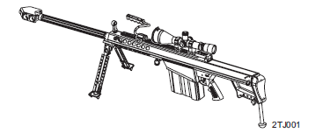
Perform Field Maintenance on the
Long Range Sniper Rifle (LRSR), M107

Slide 2
Terminal Learning Objective
ACTION: Perform Field Maintenance on the Long Range Sniper Rifle (LRSR) .50 cal, M107.
CONDITION: In a classroom environment, given the requirement to perform field maintenance on the M107 Sniper Rifle. Given TM 9-1005-239-10, TM 9-1005-239-23&P, DA Pam 750-8, a DA Form 5988-E, a DA Form 5990-E, dummy rounds, armorer toolkit, safety equipment, and a M107 Sniper Rifle
STANDARD: The student will perform field maintenance on the M107 Sniper Rifle in accordance with TM 9-1005-239-23&P and DA Pam 750-8, finding all deficiencies without losing accountability.

Slide 3
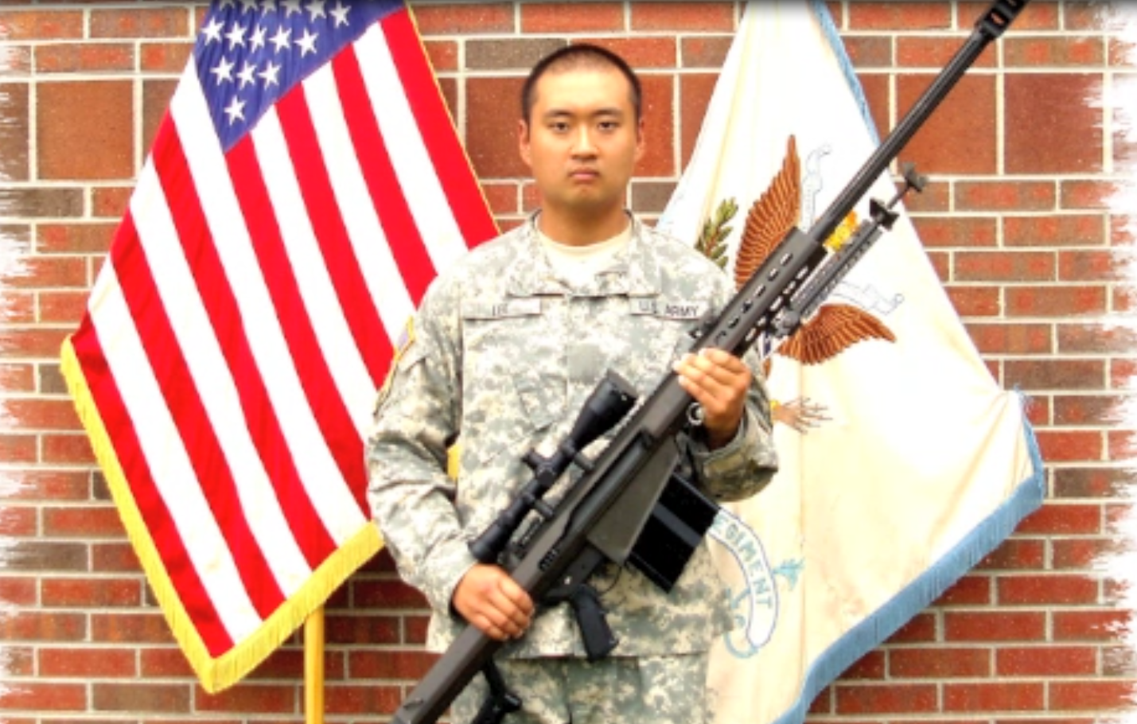
Characteristics, Capabilities & Features, Major Components

Slide 4
Cycle of Function
Feeding
Chambering
Locking
Firing
Unlocking
Cocking
Extraction
Ejection

Slide 5
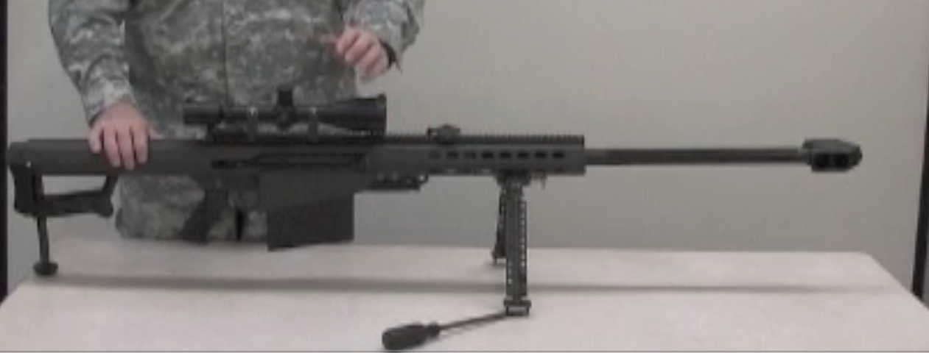
Unload, Clear and
Disassemble the M107

Slide 6
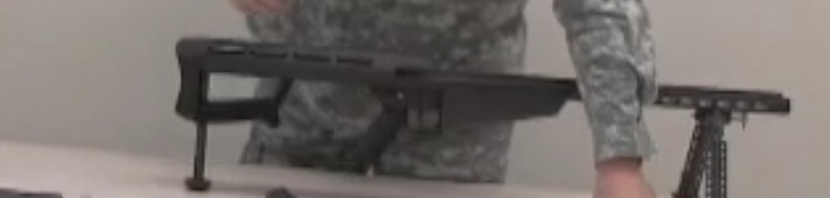
M107 Assembly and
Functions Check

Slide 7
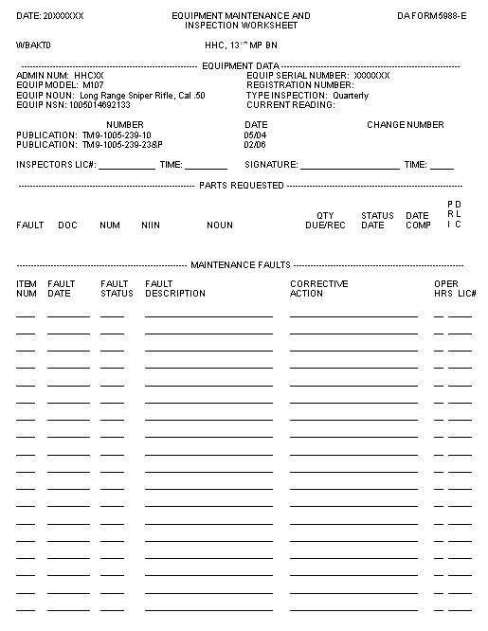
DA FORM 5988-E
Student’s Info
10
Date
X
Left Bipod leg does not extend
DA Form 5990-E (SPT MNT)

Slide 8
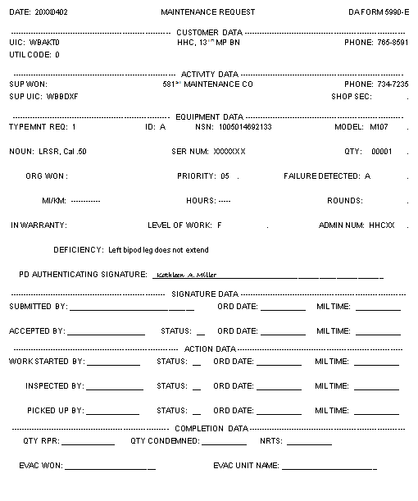
DA FORM 5990-E

Slide 9
Summary
Identify the Characteristics, Capabilities and Features, and Major Components of the M107Sniper Rifle.
Unload and Clear the M107 Sniper Rifle.
Disassemble and Troubleshoot the M107 Sniper Rifle.
Reassemble the M107 Sniper Rifle.
Perform a Function Check on the M107 Rifle.
Perform Field Maintenance on the M107 Sniper Rifle.
Verify the DA Form 5990-E.

