Slide 1
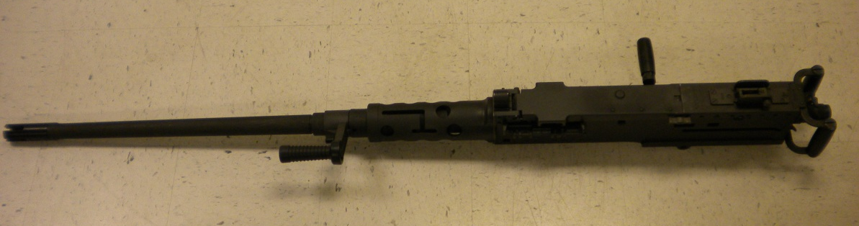
MACHINE GUN, CALIBER .50 M2A1

Slide 2
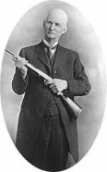
John Moses Browning 1855 - 1926

Slide 3
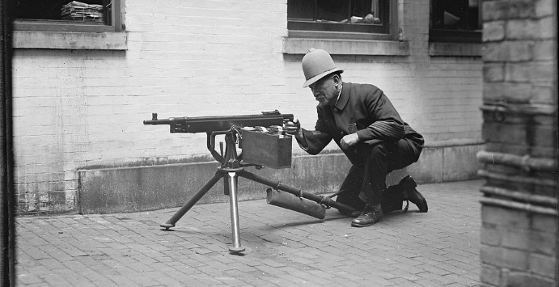
M1895
6mm Lee Navy, .30 Army in 1899
400 rds/min

Slide 4
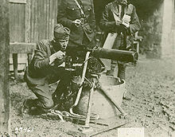
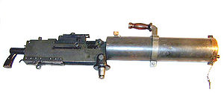
M1917 .30-06
450 rds/min
M1917A1 600 rds/min

Slide 5
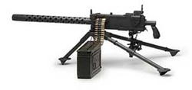
M1919 (A1-A6)
.30-06 & 7.62
400-600 rds/min

Slide 6
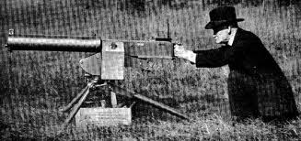
M1921
CIRCA 1919
450-600 rds/min

Slide 7
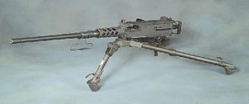
CAL .50, M2, HB
1933 –Present
450-635 rds/min

Slide 8
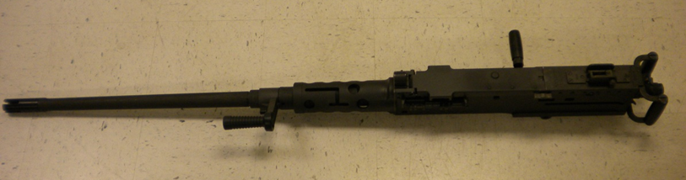
M2A1 DISASSEMBLY

Slide 9
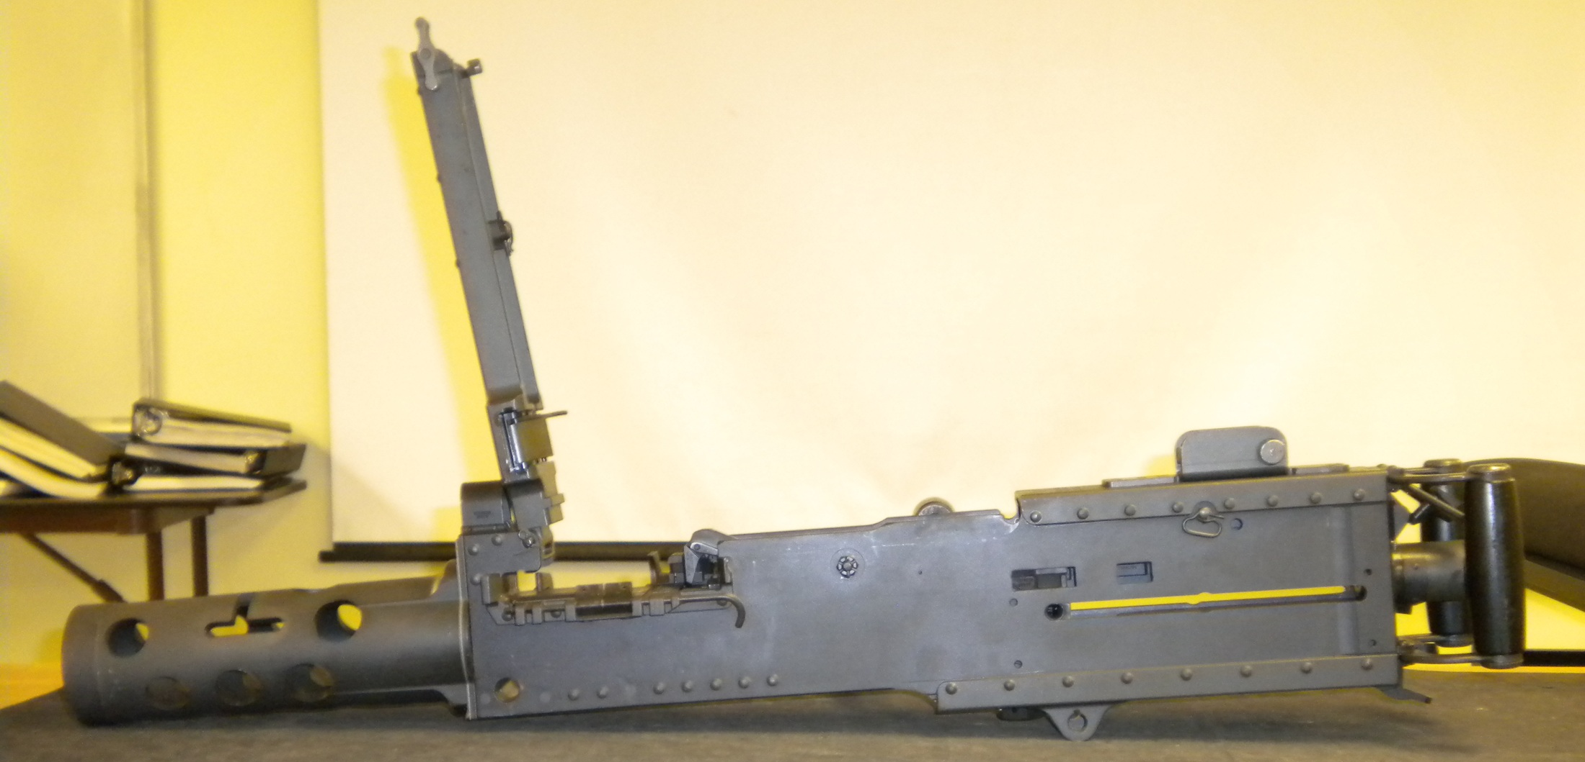
Clear the Weapon
Raise Cover
Observe Chamber
Ensure Bolt is Forward

Slide 10
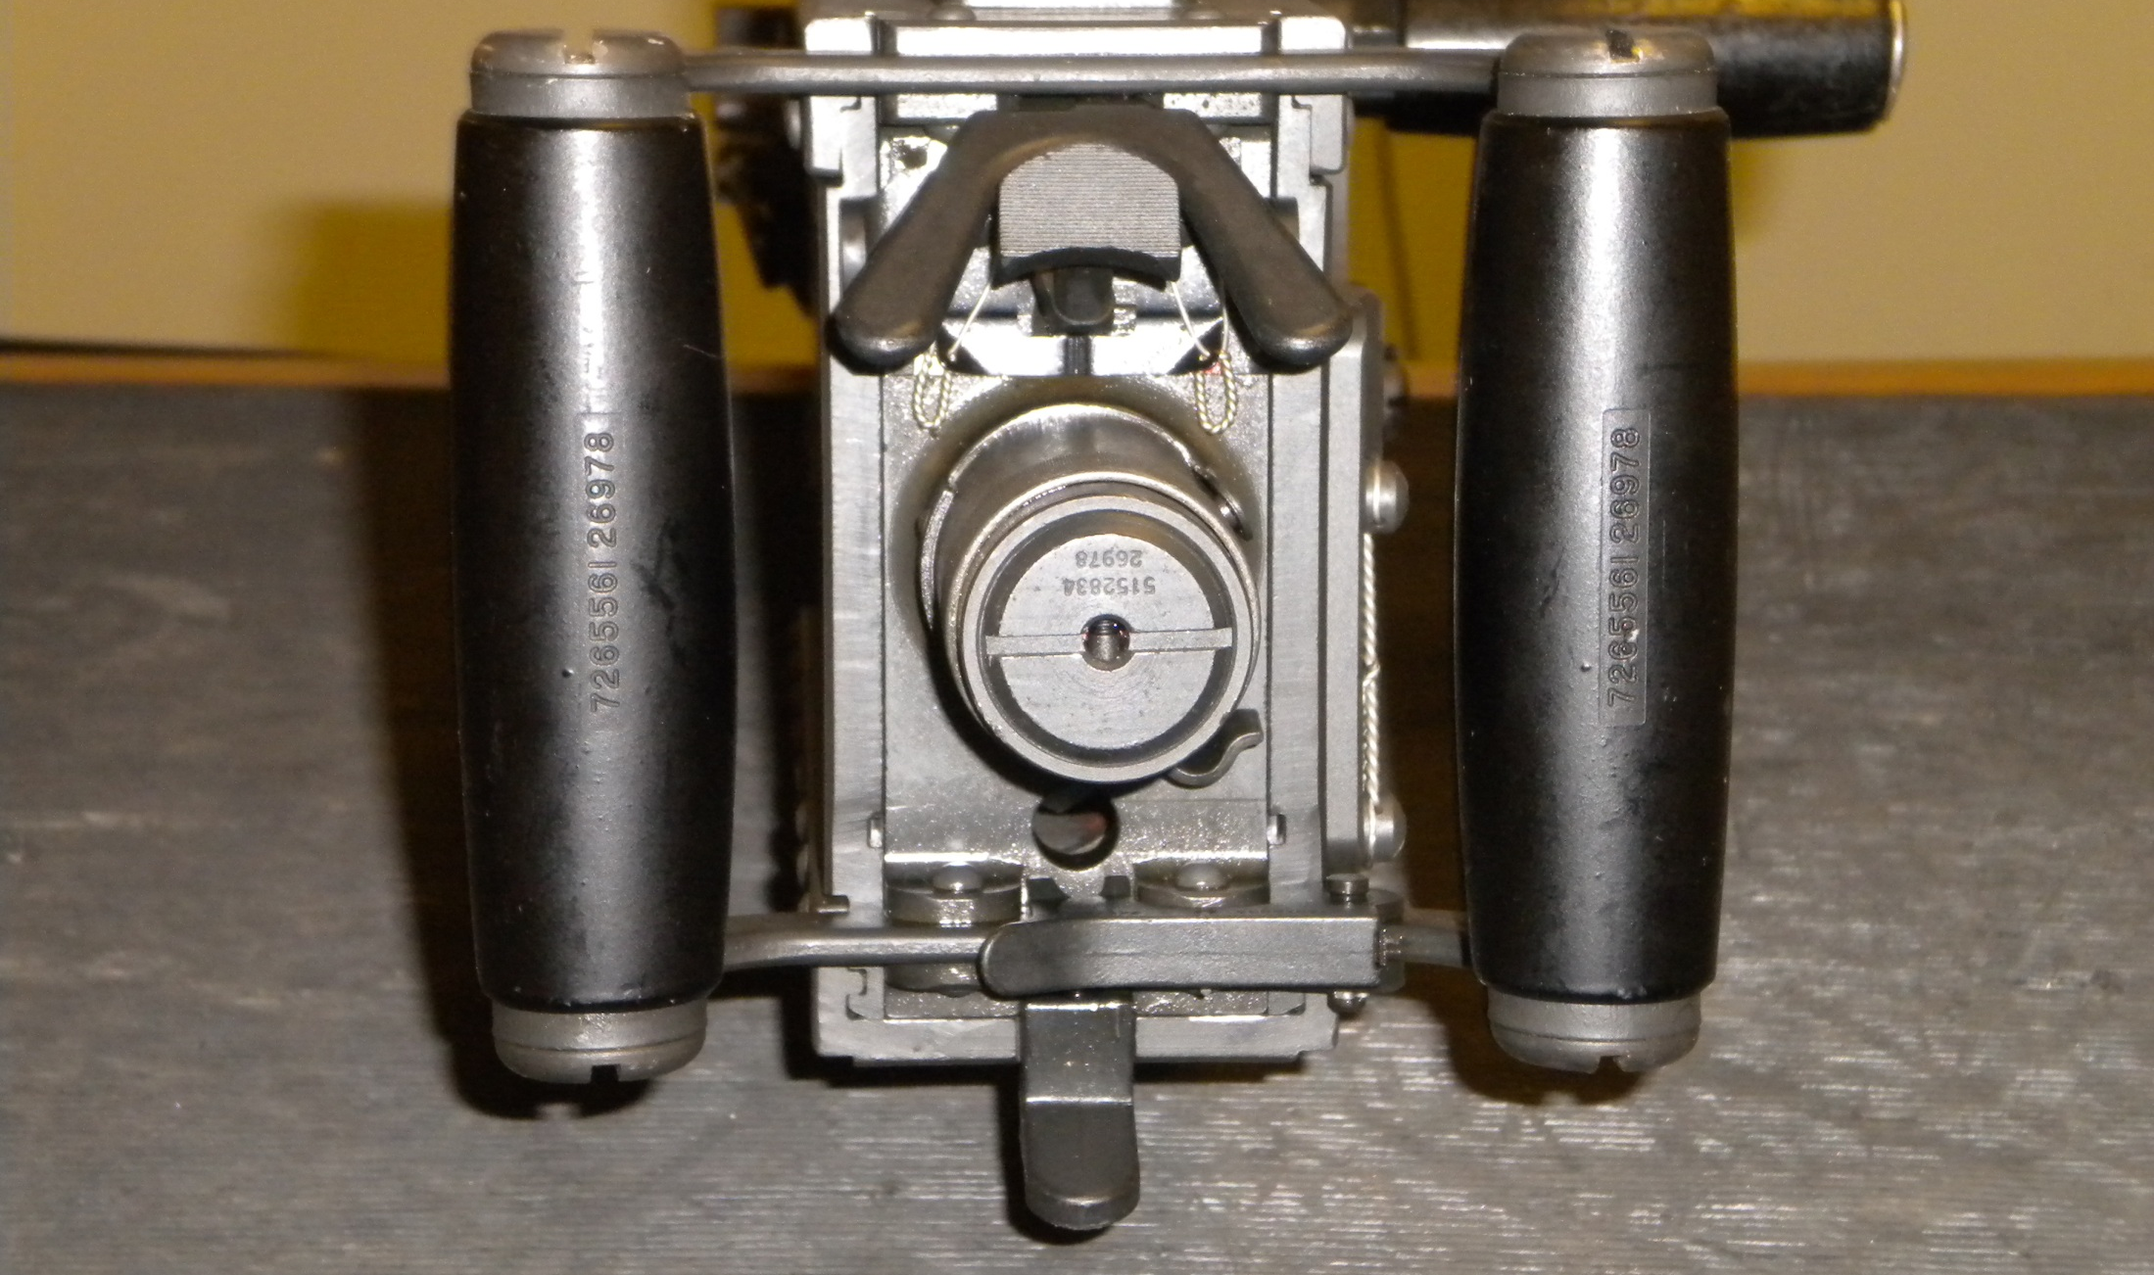

Pull out on Backplate Latch Lock
Pull up on Backplate Latch
1
2

Slide 11
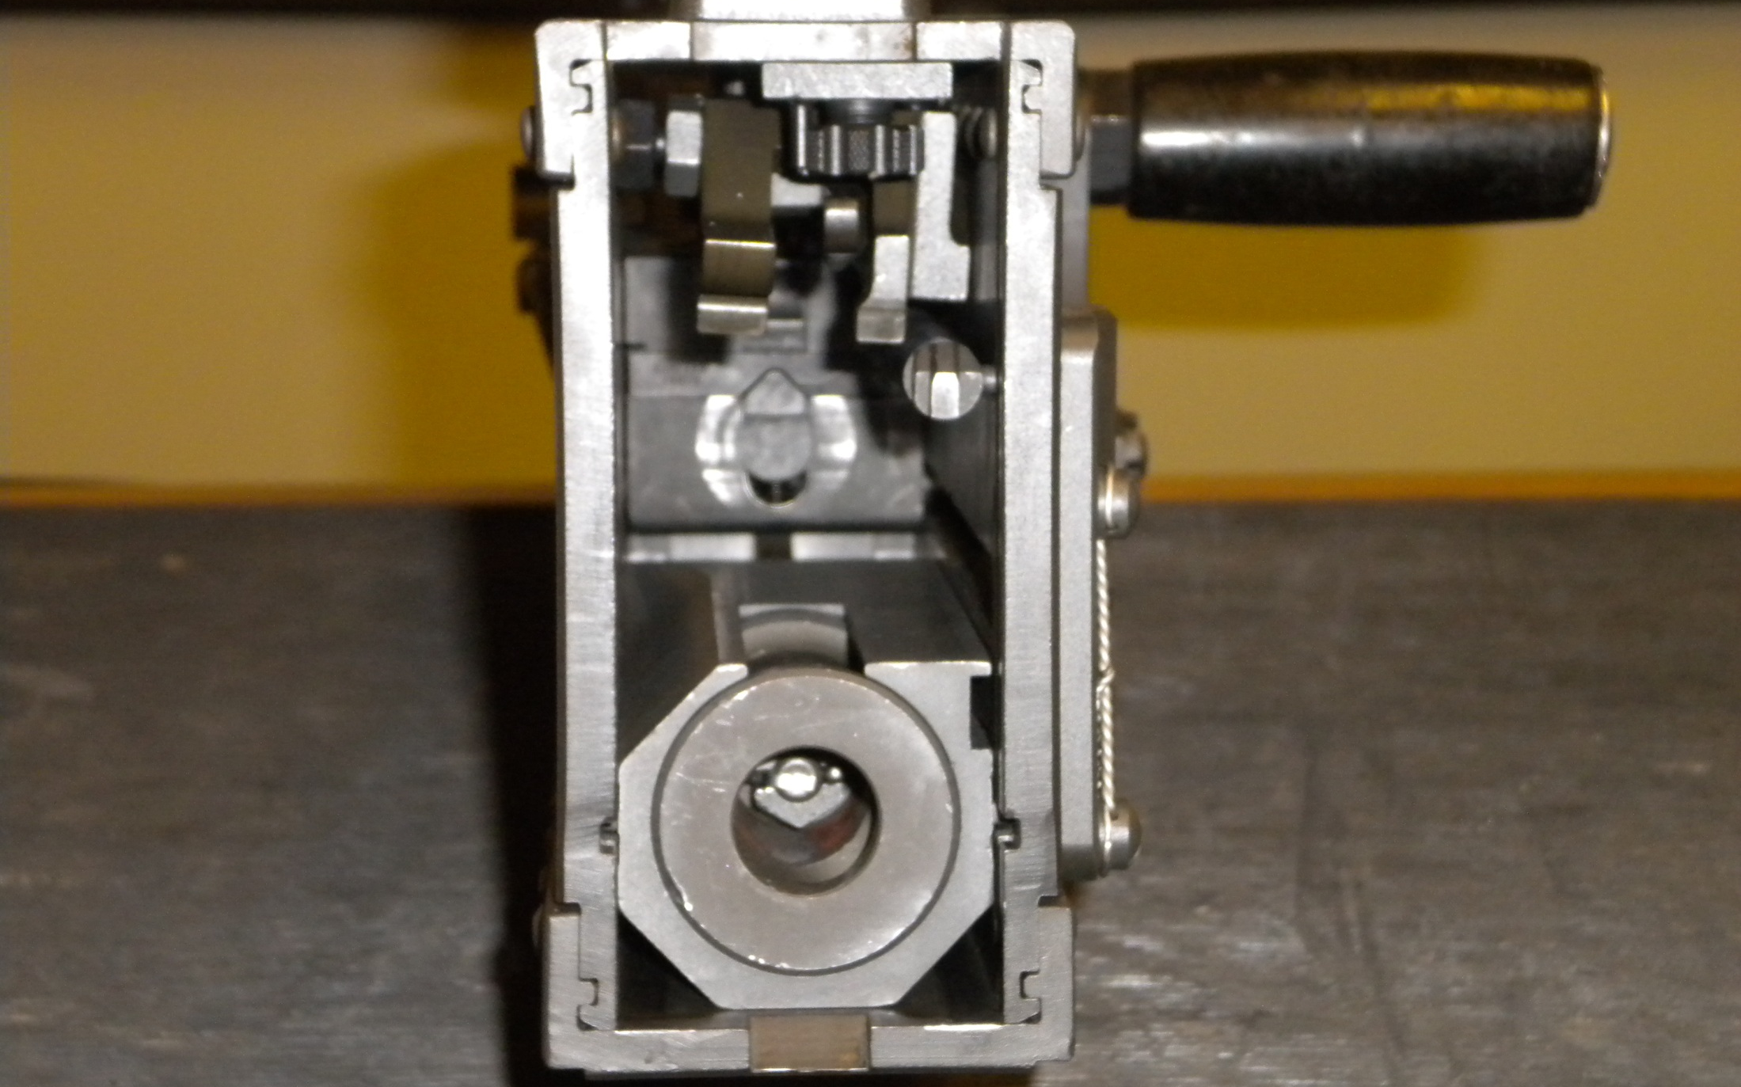

Remove Driving Spring Rod Assembly

Slide 12
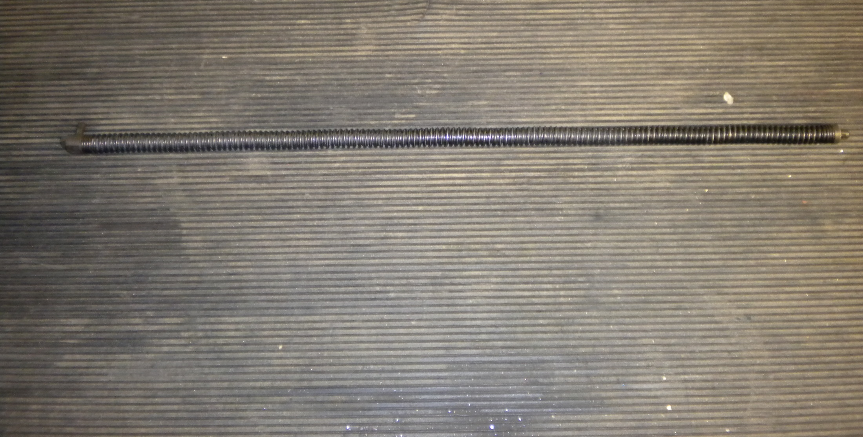
Driving Spring Rod Assembly

Slide 13
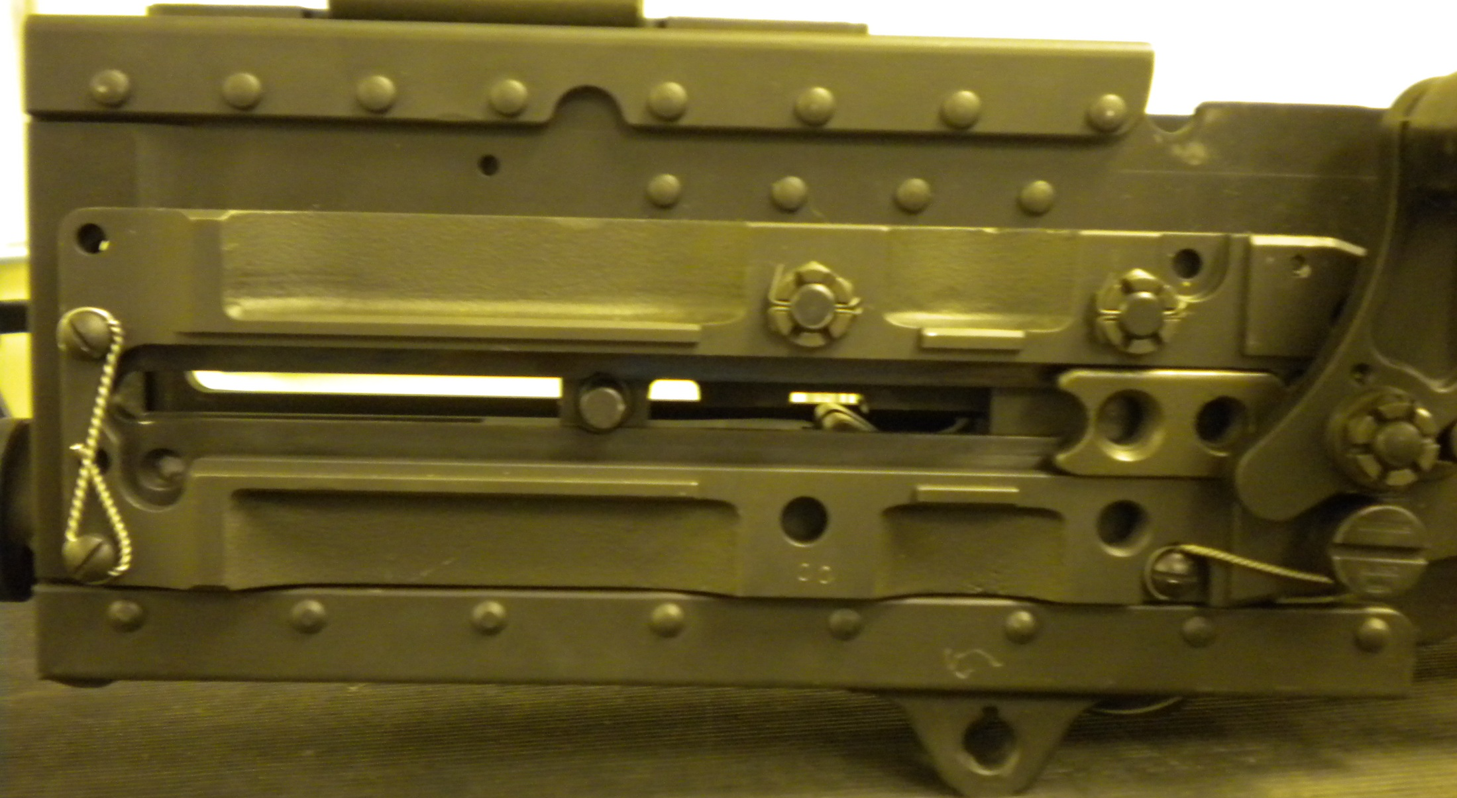

Remove Bolt Stud

Slide 14
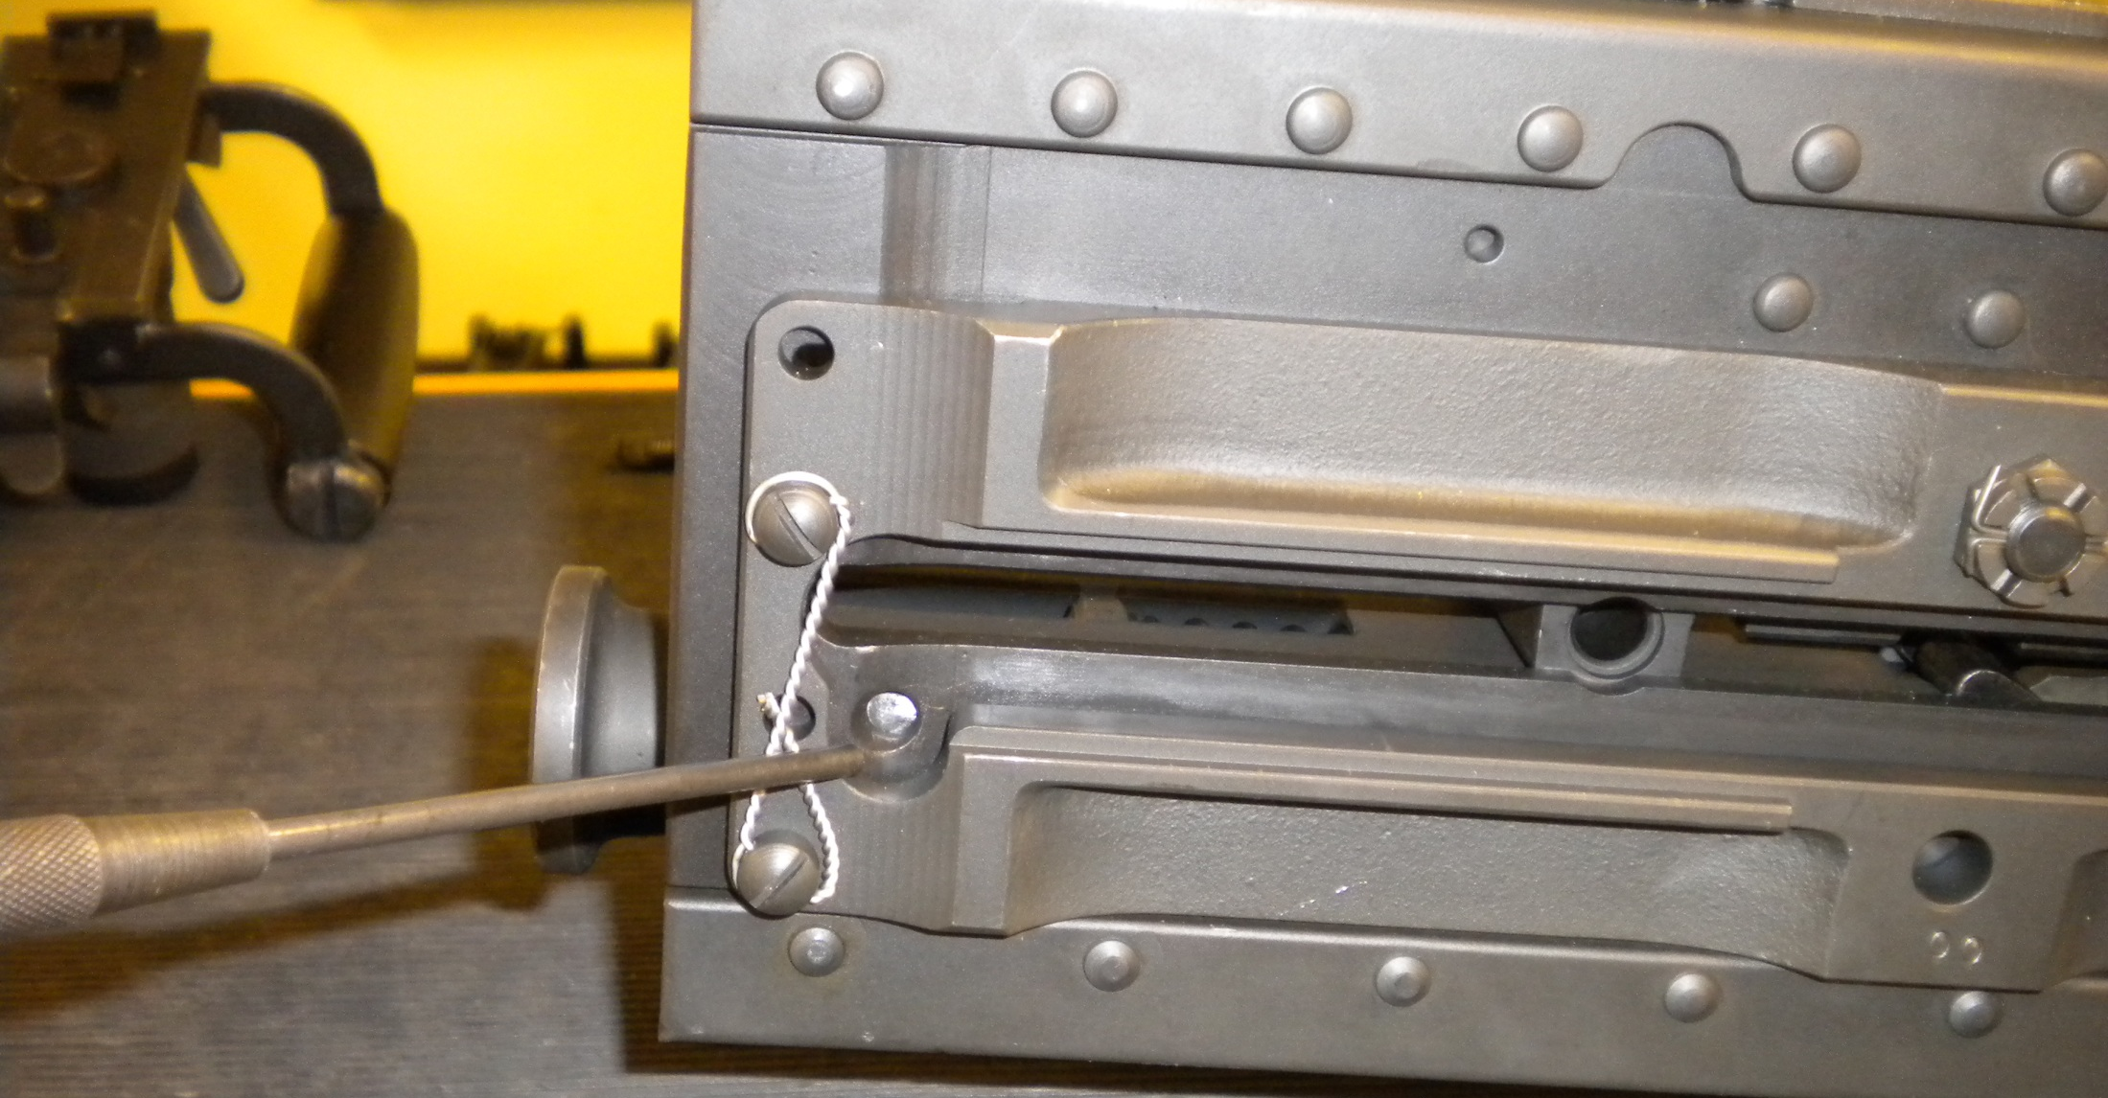

Depress Buffer Body Lock

Slide 15

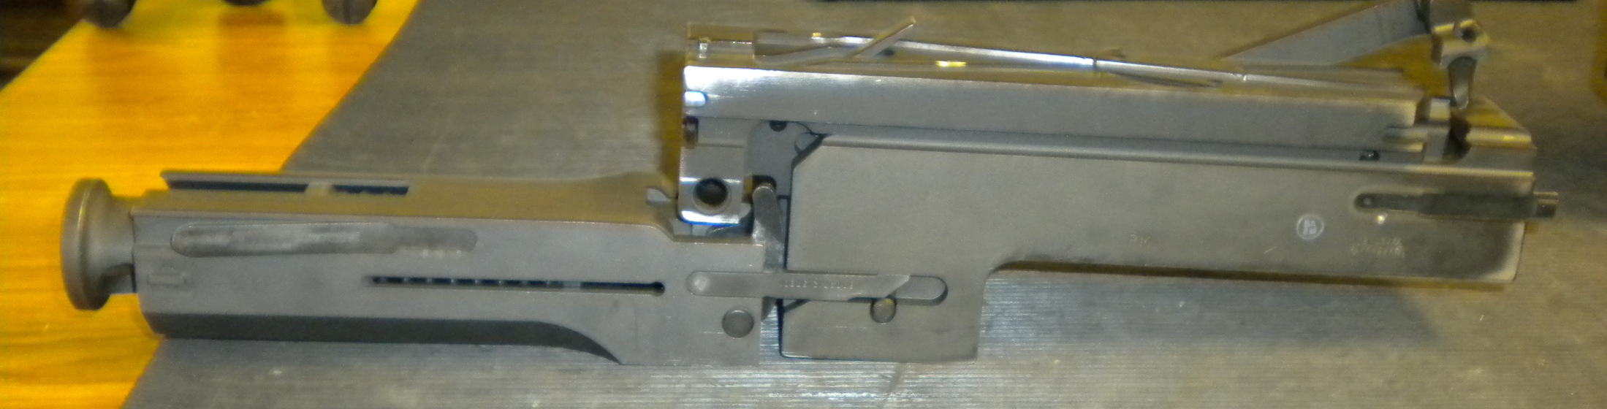
Bolt Assembly
Barrel Buffer Assembly
Barrel Extension Assembly
2
1
3

Slide 16
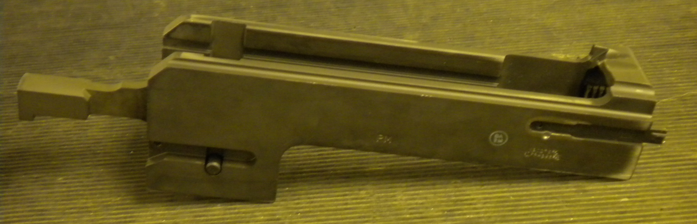
Barrel Extension Assembly

Slide 17
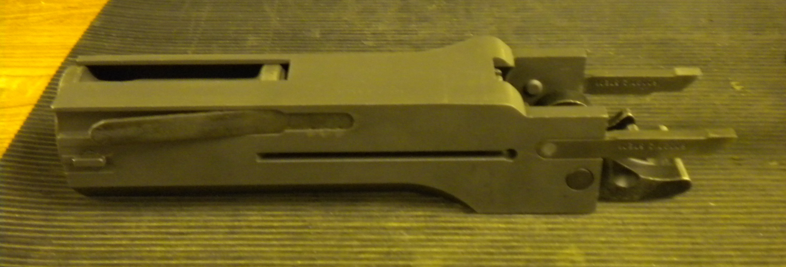
Barrel Buffer Assembly

Slide 18
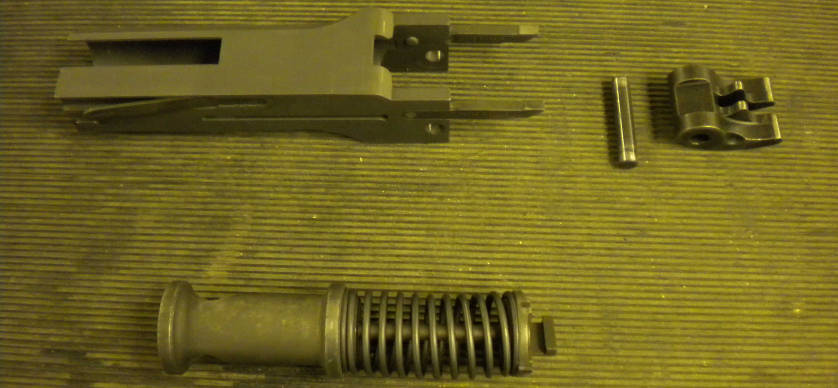

Barrel Buffer Body
Buffer Accelerator and Pin
Buffer Assembly
1
2
3

Slide 19
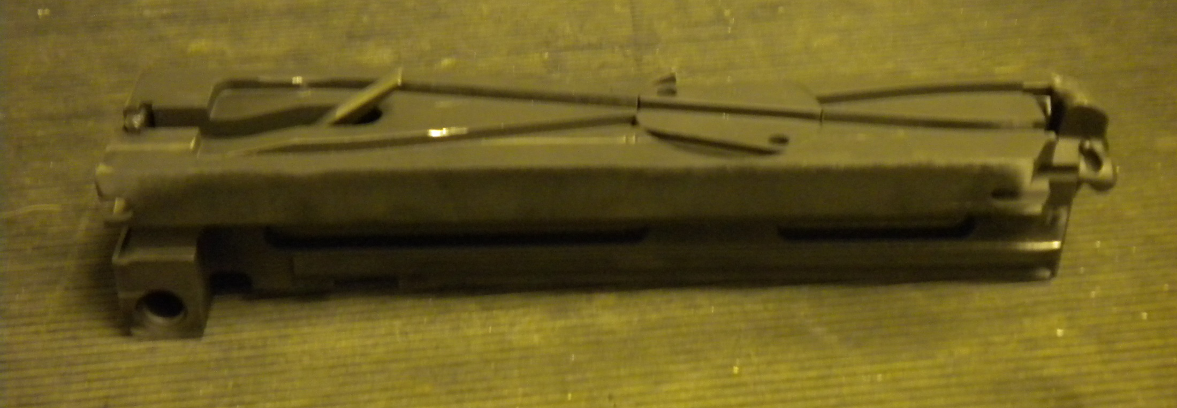
Bolt Assembly

Slide 20
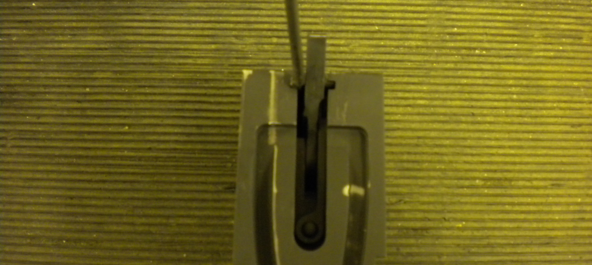
Fire the Bolt

Slide 21
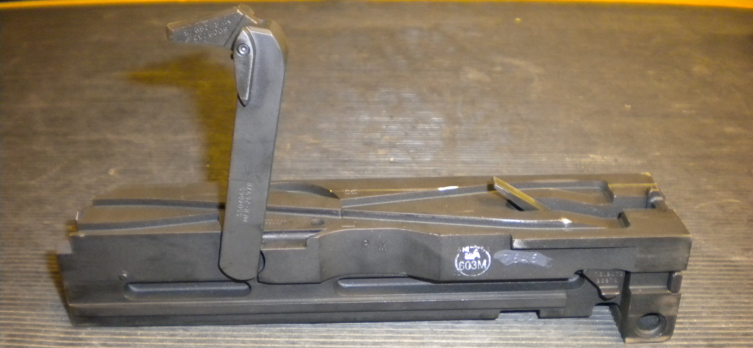

Cartridge Extractor

Slide 22
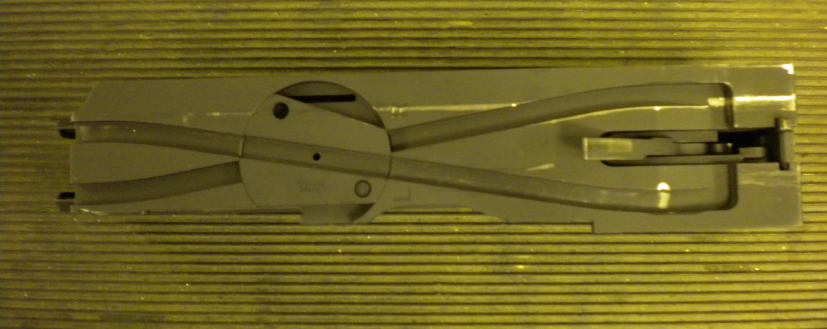



Bolt Switch
Cocking Lever
Cocking Lever Pin
1
2
3

Slide 23
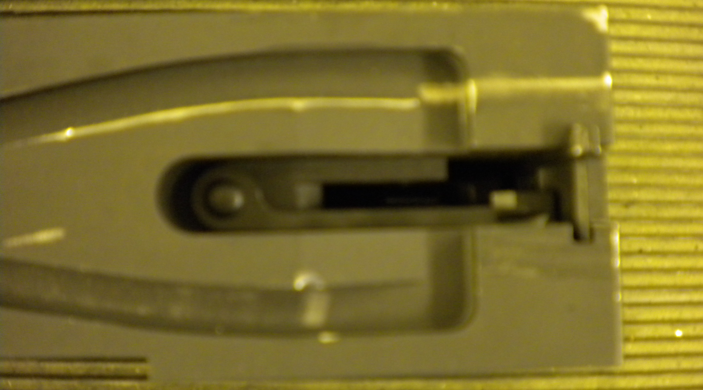
Sear Stop and Pin

Slide 24
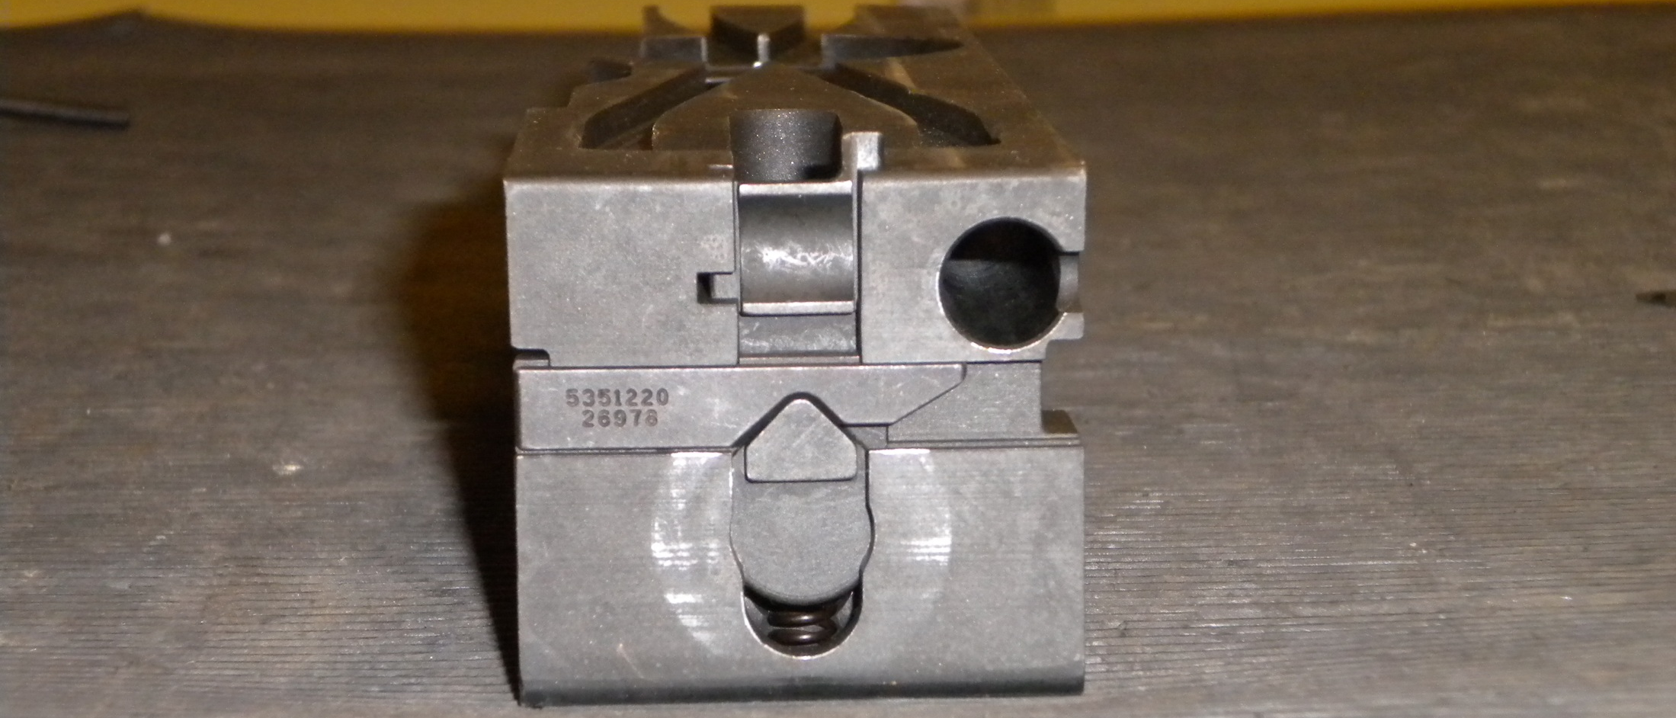

Sear Slide
Sear
Sear Spring
1
2
3

Slide 25
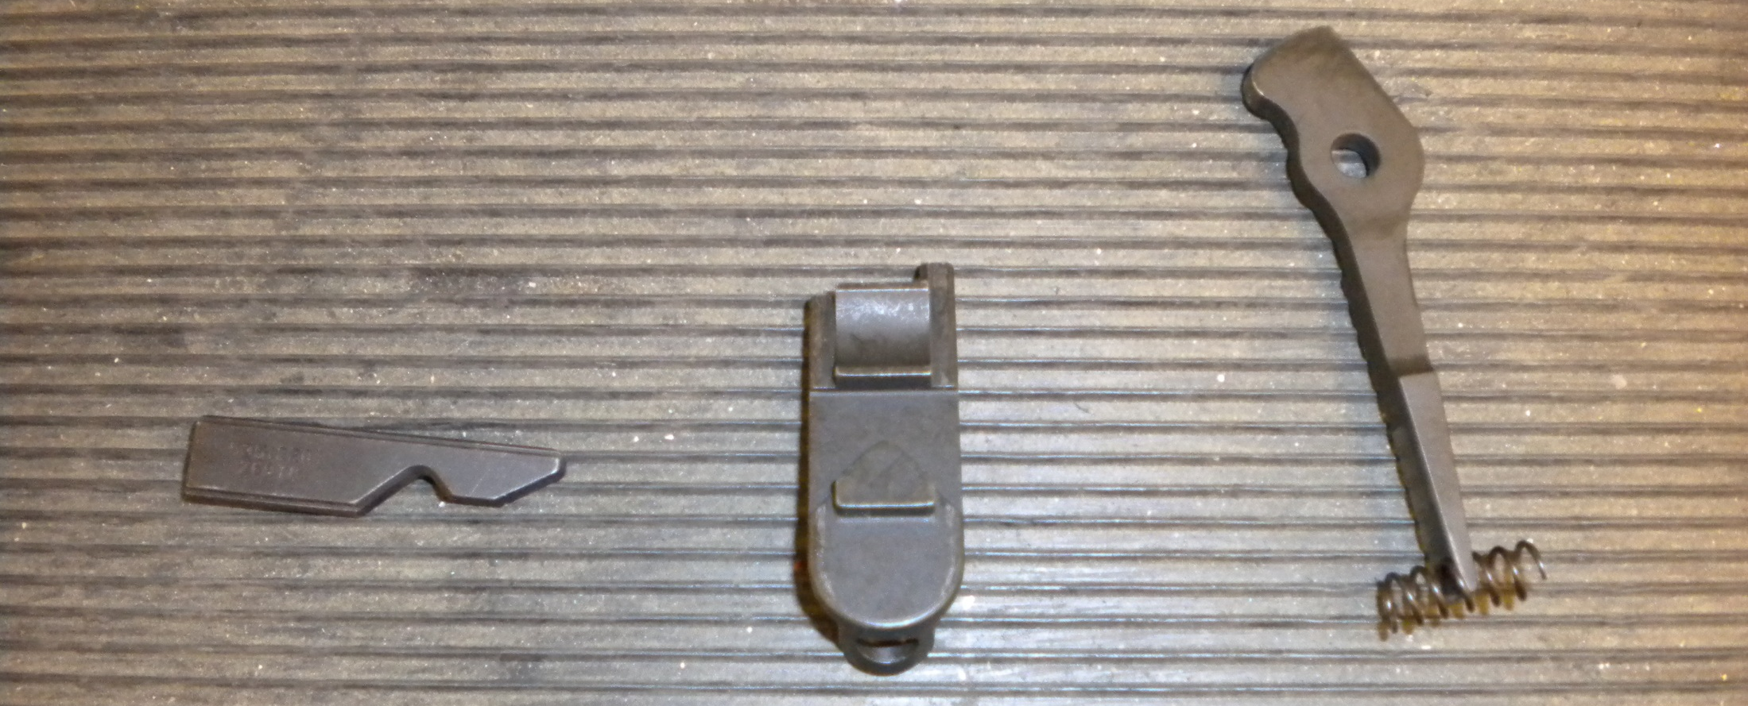

Sear Slide
Sear
Sear Spring
2
1
3

Slide 26
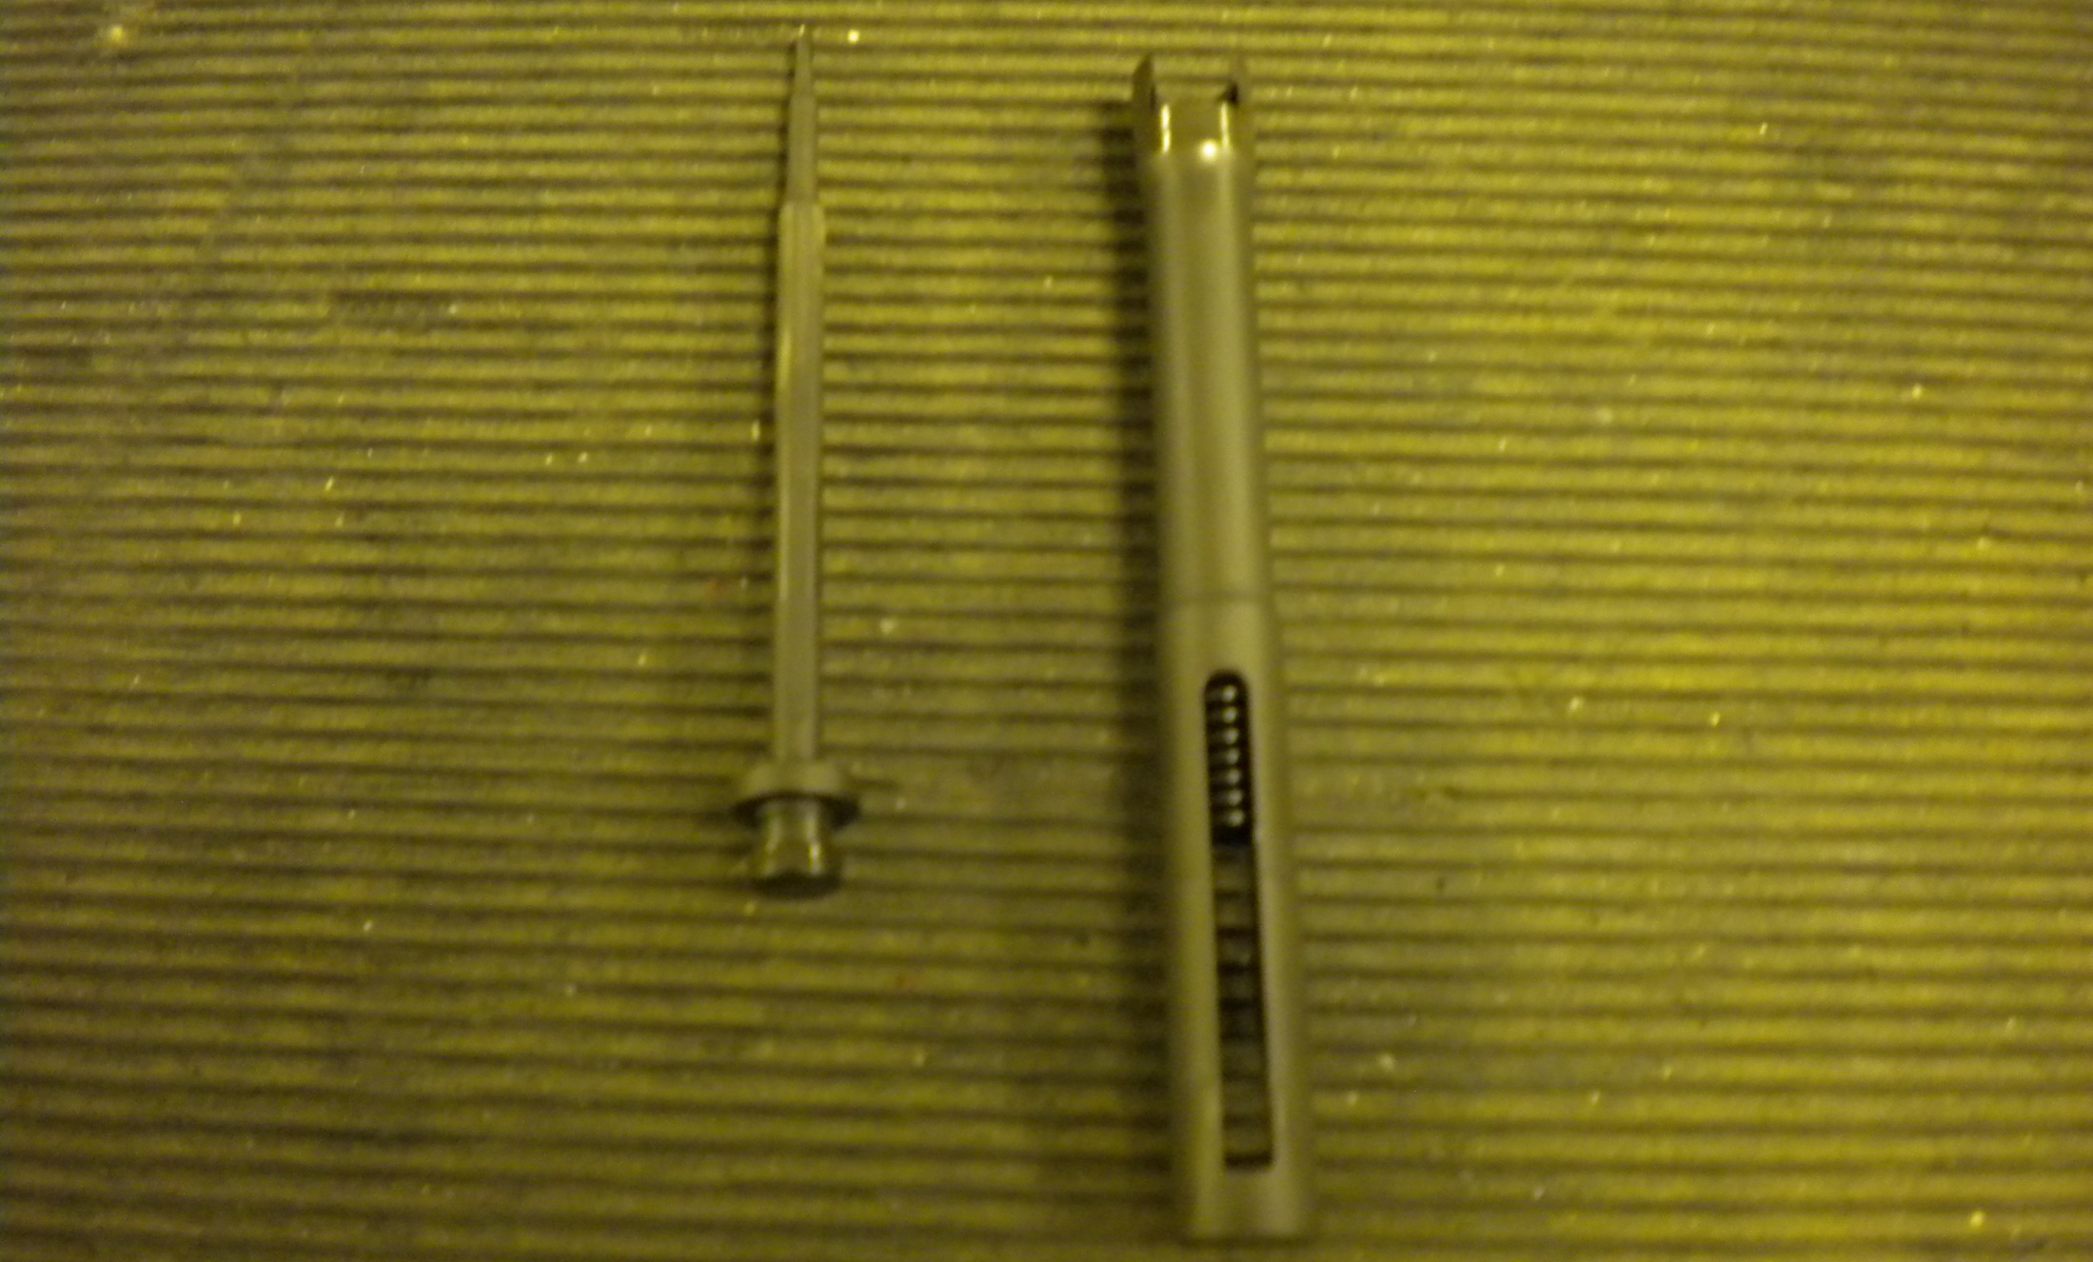
Firing Pin
Firing Pin Extension
1
2

Slide 27
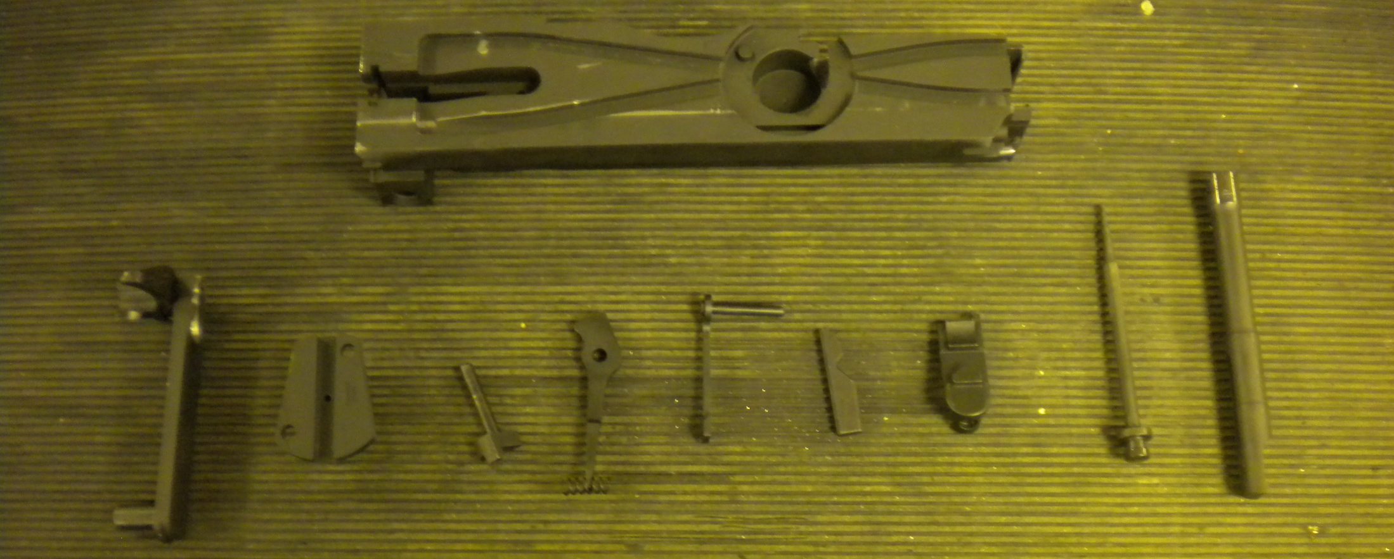
Disassembled Bolt Assembly

