Slide 1
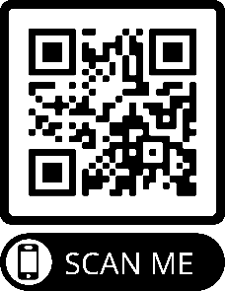
http://bit.ly/MilitaryProgramsSpring2022
MLTR 1626 Weapons Storage Facility Operations
CRN: 12025
Instructor: Eric Bundy
Semester: Spring 2022

Slide 2
http://bit.ly/MilitaryProgramsSpring2022
MLTR 1024 Unit Load Team
CRN: 21914
Instructor: Eric Bundy
Semester: Spring 2022

