Slide 1


ARMORER’S COURSE
Physical Security of Arms, Ammo & Explosives (AA&E)
DAY 1
Presented by:
Fort Riley Security Branch
Notes:
Introduction to Class

Slide 2



What is Physical Security?
INTRODUCTION TO PHYSICAL SECURITY

Slide 3
Physical Security is…
based on threat analysis
concerned with procedures and physical measures designed to safeguard personnel, property, and information
preventive measures that control unauthorized access to equipment, facilities, material, and information
protects against espionage, sabotage, damage, misuse, theft, and terrorism.
In simplest terms:
ASSET PROTECTION

Slide 4
Four Fundamental Aspects of Physical Security:
DETER
DETECT
PHYSICAL
SECURITY
DELAY
RESPOND

Slide 5
Physical Security During Deployment Operations
Layered Security Approach

Slide 6
Physical Security During Expeditionary Operations
Rear Detachment Physical Security Requirements
During the deploying unit's absence from home station, a duty officer or duty NCO will conduct a daily check of the arms room entrance.
The rear detachment armorer will test the IDS on a monthly basis. If the IDS is not operating or is malfunctioning, the rear detachment commander must post an armed guard at the arms room until all weapons and ammunition stored therein can be relocated to an alternate arms room or the IDS is repaired.
Privately owned weapons stored in unit arms room will be included on the inventory lists and stored in the arms room IAW AR 190-11 and AR 190-13.
Government property, other than AA&E, will be placed under continuous surveillance or afforded protection by other means (fenced enclosure, secured within bldg.) to preclude unauthorized access to these items.
If no rear detachment is established, all AA&E, sensitive and high value items not accompanying the unit will be turned-in to the LRC, Supply and Services Division. At no time will AA&E or sensitive items be left unattended and/or unsecured.

Slide 7
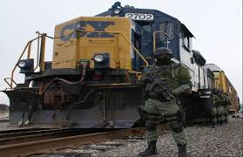
Physical Security During Expeditionary Operations
No AA&E items will be left unattended or unsecured at any time. AR 190-11 para 7-10b
Commanders will ensure that enough security measures are taken to protect AA&E being moved by unit or organization transportation, on or off installations.
All movements of Category I and Category II AA&E require armed guards regardless of the FPCON. AR 190-11 para 7-10c
Request separate containers for AA&E and classified materials. One “sensitive items” container does not met regulatory intent in most circumstances.
Individual issued AA&E is the responsibility of that Soldier.
Notes:
Introduction to Class

Slide 8
Physical Security During Expeditionary Operations
Shipping AA&E and Sensitive Items
It is Army policy that weapons or sensitive items such as funds, jewels, precious metals, or drugs will not be stored in the same container or facility used to safeguard classified information.
When used for transporting AA&E, the doors of approved intermodal containers (MILVAN, SEAVAN, or CONEX) will be securely closed and sealed.
End-opening containers will be placed door-to-door during rail shipments.
Barriers on the rail cars will be used to protect side-opening containers and deter the opening of such cars. The AA&E will be placed in the rear of containers behind non sensitive items to reduce the opportunity of theft.
In the event of contingencies, exercises, or rotational unit movements where it is not practical to use containers,
only armored vehicles that are locked and sealed will be used to ship AA&E
The AA&E will be provided double barrier protection by placing it in separate, locked, and sealed containers, affixed to the interior of the locked/sealed armored vehicles in a manner that precludes easy removal.

Slide 9
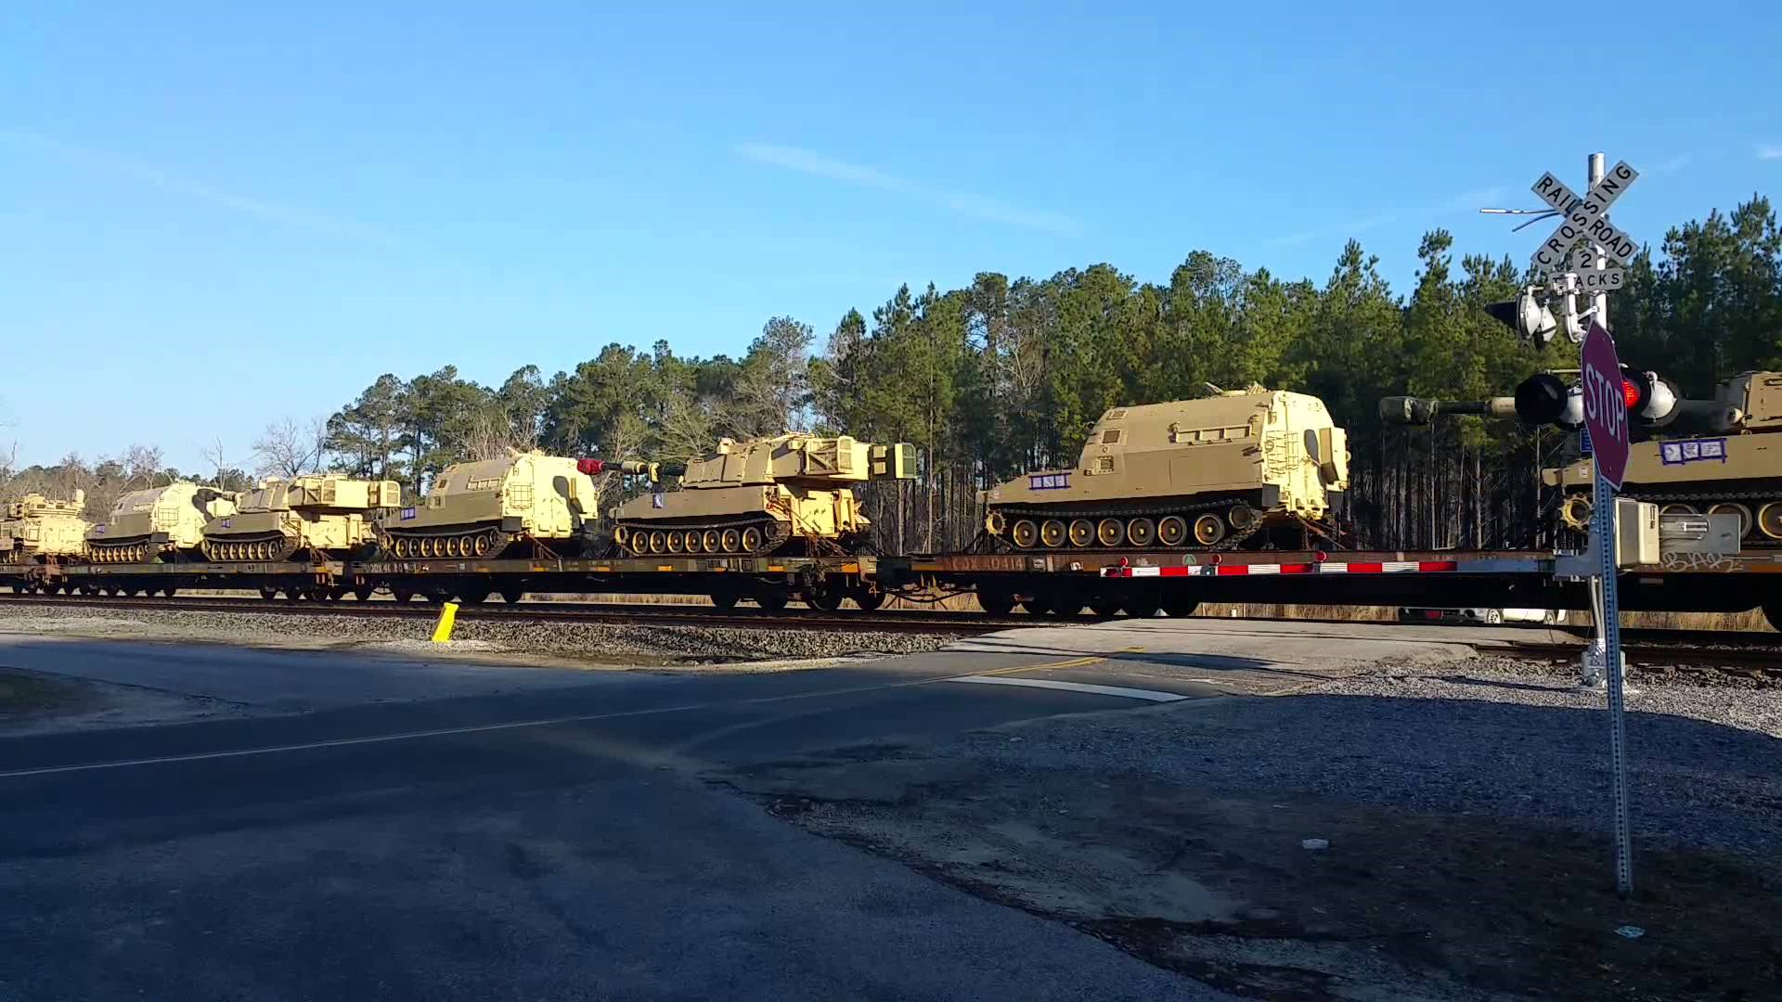
Physical Security During Expeditionary Operations
Shipping AA&E and Sensitive Items
Army activities involved with AA&E shipments will implement a
seal control program per AR 190–51 to ensure accountability/control
of seals.
Shipments must be checked immediately upon receipt to ensure
that the seals are intact and for any signs of damage or tampering.
If there are any such signs, there must be an immediate inventory
to verify quantities received and to determine the extent of any
damage or tampering on all Category I and Category II AA&E
and classified AA&E shipments.
If the seals are intact, quantity verification must take place no later than the next working day. The
requirement to check seals and verify quantities received includes shipments of all categories of sensitive or classified AA&E and uncategorized Class A and Class B ammunition and explosives.

Slide 10

Inspections
Physical Security vs ICI / SCI

Slide 11
PS vs. UNIT
Inspections
Physical Security Inspections
Initial Command Inspections (ICI)
Regulatory Driven (DA)
Announced
  Annual (18 / 24 months)
  Re-Inspection (6 months)
Un-announced
Command Requested
Command Directed
15-6 / FLIPL
Driven by your next higher element (BN, BDE, DIV)
Required for a new Company Commander
Occur during the ARFORGEN RESET phase
Subsequent Command Inspections (SCI)
Driven by your next higher element (BN, BDE, DIV)
Measure Progress
Occur during ARFORGEN Train/Ready phase

Slide 12
Inspections
Inspection Reporting:
Inspection results go to:
  Commander
  Next Higher Command
Must be maintained on file until next inspection
Recurring deficiencies will be tracked on reports until corrected
Commander required to submit Corrective Actions Plan within 30 days of receiving report. Re-inspections cannot be conducted until the CAP is submitted.
  Unit will remain Not Adequate.
  CAP submitted to both next HHQ and the FRSB Office.
Not Adequate rating requires a re-inspection within 6 months (once the Corrective Actions Plan is received).

Slide 13
Inspections
Areas Inspected by Physical Security
  Administrative Security
    CO / BTRY / TRP level
    BN / BDE level
    DIV / Directorate level
  Admin Keys and Combinations
  Supply Room Security
  Arms Room Operations
  AA&E Key Control
  Motor Pool (Tactical Vehicle Storage)
  POL Storage
  ICIDS
  Tool Security
  High-value items storage
  FP measures
  Airfield Security
  POF’s and Privately Owned Ammunition
  OCIE Storage
  Subsistence Facilities
  PLL Storage

Slide 14
Inspections
SMS (Security Management System) –
Unit must conduct risk analysis –
Submit risk analysis to DES security branch NLT 15 days prior to inspection
Inspector will input data and risk analysis into SMS
Risk analysis input will generate unit inspection check list.

Slide 15
Inspections
Staff Assistance Visit (SAV):
Conducted by Higher Headquarters (BN, BDE, DIV) coordinated through next higher S-2.
Results stay “in house” (Report generated and forwarded to the Unit Commander).

Slide 16
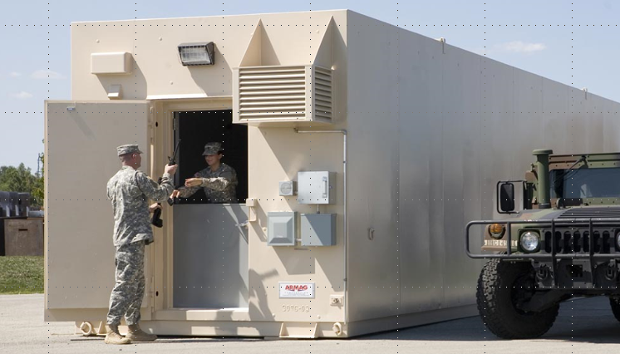
ARMS ROOM OPERATIONS
Exterior / Door Security / Documentation / Additional Property

Slide 17
Exterior
Restricted Area Warning Sign
Notes:
What should be posted outside of the arms room.

Slide 18
Exterior
RESTRICTED AREA
WARNING
THIS ACTIVITY HAS BEEN DECLARED A RESTRICTED AREA BY AUTHORITY OF THE INSTALLATION COMMANDER IN ACCORDANCE WITH THE PROVISIONS OF THE DIRECTIVE ISSUED BY THE SECRETARY OF DEFENSE ON 10 December 2005, PURSUANT TO THE PROVISIONS OF SECTION 21, INTERNAL SECURITY ACT OF 1950. UNAUTHORIZED ENTRY IS PROHIBITED. ALL PERSONS AND VEHICLES ENTERING HEREIN ARE LIABLE TO SEARCH. PHOTOGRAPHY OF THE FACILITIES IS PROHIBITED WITHOUT SPECIFIC AUTHORIZATION FROM THE COMMANDER. DEADLY FORCE IS AUTHORIZED.
Notes:
AR 190-11 Para 4-15
Must be posted at eye level outside of the arms room, and all entrances to building containing arms room.

Slide 19
Exterior
Restricted Area Warning Sign
Alarm Warning Sign
Notes:
What should be posted outside of the arms room.

Slide 20
Exterior
THIS FACILITY IS PROTECTED
BY AN
ALARM SYSTEM
UNAUTHORIZED ENTRY IS PROHIBITED
VIOLATORS WILL BE PROSECUTED
UNDER THE PROVISIONS OF THE UCMJ
OR OTHER APPLICABLE LAWS
Notes:
AR 190-11 Para 4-16
Must be posted at eye level outside of arms room

Slide 21
Exterior
Restricted Area Warning Sign
Alarm Warning Sign
Security Lighting
Notes:
What should be posted outside of the arms room.

Slide 22
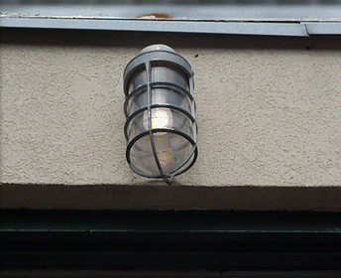
Exterior
Allows guard personnel to observe the unauthorized entry or removal of arm.
Exterior Light Must Be Covered With Wire Mesh Or Made Of A Vandal Resistant Lens.
Provide A Minimum Of 0.2 foot-candles (2lux) illumination
Switch To Light Must Be Inaccessible To Personnel
Notes:
WHEN AN ARMS ROOM IS LOCATED WITHIN ANOTHER SECURE ROOM, THE ENTRANCE TO THE SECURE ROOM WILL BE ILLUMINATED.
Iaw 190-11 5-4 a-(3) LIGHTING PROTECTION

Slide 23
Exterior
Restricted Area Warning Sign
Alarm Warning Sign
Security Lighting
Lautenberg Message Amendment (NOT REQUIRED TO BE POSTED)
Notes:
What should be posted outside of the arms room.

Slide 24
Lautenberg Amendment
Exterior
Summary court-martial convictions, non-judicial punishment under Article 15, UCMJ, and deferred prosecutions in civilian court do not constitute qualifying convictions within the meaning of the Lautenberg Amendment.
The prohibitions do not preclude a soldier from operating major weapons systems or crew served weapons such as tanks, missiles, and aircraft.
The Lautenberg Amendment application includes Soldiers with privately owned firearms and ammunition stored on or off post.
Soldiers with qualifying convictions may not:
  be assigned to positions that would give them access to firearms and ammunition.
  attend any service school where instruction with individual weapons or ammunition is part of the curriculum.
  may not reenlist and are not eligible for the indefinite reenlistment program.

Slide 25
Check-on-learning
Exterior
Q: A Soldier is given an Article 15 from his Company Commander for getting into a fight with his wife and hitting her. Is this a Lautenberg Violation?
A: No, this is non-judicial punishment and does not constitute a Lautenberg Conviction.

Slide 26
Exterior
Restricted Area Warning Sign
Alarm Warning Sign
Security Lighting
Lautenberg Message Amendment (NOT REQUIRED TO BE POSTED)
SF 702 For After Hour Security Checks
Notes:
What should be posted outside of the arms room.

Slide 27

Exterior
Armed is defined as having a firearm and appropriate ammunition readily available for immediate use.
A “Whooping” stick does not constitute an armed guard!!
Arms Storage Facilities, Containers And Safes Will Be:
Protected By Ids And Will Be Checked At Least Once Every 8 Hours
or
Under 24 Hour Armed Guard Surveillance
Staff duty and charge of quarters when tasked will document these checks on standard form 702 (security container check list).
(Fort Riley Regulation 190-11)

Slide 28
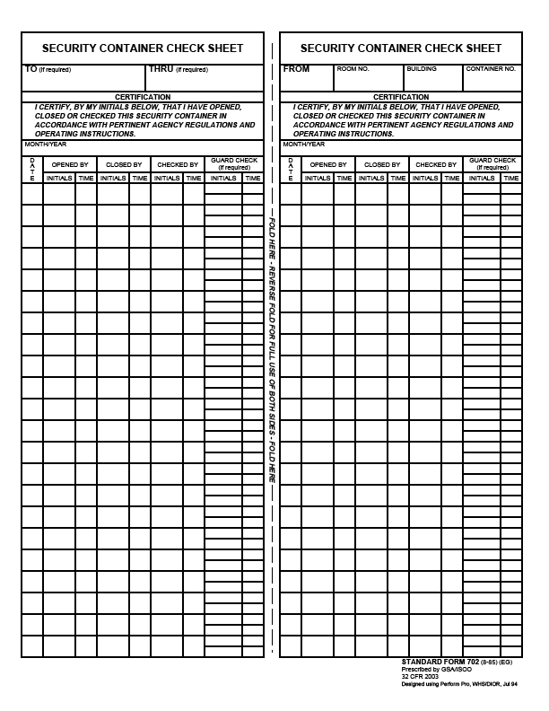
Exterior
Can be used to record opening/closing times of arms room.
SF 702
Required to be used by FR Reg 190-11 to Record After Hour Security Checks
Checking the security of building outer doors and not the vault door doe not meet regulatory requirements.
May 2016
1
LDE
0230
WHW
2230
2
WHW
0415
3
4
5
6

Slide 29
Exterior
Restricted Area Warning Sign
Alarm Warning Sign
Security Lighting
Lautenberg Message Amendment (NOT REQUIRED TO BE POSTED)
SF 702 For After Hour Security Checks
FR Reg 190-1 (Outside of arms room or posted on unit bulletin board)
Notes:
What should be posted outside of the arms room.

Slide 30
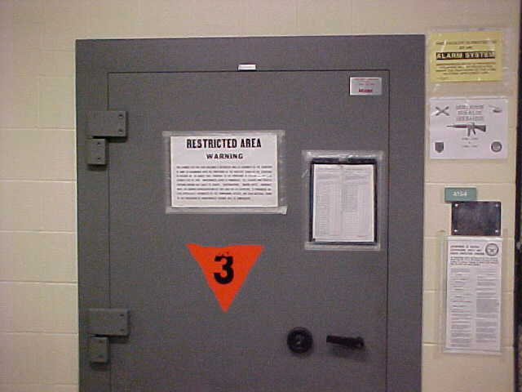
Exterior
Alarm System
Warning Sign
Restricted Area
Warning Sign
Do not post contact
Information of the armorer
Must also have one
posted on the inner
door. When door is open
sign is not visible.
SF 702 Used for Security Checks
Ammunition
Placard (Only required
When storing ammo)
Notes:
Essential element of an arms storage facility
Alerts response force to possible intrusion of a restricted area so that they may respond
Detects, NOT PREVENT, penetration of a restricted area
Permits efficient use of guard personnel, because restricted areas do not have to be guarded 24 hours a day if protected by IDS
Armorers are responsible for activating and deactivating IDS upon entry and exiting of arms room.
Alert alarm monitoring station if alarm is activated for any reason other than an intrusion.
PIC and PIN issue procedures (8-11 Mon-Fri)

Slide 31
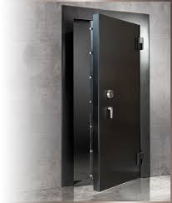
Door Security

Slide 32
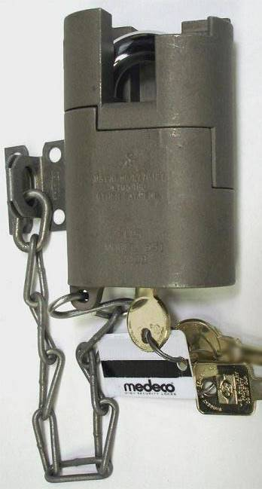
Door Security
High security padlock for approved doors
  Placed on most secure Door and Exterior Issue Window (If arms room has one.)
  Comes with three (3) keys, two round operational keys and one square maintenance key.
Notes:
MORE ON KEY AND LOCK CONTROL PORTION OF BRIEF.
What regulation (Reg and Paragraph number) covers this?
SHOW EXAMPLE OF HIGH SECURITY LOCK AND MENTION THAT IT COMES WITH 3 COUNT THEM 3 KEYS

Slide 33
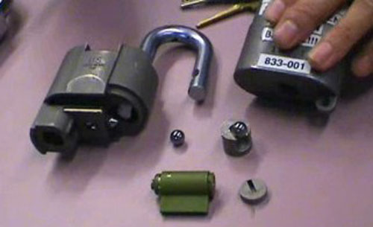
High Security Padlock
Door Security
Do Not Use The Square Maintenance Key For Daily Operations!!!!
It is used to take the lock apart in order to re-core it.
Notes:
MORE ON KEY AND LOCK CONTROL PORTION OF BRIEF.
What regulation (Reg and Paragraph number) covers this?
SHOW EXAMPLE OF HIGH SECURITY LOCK AND MENTION THAT IT COMES WITH 3 COUNT THEM 3 KEYS

Slide 34
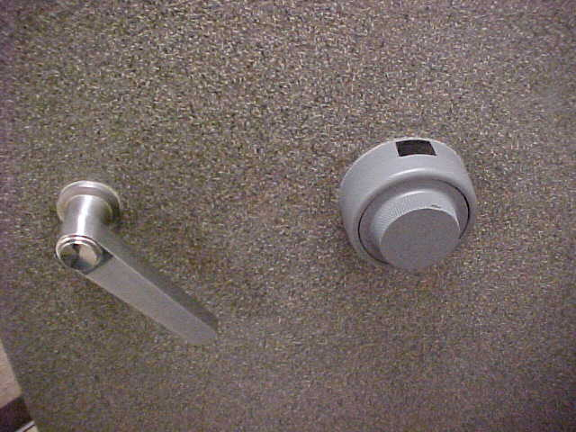
Door Security

Slide 35
Door Security
Combinations Shall Be Changed:
When first placed in use (factory default settings 50-25-50)
  Whenever an individual knowing the combination no longer requires access.
  When the combination has been subject to possible compromise.
  At a minimum annually
  Prior to transitioning out. e.g. move to another bldg., deployment, etc.
  To have your combination changed call public works service order desk at 239-0900 or check with your S-2.
Notes:
35

Slide 36
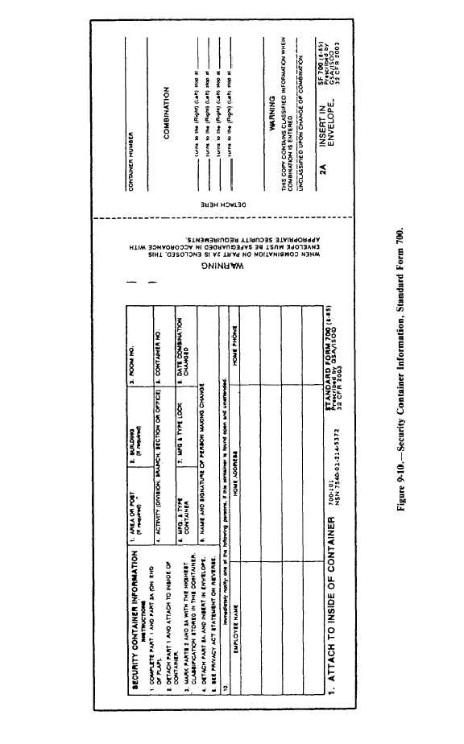
Door Security
SF 700 (security container information) shall be maintained
For each combination.
  Part 1 will be completed and posted on the inside of the vault or container.
If this SF700 is for an arms room, the personnel listed here must also be on the unaccompanied access roster.
219
Arms Room
DES
1
Hamilton X-07
12 Sep 19
Joe Locksmith, PW
Jim D. Armorer
232 Milford Drive, Junction City
555-1010
I.B Dmann
111 Crazy Circle, Junction City
555-2526
Notes:
36

Slide 37
Door Security
  The combination of the vault or container will be printed part 2a
Arms Room
1
219
DES
1
Hamilton X-07
12 Sep 19
22
Joe Locksmith, PW
45
76
Jim D. Armorer
232 Milford Drive, Junction City
555-1010
I.B Dmann
111 Crazy Circle, Junction City
555-2526
Notes:
37

Slide 38
Door Security
  Part 2A will be detached and inserted in the envelope, (part 2)
219
Arms Room
1
DES
1
Hamilton X-07
12 Sep 19
22
Joe Locksmith, PW
45
76
Jim D. Armorer
232 Milford Drive, Junction City
555-1010
I.B Dmann
111 Crazy Circle, Junction City
555-2526
Notes:
38

Slide 39
Door Security
  Part 2A will be detached and inserted in the envelope, (part 2)
219
Arms Room
1
DES
1
Hamilton X-07
12 Sep 19
Joe Locksmith, PW
22
45
76
Jim D. Armorer
232 Milford Drive, Junction City
555-1010
I.B Dmann
111 Crazy Circle, Junction City
555-2526
Notes:
39

Slide 40
Door Security
  Part 2 will be stored in a different security container.
219
Arms Room
DES
1
Hamilton X-07
12 Sep 19
Joe Locksmith, PW
Jim D. Armorer
232 Milford Drive, Junction City
555-1010
I.B Dmann
111 Crazy Circle, Junction City
555-2526
Notes:
40

Slide 41

Documentation

Slide 42
Documentation
DA Form 4604 (Security Construction Statement):
Existing arms rooms inspected by qualified engineer every 5 years.(AR 190-11 2-2d)
Identifies an Waivers, Exceptions, Compensatory measures in place in order to approve vault storage.
Will be posted inside the unit arms vault.
Form will indicate highest category of weapons that may be stored in the arms room.
POC: Mr. William (Andy) Anderson 239-6672
Notes:
Security Construction Statement DA Form 4604-R
Posted on the wall of an arms room
Signifies the Arms room is constructed with the guidelines listed in AR 190-11
Valid for 5 years
Unit armorer’s responsibility to ensure it is current and valid
Reviewed during physical Security Inspections.

Slide 43
Documentation
Armorer Hand Receipt:
Commander sub-hand receipts all equipment in the arms room down to the primary armorer:
  Use DA Form 3161 or system generated property receipt.
  Places responsibility / accountability upon individual who has direct control of it.
  Clearly identifies what the Armorer is responsible for.
  Includes all property to be stored in the vault. NOT just AA&E (e.g. bayonets, compasses, etc.)
  Must be signed for with in 30 days of appointment. (IAW Supply regulations)

Slide 44
Documentation
Unaccompanied Access Roster
Keep the number of personnel on the roster to a minimum.
Personnel Reliability Screening And Evaluation (DA Form 7708) is completed before unaccompanied access is authorized
Personnel Reliability Screening And Evaluation
  DA Form 7708
  Valid for one year
  Continuing Periodic Evaluation required
  Does not need to be redone when a new Commander assumes command.
  Must be redone when the Soldier transfers to/from another unit.
Notes:
Commanders oriented screening per AR 190-11 para 2-11 consists of:
Commanders interview
Personnel records screening (201)
Medical Records Screening
PMO (Local Files Check)
Civilian Law Enforcement
Commanders evaluation

Slide 45
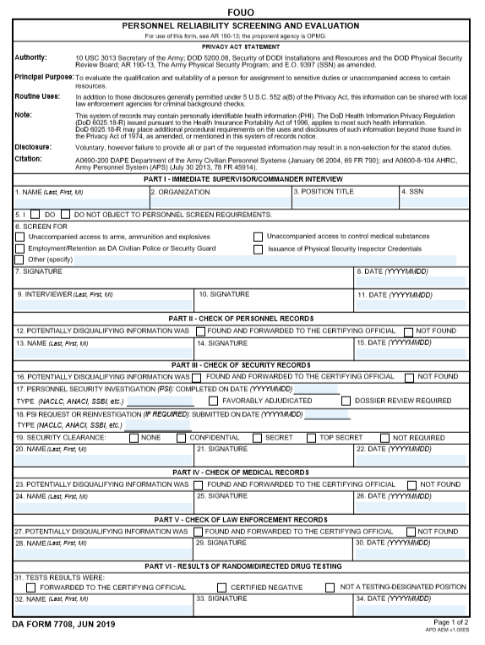
PERSONNEL RELIABILITY SCREENING AND EVALUATION
Armorer, Tony
111th Signal Company
Armorer
000-00-0000
Commander of the candidate will conduct the initial interview than print, sign and date.
X
X
The candidate will sign and date.
Tony D. Armorer
20191001
Commander, Best, D
Best D. Commander
20191001

Slide 46
PERSONNEL RELIABILITY SCREENING AND EVALUATION
Completed by S-1
X
Jackson, Andrew, T
Andrew T. Jackson
20191001
Commanders Discretion if Not Required Completed by Commander. Clearance validation completed by S-2
X
Commander, Best, D
Best D. Commander
20191002
Completed by DES ADMIN Building 219) (Might take 24 to 48 hours turnaround
X
Jefferson, Thomas, T
Thomas T. Jefferson
20191003
Completed by Medical Facility / Provider
DES No Record
X
Washington, George D
George D. Washington
20191004
Completed at Unit by Commander of Candidate
X
Commander, Best, D
Best D. Commander
20191001

Slide 47
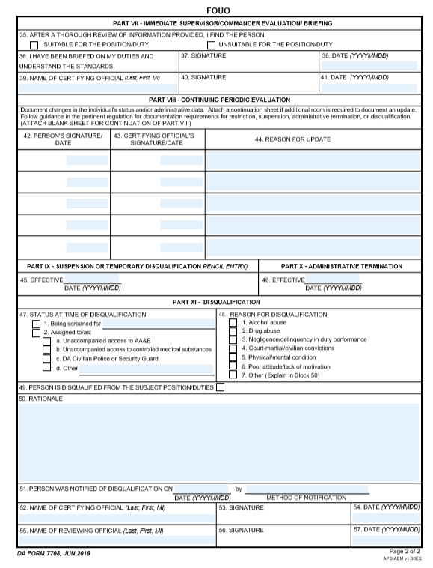
PERSONNEL RELIABILITY SCREENING AND EVALUATION
Candidate screened will acknowledge being briefed on duties, sign and date.
X
Tony D. Armorer
20191004
Commander, Best, D
Best D. Commander
20191004
Commander validates Candidate suitable or unsuitable selection with, printed name, signature and date.
Annual periodic Evaluations

Slide 48
PERSONNEL RELIABILITY SCREENING AND EVALUATION

Slide 49
Documentation
Dates
The dates in section I and VII are the start and end dates of the investigation. Both signed by the CDR (NOT at the same time).
All dates in sections II thru VI (section checks) should fall between the start and end dates.
Appointment orders must be dated after the form is finalized in section VII.
Must be Evaluated Periodically in section VIII (Minimum Annually).
Notes:
The unit armorer is responsible for enforcing access control by:
Verifying authorization of personnel prior to entry. (Access Rosters)
Providing supervision of personnel while they are in the arms room.

Slide 50
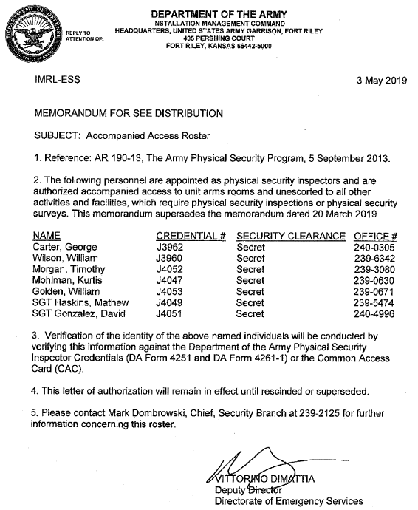
Documentation
Accompanied Access Rosters:
DES Physical Security
DIV / BDE / BN S-2
Alarm Maintenance Personnel
Access Rosters Not Required For:
DIV Family Readiness Group (FRG)
Boy Scouts / Girl Scouts
Kansas State Activities
Any activity that will be escorted by Armorer
Notes:
The unit armorer is responsible for enforcing access control by:
Verifying authorization of personnel prior to entry. (Access Rosters)
Providing supervision of personnel while they are in the arms room.

Slide 51
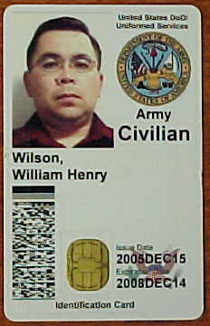

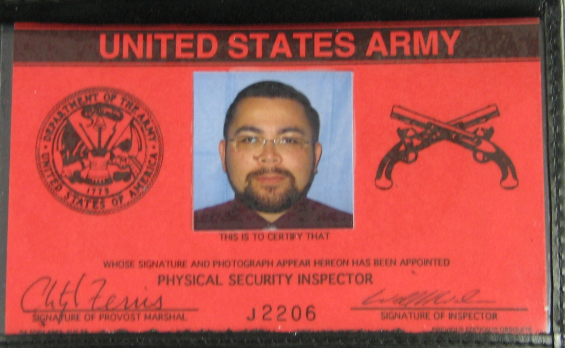

Morgan,
Dexter G.
Always Check Identification To Verify
Access Roster Information.
Notes:
The unit armorer is responsible for enforcing access control by:
Verifying authorization of personnel prior to entry. (Access Rosters)
Providing supervision of personnel while they are in the arms room.

Slide 52
Documentation
Unit must have:
Appointment orders for an AA&E Key Custodian
Seal Custodian
Bolt Cutter Custodian (New requirement 1 Oct 2019)
Arms Room Officer (New requirement 1 Oct 2019)

Slide 53

Physical Security Plan / SOP

Slide 54
Plans
Physical Security Plan:
Detailed and organized decision for achieving something
Coordinated with and taking into consideration HHQ plan
Established at (minimum) BN level and distributed down to Company level
Forwarded to HHQ for incorporation into BDE, DIV and Installation Plans
Supplemental SOP:
Step-by-step process and procedures to accomplish a specific assignment / mission
Based on HHQ Guidance and Commanders Intent
  e.g. Arms Room SOP at every Company

Slide 55
Plans / SOP
Physical Security Plan
Based on the format outlined and regulatory guidance in AR 190-13, app B
Will provide proper and economical use of personnel, land, and equipment to prevent or minimize loss or damage from terrorist acts or attacks
Will be exercised, reviewed, revised and certified annually as being current
Will be incorporated into the HHQ Plan
Established at DIV / BDE and BN levels
SOP
The Commanders are responsible for developing security procedures to protect unit assets under their control.
Procedures will be reviewed, revised and certified as current annually
Procedures will be distributed to unit personnel.

Slide 56
Plans
Arms Room SOP Must Contain:
Commander’s Responsibilities
Arms Room Officer (Physical Security Officer) Responsibilities
Armorer’s Responsibilities
Inventory Procedures (Opening/Closing, Monthly)
Weapon Issue Procedures
Weapon Security During FTX’s
Procedures for the control of privately owned firearm will be included in this SOP and will include:
  Withdrawal and issue of privately owned firearms from the arms room.
  Storage and inventory procedures
  Limits on how much privately owned ammunition can be stored
Notes:
COMMANDERS DO NOT HAVE TO DEVELOP AN SOP, BUT GUIDANCE WILL BE REVIEWED ANNUALLY.
Fort Riley Reg 190-1 States that POW procedures will be in the form of an SOP.

Slide 57

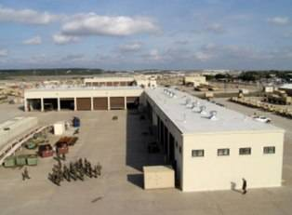
Plans
Consolidated Arms Rooms
Door lock
  Separate key containers
One Armorer vs. Multiple
One Access Roster
  DA Form 7281’s
  Updating personnel changes
Armed Guard Requirements
MOA signed by CURRENT Commanders
Consolidated Facilities
Motor Pool
Building (co-located) with Contractor / other Unit

Slide 58
Plans
A 1-34
B 1-34 (Rear Det)
A
B
A
A
A
B
C
B
C 1-34
B
A
C

Slide 59
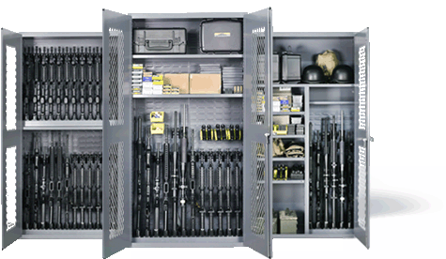
Weapons Storage / Ammunition Storage
Racks / Locks

Slide 60
Racks
When not in use, arms will be stored in banded crates, metal containers, approved standard issue racks or locally fabricated arms racks, and secured in approved weapons storage facilities. Standard issue approved metal wall lockers or metal cabinets may be used (when certified).

Slide 61
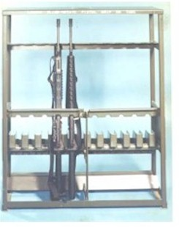
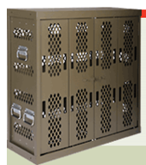
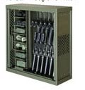
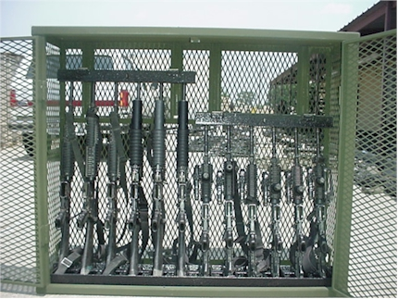
Racks
STANDARD ISSUE
Marvel
Space Saver
War-Tec

Slide 62
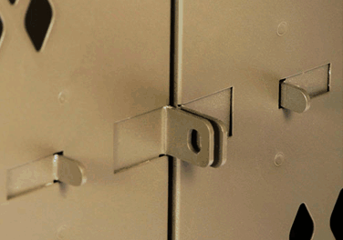
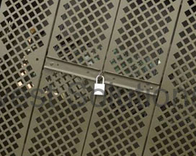
Racks
Marvel
“Push Together”
Space Saver
“Swing Arms”

Slide 63
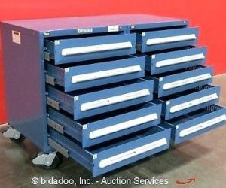
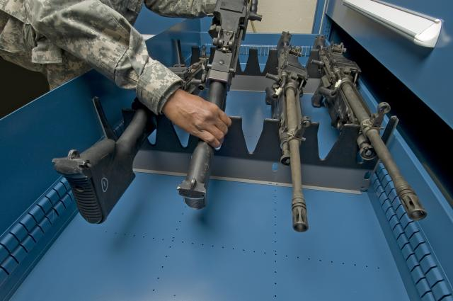
Racks
Stanley-Vidmar
Based on four (4) specific configurations.
Salesman will sell you any configuration.
Approved configurations will have NSN.

Slide 64
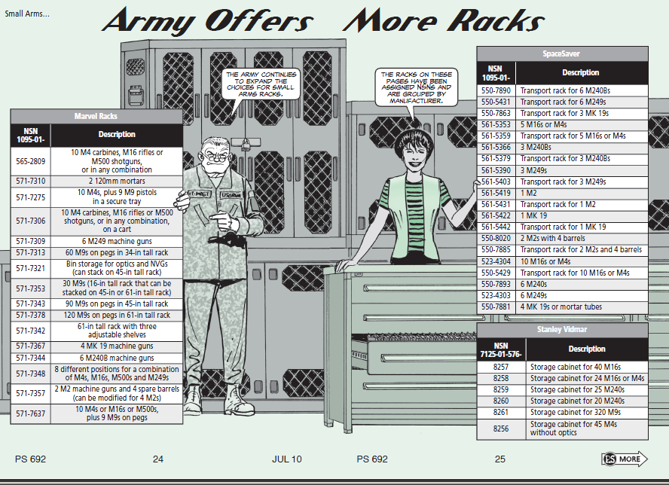
Racks
Authorized Weapons Racks:
Space Saver
Marvel
Stanley Vidmar (limited)
War-Tac

Slide 65
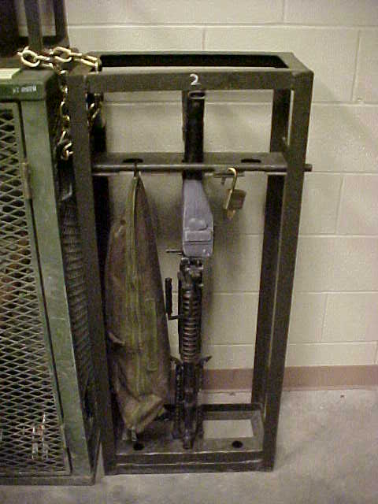
Racks
    The use of locally fabricated racks is prohibited unless certified by TACOM as security equivalent to standard issue racks.

Slide 66

Racks
GSA: General Services Administration
Includes all GOV agencies (e.g. Forestry Service, IRS, etc.)
Not a guarantee of meeting DA standards.
Notes:
Iaw AR 190-11 4-2C2

Slide 67
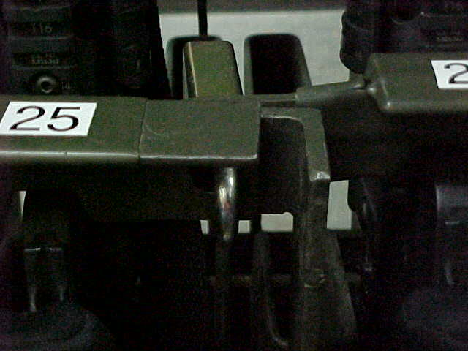
Racks
Incorrect
Notes:
Iaw AR 190-11 4-2C2

Slide 68
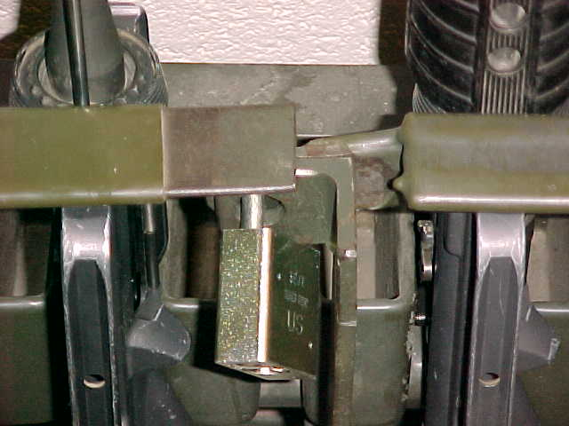
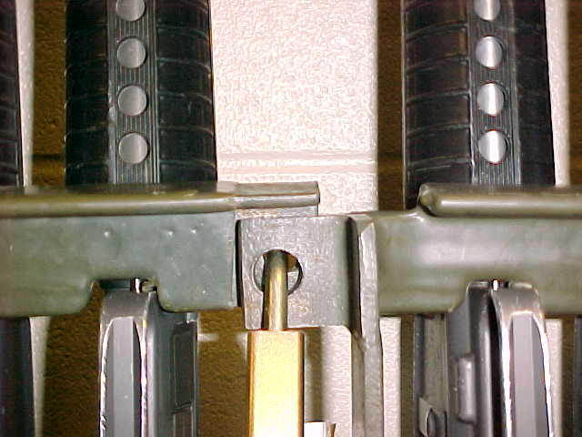
Racks
Correct
Notes:
Iaw AR 190-11 4-2C2

Slide 69
Racks
First Generation Marvel
First Generation Space Saver
Modification: Hinge pins spot welded or crimped and certified by TACOM
Modification Required Certification Packet Required

Slide 70
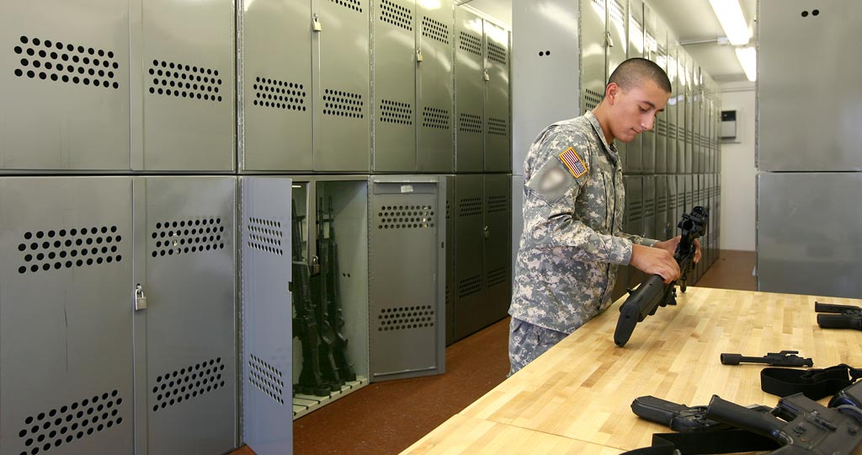
Racks
Naval Universal Racks
Modification Required Certification Packet Required

Slide 71
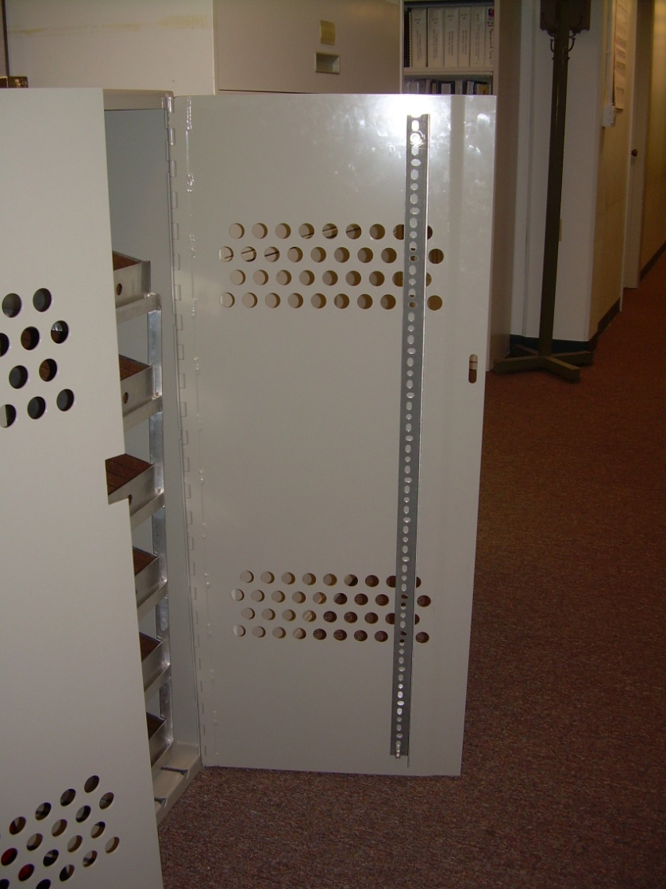
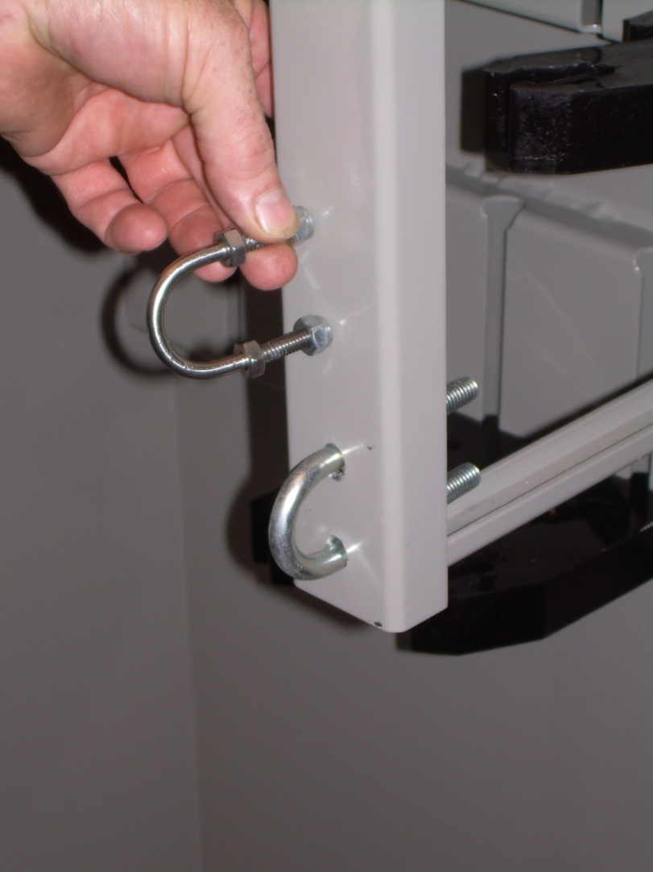
Racks
Re-enforced Door
Locking Shackle
(5/16” Hardened Steel)

Slide 72
Arms Rack Certification:
Racks
The Tank and Armament Command (TACOM) based out of Rock Island, IL is responsible for certifying all weapon racks and containers.
  Pre-inspection conducted by TACOM Reps.
  Unit Completes Paper Work and Forwards to Rock Island, IL
  Packets are returned to local TACOM reps
  Final Inspection Conducted /Serial Numbers Issued.

Slide 73
Racks
TACOM Local Area Representatives (LARs)
1 ABCT - William “Larry” Saddler – 240-5600 william.l.saddler.civ@mail.mil
2 ABCT - Gary Crippens – 240-0491
Gary.l.crippen.civ@mail.mil
CAB - Steve Baudoin – 240-6016
etienne.j.baudoin.civ@mail.mil
LSE - Randy Garcia– 240-0500
randolph.m.garcia.civ@mail.mil

Slide 74
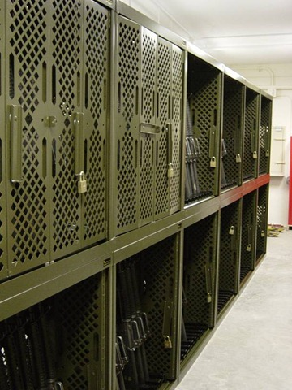
Racks
Arms racks and containers weighing less than 500 pounds will be secured to the structure with bolts or chains, or fastened together in groups totaling more than 500 pounds. (IAW AR 190-11 para 4-2c(2)
Racks secured together in groups of four is the general “rule of thumb” to meet this standard.
Notes:
HEAVY DUTY HARDENED STEEL, WELDED, STRAIGHT LINKS STEEL, GALVANIZED OF AT LEAST 5/16-INCH THICKNESS.

Slide 75
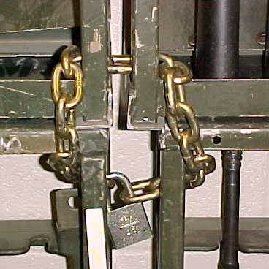
Racks
Approved Chain to Secure Arms Racks is heavy duty hardened steel, welded, straight links steel, galvanized of at least 5/16–inch thickness.
*NOTE: Steel Cable cannot be used as it is composed of smaller fibers of cable that can be easily cut.
General Rule To Follow:
The chain must be at least as thick as the shackle of your low security secondary padlock. (5200 Series) (Weakest Link Theory)
Notes:
HEAVY DUTY HARDENED STEEL, WELDED, STRAIGHT LINKS STEEL, GALVANIZED OF AT LEAST 5/16-INCH THICKNESS.

Slide 76
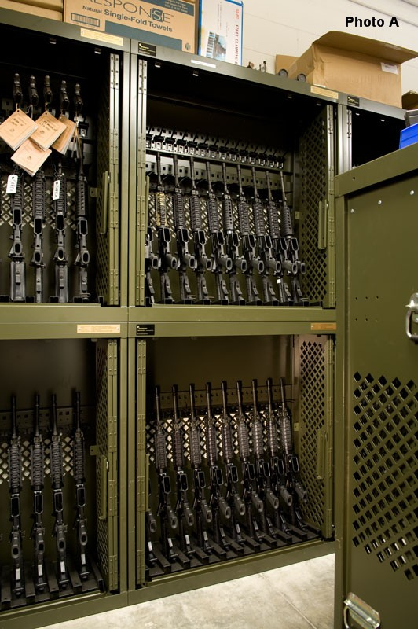
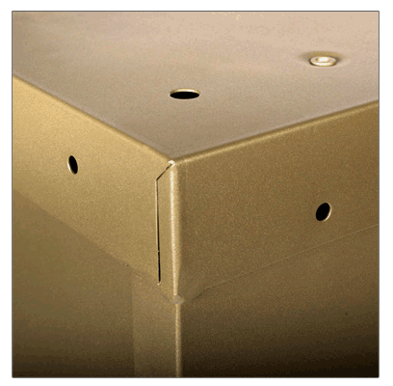
Racks
Marvel and Space Saver Weapon Racks
Use Nuts and Bolts that will fit existing holes.
DO NOT widen or drill holes to make them bigger.
Notes:
HEAVY DUTY HARDENED STEEL, WELDED, STRAIGHT LINKS STEEL, GALVANIZED OF AT LEAST 5/16-INCH THICKNESS.

Slide 77
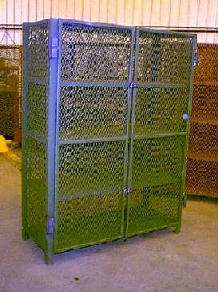
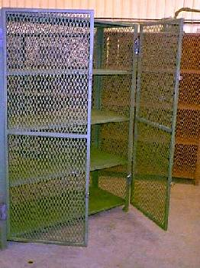
Racks
DA Approved Universal Arms Rack – NSN 1095-01-454-6320
Rack meets the 500lbs weight requirement. Do not cut rack to thread chain.
1 container – cannot store Govt. property AND privately-owned weapons / ammo at the same time.
FYSA – tendency to stack equipment several rows deep. Lax inventory procedures combine to increase larceny risks.

Slide 78
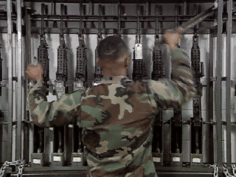
Racks
Ensure You Secure Your Arms Racks And Security Containers Prior To Leaving The Arms Room.
Notes:
Iaw AR 190-11 4-2C2

Slide 79
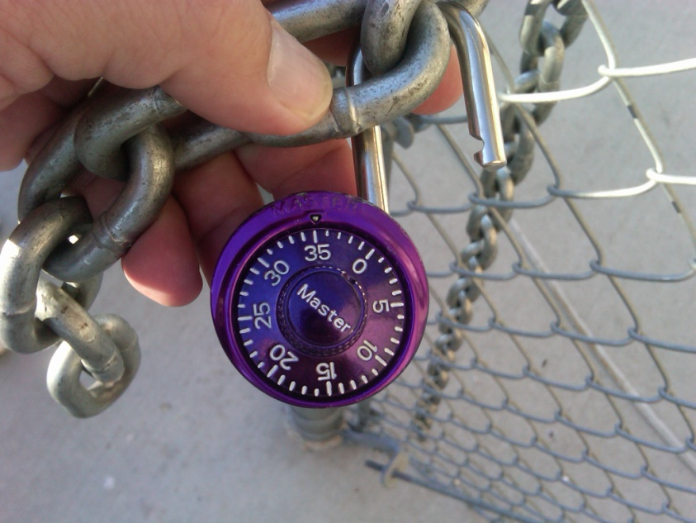
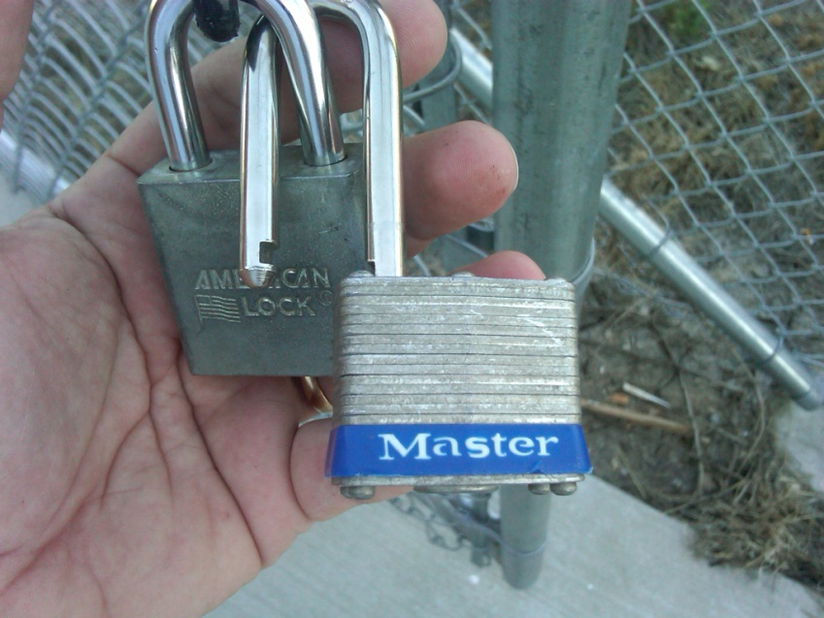
Racks
Lessons Learned
Motor Pool Gate Found Unsecured By Police Patrol
Three Different Locks “Daisy Chained” Together
Notes:
Iaw AR 190-11 4-2C2

Slide 80
Racks
Chain of Events:
Police Patrol Began Clearing Motor Pool and Found Building Door Unsecured.
Police Patrol Then Began Clearing Unsecured Building
Police Patrol Pulled on Vault Door To Arms Room and Arms Room Door Opened. Combination Dial was not “Spun” to Secure Door!
ICIDS Alarm Sounded (ICIDS Was Activated)
Upon Entering “Unsecured” Arms Room the Following Was Found:
Notes:
Iaw AR 190-11 4-2C2

Slide 81
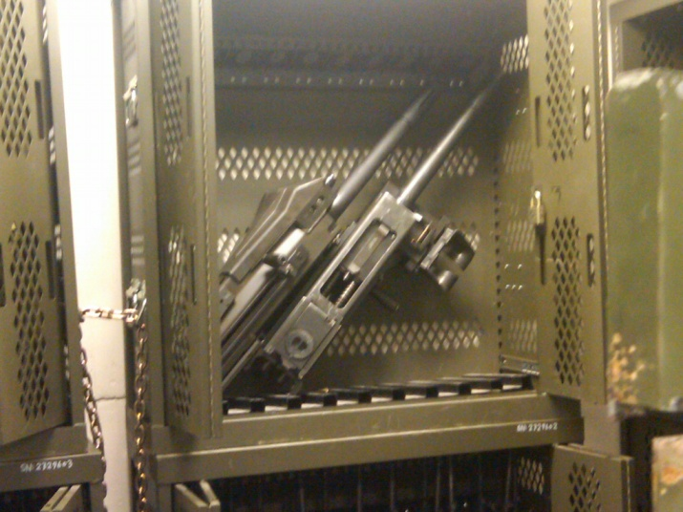
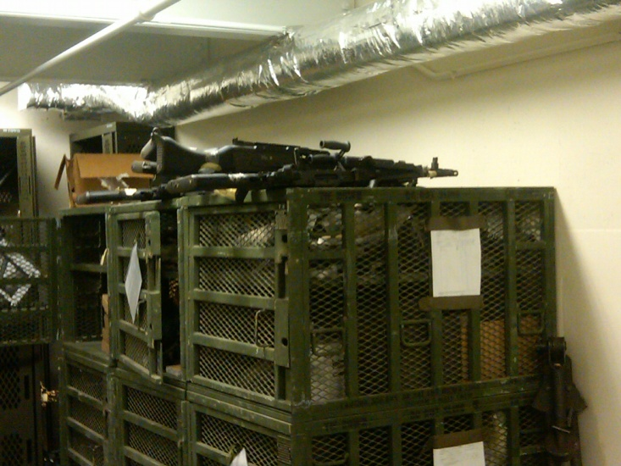
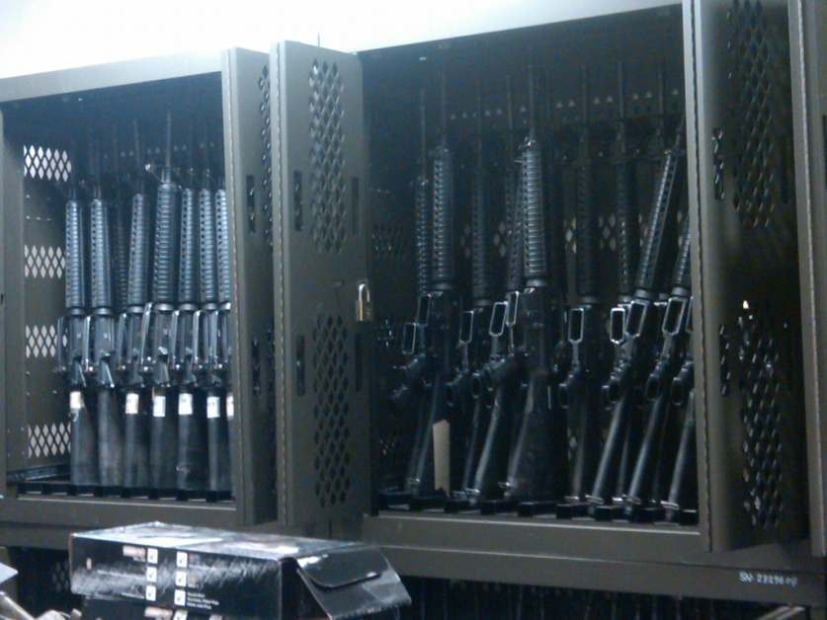
Racks
Weapons Stored On Top of Weapon’s Racks
All Weapon’s Racks Unsecured
Notes:
Iaw AR 190-11 4-2C2

Slide 82
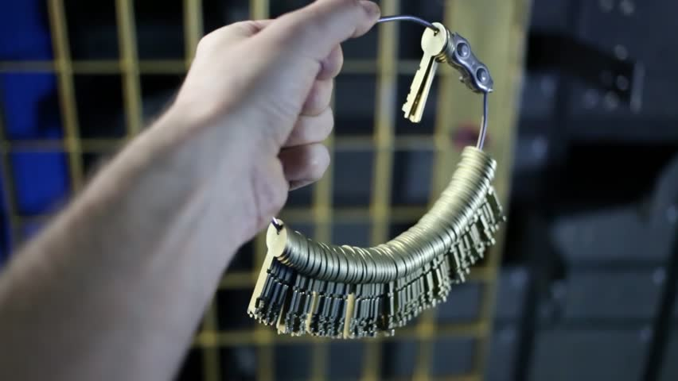
AA&E Key Control

Slide 83
Fact or Fiction
The serial number on the lock cannot be the same as the serial number on the key.
FICTION
AR 190- 51, app D and AR 190-11, para 3-8 n. state, “Padlocks and keys which do not have a serial number will be given one. This number will be inscribed on the lock or key as appropriate.” New Master locks have the same serial number on both the lock and key.

Slide 84
Fact or Fiction
The key ring used must be a solid braised (welded) metal key ring.
FICTION
Neither AR 190-51 (admin) nor AR 190-11 (AA&E) require keys be on any type of ring, string or cable.

Slide 85
Fact or Fiction
Staff Duty or the S2 is the key and lock control custodian for the unit.
FICTION
Staff Duty is only the keeper of the locked ammo can during non-duty hours. In the case of the S2, they are only securing the locked and sealed container with the spare keys in them.

Slide 86
Fact or Fiction
I cannot list where the locks are located at in the arms room on the DA Form 5513. (Ex. Key Number #1, goes to lock #1 which is on M16 rack #2)
FICTION
AR 190-51, app D and AR 190-11 para 3-8 n state, “A key and lock inventory will contain a record of keys, locks, key serial numbers, lock serial numbers, location, and the number of keys maintained for each lock. This record will be secured in the key depository.”

Slide 87
AA&E Key Control
AA&E Key Control Custodian
Required to have a DA Form 7708 Personnel Reliability Screening And Evaluation completed prior to assuming duties as AA&E Key Custodian.
Be appointed in writing to issue and receive keys and account for keys.
Issues primary keys to Armorer and Locked & Sealed container (spare set) to HHQ (S-2)
Ensure that individuals who are designated to issue keys in their absence, clearly understand key control procedures.
Maintain a key control register (DA Form 5513) at all times to ensure continuous accountability for keys of locks used to secure Government property.
Inventory Keys at a minimum Semi-annually (Conducted by disinterested individual).
Conduct an inquiry when a key is lost or stolen.
Attend refresher training annually. (New Requirement)

Slide 88
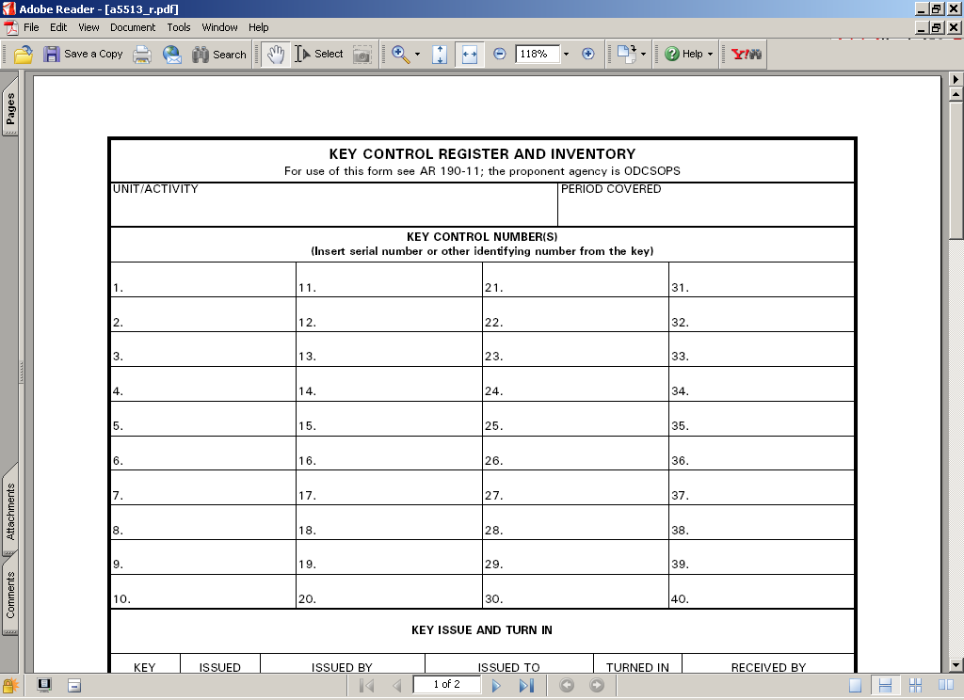
AA&E Key Control
UNIT: HHT 1-4 CAV
44322 High Security Padlock Main Door
1234H M16 Rack 1
5678H M16 Rack 2
1122B M9 Rack 1
Key Serial Number
Lock Location
Input Unit Information
Lock Number 1
Number of Keys
HHT 1-4 CAV
44322
(3)
Arms Room Door
1234H
(2)
M16 Rack 1
5678H
(2)
M16 Rack 2
1122B
(2)
M9 Rack 1

Slide 89





Issuing AA&E Keys
AA&E Key Control
Primary Keys
Armorer
AA&E
Key Custodian
Spare Keys
BN S-2

Slide 90
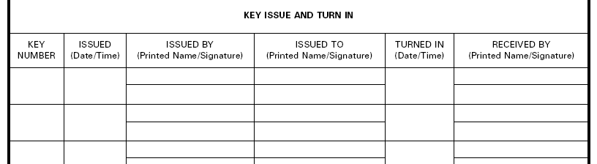
AA&E Key Control
1-24
0900
1 Oct 19
Key Custodian Print
Armorer Print
Key Custodian Sign
Armorer Sign
Seal#
12345
0920
1 Oct 19
Key Custodian Print
S-2 Print
Key Custodian Sign
S-2 Sign
Primary Keys Issued To Armorer
Spare Keys Issued To S-2
All Keys Are Now Issued and Accounted For Properly!

Slide 91
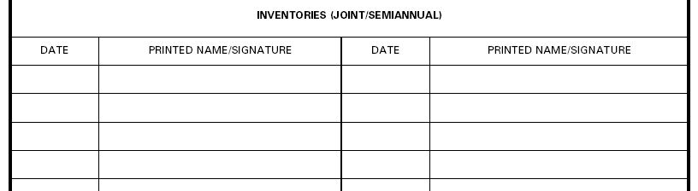
AA&E Key Control
1 Oct 19
Key Control Custodian Sign
Key Custodian Signs and Dates When Keys Are First Inventoried. This Is The Benchmark For Future Semi-Annual Inventories.

Slide 92
AA&E Key Control
Unit Armorer Responsibilities:
Sign For Operational Set Of Keys
Ensure Keys Are Never Left Unattended.
Ensure Keys Are Never Taken Off-post (Off The Installation) Unless They Are Being Secured At Another Location
Report Immediately All Lost, Misplaced, Broken Or Stolen Keys To The AA&E Key Lock Custodian.
Ensure Keys Are Properly Secured At The Close Of Business Each Day.
Ensure Keys Signed for at all times.
NOTE: Getting locked ammo can from Staff Duty is NOT signing for the keys.
Notes:
92

Slide 93
Armorer’s DA Form 5513 Setup.

Slide 94
AA&E Key Control
Armorer’s DA Form 5513 Inside Ammo Can
HHT 1-4 CAV
44322
Arms Room Door
1234H
M16 Rack 1
5678H
M16 Rack 2
1122B
M9 Rack 1

Slide 95
Transfer of Arms Room Keys
AA&E Key Control
0900
1 Oct 19
Primary Armorer Print
Alt Armorer Print
0900
2 Oct 19
Primary Armorer Print
1-4
Primary Armorer Sign
Alt Armorer Sign
Primary Armorer Sign
1-4
Primary Armorer Print
Primary Armorer Sign
Used When Arms Room Keys are Transferred Between Two Authorized Personnel
Coincides with opening and closing inventories.
Notes:
Example of 5513 when custody of keys is transferred between authorized personnel. Alt Armorer signs for keys when taking the vault.
When identified that keys are sign by other Armorer…must take possession back by signing for them.
Pre-sign in the event their not present for next time.

Slide 96
AA&E Key Control
Key Turn-In Procedures
Keys signed back in to AA&E Key Custodian on DA Form 5513.
or
Keys placed in a locked ammo can, and the locked ammo can is signed for on DA Form 5513 to Staff Duty or CQ as “Key Box”. Staff Duty/CQ not authorized to sign for actual keys.

Slide 97
AA&E Key Control
DA Form 5513 At Staff Duty Desk
HHT 1-4 CAV
Locked Ammo Can
Staff Duty is Only Maintaining a Locked Ammo Can (Contents Unknown)

Slide 98

Issuing Locked Key Box to Staff Duty
AA&E Key Control
Staff Duty
Primary Keys
Armorer
Primary Key Box

Slide 99
Signing for Ammo Can
AA&E Key Control
1
0700
3 Oct 19
Staff Duty Print
Armorer Print
1700
3 Oct 19
Staff Duty Print
Staff Duty Sign
Armorer Sign
Staff Duty Sign
Picking Up Keys From Staff Duty
Returning Keys To Staff Duty
Key to AA&E “lock box” / “ammo can”
May be “permanently” issued. Not required to turn in at EODD.
Is considered an Admin Key and issued by Admin Key Custodian.

Slide 100
AA&E Key Control
Authorized storage locations of AA&E keys
20 Gauge Steel Key box equipped with a low security padlock. Same as standard key box. Requires hasp addition for lock.
  Located in a room that is secured when unoccupied
GSA Class 5 or Class 6 container with a built in 3 position changeable combination lock.
  Container will not contain classified material
  If the container weighs less than 500 lbs it will be chained to the floor or building
  Typical storage of spare keys at S-2
Keys stored in an ammo can (20 gauge steel) with low security padlock and
  Chained to an eyebolt in the floor at the staff duty / CQ desk
  or secured in safe

Slide 101
AA&E Key Control
Case Study
Unit Rear-D Armorer With Access To Exterior Arms Vault
Brought AA&E Keys With Him To Lunch Off The Installation
Could Not Locate Keys After Lunch
Searched Car, Barracks Room, Subway Could Not Locate Keys
Retrieved Spare Set Of Keys From S2, Spare Keys Did Not Work. They Were Never Shown Any “Love”
Called Pw To Gain Access To Vault. Pw USED PLASMA CUTTER

Slide 102

AA&E Key Control
Cost Break Down:
$2500 To Cut High Security Hasp And Padlock Off Vault Door And Have Door Recertified
$700 For High Security Padlock
35 Low Security Padlocks At $8 Each -- $360
Total Cost: $3,560
Cost Of A Good AA&E Key Control Program: Priceless!!!!

Slide 103
Hands On Key Control Practical Exercise.

Slide 104
AA&E Key Control
Practical Exercise # 1
SFC Roy Jones Is The AA&E Key Custodian For
B Btry 1-12 FA
The Following Keys Are Used In The Arms Room:
23456 - High Security Padlock
2322H - Inner Door
5443B - M16 Rack 1
2722H - M16 Rack 2
6788B - M9 Rack 1
6777G - M9 Rack 2
1233G - POF Locker
2233P - Ammo Can Lock
Seal #12388
*You are the Primary Armorer
*SGT Ricky Steamboat is the S2

Slide 105

AA&E Key Control
B Btry 1-12 FA
23456 (3)
High Security Padlock
2322 H(2)
Arms Room Inner Door
5443B (2)
M16 Rack 1
2722H (2)
M16 Rack 2
6788B (2)
M9 Rack 1
6777G (2)
M9 Rack 2
1233G (2)
POF Locker
2233P (2)
Ammo Can
Admin Key!! Not Added to AA&E DA Form 5513

Slide 106

Answers
1500
1 Oct 2019
Jones, Roy
Primary Armorer
1-7
Roy Jones
Primary Armorer
Seal #
12388
1530
1 Oct 2019
Jones, Roy
Steamboat, Ricky
Roy Jones
Ricky Steamboat

Slide 107

Answers
1 Oct 2019
Roy Jones

Slide 108

AA&E Key Control
Practical Exercise # 2
Q: When Signing for the Spare Set of AA&E Keys, The S-2 Signs for the “Ring” Containing All of the Spare Keys?
A: NO. The S-2 Signs for a LOCKED and SEALED Container of Keys, NOT a “Ring” of Keys or the Keys Themselves.

Slide 109
AA&E Key Control
AA&E KEYS | ADMIN KEYS
DA Form 7708 Required | No DA Form 7708 Needed
20 Gauge Steel Key Box | 26 Gauge Steel Key Box
Low Security Padlock | Tumbler Type Locking Device
Ammo Can Secured in Safe | Affixed To The Wall

Slide 110
AA&E Key Control
Common Deficiencies:
No DA Form 7708 completed for AA&E Key Custodian
No appointment orders / orders issued prior to DA Form 77708 completed
AA&E keys not issued to Armorer from Key Custodian
AA&E keys not inventoried
Armorer’s not conducting Change-of-Custody procedures to include keys

Slide 111


Secondary (Low Security) Padlock

Slide 112







Locks
Only approved secondary padlocks (low security) will be used to secure government equipment
Series 200/5200 padlocks are approved for this purpose
Double bit
Key retainability
Stamped with US or US SET
Notes:
Iaw AR 190-11 4-2C2

Slide 113

Locks
Are these approved padlocks?
YES
AMERICAN 5200 Series
Long and Short Shackle
Notes:
Iaw AR 190-11 4-2C2

Slide 114

Locks
Is this an approved padlock?
YES
US Master Lock
Notes:
Iaw AR 190-11 4-2C2

Slide 115

Locks
Is this an approved padlock?
NO
Does Not Have Key Retention Ability
Notes:
Iaw AR 190-11 4-2C2

Slide 116

Locks
Is this an approved padlock?
YES
Pacific Lock Company
Notes:
Iaw AR 190-11 4-2C2

Slide 117


Locks
Laminated Steel
(Stacked Plates)
Solid Steel
Same NSN will get you either Master Lock, American Lock or Pacific Lock

Slide 118

Locks
Is this an approved padlock?
NO
Non-Sparking Brass Padlock
Notes:
Iaw AR 190-11 4-2C2

Slide 119

Locks
Is this an approved padlock?
NO
Brass Padlock
¼” shackle
Shiny Brass Color
Stamped with US SET
US set locks come in sets of 2-10,000 locks per set
Notes:
119
Iaw AR 190-11 4-2C2

Slide 120

Security Alarms
Integrated Commercial Intrusion Detection System (ICIDS)

Slide 121

Intrusion Detection System
INTRUSION DETECTION
Although the Intrusion Detection System (IDS) contributes to many factors in the overall Security Plan, it’s main role is to detect.

Slide 122
Intrusion Detection System
Unless continuously manned or under constant surveillance (guard), the arms room will be protected by an operational intrusion detection system (IDS).
IDS will be tested Monthly by contacting the Alarms Monitor (239-5469) IAW AR 190-11 para 3-6 m(1).
  All alarms and tests will be recorded on DA Form 4930 (alarm / intrusion detection record).
Fort Riley uses ICIDS IV as its IDS for record.
Notes:
Essential element of an arms storage facility
Alerts response force to possible intrusion of a restricted area so that they may respond
Detects, NOT PREVENT, penetration of a restricted area
Permits efficient use of guard personnel, because restricted areas do not have to be guarded 24 hours a day if protected by IDS
Armorers are responsible for activating and deactivating IDS upon entry and exiting of arms room.
Alert alarm monitoring station if alarm is activated for any reason other than an intrusion.
PIC and PIN issue procedures (8-11 Mon-Fri)

Slide 123

Intrusion Detection System
Remote Area Data Collector
RADC
The RADC is the brain of your ICIDS IV SYSTEM
It compiles a list of data and changes and reports to the Primary Monitor Console (Alarm Monitors).
If a RADC triggers an event, the
system alarms and notifies the operator.
RADC Lights:
= Access / Unsecured Zone
= Secure / Secured Zone
= DATA Entered and PIN Prompt

Slide 124




Intrusion Detection System
Ensure your sensors are not blocked by boxes or arms racks
Motion Sensors should have an unobstructed view of the door
Two types of sensors required, one of which must be a volumetric sensor
Motion Sensors (Volumetric Sensor)
Point of Entry Sensor
BMS – Balanced Magnetic Switch
PIR – Passive Infrared

Slide 125



Intrusion Detection System
Duress Switch
Unit is a silent application that sounds the alarm when
personnel are under duress.

Slide 126

Intrusion Detection System
Reasons for Activation
Unauthorized Entry Attempts
Tampering
Power Loss
Communications Failure
Duress
Nuisance
Test

Slide 127
Intrusion Detection System
PIC/PIN
PIC-Personal Identification Cipher (6 Digit #)
PIN-Personal Identification Number (4 Digit #)
Shows who accessed or secured the system and at what time.
No logging out of the system required.
PIC/PIN will work in other arms rooms if you are listed on the unaccompanied access roster.

Slide 128

Intrusion Detection System
Complete your Personnel Reliability Screening And Evaluation (DA Form 7708).
Obtain your updated Unaccompanied Access Roster.
Assumption of command orders.
Bring the completed documents to ICIDS PIC/PIN Office located in BLDG 221.
Numbers are issued daily from 0800 – 1600 in Bldg 221

Slide 129


Intrusion Detection System
A CO, 123rd CSSB/ FORT RILEY
BLDG 7803-1
4
Monthly Test
Called Alarms Monitor
RAB
JDA
23 Jul 19
1003
1013
HOT
BLDG 7803-1
3
Mouse in Arms Room
Activated PIR
JDA
1 Aug 19
0200
0330
HOT
Reset Alarm
Enter Alarms
Monitor Initials and
Your Initials
Ensure you annotate All False and Nuisance Alarms As Well On This Form. This Information Is Used By The Alarm Tech To Trouble Shoot The System. Semi-annual Maintenance checks performed by maintenance personnel will be annotated.
Enter What You
Did
Enter Bldg Number and
“Room” Number
Enter Date
Enter Start and
Stop Time
Enter Weather
Conditions
Completed DA Form 4930 must be maintained on file for 90 Days.
Notes:
Essential element of an arms storage facility
Alerts response force to possible intrusion of a restricted area so that they may respond
Detects, NOT PREVENT, penetration of a restricted area
Permits efficient use of guard personnel, because restricted areas do not have to be guarded 24 hours a day if protected by IDS
Armorers are responsible for activating and deactivating IDS upon entry and exiting of arms room.
Alert alarm monitoring station if alarm is activated for any reason other than an intrusion.
PIC and PIN issue procedures (8-11 Mon-Fri)

Slide 130
Intrusion Detection System
Access rosters not utilizing the proper format will not be accepted
  Proper room number and zone number listed on access roster
  Ensure the DoD ID Number is used, not SSN
  Building number and phone number of duty hour and non-duty hour POCs
  Email address of Commander and 1SG at a minimum.

Slide 131
Intrusion Detection System
Alarm sign must be placed at eye level on exterior of alarmed facility
THIS FACILITY IS PROTECTED
BY AN
ALARM SYSTEM
UNAUTHORIZED ENTRY IS PROHIBITED
VIOLATORS WILL BE PROSECUTED
UNDER THE PROVISIONS OF THE UCMJ
OR OTHER APPLICABLE LAWS
Fort Riley Regulation 190-11 Requires You to Secure Your ICIDS System Whenever Your Arms Room Is Unoccupied For Any Amount of Time.

Slide 132

Armed Guard
Intrusion Detection System
If your ICIDS IV fails or is inoperable for any reason for any amount of time, there must be an armed guard present until service is restored.

Slide 133
Intrusion Detection System

Slide 134
Intrusion Detection System

Slide 135

Intrusion Detection System
Alarm Monitoring 239-5469

Slide 136




Security Of Additional Property

Slide 137
Additional Property
Tool Such As Hammers, Bolt Cutters, Chisels, Crow Bars And Similar Items Will Not - - -
  Be readily accessible.
  Be stored in the vicinity of the arms room
  Be stored in the supply room when entry to the arms room is located within the supply room.
Bolt cutter control and accountability
  Be Secured in supply room.
  Double barrier protection.
  Issued by primary or alternant key control personnel.
  Hard covered log book for control and accountability.
  Accurate information annotated pertaining to lock being cut.
  Keys controlled IAW AR 190-51.

Slide 138
Additional Property
High-Value Items:
Will not be stored in the arms room when other secure facilities are reasonably available.
When other secure facilities are not available, the Commander must prepare an informal memorandum to the Armorer authorizing the storage of high-value, sensitive items in the arms room
NOTE: If the item is not a weapon, ammo or night vision device it must be listed on the memorandum authorizing it to be stored in the arms room.
Notes:
High Value Items include but are not limited to:
Any items stored in the arms room besides weapons and weapon parts require written authorization from the commander.
MEMORANDUM SHOULD LIST ITEMS AND QUANTITY THE COMMANDER IS AUTHORIZING TO BE STORED IN THE ARMS ROOM.

Slide 139
Additional Property
Pilferable Items:
Readily available civilian equivalent.
May or may not be sensitive items.
Typically don’t have serial numbers assigned to specific items.
Required to be inventoried at same frequency as other property stored in the arms room. (open/closing, change-of-custody, 100% serial number, etc.)
Notes:
High Value Items include but are not limited to:
Any items stored in the arms room besides weapons and weapon parts require written authorization from the commander.
MEMORANDUM SHOULD LIST ITEMS AND QUANTITY THE COMMANDER IS AUTHORIZING TO BE STORED IN THE ARMS ROOM.

Slide 140

Additional Property
Storage of Controlled Cryptographic Items (CCI)
CCI (keyed or unkeyed) shall not be stored in vaults, security containers, or arms storage facilities containing items of monetary value (e.g., cash, jewelry, precious metals, etc), weapons, ammunition, or other sensitive items.
All CCI will have a data-plate on it identifying it as a Controlled Cryptographic Item.
CCI is anything with a CIIC (Controlled Item Inventory Code) “9”
AR 380-40, paragraph 8-8 c.
Notes:
High Value Items include but are not limited to:
Any items stored in the arms room besides weapons and weapon parts require written authorization from the commander.
MEMORANDUM SHOULD LIST ITEMS AND QUANTITY THE COMMANDER IS AUTHORIZING TO BE STORED IN THE ARMS ROOM.
FOR TEST PURPOSED CG POLICY LETTER 12-3 IS STILL IN EFFECT

Slide 141

Additional Property
Click on CIIC for More Information

Slide 142


QUESTIONS?
COMMENTS?
CONCERNS?

