Slide 1
GC Update
LTC Campbell
Director Emergency Services
USAG/DES
Subtitle Here
Version Number
As of DD MMM YYYY

Slide 2


ARMORER’S COURSE
Physical Security of Arms, Ammo & Explosives (AA&E)
DAY 2
Presented by:
Fort Riley Security Branch
Notes:
Introduction to Class

Slide 3
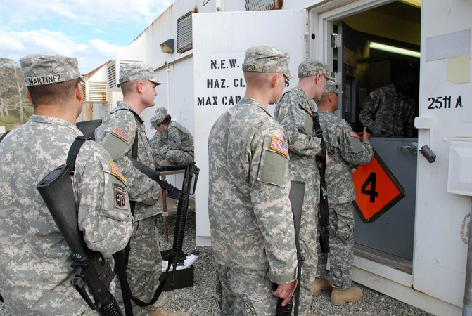
Issue and turn-in procedures

Slide 4
Issue / Turn-In Procedures
The Armorer must maintain a Master Authorization List (MAL)
The MAL will at minimum list:
    Name of the Soldier.
    Type and serial number of the primary equipment assigned to the Soldier.
The Armorer will keep the MAL updated to reflect all personnel changes. (living document)
Notes:
MAL – IAW DA Pam 710-2-1 PARA 5-6d(1)

Slide 5
Hand Receipts
  DA Form 3749 – Equipment Receipt (Weapons Card)
    Continuous Use Hand Receipt (Can be used Multiple Times)
  DA Form 2062 – Hand Receipt
    Limited Use Hand Receipt (Six Columns A-F = Six Uses)
    No Expiration – Valid Until Equipment is Returned
  DA Form 3161 – Request for Issue or Turn-In
    Temporary Hand Receipt (Up to 30 Days - “Temporary Hand Receipt” Written in Block 1.)
Notes:
MAL – IAW DA Pam 710-2-1 PARA 5-6d(1)

Slide 6
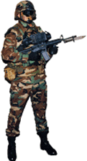

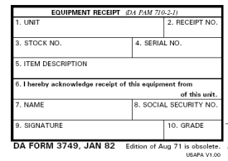
Issue / Turn-In Procedures
Weapon Issue Less Than 24 Hours
Soldier Hands Weapon’s Card To Armorer
Soldier
Armorer

Slide 7
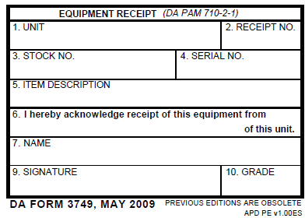
Issue / Turn-In Procedures
Before a weapon is issued, check DA Form 3749 against the MAL to ensure an authorized and correct issue is being made.
HHC 1 ID M16 MAL
Rank Name Rack # Serial #
PFC Jones, J 3 2211
SGT Fielder, M 5 3456
SSG Kruger, F 8 3422
PFC Smith, J 1 1123
1SG Johnson, S 2 2345
SSG Gabriel, R 9 9965
PVT Ubetcha, P 4 8878
HHC 1 ID
1
510-11-322-5565
1123
M16A4
Arms Room
Smith, John
SPC

Slide 8

Issue / Turn-In Procedures
Weapon Issue Less Than 24 Hours
Armorer issues weapons to soldier
Soldier
Armorer

Slide 9
Issue / Turn-In Procedures
Greater Than 24 Hours
Follow Same Procedures As Above
Soldier Must Also Make Entry On Weapon Control Log
(FR Form 43-1)
Armorer
Soldier

Slide 10
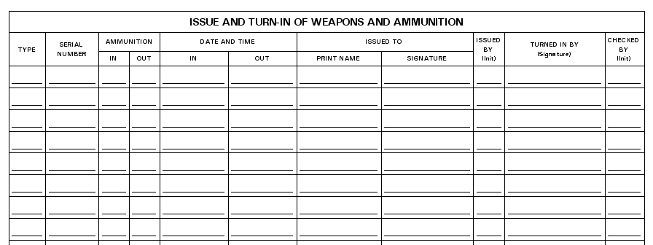
Issue / Turn-In Procedures
Weapon Control Log FR 43-1
M16A4
1123
0
2 Dec 19 / 0900
PFC J. Smith
J. Smith
JA

Slide 11
Issue / Turn-In Procedures
Lost Weapons Card
Use hand receipt procedures (DA Form 2062)
Soldier
Armorer

Slide 12
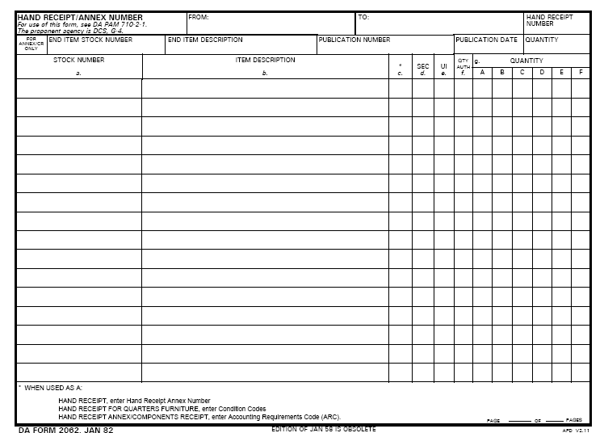
Issue / Turn-In Procedures
Joe D. Armorer
PFC J. Smith
210-01-111-1111
M16A4 SN# 1123
ea
1
1
J. Smith 2 December 2019

Slide 13
Issue / Turn-In Procedures
Lost Weapons Card
Use hand receipt procedures (DA Form 2062)
Soldier must also make entry on weapon control log (FR form 43-1)
Soldier
Armorer

Slide 14
Issue / Turn-In Procedures
  Do not use only the FR 43-1 for weapons issue.
  It is not a hand receipt. It is only a Control Log for tracking purposes!
  The FR 43-1 does not assign responsibility to the soldier.

Slide 15
Issue / Turn-In Procedures
M16A4
1123
0
0
2 Dec 19 / 1010
2 Dec 19 / 0900
PFC J. Smith
J. Smith
JA
J. Smith
JA
M16A4
9083
0
2 Dec 19 / 0905
SGT R. Smith
Roy Smith
JA
M16A4
9873
0
0
2 Dec 19 / 1015
2 Dec 19 / 0906
SGT G. Poe
Grace Poe
JA
Grace Poe
JA
M16A4
6765
0
0
2 Dec 19 / 1017
2 Dec 19 / 0910
SGT W. Wilson
William Wilson
JA
William Wilson
JA
M16A4
3343
0
0
2 Dec 19 / 1019
2 Dec 19 / 0911
SGT J. Fielder
Judy Fielder
JA
Judy Fielder
JA
Completed Control Logs (FR 43-1) are kept on file until the next monthly 100% serial number inventories are complete.
Do not destroy the FR 43-1 if there is still an open entry.

Slide 16
Issue / Turn-In Procedures
Additional Issue Situations
Equipment not assigned to a single, specific individual:
  DA Form 2062 and Weapons Control Log.
When a single weapon is needed for issue to more than one Soldier (ex. Squad assigned weapon):
  DA Form 3749 for each person authorized to withdraw it and Weapons Control Log.

Slide 17
Check on Learning
Issue / Turn-In Procedures
Q: How would you issue an M4 to a soldier who will be attending Warrior Leaders Course for Two Weeks?
A: Soldier Turns In Weapons Card (DA Form 3749) or Hand Receipt (DA Form 2062), and soldier makes an entry on weapon control log (FR Form 43-1)

Slide 18
Issue / Turn-In Procedures
Check on Learning
Q: How would you issue the Commander’s M9 to his driver so that his driver may clean the Commander’s weapon?
A: Commander’s Driver turn in a hand receipt (DA Form 2062) and makes an entry on the weapons control log since the weapon is not assigned to him on the MAL.

Slide 19
Simple Vs. Complicated
* Simple Issue – Only DA Form 3749 (Less Than 24 Hours)
* Complicated Issue – Weapons Control Log (FR 43-1)
Some Type of Hand Receipt
Issue / Turn-In Procedures

Slide 20
STORAGE OF AMMUNITION
Notes:
20

Slide 21
IS AMMUNITION AUTHORIZED TO BE STORED IN THE ARMS ROOM?
YES
With An Approved Ammunition Site License
Notes:
21

Slide 22
Ammunition Storage
Must Have a Ammunition Site License To Store Operational Load Ammunition
NOTE: Each unit MUST maintain an operational load on hand in the event that the IDS fails
AR 190-11, para 4-2 a.(3) / FR 190-11, para 11 a. (2)
OPLOAD Ammunition Must Be Included In all Inventories (Opening / Closing, Change of Custody, Monthly 100% etc)

Slide 23
Ammunition Storage
Installation Safety Office has implemented a new digital site licensing process.
Entire packet is emailed from POC to POC (Eliminates the need for unit armorers to hand carry packet from location to location)
Follow flow chart contained in Arms Room Site License folder on the Physical Security Resource CD.

Slide 24
Ammunition Storage
Ammunition Site License
    Ammo Storage Authorization Memo (Form 1)
Notes:
24
Operational load : 100 rounds IAW FR PAM 710-16 para 9-2 a, b
Training Ammo IS not authorized for storage in arms room (FR Pam 710-16)
Blank ammunition is excluded from this requirement IAW Ar 190-11 para 1-1c (2) (c)
NOTE: Blank ammo will be on a memo for high value items.

Slide 25
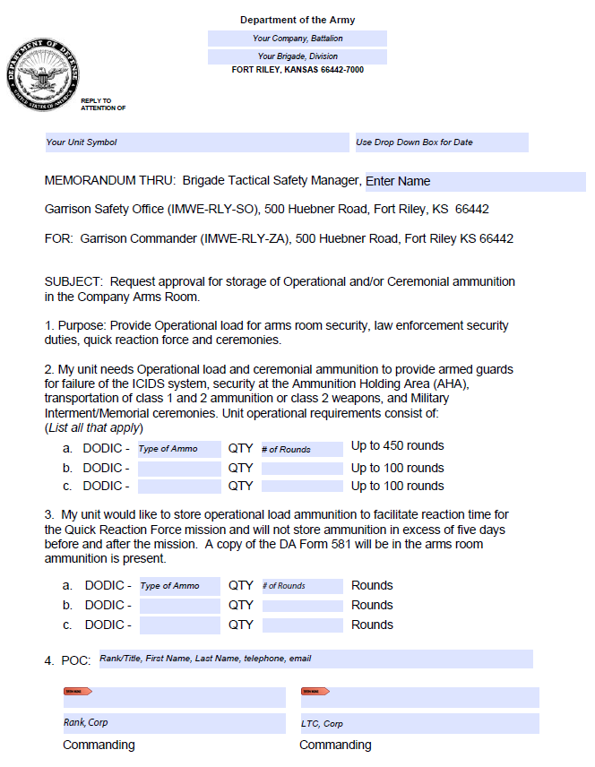
Ammunition Storage

Slide 26
Ammunition Storage
Ammunition Site License
    Ammo Storage Authorization Memo (Form 1)
    Explosive Site License Worksheet (Form 2)
Notes:
26
Operational load : 100 rounds IAW FR PAM 710-16 para 9-2 a, b
Training Ammo IS not authorized for storage in arms room (FR Pam 710-16)
Blank ammunition is excluded from this requirement IAW Ar 190-11 para 1-1c (2) (c)
NOTE: Blank ammo will be on a memo for high value items.

Slide 27
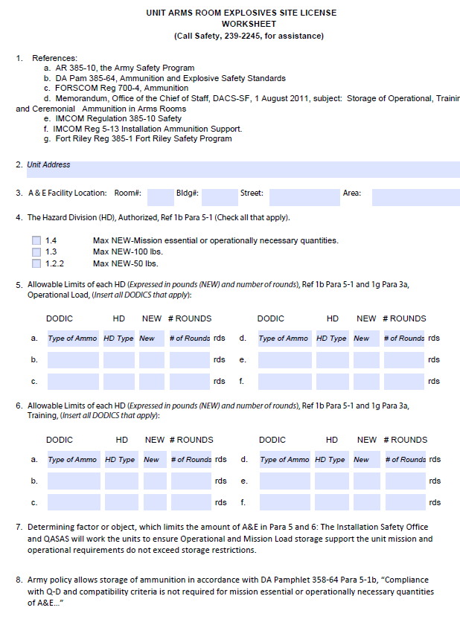
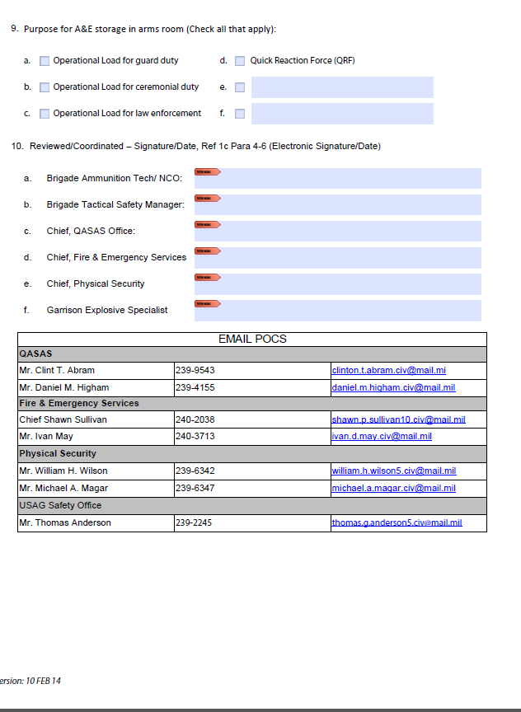

Slide 28
Ammunition Storage
Ammunition Site License
    Ammo Storage Authorization Memo (Form 1)
    Explosive Site License Worksheet (Form 2)
    Risk Assessment Worksheet (FR Form 108)(Form3)
Notes:
28
Operational load : 100 rounds IAW FR PAM 710-16 para 9-2 a, b
Training Ammo IS not authorized for storage in arms room (FR Pam 710-16)
Blank ammunition is excluded from this requirement IAW Ar 190-11 para 1-1c (2) (c)
NOTE: Blank ammo will be on a memo for high value items.

Slide 29
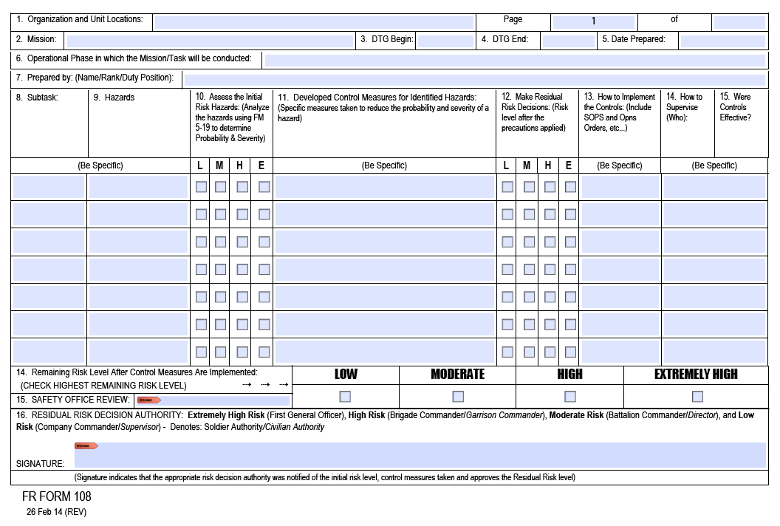

Slide 30
Ammunition Storage
Ammunition Site License
    Ammo Storage Authorization Memo (Form 1)
    Explosive Site License Worksheet (Form 2)
    Risk Assessment Worksheet (FR Form 108)(Form 3)
    Quantity Distance Verification (FORSCOM Form 133-R)
    Security Construction Statement (DA Form 4604 – R)
POC: TOM ANDERSON – Garrison SAFETY OFFICE
239-2245 / 2514
thomas.g.anderson5.civ@mail.mil
Notes:
30
Operational load : 100 rounds IAW FR PAM 710-16 para 9-2 a, b
Training Ammo IS not authorized for storage in arms room (FR Pam 710-16)
Blank ammunition is excluded from this requirement IAW Ar 190-11 para 1-1c (2) (c)
NOTE: Blank ammo will be on a memo for high value items.

Slide 31
Ammunition Storage
Operational Load Will Not Exceed:
100 Rounds of Ball Ammunition*
2280 Round of Blank Ammunition
*Commanders must identify Operational necessity. Military, DA Police, Field Artillery Battalions and Specific Units On The Air Field have already identified increased Operational load ammunition quantities.
Notes:
31

Slide 32
Ammunition Storage
DA Pam 710-2-1 - Establishes Proper Hand Receipt Procedures. Ammo will be inventoried whenever sensitive items are inventoried.
DA Form 581 – Original draw document at BN, each CO will maintain a copy that should be “visible”
DA Form 5515 - This document assigns responsibility from the individual drawing the ammo to the user (Hand Receipt) (TRAINING AMMO)
DA Form 5203 - IMCOM Regulations requires units to track the issuing and receiving of ammunition from the arms room on this form. (Ammunition version of the Fort Riley Form 43-1 weapons control log)

Slide 33
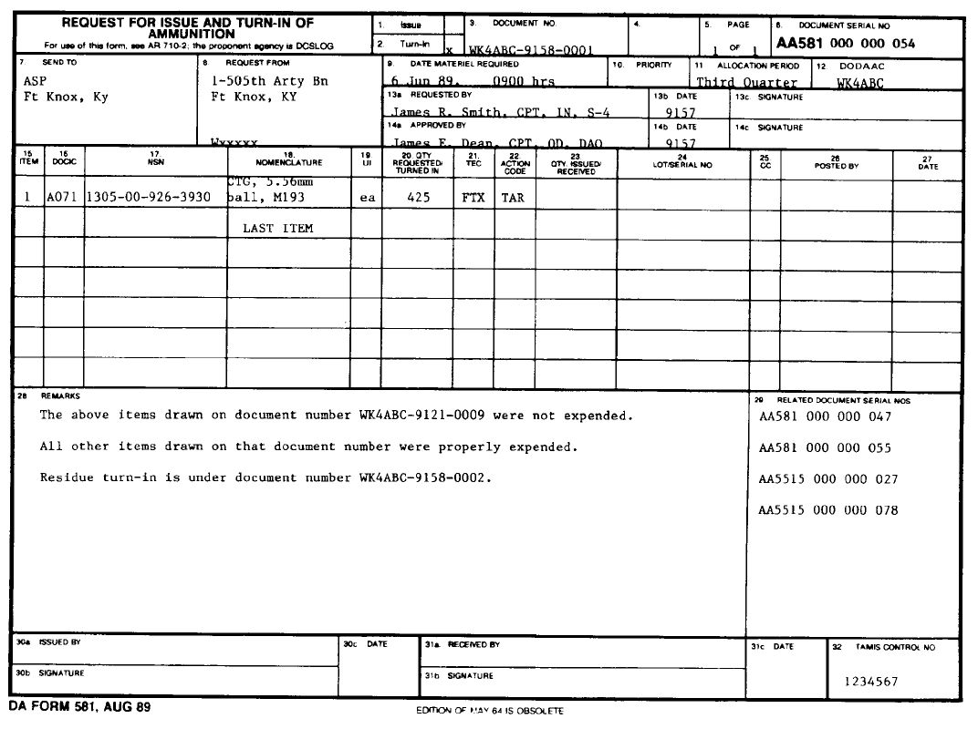
DA Form 581

Slide 34
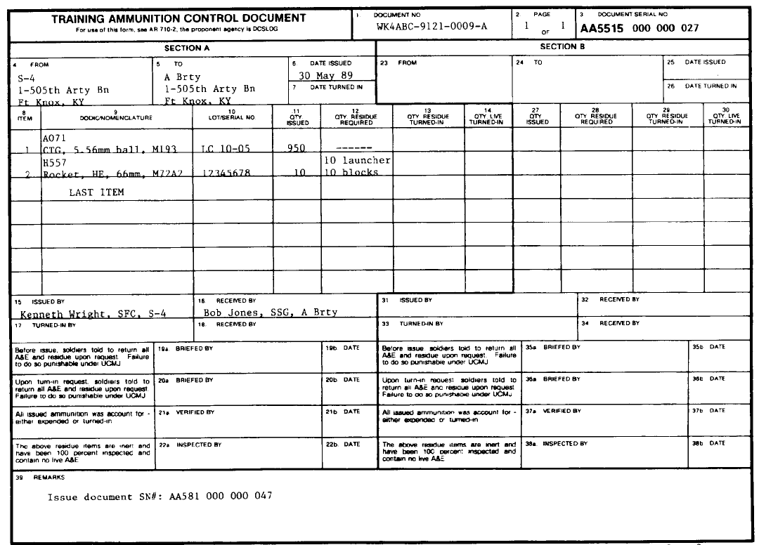
DA Form 5515

Slide 35
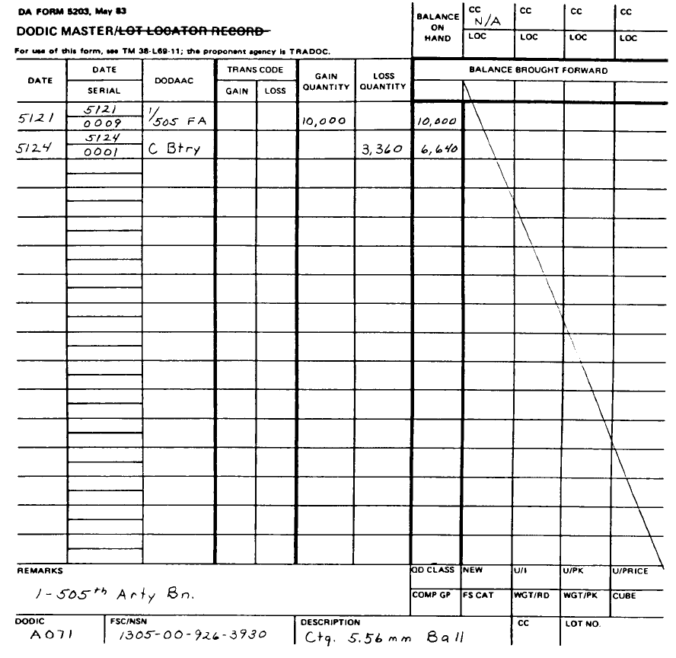
DA Form 5203

Slide 36
Ammunition Storage
Chain of Custody
Ammunition Drawn from ASP by BN Rep using DA Form 581
BN Rep issues OPLOAD ammo to Supply SGT using DA Form 2062 (Must Ensure copy of DA Form 581 is Attached)
Supply SGT will issue OPLOAD ammo to Armorer using DA Form 2062 (Ensure copies of all DA Form 2062 and DA Form 581 Maintained in Arms Room Unless OPLOAD Ammo is on Property Book)

Slide 37
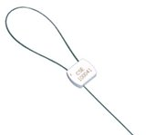
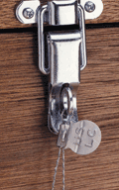
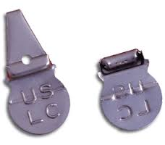
Ammunition Storage
Seals Used by ASP “Unauthorized”

Slide 38
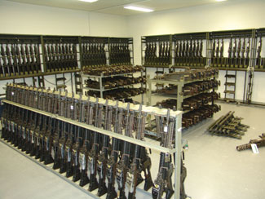
Inventory procedures
AA&E

Slide 39
Inventory Procedures
Monthly 100% serial number inventories conducted by:
Responsible Officer (Commander).
An Officer, Warrant Officer, or NCO appointed by the Responsible Officer
The same person will not be appointed in consecutive months.
Personnel identified on the unaccompanied access roster will not conduct or assist in the inventory.
Notes:
Normally the inventory will be conducted by someone appointed by the commander and not the commander himself, although he is authorized to conduct the inventory.
Inventories conducted by IAW DA PAM 710-2-1 par 9-10 b

Slide 40
Inventory Procedures
Ensure the following items are included in the monthly serial number inventory:
All Privately Owned Firearms and ammunition.
All military ammunition.
All night vision devices (NVDs) and items on the High Value Storage Memorandum.
All accountable property not just sensitive items.
Notes:
Example of the memorandum can be found in the armorer’s quick reference guide (Figure 1-3)
Inventories kept on hand IAW AR 190-11 para 6-2 b(2)(b)1

Slide 41
Inventory Procedures
Inventory documentation:
Results of serial number inventories will be recorded on a memorandum.
Retain the results for 2 years if no discrepancy is noted; 4 years if a discrepancy is noted.
Ensure the person conducting the inventory signs the inventory.
Try to keep the “working copy” of the inventory in the arms room. If you are unable to obtain the “working copy” ensure memorandum is on hand.
Notes:
Example of the memorandum can be found in the armorer’s quick reference guide (Figure 1-3)
Inventories kept on hand IAW AR 190-11 para 6-2 b(2)(b)1

Slide 42
Inventory Procedures
UNIT LETTERHEAD
OFFICE SYMBOL DATE
MEMORANDUM FOR RECORD
On (This Date), I (Rank Name) conducted the monthly 100% inventory for B Btry 1-12 FA. All weapons, ammunition and sensitive items were accounted for, no discrepancies were found during the inventory.
2. The following privately owned fire arms and ammunition were also inventoried:
.50 Cal Desert Eagle SN# 12345
25 round of .50 cal ammunition.
3. Point of Contact for this memorandum is the undersigned at 239-xxxx.
Signature Block
Notes:
Example of the memorandum can be found in the armorer’s quick reference guide (Figure 1-3)
Inventories kept on hand IAW AR 190-11 para 6-2 b(2)(b)1

Slide 43
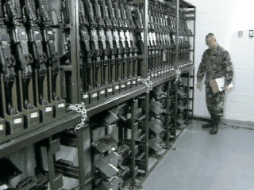
Inventory Procedures
Notes:
Change of Custody inventories IAW DA Pam 710-2-1 para 9-10 a.

Slide 44
Inventory Procedures
Opening / Closing And Change Of Custody Inventories:
Occurs when the responsibility for custody of the arms room or the arms room keys is transferred between authorized personnel.
The person receiving the keys to the arms room will receipt for all AA&E and accountable property stored in the arms room. Results of this inventory will be recorded on DA Form 2062.
The Opening/Closing as well as the Change-of-Custody inventories will be maintained on file until the next monthly 100% serial number inventory.
Notes:
Change of Custody inventories IAW DA Pam 710-2-1 para 9-10 a.

Slide 45
Inventory Procedures
Opening / Closing Inventory
M16A4
53
55
EA
65
EA
M9
65
MK19
EA
6
M249
EA
6
4
4
POW Ruger 9mm SN# 12345
EA
1
1
J. Smith 9 October 2019-----------------\
Notes:
Change of Custody inventories IAW DA Pam 710-2-1 para 9-10 a.

Slide 46
Inventory PE
Inventory Procedures
You are the primary Armorer for A btry 2-32 FA.
Your hand receipt shows you are signed for the following equipment from the BTRY Commander:
M16-A4 – QTY 40
M4 – QTY 20
M9 – QTY 5
You also have a privately-owned firearm belonging to SPC Snuffy:
.50 Cal Desert Eagle pistol serial number 12345
Privately-own ammunition – 25 .50 Cal round
Establish a DA Form 2062 to use for inventories.
Notes:
Change of Custody inventories IAW DA Pam 710-2-1 para 9-10 a.

Slide 47
Inventory Procedures
Opening / Closing Inventory
M16A4
40
EA
EA
M4
20
M9
EA
POF SPC SNUFFY SN 12345
5
EA
1
POF AMMUNITION .50 CAL
EA
25
Notes:
Change of Custody inventories IAW DA Pam 710-2-1 para 9-10 a.

Slide 48
Inventory Procedures
As the primary Armorer you are opening the arms room.
You have the following equipment on hand when you open the arms room:
M16-A4 – QTY 35
M4 – QTY 20
M9 – QTY 4
You have a weapons card in each slot for the five missing M16’s and a DA Form 2062 signed by the BTRY XO for one M9.
All privately-owned weapons and ammunition are accounted for.
Complete your DA Form 2062 for your opening inventory.
Notes:
Change of Custody inventories IAW DA Pam 710-2-1 para 9-10 a.

Slide 49
Inventory Procedures
Opening / Closing Inventory
M16A4
40
35
EA
EA
M4
20
20
M9
EA
4
POF SPC SNUFFY SN 12345
5
EA
1
1
POF AMMUNITION .50 CAL
EA
25
25
Joe D. Armorer 22 October 2019---------/
Notes:
Change of Custody inventories IAW DA Pam 710-2-1 para 9-10 a.

Slide 50
Inventory Procedures
You are the primary Armorer closing the arms room later that afternoon:
All equipment that was signed out has been returned and you have the following items in the arms room:
M16-A4 – QTY 40
M4 – QTY 20
M9 – QTY 5
All privately owned weapons and ammunition are accounted for.
Complete your DA Form 2062.
Notes:
Change of Custody inventories IAW DA Pam 710-2-1 para 9-10 a.

Slide 51
Inventory Procedures
Opening / Closing Inventory
M16A4
40
35
40
EA
EA
M4
20
20
20
M9
EA
5
POF SPC SNUFFY SN 12345
EA
5
4
1
1
1
POF AMMUNITION .50 CAL
EA
25
25
25
Joe . Armorer 22 October 2019-----------/
Joe D. Armorer 22 October 2019---------/
Notes:
Change of Custody inventories IAW DA Pam 710-2-1 para 9-10 a.

Slide 52
Inventory Procedures
You are the assistant Armorer opening the arms room the next duty day.
You have the following equipment on hand in the arms room.
M16-A4 – QTY 39
M4 – QTY 20
M9 – QTY 5
You do not find any hand receipt or weapons cards for the “missing” M16.
All privately owned weapons and ammunition are accounted for.
What do you do next?
Notes:
Change of Custody inventories IAW DA Pam 710-2-1 para 9-10 a.

Slide 53
Inventory Procedures
Opening / Closing Inventory
M16A4
40
35
40
39
EA
EA
M4
20
20
20
20
M9
EA
5
4
5
5
POF SPC SNUFFY SN 12345
EA
1
1
1
1
POF AMMUNITION .50 CAL
EA
25
25
25
25
Joe D. Armorer 22 October 2019--------/
Joe D. Armorer 22 October 2019--------/
John Snuffy 23 October 2019-----------/
Notes:
Change of Custody inventories IAW DA Pam 710-2-1 para 9-10 a.

Slide 54
Inventory Procedures
Missing AA&E Actions:
Complete the DA Form 2062.
Stop all operations and notify Commander and 1SG that you came up a weapon short on your opening inventory.
Unit begins investigation to determine accountability of all weapons.
Notify FRPD, Initiate SIR notifications / procedures.
Notes:
Change of Custody inventories IAW DA Pam 710-2-1 para 9-10 a.

Slide 55

Privately owned Weapons
Storage and Control of POW’s

Slide 56
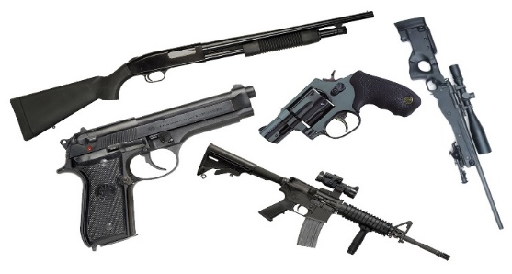
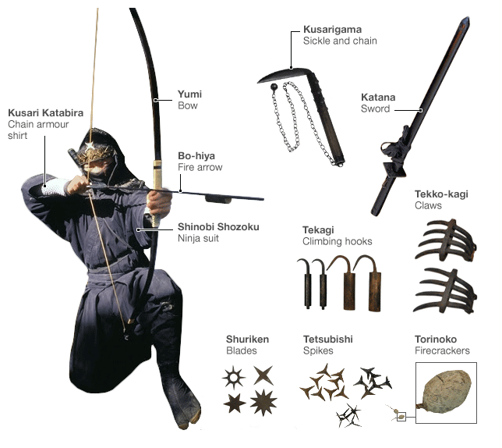
Privately Owned Weapons
Firearm
Any revolver, pistol, rifle, shotgun, or other device designed for or capable of propelling a bullet or other projectile by means of an explosive or compressed charge.
Weapon
Anything designed or used for inflicting bodily harm or physical damage.
Privately-Owned Weapon
Any weapon in the possession of an individual, other than authorized military weapons in an individual’s possession as part of official military duties.
Notes:
56
Cross bows, Bows, Knives, Swords, Slingshots are not required to be registered on the installation.

Slide 57
Privately Owned Weapons
Applicable Regulations:
AR 190-11 para 4-5: prohibits POFs unless policy designated in writing by Senior Commander.
FR 190-1 (Dated: 3 Apr 2018): Fort Riley specific regulation titled Privately Owned Weapons, Explosives and Ammunition.
Unit Requirements:
FR Form 102-1 maintained on file until the Soldier/Family Member departs the organization.
Have policies, plans and procedures in place for storing privately owned weapons. Plan tailored by the CDR for their specific situation based on mission, facility space, etc.…
NEW REGULATION
APR 2018!
Notes:
Are POFs store in a separate container from government weapons?
Is private ammo stored separate from GOV ammo?
Does the current CDR/1SG know who has POFs?
Does the armorer have a list of who in the unit have authorized POFs registered and store elsewhere? Quarters, BEQ, BOQ.
You can not require a Soldier to register POF on post if the firearm is never brought on the installation.
You can not authorize a Soldier in the barracks to store his POF elsewhere on the Installation besides the Arms Room.
Transported directly to and from authorized activities. Range, hunting, dog training area, others to be designated by SMC

Slide 58
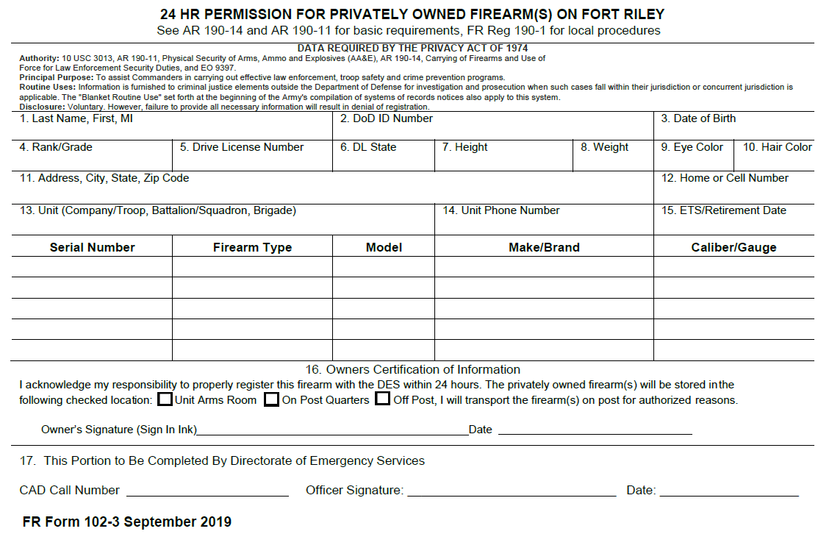
Privately Owned Weapons
Permission to Register
FR 102-3 (SEP 2019)
Request permission for up to 5 firearms per form.
Valid for 24 Hours.
Firearms brought onto post or purchased on post must be registered in the ALERTS within 24 hours.
Issued at AAFES gun counter, and all ACP during VCC non business hours.
VCC authorized to issue 7 day temporary registration.

Slide 59
Privately Owned Weapons
Approved for Registration
FR 102-1 (MAR 2018)
Register up to 6 firearms per form
Valid for 3 years (All)
DES VCC will stamp the Commanders copy of the FR Form 102-1.
Commander must maintain copies of the FR Form 102-1 of personnel within the unit approved to bring firearms on post. (including family members and guest). (Generally maintained by the Unit Armorer)

Slide 60
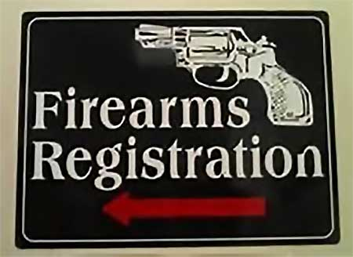
Privately Owned Weapons
Registration Process
    Validate POF is legal FR Form 102-3 (24 HR Permission for Privately Owned Firearms On Fort Riley)
    Obtain Commander’s permission by completing FR form 102-1 Request for Registration of Privately Owned Firearms.
    Complete registration process at Visitor Control Center (VCC). (Henry ACP, I-70 exit 301)
    DES VCC personnel is the final registration authority, and will stamp the Commanders copy of the FR Form 102-1, and the ALERTS generated permanent registration form.
Notes:
Are POFs store in a separate container from government weapons?
Is private ammo stored separate from GOV ammo?
Does the current CDR/1SG know who has POFs?
Does the armorer have a list of who in the unit have authorized POFs registered and store elsewhere? Quarters, BEQ, BOQ.
You can not require a Soldier to register POF on post if the firearm is never brought on the installation.
You can not authorize a Soldier in the barracks to store his POF elsewhere on the Installation besides the Arms Room.
Transported directly to and from authorized activities. Range, hunting, dog training area, others to be designated by SMC

Slide 61
Privately Owned Weapons
Commanders Responsibilities:
Brief all newly assigned personnel on this regulation and ensure that members of their command are briefed on any changes to this regulation, Federal laws, state laws, or local ordinances.
Establish in and out-processing procedures at the unit level to identify if Soldiers in the command and Family Members they sponsor who reside on the installation own or possess a firearm requiring storage on the installation or those who reside off the installation have a need to bring a firearm on the installation. Establish unit SOP for POFs.
Make decisions on the appropriate storage location of firearms on request approvals by appropriate annotation on FR 102-1.
Ensure POFs and ammunition in the arms room are inventoried at the same frequency as military weapons and ammunition. (Add to monthly serial number inventory)
Provide written authorization to store and remove POFs, ammunition and other privately owned weapons in the arms room.
Notes:
61

Slide 62
Privately Owned Weapons
Commanders Responsibilities cont.:
Maintain records of all approved FR 102-1 of Soldiers in the command and their immediate Family members. Once the firearms are registered through DES, the Soldier will return the FR 102-1 to the Commander. (Generally maintained by the Unit Armorer)
Establish and identify individual limits on the quantity and type of privately owned ammunition that may be stored in the arms room, based upon availability of space and safety considerations. Limits must be annotated in the unit arms room standing operating procedures (SOP).
Ensure the security and control of privately-owned firearms that are stored in the unit arms room.
Secure privately owned weapons and ammunition in unit arms rooms in locked containers separate from military arms, ammunition, and explosives.
Conduct unannounced inspections of their unit areas to include parking areas to ensure that proper storage of weapons and registration of firearms is being accomplished.
Immediately notify the Military Police (MP) Desk Sergeant upon discovery of a loss of accountability for privately owned firearms stored in the unit arms room.

Slide 63
Privately Owned Weapons
Armorers Responsibilities:
Meet the storage requirements of FR 190-1 Appendix B.
Sign for POF from owner and give owner hand receipt. Issue owner DA Form 3749 (equipment receipt) in order for owner to draw POF in the future.
Ensure written permission is received from the unit commander prior to issuing the POF.
Ensure same issuance procedures are followed when issuing a POF as you would when issuing a military weapon.
Ensure POFs and civilian ammunition are stored separately from military weapons and ammunition. The are required to be stored in an approved container for AA&E.
Inventory POFs and other privately owned weapons at the same frequency as Government owned AA&E
Maintain accountability of temporary release authorization documents for 90 days and permanent removal documentation for 2 years.
Notes:
63
IAW AR 190-11 4-5 a(1)

Slide 64
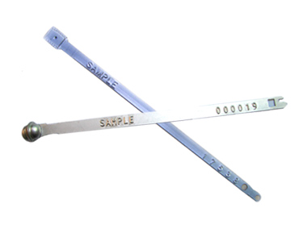
Seal control
Use and Control of Protective Seals
Protective Seals

Slide 65
Use and Control of Protective Seals
What are seals used for (purpose)?
When can seals be used?
How do I use and account for seals?

Slide 66
Use and Control of Protective Seals
Purpose of Seal- show whether the integrity container has been compromised
Defeated if strict accountability and disciplined application are not maintained.
A plain seal is not a lock, although combination items referred to as “seal–locks” are available.

Slide 67
Use and Control of Protective Seals
Unused seals will be-
  Secured in a locked, metal container with controlled access.
  Only seal custodians and alternates will have access.
  Recorded monthly inventories will be conducted
Seal Logbooks (Can use Excel Spreadsheet)
  Seal Number
  Date and Time applied
  Identification of items to which applied
  location on item if other than main door(s)
  Name of the person applying the seal
  Date and Time seal removed and destroyed

Slide 68
Use and Control of Protective Seals
Seal # | Date / Time Applied | Items Sealed | Seal Location | Name of Person Applying | Date/Time Removed and Destroyed
R170001 | 17 Sep 19 0900 hrs | Ammo Can with 60 rnds 5.56 mm | Ammo Can Hasp | SPC Mark Jones
R170002 | 19 Sep 19 1030 hrs | Tuff Box w/ 200 Bayonets | Right Lock Opening | SPC Mark Jones | 22 Sep 19 1000 hrs
R170003 | 22 Sep 19 1030 hrs | Tuff Box w/ 200 Bayonets | Right Lock Opening | SPC Mark Jones
R170004
R170005
R170006
R170007
R170008
R170009
R170010
R170011
SAMPLE SEAL LEDGER

Slide 69
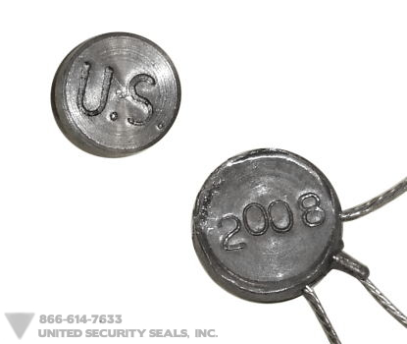
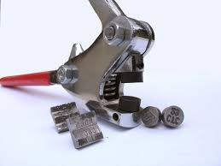
Use and Control of Protective Seals
Minimum Characteristics
  Durability – Strong enough to NOT break accidentally
  Design – sufficiently complex to make unauthorized replacement difficult
  Tamperproof – provide readily identifiable evidence of tampering
  Individually Identifiable – Embossed serial number and owner ID
  NOTE: Lead Crimp Seals not authorized for use.

Slide 70
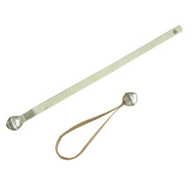
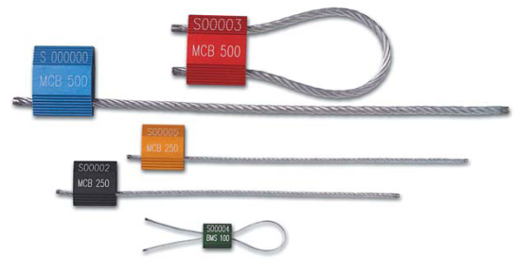

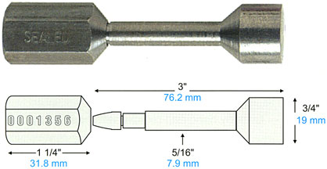
Use and Control of Protective Seals
For AA&E or classified materiel shipments, security seals types 9, 11, 12, or 13 are required.
Type 11 – One Piece Cable (High Strength Seal)
Type 9 – Ball Seal (Low Strength Seal)
Type 12 – Cable Piece Cable (High Strength Seal)
Type 13 – Unthreaded Bolt (High Strength Seal)

Slide 71
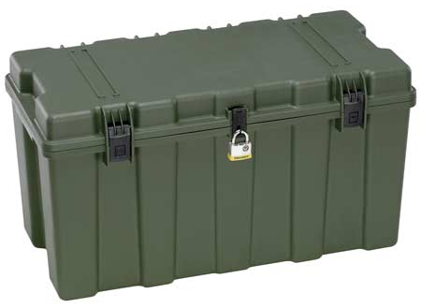
Use and Control of Protective Seals
UNIT LETTERHEAD
OFFICE SYMBOL DATE
MEMORANDUM FOR RECORD
On (This Date), 200 M9 Bayonets were sealed in this footlocker using Seal # 12345”
Point of Contact for this memorandum is the unit armorer at 239-xxxx.
Unit Armorer Witness
Signature Block Signature Block
xxxxxxxxxxxxxxxxxxxxxxxxxxxxxxxxxxxxxxxxxxxxxxxxxxx
NOTE: Recommend using Senior NCO as Witness or Commander.

Slide 72


QUESTIONS?
COMMENTS?
CONCERNS?

Slide 73
Course Exam
TURN IN:
  Answer Sheet
  Critique Sheet
  Take a break until everyone is done
  Please remain QUIET
Test Booklet will be used for Test Review and turned in after review.

Slide 74
Course Exam
COURSE EXAM
  Open Book / Open Note / Open Computer
  Half of Final Course Total
  Must Achieve 70% Average or Better
  One Hour to Complete Test

Slide 75
Course Exam
Select the answer you believe to be correct.
ONLY ONE correct answer is given for any question.
Fill in the gap completely on the answer sheet.
If you make a mistake X thru the incorrect answer:
DO NOT WRITE IN TEST BOOK
Do: (A) (B) (C) (D)
Do Not: (A) (B) (C) (D)

