Slide 1


PHYSICAL SECURITY OFFICERS (PSO) COURSE
DAY 1
Presented by:
Fort Riley Security Branch
Notes:
Introduction to Class

Slide 2


Army Protection Program Pillars
Execution of
Army Missions
ARMY PROTECTION PROGRAM
Antiterrorism (AT)
Computer Network Defense
(CND)
Continuity of Operations
(COOP)
Critical Infrastructure Risk Management (CIRM)
Emergency Management
(EM)
Fire & Emergency Services
(F&ES)
Health Protection (HP)
High Risk Personnel
(HRP)
Information Assurance
(IA)
Law Enforcement (LE)
Operations Security
(OPSEC)
Physical Security (PS)
Intelligence Support to AT
Military Working Dogs (MWD)
Security Programs (SP)
OPMG
ARCYBER
G-3/5/7
G-3/5/7
G-3/5/7
ACSIM
OTSG
OPMG
CIO/G-6
OPMG
G-3/5/7
OPMG
Intelligence – Counterintelligence (G-2) – Security Engineering (USACE)
DPTMS AT | NEC | DPTMS P&P | N/A | DPTMS EM | DES FD | IACH PH | N/A | NEC | DES PD | DPTMS AT | DES PS
(DA G2, USACIDC/1ID G2, CID, 902nd)
(USACE/DPW)

Slide 3
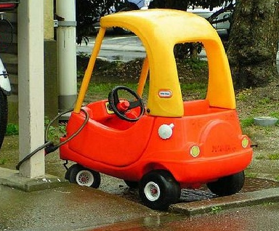
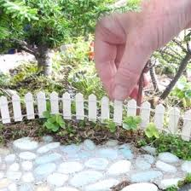
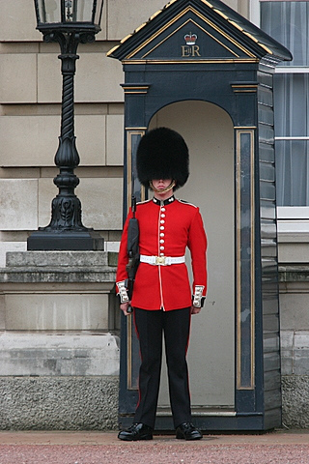
What is Physical Security?
INTRODUCTION TO PHYSICAL SECURITY

Slide 4
Physical Security is…
based on threat analysis
concerned with procedures and physical measures designed to safeguard personnel, property, and information
preventive measures that control unauthorized access to equipment, facilities, material, and information
protects against espionage, sabotage, damage, misuse, theft, and terrorism.
In simplest terms:
ASSET PROTECTION

Slide 5
Four Fundamental Aspects of Physical Security:
DETER
DETECT
PHYSICAL
SECURITY
DELAY
RESPOND

Slide 6
Physical Security During Deployment Operations
Layered Security Approach

Slide 7
Physical Security Program
Regulatory Program
Division Program
Command Oversight
Planning
SAV’s
BDE Program
Planning / SAV’s / Command Guidance
BN
Program
*Planning
*SAV’s
*CMD Guidance
BN
Program
*Planning
*SAV’s
*CMD Guidance
BN
Program
*Planning
*SAV’s
*CMD Guidance
BN
Program
*Planning
*SAV’s
*CMD Guidance
BN
Program
*Planning
*SAV’s
*CMD Guidance
Company Program
Execution / Elemental Feedback

Slide 8
Physical Security Officer Battalion and Higher
Duties:
Conduct Risk Analysis of all required areas within the command.
Conduct Crime Prevention Survey’s
Develop a Physical Security Plan for the CDR’s approval (IAW AR 190-13, app B) and disseminate it to subordinate units and forward to HHQ.
Develop ME/VA list with barrier plan, Restricted Area list, and HRTs for CDR’s approval and forward to HHQ.
Review key control programs to ensure Key Custodians are maintaining unit locks and keys within the command.
AA&E
Admin (real property, vehicles, supply, etc.)
Review AA&E program to ensure Armorer is maintaining accountability of entrusted property.
Review security of other SI storage areas and areas required IAW AR 190-51 to ensure PS Program is in compliance.

Slide 9
Program Deliverables
To Higher Command:
Physical Security Plan
MEVA List (Prioritized)
Restricted Area List
Barrier Plan
To Subordinate Commands:
Physical Security Plan
Barrier Plan
Conduct Risk Analysis
MEVA List (Prioritized)
Restricted Area List
Provide updates on changes to PS policies and status
Ensure Commanders have established annual PS training for all personnel.
Conduct SAV’s

Slide 10
Physical Security Plan
Established IAW AR 190-13, appendix B
Must Address:
Establish security procedures for all operational environments
Expeditionary operations
Transition (pre-deployment / re-deployment)
Program assurance at all phases
Establish a Crime Prevention Program
End-of-day checks
Personal and personnel security
Reduce crime within the organization
Establish security plans to restrict access
Barrier Plan
FPCON upgrade

Slide 11
Physical Security Plan
Cont:
Instructions on individual responsibilities for securing military weapons during garrison and field operations.
Procedures for armed guards (IDS failure, AHA guard, transport of bulk AA&E, etc.)
Monthly IDS testing and protection of PIC/PIN’s.
Address Privately Owned Firearms (POF) registration procedures, weekends and holidays, storage requirements, control of POF, and the disposition of POF for unit deployments
Procedures to ensure the security of unit assets outside the arms room (eg. Admin areas, Supply, PII, etc.)
Key control procedures.

Slide 12
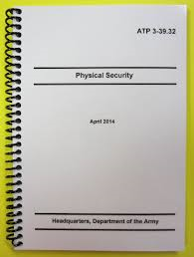
Regulatory Resources
Regardless of the environment or available resources, the protection of Army personnel and assets follow the same general procedures:
Identify the asset or area to be protected.
Determine its mission criticality.
Assess the likelihood of compromise.
Assess potential threats and tactics.
Develop and implement control measures.
References:
AR 190-13
AR 190-11
AR 710-2
DA PAM 710-2-1
UFC 4-010-01
UFC 4-010-03
UFC 4-020-04
AR 190-14
AR 190-51
DA PAM 190-51
ATTP 3-39.32
UFC 4-010-02
UFC 4-020-02
UFC 4-022-03

Slide 13
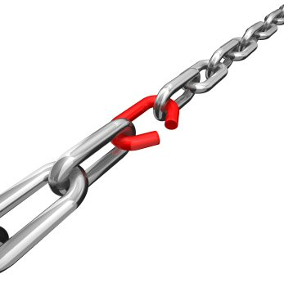

Risk Analysis

Slide 14
Risk Analysis
Identify area
Determine asset value
Determine likelihood of aggression
Determine risk level
Determine required protective measures
Identify asset
Risk identification and mitigation process

Slide 15
Risk Analysis
Areas to Assess:
Arms, Ammunition & Explosive (AA&E) Storage
- Arms Room, Small Arms Repair, AHA
Motor Pool (Vehicles, PLL, POL, etc)
Supply Storage to include Supply Support Activity (SSA)
Tool Room
SIPR-NET
COMSEC
Designated Restricted Areas
Mission Essential / Vulnerable Areas

Slide 16
Risk Analysis
Identify area
Determine asset value
Determine likelihood of aggression
Determine risk level
Determine required protective measures
Identify asset
Risk identification and mitigation process

Slide 17
Risk Analysis
The components of risk are comprised of two factors.
Asset Value
Risk factor indicates the value or importance of the asset to its user and to the Army.
Likelihood
Indicates the attractiveness of the asset to the aggressor and the likelihood that an aggressor will attempt to compromise the asset based on its attractiveness.

Slide 18
Risk Analysis
Identify area
Determine asset value
Determine likelihood of aggression
Determine risk level
Determine required protective measures
Identify asset
Risk identification and mitigation process

Slide 19
Risk Analysis
Two Categories of Aggressors
Criminals
Include unsophisticated criminals, sophisticated criminals, organized crime groups, activists and vandals.
Terrorists
Include CONUS, Outside CONUS (OCONUS), and paramilitary OCONUS terrorists
Paramilitary OCONUS are distinct from OCONUS terrorists based on the severity of their attacks and their demonstrated state-sponsored, transitional, and paramilitary character.

Slide 20
Risk Analysis
Identify area
Determine asset value
Determine likelihood of aggression
Determine risk level
Determine required protective measures
Identify asset
Risk identification and mitigation process

Slide 21
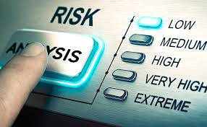
Risk Analysis
Protective Measures & Security Measures
Risk Level I
Lowest level
Least secure
Bare minimum
Risk Level II
Increased protective measures
Will include all protective measures from Risk Level I
Risk Level III
Highest level of security
Will include all protective measures from Risk Level I and II

Slide 22
Risk Analysis
Identify area
Determine asset value
Determine likelihood of aggression
Determine risk level
Determine required protective measures
Identify asset
Risk identification and mitigation process

Slide 23
Risk Analysis
Use the completed risk analysis to identify the required security measures for the protected assets. This will include
Physical Protective Measures
Security Procedural Measures
Anti-Terrorism Measures

Slide 24
Risk Analysis
Physical Protective Measures
Physical security measures used to mitigate risk are usually permanent and involve expenditure of funds.
Proper application of equipment in place and sound security plans that are well executed help conserve resources while maximizing mitigation efforts.
Security Procedural Measures
Application of physical security measures to mitigate risk factors that can be adjusted to reacted to changes in the criminal, adversary, and terrorist threats.
The procedures can usually be changed within a short amount of time and often times involve manpower.

Slide 25
Risk Analysis
Types of Threats
Natural
Earthquakes
Fires
Floods
Storms
Insects and Animals
Man-Made
Subversion
Espionage
Sabotage
Accidents
Pilferage
Terrorism
* The five man-made threats are analyzed independently during the risk analysis process to determine each threat’s level or degree of risk.

Slide 26
Risk Analysis
Physical Security Standards
Common types of U.S. Army property are classified in readily understandable categories for quick reference.
Guidance for each category of property listed includes references to the primary directives for management and accountability of that category of property and minimum security standards to be implemented.
The measures are categorized according to their risk levels established using the risk analysis procedure in DA Pam 190-51.
Risk Level I physical protective and security procedural measures will be treated as minimums.
Conflicts between security and safety requirements must be identified in writing. Waiver or exception request must list compensatory measures and be forwarded through the local provost marshal and MACOM to HQDA for approval.

Slide 27
Risk Analysis
When to conduct a Risk Analysis
When a unit or activity is activated.
When a unit permanently relocates to another site or facility.
When there is no record of a prior risk analysis.
Every 3 years or more frequently as required by the Commander.
During the planning stages of new facilities, additions to facilities, and facility renovations.
When an incident occurs in which an asset is compromised.

Slide 28
Risk Analysis
Protective Measures & Security Measures
WILL be applied to ALL Army assets being considered for protection, including those in existing facilities and those in facilities yet to be constructed or under major renovation.
Consult with operations and intelligence personnel, operation security personnel (OPSEC), the provost marshal, the facility engineer, and the users of the assets being analyzed prior to conducting the analysis.

Slide 29
Risk Analysis
Risk Analysis is Conducted in 6 step process
STEP 1: Identify the unit or organization to which the asset belongs and the area in which the asset is located.
STEP 2: Identify the asset for which the analysis is being performed, located in Table 2-1 and give brief description
STEP 3: Determine asset value
STEP 4: Determine likelihood of aggression
STEP 5: Determine the risk levels for assets using Table 2-2
STEP 6: Refer to AR 109-11 or AR 190-51 as appropriate, using risk levels to determine required protective measures

Slide 30

Risk Analysis Process

Slide 31
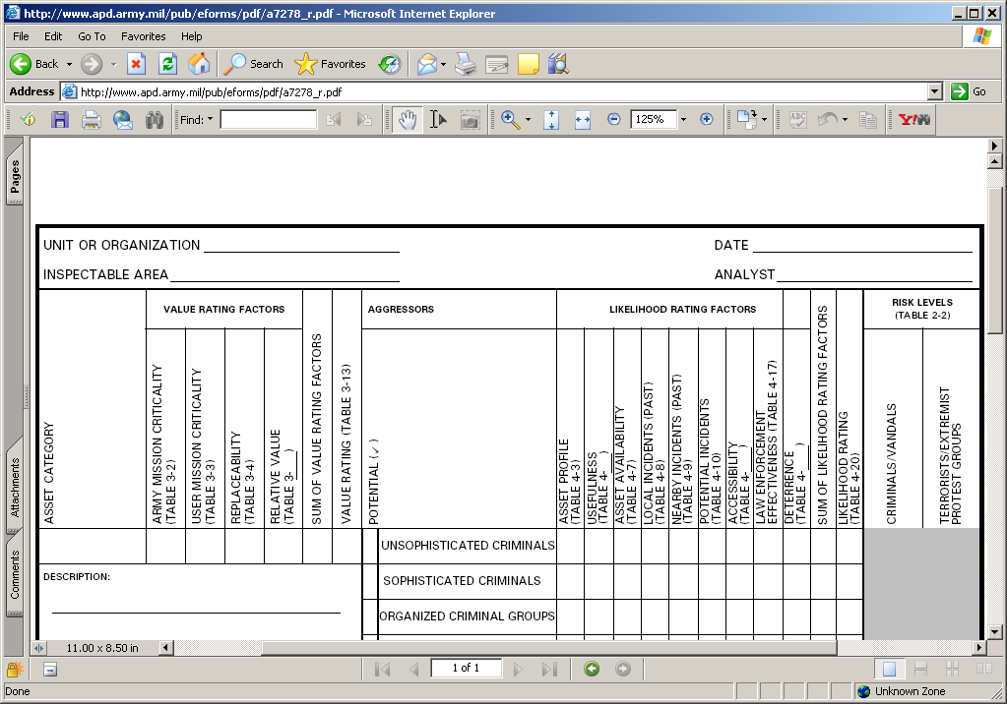
Risk Analysis
Identify the Organization to which the asset belongs.
C Co 2-16 IN
11 Apr 16
Motor pool
CPT Jones

Slide 32
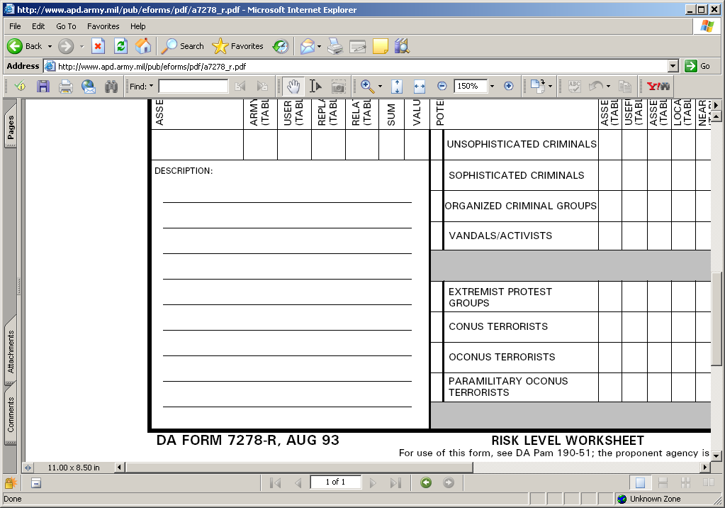
Risk Analysis
List a description of the assets
6- 2 ½ Ton Vehicles
4- M113 Personnel Carriers
15- M998 HMMWV

Slide 33
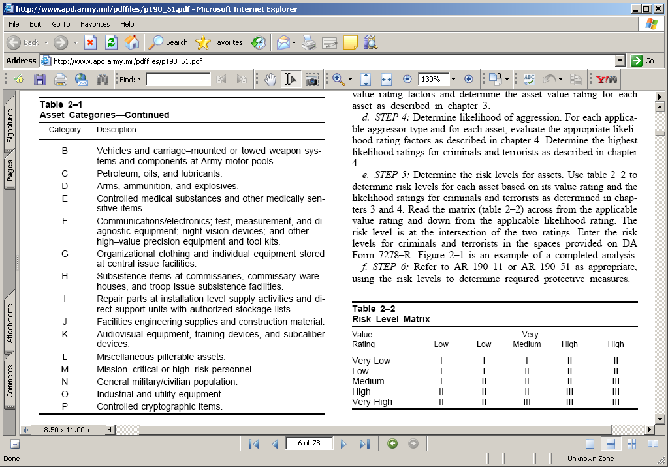
Risk Analysis
Determine appropriate Asset Category

Slide 34
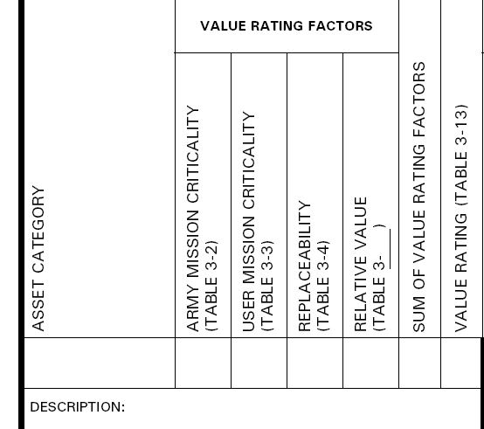
Risk Analysis
Fill In Asset Category Code
B

Slide 35
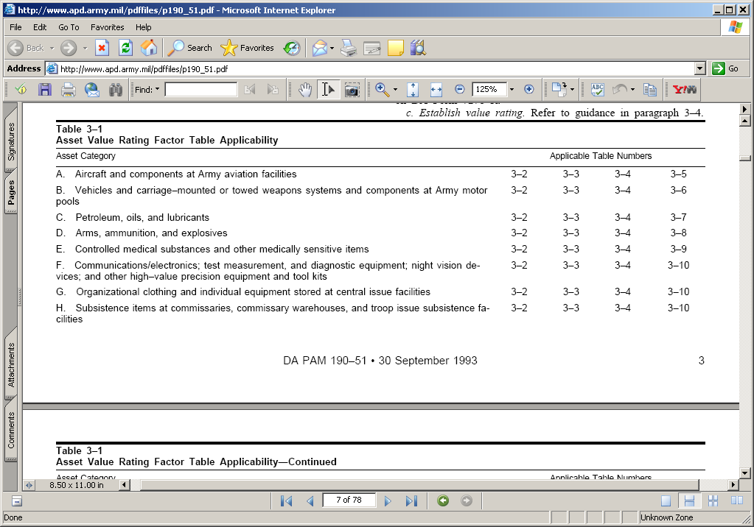
Risk Analysis
Determine which tables are applicable using Table 3-1.

Slide 36
Risk Analysis
Fill In Missing Table Number For Value Ratings Factors
6
B
Relative Value Table 3-6

Slide 37
Risk Analysis
Determine Asset Value Using Appropriate Tables
6
B

Slide 38
Table 3-2 Criticality to Army’s Mission
Risk Analysis
Addresses the criticality of the asset in its support of the Army’s capability to mobilize and fight a war

Slide 39
Risk Analysis
Enter Value from Table 3-2
6
B
0

Slide 40
Table 3-3 Criticality to User’s Mission
Risk Analysis
Addresses the criticality of the asset in support of it’s users mission.

Slide 41
Risk Analysis
Enter Value From Table 3-3
6
B
0
5

Slide 42
Table 3-4 Asset Replaceability
Risk Analysis
Addresses the time required to replace assets which have been compromised.

Slide 43
Risk Analysis
Enter Value From Table 3-4
6
B
0
5
4

Slide 44
Table 3-6 Relative Value of Vehicles
Risk Analysis

Slide 45
Risk Analysis
Enter Value From Table 3-6
6
Enter Sum of Value Rating Factors
B
0
5
4
4
13

Slide 46
Table 3-13 Asset Value Rating
Risk Analysis

Slide 47
Risk Analysis
Determine Asset Value Using Appropriate Tables
6
B
0
5
4
4
13
M

Slide 48
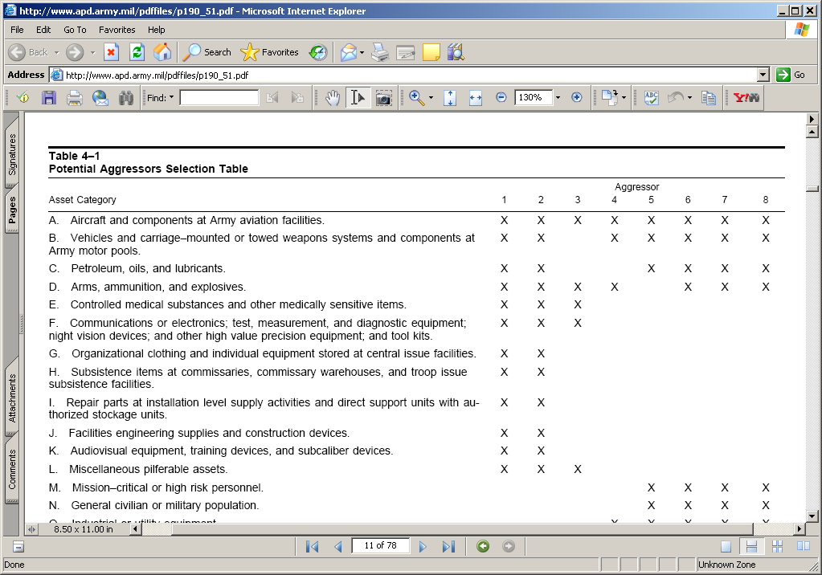
Risk Analysis
Determine Aggressors Using Table 4-1

Slide 49
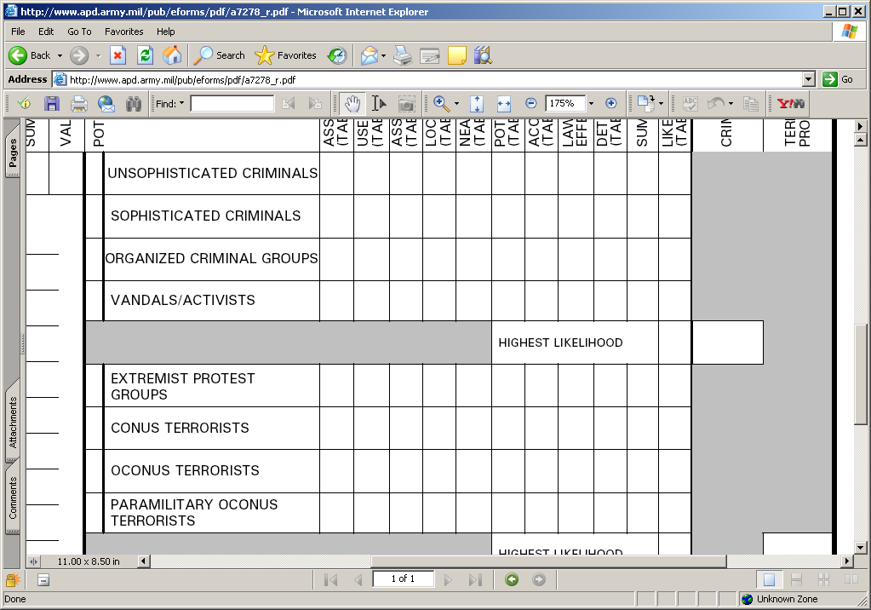
Risk Analysis
Select Aggressors Annotated on Table 4-1
X
X
X
NOTE: the aggressors listed on Table 4-1 is only a suggestion, you can always add potential aggressors.
X
X
X
X

Slide 50
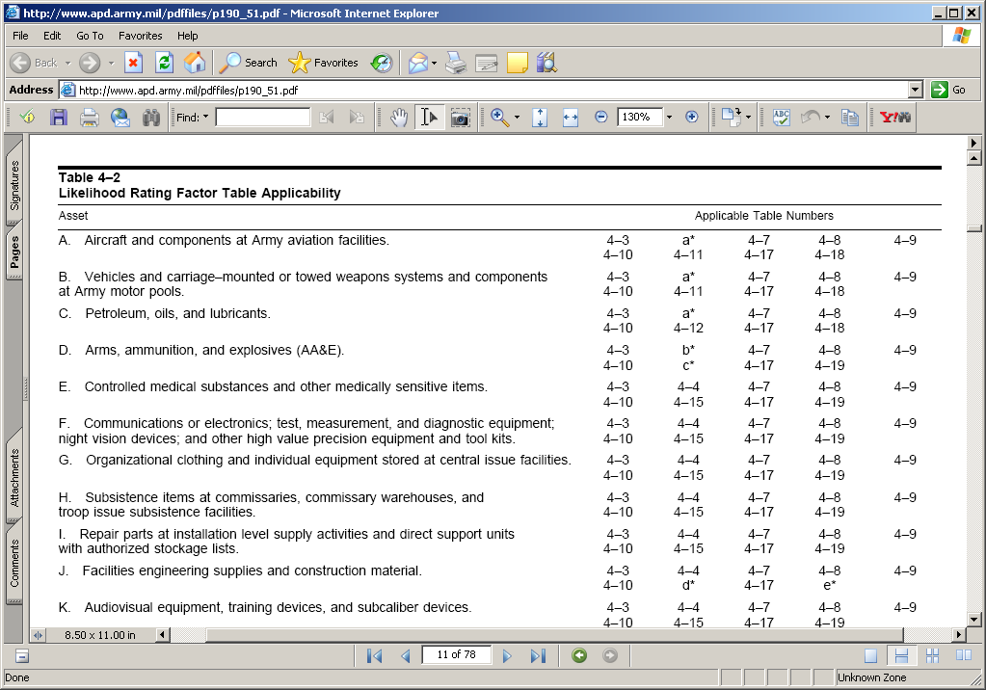
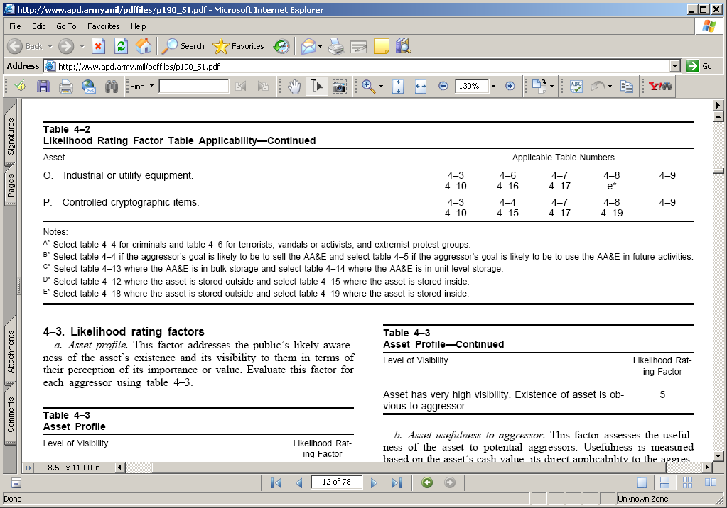
Risk Analysis
Determine Likelihood Rating Factor Tables.

Slide 51
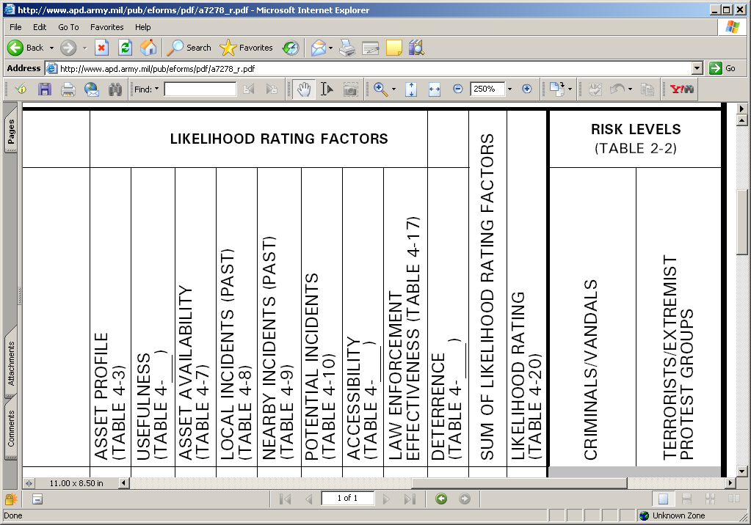
Risk Analysis
Determine Likelihood Rating Factor Tables
4-6
11
18
4

Slide 52
Table 4-3 Asset Profile
Risk Analysis
Addresses the public’s likely awareness of the asset’s existence and it’s visibility.

Slide 53
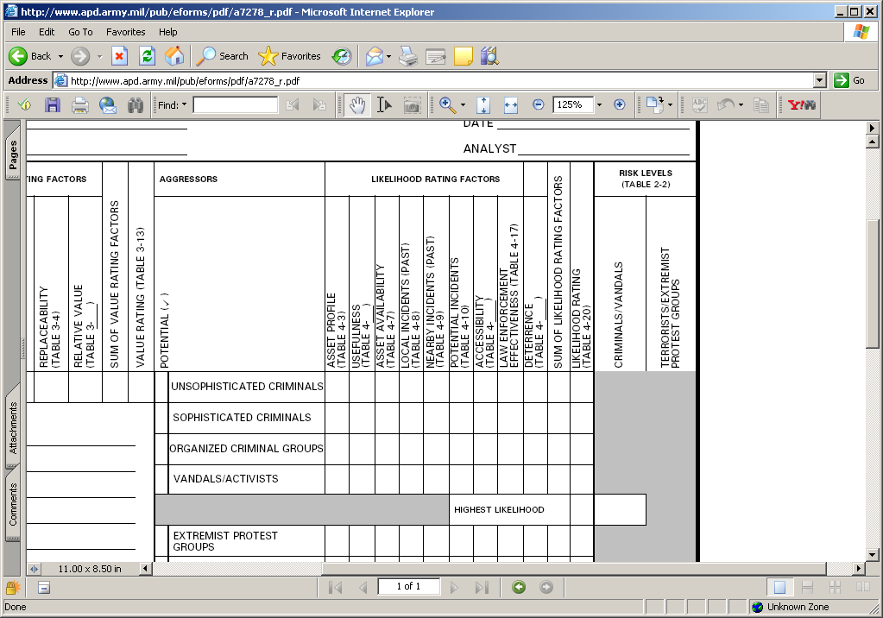
Risk Analysis
Enter value rating from Table 4-3
4-6
4
11
18
x
3
x
x

Slide 54
Table 4-4 Usefulness for Assets with Cash Value
Risk Analysis
Addresses the usefulness of the asset to potential aggressors.

Slide 55
Risk Analysis
Enter value rating from Table 4-4
4-6
4
11
18
x
3
3
x
x

Slide 56
Table 4-7 Asset Availability
Risk Analysis
Addresses the availability of the asset or similar assets at places other than in the inspectable area.

Slide 57
Risk Analysis
Enter value rating from Table 4-7
4-6
4
11
18
x
3
3
3
x
x

Slide 58
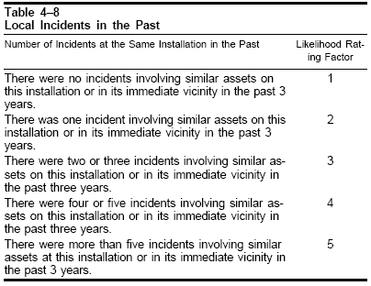
Table 4-8 Local Incidents in the Past
Risk Analysis
Addresses the history of attempts by the applicable aggressor to compromise similar assets at the assets at the installation

Slide 59
Risk Analysis
Enter value rating from Table 4-8
4-6
4
11
18
x
3
3
3
1
x
x

Slide 60
Table 4-9 Nearby Incidents in the Past
Risk Analysis
Addresses the history of attempts by the applicable aggressor to compromise similar assets in the same general geographic area
Unless other wise indicated, use the numbered Army Regions in CONUS.

Slide 61
Risk Analysis
US ARMY NORTH REGIONS
Seattle
I
X
II
VIII
Chicago
IX
V
III
Oakland
Denver
VII
Kansas
City
VI
IV
Atlanta
Denton
Notes:
This build slide allows one to appreciate the range and full scope of our mission and why we can nt et focused on just the current disaster.
As it shows we are providinig DoD support to the LFA within that hurricane JOA.
First build: suddenly – no notice a terrorist attack occurs on the west coast.
Build two: The DCO will move as in the previous disaster with the JFO, however more than likely since this is a HLD event DoD could be the LFA and therefore ARNORTH would launc a Cdr’s Assessment Element or Tac CP to begin to assume responsibility, assess the situation and begin to coordinate a federal response
Build three: The complete OCP / JTF would quickly flow in and build out the CAE and provide that C2 to ensure unity of effort in the federal response
Throughout the ARNORTH Main must maintain that entire AOR situational awareness, while providing support to both incidents

Slide 62
Table 4-9 Nearby Incidents in the Past
Risk Analysis

Slide 63
Risk Analysis
Enter value rating from Table 4-9
4-6
4
11
18
x
3
3
3
1
1
x
x

Slide 64
Table 4-10 Nearby Incidents in the Past
Risk Analysis
Addresses the probability that aggressors will attempt to compromise the asset in the future

Slide 65
Risk Analysis
Enter value rating from Table 4-10
4-6
4
11
18
x
3
3
3
1
1
2
x
x

Slide 66
Table 4-11 Accessibility of Aircraft and Vehicles
Risk Analysis
Addresses any protective measures which are in place for existing facilities or planned for new facilities.

Slide 67
Risk Analysis
Enter value rating from Table 4-11
4-6
4
11
18
x
3
3
3
1
1
2
6
x
x

Slide 68
Table 4-17 Effectiveness of Law Enforcement
Risk Analysis
Address the general attitude of the local populace regarding their respect for and cooperation with the law enforcement community.

Slide 69
Risk Analysis
Enter value rating from Table 4-17
4-6
4
11
18
x
3
3
3
1
1
2
6
6
x
x

Slide 70
Table 4-18 Deterrence
Risk Analysis

Slide 71
Risk Analysis
Enter value rating from Table 4-18
4-6
4
11
18
x
3
3
3
1
1
2
6
6
4
29
Enter the Sum of the likelihood rating factors
x
x

Slide 72
Table 4-20 Likelihood Rating
Risk Analysis

Slide 73
Risk Analysis
Enter Rating from Table 4-20
4-6
4
11
18
x
3
3
3
1
1
2
6
6
4
L
29
x
x

Slide 74
Risk Analysis
Continue with the likelihood rating factors of the other groups you have selected
x
x
x

Slide 75
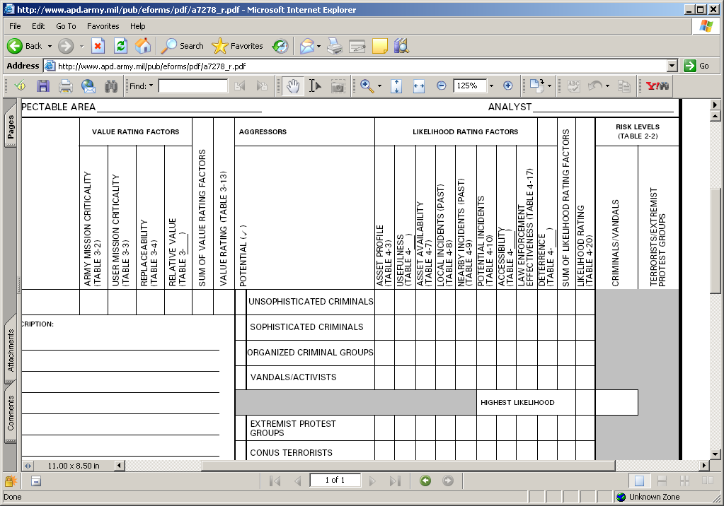
Risk Analysis
Determine Highest Likelihood Rating
29
L
Enter Highest Rating Level
29
L
33
M
29
L
M

Slide 76
Risk Analysis
Determine Risk Level Using Table 2-2
29
L
29
L
33
M
29
L
M

Slide 77
Table 2-2
Risk Analysis
Value Rating was a Medium
Likelihood Rating was a Medium

Slide 78
Risk Analysis
Determine Risk Level Using Table 2-2
29
L
29
L
33
M
29
L
M
II
*Results in a Risk Level II for Physical Protective Measures &Security Procedural Measures

Slide 79
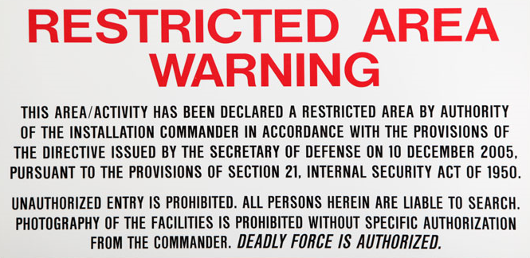
Restricted Areas

Slide 80
Restricted Areas
All Assets vs. Critical Assets
Determine what resources require protection
value of the property (Criticality)
importance of the property (Vulnerability)
local threat (Threat)
Based on your mission and the Division’s mission
Restricted Areas
ME/VA’s
HRT’s

Slide 81
Restricted Areas
ME/VA
Situation is constant
Regulatory Driven
Commanders intent
High Risk Target – HRT
Situation is limited/inconsistent
Significant impact but still mission capable
Criticality/Vulnerability

Slide 82
Restricted Areas
CONTROLLED AREA
LIMITED AREA
ASSET EXCLUSION AREA

Slide 83
Restricted Areas
ME/VA / HRT / Restricted Area Lists
Established in writing by the Commander.
IAW AR 190-13, para 2-7 and Chpt. 6
Prioritized
Reviewed annually
Incorporated into the Physical Secuirty Plan
Forwarded to Higher Headquarter for incorporation in their PS Plan
High Risk Target – HRT
Situation is limited/inconsistent
Significant impact but still mission capable
Criticality/Vulnerability

Slide 84
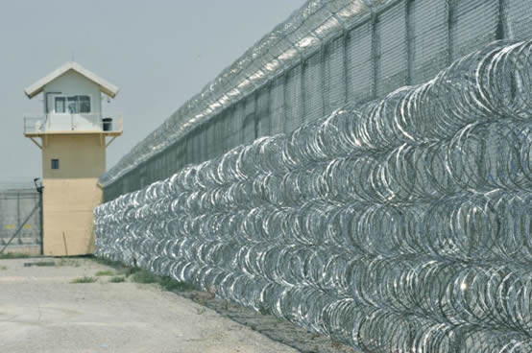
Deviations

Slide 85
Deviations
Waiver: Temporary relief from a specific requirement pending actions to conform to the requirement:
May be approved for a period not to exceed 12 months
May be extended after a complete review (re-submittal)
Requires Compensatory Measures to mitigate risk associated with not complying with specific requirement
Compensatory Measures must be identified in writing
HQDA (OPMG) is approving authority

Slide 86
Deviations
Exceptions: May be approved only when correction of the deviation is not considered to be feasible or cost effective:
Reviewed during
Physical security inspections
Change in situation / mission
HQDA (OPMG) is approving authority
Commander to whom exception was granted will conduct reviews. Review will be forwarded through command channel to HQDA (OPMG)
HQDA (OPMG) will be notified when the exception is no longer needed

Slide 87
Deviations
Request: Will be in writing and forwarded through command channels to HQDA (OPMG) for approval
Guidance on requirements of request are found in AR 190-13, para 2-3 f and include
Subject of request
Reasons for request
Reasons for noncompliance
Compensatory measures
List of all waivers and exceptions currently in effect
Coordination
Commander’s evaluation of the requests
Classification

Slide 88
Deviations
Two Routes:
Equipment, Procedures (e.g. arms racks, security checks, etc.)
BN – FRSB - BDE – DIV – III CORPS – FORSCOM – OPMG
Real Property (e.g. construction standards, arms vault, fencing, etc.)
BN – FRSB – IMCOM – OPMG
Notification track: FRSB – BDE – DIV – III CORPS – FORSCOM

Slide 89
Risk Analysis

Slide 90
Practical Exercise
Risk Analysis
GENERAL SITUATION: You are a Physical Security Officer for the Blue Mountain Army Depot, Virginia (BMAD). You are about to conduct physical security inspections on several facilities:
SITUATION #1: You are inspecting the BMAD Airfield (Unit Identification Code (ABCD59). The battalion security officer, after being questioned on the level of security implemented, states that he was not aware that a risk analysis was required.

Slide 91
Risk Analysis
PE -The Security Officer Provides the following:
The facility has a total of nine aircraft assigned. There are no attack aircraft assigned.
The loss of the aircraft would have a negligible impact on the Army’s mission; however, they are mission essential to the user, will take more than 180 days to replace an aircraft.
The security officer agrees with potential aggressor list suggested in DA PAM 190-51.
The value of aircraft inventory is greater than $1,000,000 and each aircraft is valued greater than $100,000 and the aircraft of this type have limited availability off of the installation.
There have been no incidents on BMAD or its immediate vicinity in the past 3 years.
The aircraft are stored within a fenced perimeter with security lighting. The Staff Duty makes a check of the area once an hour.
The security officer thinks the Law Enforcement is moderately effective and that the local population has moderate respect for law and police
The security officer thinks any aggressor is likely to believe a loss of an aircraft would result in considerable publicity.

Slide 92
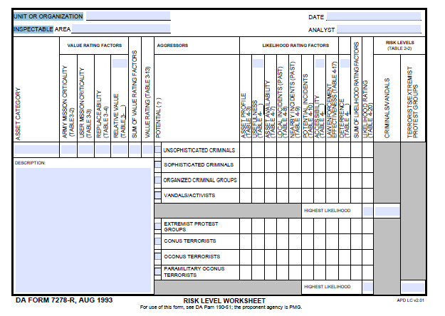
Practical Exercise
Risk Analysis

Slide 93
Practical Exercise
Risk Analysis
UIC:ABCD59
BMAD Airfield

Slide 94
Practical Exercise
Risk Analysis
UIC:ABCD59
Today’s date
BMAD Airfield
SSG Suber
Table 3-1
Table 2-1
A
- Aircraft

Slide 95
Practical Exercise
Risk Analysis
UIC:ABCD59
Today’s date
BMAD Airfield
SSG Suber
Table 3-1
3-5
Table 2-1
A
- Aircraft

Slide 96
Practical Exercise
Risk Analysis
UIC:ABCD59
Today’s date
BMAD Airfield
SSG Suber
Table 3-1
3-5
Table 4-1/ Table 4-2
4-4
4-6
4-11
4-18
Table 2-1
A
0
5
4
1
10
M
x
4
3
4
1
1
2
4
6
6
31
M
x
5
1
4
6
6
33
Table 2-2
- Aircraft
4
4
1
2
M
x
4
5
4
1
1
2
4
6
6
33
M
x
2
4
6
32
4
4
4
1
1
6
M
M
II
x
4
4
4
1
1
2
4
6
6
32
M
x
4
4
4
1
1
2
4
6
6
32
M
M
II

Slide 97

Inspections
Physical Security vs ICI / SCI

Slide 98
PS vs. UNIT
Inspections
Physical Security Inspections
Initial Command Inspections (ICI)
Regulatory Driven (DA)
Announced
Annual (18 / 24 months)
Re-Inspection (6 months)
Un-announced
Command Requested
Command Directed
15-6 / FLIPL
Driven by your next higher element (BN, BDE, DIV)
Required for a new Company Commander
Occur during the ARFORGEN RESET phase
Subsequent Command Inspections (SCI)
Driven by your next higher element (BN, BDE, DIV)
Measure Progress
Occur during ARFORGEN Train/Ready phase

Slide 99
Inspections
Inspection Reporting:
Inspection results go to:
Commander
Next Higher Command
Must be maintained on file until next inspection
Recurring deficiencies will be tracked on reports until corrected
Commander required to submit Corrective Actions Plan within 30 days of receiving report. Re-inspections cannot be conducted until the CAP is submitted.
Unit will remain Not Adequate.
CAP submitted to both next HHQ and the FRSB Office.
Not Adequate rating requires a re-inspection within 6 months (once the Corrective Actions Plan is received).

Slide 100
Inspections
Areas Inspected by Physical Security
Administrative Security
CO / BTRY / TRP level
BN / BDE level
DIV / Directorate level
Admin Keys and Combinations
Supply Room Security
Arms Room Operations
AA&E Key Control
Motor Pool (Tactical Vehicle Storage)
POL Storage
ICIDS
Tool Security
High-value items storage
FP measures
Airfield Security
POF’s and Privately Owned Ammunition
OCIE Storage
Subsistence Facilities
PLL Storage

Slide 101
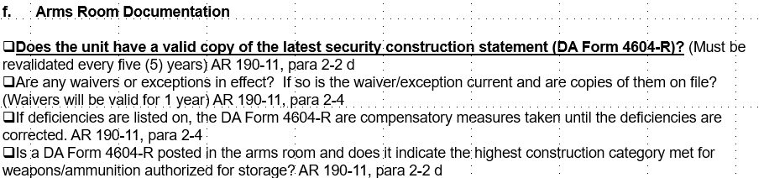
Inspections
Regular font – Minor Deficiency
Bold font – Major Deficiency
Represents a risk great enough to compromise the entire program
Represents multiple minor deficiencies

Slide 102
Inspections
Staff Assistance Visit (SAV):
Conducted by Higher Headquarters (BN, BDE, DIV) coordinated through next higher S-2.
Results stay “in house” (Report generated and forwarded to the Unit Commander).

Slide 103

Administrative physical security
AREA

Slide 104
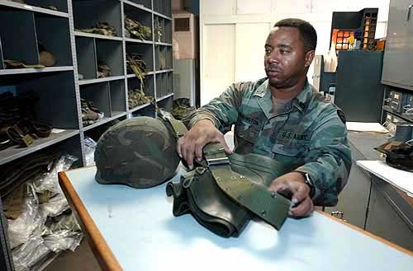
Supply room activities

Slide 105
Supply Room
Unit level supplies will be stored in:
Secure Storage (see appendix B, AR 190-51)
Locked metal cage in a secured building
Must be signed for and controlled by Supply NCO or designated individual at all times. (Appointment Orders)
Key and Lock control per appendix D, AR 190-51
Access Roster
SF 701

Slide 106
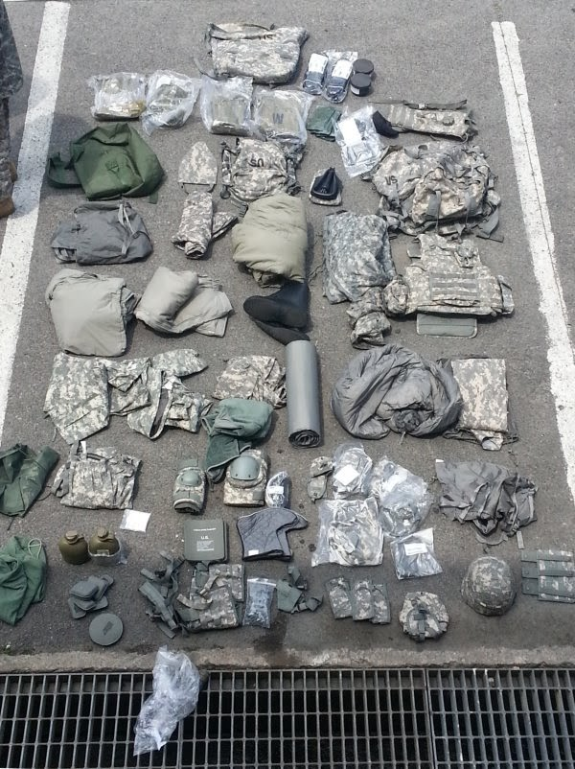
OCIE
Organizational Clothing And Individual Equipment (OCIE)
ORGANIZATIONAL CLOTHING AND INDIVIDUAL EQUIPMENT

Slide 107
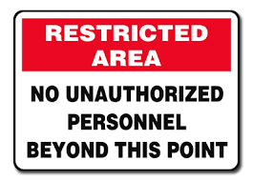
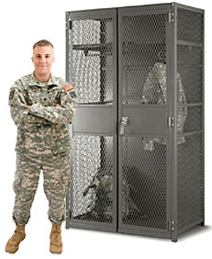
Organizational Clothing And Individual Equipment (OCIE)
OCIE is highly pilferable items and its protection must be included in the organizations Physical Security Plan.
If the organization provides OCIE storage for its Soldiers it must:
Post “Off Limits to Unauthorized Personnel” signs posted on entrances to “readiness bay” areas.
Control access to the facility, keys, padlocks and protective seals protecting the equipment per Appendix D of AR 190-51.
Utilize approved low security padlocks to secure OCIE.
*Note: If OCIE is stored at a Soldiers residence, include its protection in the crime prevention plan i.e. (Don’t leave in POV, secure in wall locker, etc…

Slide 108
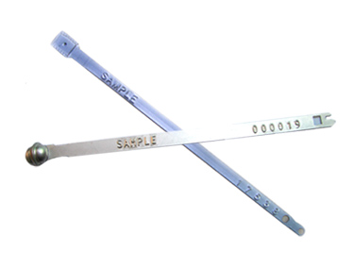
Seal control
Use and Control of Protective Seals
Protective Seals

Slide 109
Use and Control of Protective Seals
What are seals used for (purpose)?
When can seals be used?
How do I use and account for seals?

Slide 110
Use and Control of Protective Seals
Purpose of Seal- show whether the integrity container has been compromised
Defeated if strict accountability and disciplined application are not maintained.
A plain seal is not a lock, although combination items referred to as “seal–locks” are available.

Slide 111
Use and Control of Protective Seals
Unused seals will be-
Secured in a locked, metal container with controlled access.
Only seal custodians and alternates will have access.
Recorded monthly inventories will be conducted
Seal Logbooks (Can use Excel Spreadsheet)
Seal Number
Date and Time applied
Identification of items to which applied
location on item if other than main door(s)
Name of the person applying the seal
Date and Time seal removed and destroyed

Slide 112
Use and Control of Protective Seals
Seal # | Date / Time Applied | Items Sealed | Seal Location | Name of Person Applying | Date/Time Removed and Destroyed
R170001 | 17 Sep 16 0900 hrs | Ammo Can with 60 rnds 5.56 mm | Ammo Can Hasp | SPC Mark Jones
R170002 | 19 Sep 16 1030 hrs | Tuff Box w/ 200 Bayonets | Right Lock Opening | SPC Mark Jones | 22 Sep 16 1000 hrs
R170003 | 22 Sep 16 1030 hrs | Tuff Box w/ 200 Bayonets | Right Lock Opening | SPC Mark Jones
R170004
R170005
R170006
R170007
R170008
R170009
R170010
R170011
SAMPLE SEAL LEDGER

Slide 113
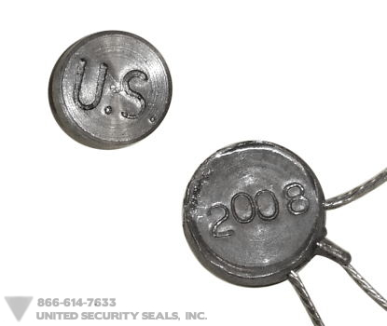
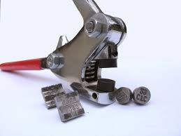
Use and Control of Protective Seals
Minimum Characteristics
Durability – Strong enough to NOT break accidentally
Design – sufficiently complex to make unauthorized replacement difficult
Tamperproof – provide readily identifiable evidence of tampering
Individually Identifiable – Embossed serial number and owner ID
NOTE: Lead Crimp Seals not authorized for use.

Slide 114
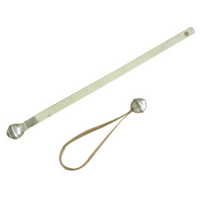
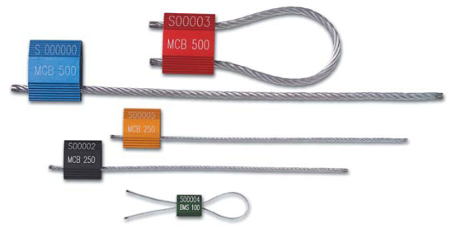

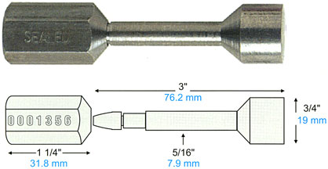
Use and Control of Protective Seals
For AA&E or classified materiel shipments, security seals types 9, 11, 12, or 13 are required.
Type 11 – One Piece Cable (High Strength Seal)
Type 9 – Ball Seal (Low Strength Seal)
Type 12 – Cable Piece Cable (High Strength Seal)
Type 13 – Unthreaded Bolt (High Strength Seal)

Slide 115
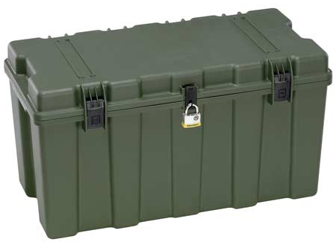
Use and Control of Protective Seals
UNIT LETTERHEAD
OFFICE SYMBOL DATE
MEMORANDUM FOR RECORD
On (This Date), 200 M9 Bayonets were sealed in this footlocker using Seal # 12345”
Point of Contact for this memorandum is the unit armorer at 239-xxxx.
Unit Armorer Witness
Signature Block Signature Block
xxxxxxxxxxxxxxxxxxxxxxxxxxxxxxxxxxxxxxxxxxxxxxxxxxx
NOTE: Recommend using Senior NCO as Witness or Commander.

Slide 116
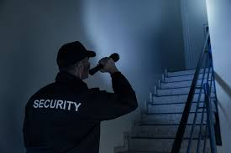
Security checks

Slide 117
Security Checks
Commanders must establish end-of-day checks
At minimum one form placed at main entrance/exit (door used first/last).
CO / PS Officers must identify other areas requiring checks based on Risk Analysis.
Items to check:
PII Storage secured
Secure Areas secured (ICIDS set and locked)
SIPR secured
Shredder emptied
Doors/Windows secured
Annotate these checks on SF 701 and maintain on file for 90 days.

Slide 118
Security Checks
Frequency
Arms Room – Once every 8 hours (vault must be physically checked)
Motor Pool – Once every 2 hours (level II SPM)
Airfield – Once every 1 hour (level II SPM)
Additional Areas may require security checks at level III SPM (Communications Equipment, SSA’s, etc.)

Slide 119
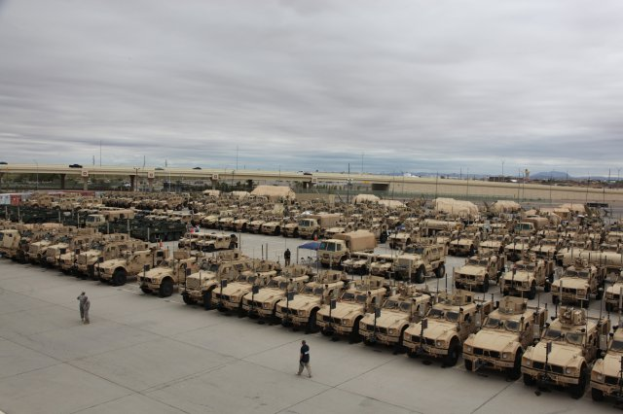
Motor Pool
Area

Slide 120
Motor Pool
Most motor pools on Fort Riley are rated at Risk Level II. This is due to the value of the equipment stored within the motor pool.
Paragraph 3-5 of AR 190-51 provides physical protective and security procedural measures used for vehicles and carriage-mounted/towed weapon systems and components.

Slide 121
Motor Pool
Vehicles will be parked in motor pool protected by a perimeter fence or dedicated guards. The Motor Pool fence requirements are found in ATTP 3-19.32. Minimum 6 foot chain link fence with one foot top guard.
Fence fabric must be taut and securely fastened to rigid metal post set in concrete and the Fence must reach within 2 inches of hard ground or pavement. (On soft ground the fence must reach below the surface deep enough to compensate for shifting soil).
A Clear zone of 20 feet will be maintained. Clear zone should be free of all weeds, rubbish or other materials that could be used as concealment.

Slide 122
Motor Pool
Physical Protective Measures Risk Level I steps include:
Ensuring all Army vehicles parked in noncombat areas are secured:
Method of security will be determined by the type of vehicle (i.e. immobilizing the steering column of a HMMWV.
Activate manufacturer installed door and ignition locking devices
Securing all hatches on armored/tank vehicles
Safety regulations may prohibit securing fuel tankers (Check with Safety Office)
Trailers, towed weapon systems and non-self propelled vehicles do not need to be secured.
Ensure accessible and easily removable components are secured.
Posting “Off Limits to Unauthorized Personnel” signs at all entrances to the motor pool (Includes vehicle and pedestrian entrances).
Items used to defeat security measures will be secured (i.e bolt cutters, torches, axes, steel rods or bars).

Slide 123
Motor Pool
Physical Protective Measures Risk Level II steps include:
Ensure all measures of Risk Level I are implemented.
Vehicle parking areas will be lighted during hours of darkness (with the exception of parking areas for empty trailers).
Vehicles will be parked at least 20 feet from the perimeter of the parking area or as far from the perimeter as possible (General rule of thumb keep gravel area clear if provided).
Master Keyed Locksets are Prohibited except under the following conditions:
When the lock set is used within one vehicle to secure the vehicle and its various compartments.
The same lock set will not be used on more than one vehicle.
Keys and locks controlled IAW Appendix D of AR 190-51

Slide 124
Motor Pool
Security Procedural Measures Risk Level I steps include:
Motor Pools will be checked for tampering, sabotage, loss, and damage not less than once every 4 hours.
Privately owned vehicles will not be permitted in the motor pool.
Security Procedural Measures Risk Level II steps include:
Ensure all measures of Risk Level I are implemented.
Entry to and exit from the motor pool will be controlled.
Guards will check the motor pool on an irregular basis not less than once every 2 hours (Overrides Risk Level I checks).

Slide 125
Tools
Tool sets and kits with lockable tool boxes:
Secured with a US Government approved key operated lock or factory installed built in key operated tumbler type lock.
The individual signed for the kit will retain key
Duplicate key may be held by the supervisor or commander if it is stored in a locked container with controlled access.
Portable hand tools, tool sets or kits and shop equipment:
When not in use or under the surveillance of a responsible person will be secured in:
A locked building or room meeting the requirements of a secure storage structure in appendix B
Locked in a metal cage
Locked in a built in cabinet, bin or drawer in a secure room
Attached to the building structure with 5/16 inch chain or equivalent cable
Locked enclosed truck, van, armored vehicle or vehicle trunk
A locked CONEX container

Slide 126
Tools
Common Tools and Portable Shop Equipment:
When not on a hand receipt to a user, will be controlled through a locally devised sign-in/sign-out log or exchangeable tag system.
Access to tools and shop equipment will be controlled to the maximum extent possible (i.e individual designated as responsible for security of the tools, and supervisory and command personnel)
All keys used to secure tools will be controlled IAW Appendix D of AR 190-51.
Master keyed or keyed alike lock sets will not be used.

Slide 127
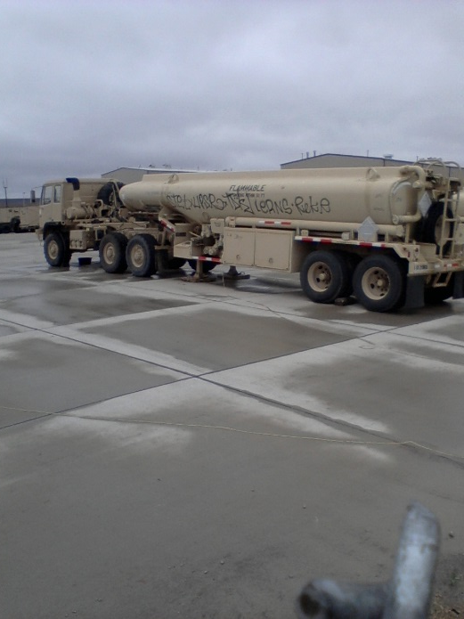
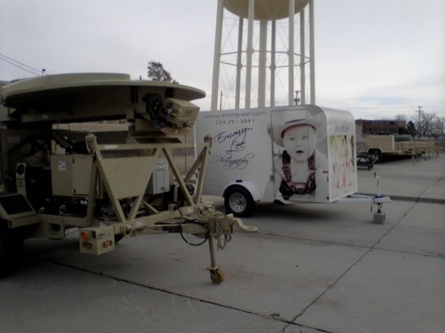
POL (Petroleum, Oils And Lubricants)
Physical Protective Measures Risk Level I:
POL pumps will be locked and electrical power turned off when not
under the surveillance of personnel authorized to dispense the products.
Packaged POL will be stored in structures meeting secure storage structure standards of Appendix B.
Keys to POL storage areas, equipment and buildings will be secured per Appendix D.
Security Procedural Measures Risk Level I:
When unattended the facility will be checked once every 4 hours.
Privately owned vehicles will not be permitted in storage facilities.
All issues of fuel will be accounted for and supervised by authorized personnel.
Containers storing used POL will be marked and stored separately.

Slide 128
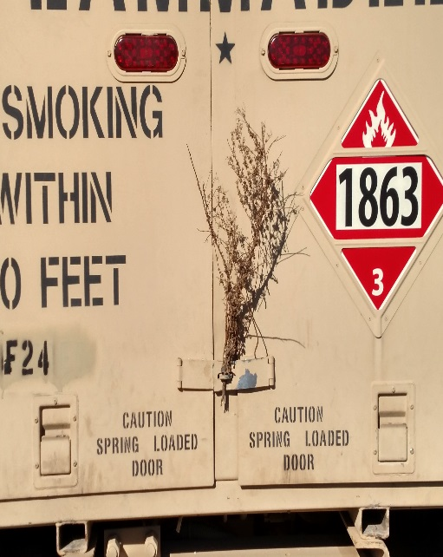
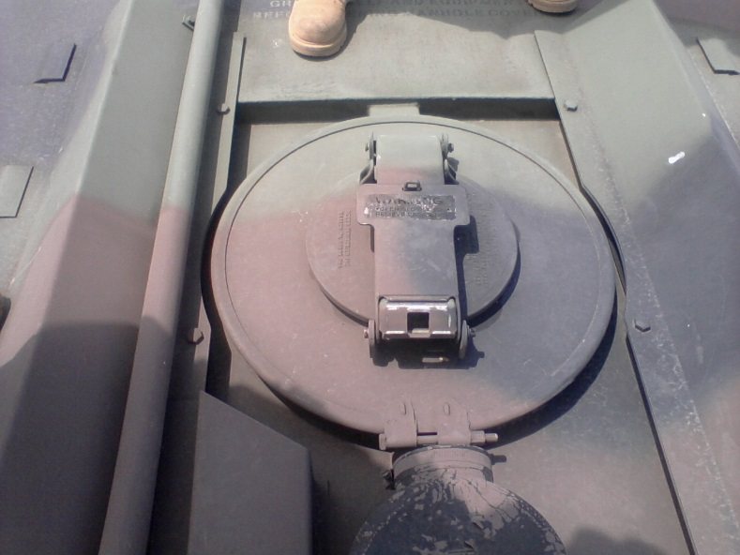
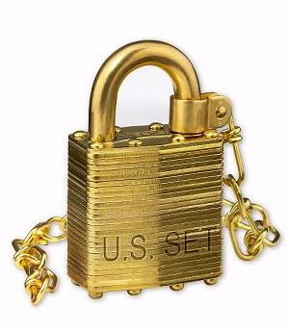
POL (Petroleum, Oils And Lubricants)
POL Tank Trucks that contain fuel and are not under the surveillance of the operator or dedicated guard force will:
Have locked hatch covers where possible
Have locked manifold access doors.
Each manifold valve secured with a transportation seal if the manifold access door cannot be locked
Approved padlocks – non-sparking brass locks for safety if available.

Slide 129
Additional Areas
Areas with specific security concerns:
Supply Support Activity (SSA)
Located within Motor Pool
Separate Activity
Field Level Munitions Support Activity (FLMSA)
Specific requirements outlined in AR 190-11, para 2-5
Small Arms Repair (SAR)
Operated as an Arms Room.
Awareness of SI parts (CIIC code 1-6, 7, 8, 9, N, P, Q, R and Y)
Communications Storage / Repair Facility

Slide 130
Day 2 Pre-View
Expeditionary Security
Arms Room Ops
POF’s

Slide 131


QUESTIONS?
COMMENTS?
CONCERNS?

