Slide 1


PHYSICAL SECURITY OFFICERS (PSO) COURSE
DAY 2
Presented by:
Fort Riley Security Branch
Notes:
Introduction to Class

Slide 2
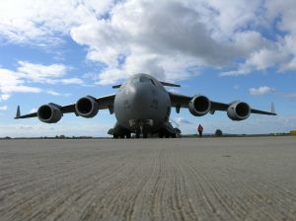
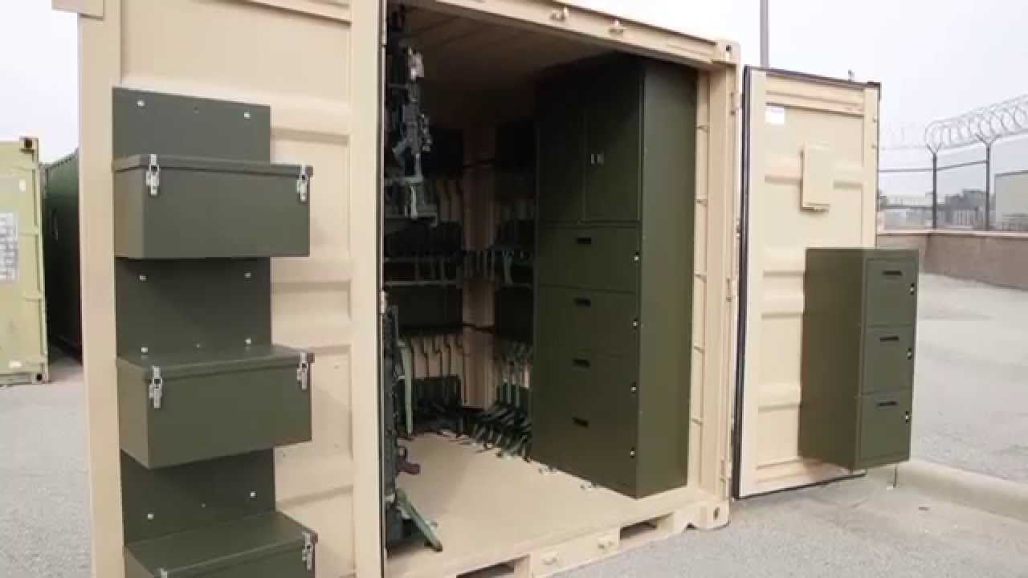
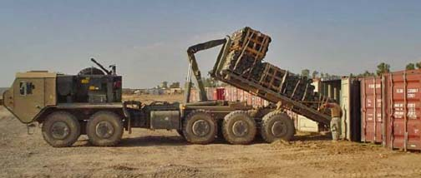
Physical Security During Expeditionary Operations
“The force is often most vulnerable to an enemy or adversary surprise attack during preparation.” ADRP 3-37
Notes:
Introduction to Class

Slide 3
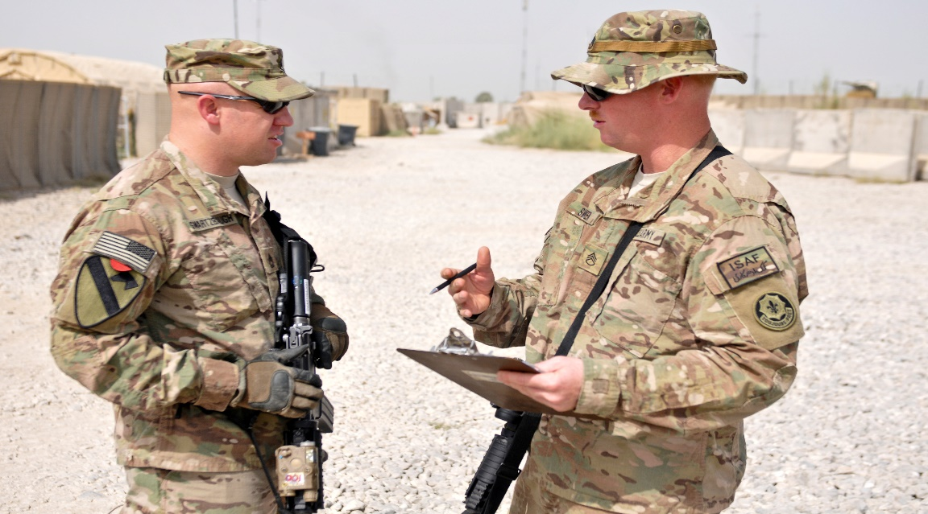
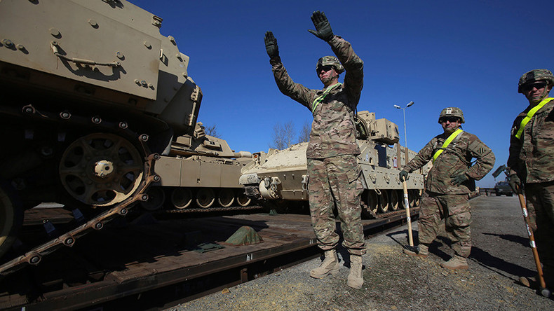
Physical Security During Expeditionary Operations
The organization's Physical Security Officer (PSO) is a key member of the
team that will ensure the protection of it’s assets during all phases of the
deployment, expeditionary operation or exercise.

Slide 4
Physical Security During Expeditionary Operations
The requirement for Physical Security never ends!
It is included in all operations irrespective of the locations and conditions.
The PSO will ensure that physical security requirements are included in all operations regardless of the location, this includes:
Deployments (both operational and combat)
CTC (JRTC, NTC) rotations
Field Training Exercises (FTX)
Emergency Deployment Readiness Exercise (EDRE)
Other events outside of the organizations normal operating area.

Slide 5
Physical Security During Expeditionary Operations
PSO Considerations During Deployment
Security of Sensitive Items During Shipment/Movement
Rear Detachment Physical Security Responsibilities
In-transit Security/Guard Forces
Establishment of Security at Forward Locations
Protective Barriers
Security Lighting
Electronic Security Systems
Access Control Points
Security/Guard Forces

Slide 6
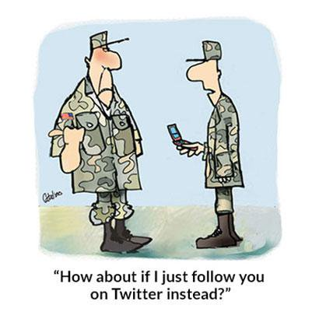
Physical Security During Expeditionary Operations
Rear Detachment Physical Security Requirements
There is no relief from physical security requirements for the Rear Detachment. The rear detachment area is often a haven for criminal activity.
Rear Detachment Commanders must ensure that assets are protected, inspections are conducted, and equipment is accounted for. Security checks are an important tool to accomplish this mission.
At times, this can be more difficult due to consolidated assets, including arms rooms, motor pools, and other property book adjustments.
Additionally, personal property should be included in security plans and special considerations given to “pack-in” situations in the barracks.
The PSO should assist Rear Detachments with establishing their physical security plans and battle rhythm prior to deployment, it should be planned, resourced, and rehearsed during field training and other opportunities.

Slide 7
Physical Security During Expeditionary Operations
Rear Detachment Physical Security Requirements
During the deploying unit's absence from home station, a duty officer or duty NCO will conduct a daily check of the arms room entrance.
The rear detachment armorer will test the IDS on a monthly basis. If the IDS is not operating or is malfunctioning, the rear detachment commander must post an armed guard at the arms room until all weapons and ammunition stored therein can be relocated to an alternate arms room or the IDS is repaired.
Privately owned weapons stored in unit arms room will be included on the inventory lists and stored in the arms room IAW AR 190-11 and AR 190-13.
Government property, other than AA&E, will be placed under continuous surveillance or afforded protection by other means (fenced enclosure, secured within bldg.) to preclude unauthorized access to these items.
If no rear detachment is established, all AA&E, sensitive and high value items not accompanying the unit will be turned-in to the LRC, Supply and Services Division. At no time will AA&E or sensitive items be left unattended and/or unsecured.

Slide 8
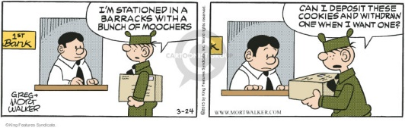
Physical Security During Expeditionary Operations
Rear Detachment Physical Security Requirements
Personal property, when removed from individual billet rooms, will be locked, sealed, and protected by controlling access to building/areas where the property is stored. Commanders will either post guards or secure the storage building (or room) and control access to the keys.
When personal property is stored in the barracks, personnel not deploying with the unit should be consolidated in the barracks. Personnel staying back will be separated from billets/rooms used as storage areas.
Checks of the storage area(s) will be conducted every eight hours and recorded on the staff duty DA 1594, Staff Journal.

Slide 9
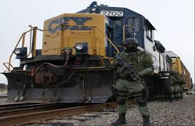
Physical Security During Expeditionary Operations
No AA&E items will be left unattended or unsecured at any time. AR 190-11 para 7-10b
Commanders will ensure that enough security measures are taken to protect AA&E being moved by unit or organization transportation, on or off installations.
All movements of Category I and Category II AA&E require armed guards regardless of the FPCON. AR 190-11 para 7-10c
Request separate containers for AA&E and classified materials. One “sensitive items” container does not met regulatory intent in most circumstances.
Individual issued AA&E is the responsibility of that Soldier.
Notes:
Introduction to Class

Slide 10
Physical Security During Expeditionary Operations
Shipping AA&E and Sensitive Items
It is Army policy that weapons or sensitive items such as funds, jewels, precious metals, or drugs will not be stored in the same container or facility used to safeguard classified information.
When used for transporting AA&E, the doors of approved intermodal containers (MILVAN, SEAVAN, or CONEX) will be securely closed and sealed.
End-opening containers will be placed door-to-door during rail shipments.
Barriers on the rail cars will be used to protect side-opening containers and deter the opening of such cars. The AA&E will be placed in the rear of containers behind non sensitive items to reduce the opportunity of theft.
In the event of contingencies, exercises, or rotational unit movements where it is not practical to use containers,
only armored vehicles that are locked and sealed will be used to ship AA&E
The AA&E will be provided double barrier protection by placing it in separate, locked, and sealed containers, affixed to the interior of the locked/sealed armored vehicles in a manner that precludes easy removal.

Slide 11
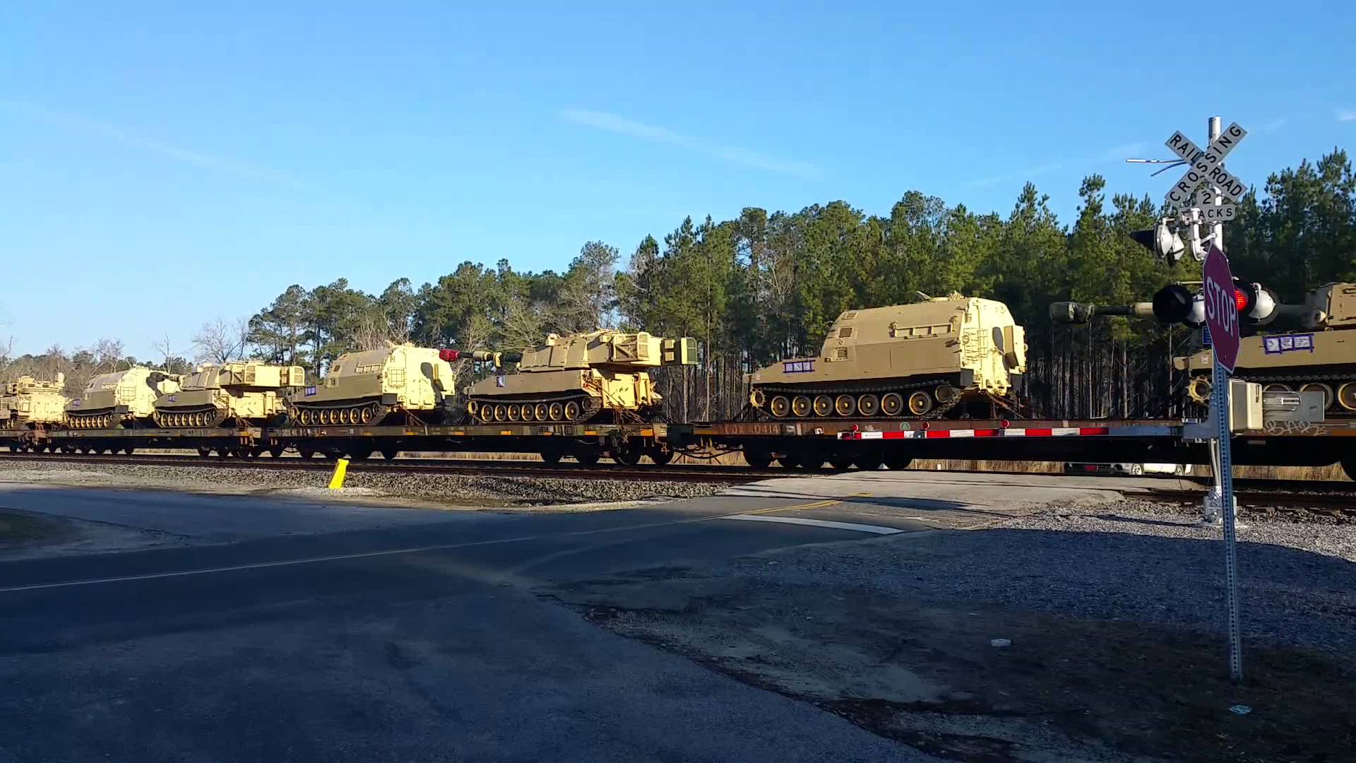
Physical Security During Expeditionary Operations
Shipping AA&E and Sensitive Items
Army activities involved with AA&E shipments will implement a
seal control program per AR 190–51 to ensure accountability/control
of seals.
Shipments must be checked immediately upon receipt to ensure
that the seals are intact and for any signs of damage or tampering.
If there are any such signs, there must be an immediate inventory
to verify quantities received and to determine the extent of any
damage or tampering on all Category I and Category II AA&E
and classified AA&E shipments.
If the seals are intact, quantity verification must take place no later than the next working day. The
requirement to check seals and verify quantities received includes shipments of all categories of sensitive or classified AA&E and uncategorized Class A and Class B ammunition and explosives.

Slide 12
Physical Security During Expeditionary Operations
Representative Risk Categories
Category I (Missiles And Rockets).
(1) Nonnuclear man portable missiles and rockets “in a ready-to-fire” configuration; for example, Redeye, Stinger,
Dragon, Javelin, light antitank weapon (66mm), shoulder-launched multi-purpose assault weapon rocket (83mm), and AT–4 anti-armor launcher and cartridge (84mm). Also included are the tube-launched, optically-tracked, wire-guided missile (TOW) weapon and the Hellfire missile.
(2) These weapons, when jointly stored or transported with the launcher tube and/or grip stock and the explosive
round, though not in a ready-to-fire configuration will be considered Category I weapon items.
Category II. Light automatic weapons, including .50 caliber, M16A2 rifle, M4 rifle, Squad Automatic Weapon,
M240b machine gun, and 40mm MK 19 grenade launcher.
*Weapon components such as silencers, mufflers, and noise suppression devices will be treated as Category II items.
*Research your specific items in AR 190-11 APP B

Slide 13
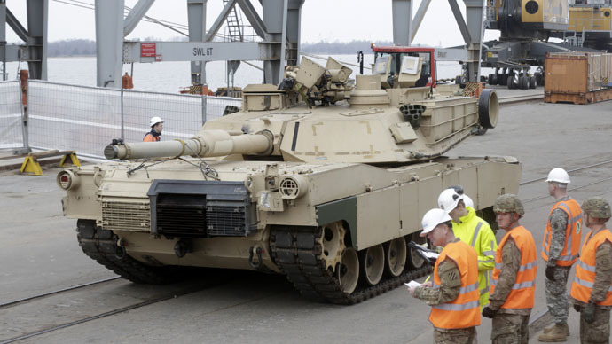
Physical Security During Expeditionary Operations
In Transit Guard Forces
Unit equipment must be safeguarded according to governing regulations and SOPs while it is being transported to, and staged at, installations, marshaling areas, and ports of embarkation.
Certain cargo categories require care while in transit and some special cargo categories require extraordinary protection and monitoring while in transit.
Measures of protection and monitoring range from continuous surveillance to a simple seal used in shipping.
Rail movement may require rail guards, while shipments by sea may require personnel assigned as supercargo.
The threat to the particular asset can increase the specific security requirement, however, the minimums are mandatory.

Slide 14
Physical Security During Expeditionary Operations
Rail Guards
Physical Security Requirements remain during rail load operations and shipments.
The deploying unit commander coordinates with the installation transportation officer (continental United States) or the unit movement coordinator (outside the continental United States) and authorized railroad representatives on guard or escort matters.
Guards or escorts are armed at the installation commander’s discretion for CAT III and IV AA&E. When armed guards are used, all participating railroads must be notified. All armed guards must be familiar with the rules of engagement and trained in the use of force.
Cargo guards or escorts maintain surveillance over military equipment during the journey and notify railroad personnel of any problems. When outside the continental United States, host nation support is used when appropriate.
Escorts are instructed on locomotive and railroad safety. Additionally, escorts will be briefed on the rules of engagement before the train leaves the station.

Slide 15
Physical Security During Expeditionary Operations
Ship Guards
Supercargoes are unit personnel designated on orders to accompany, secure, and maintain unit cargo aboard ships.
They perform liaison during cargo reception at the seaport of embarkation, shipload and discharge operations, and seaport of debarkation port clearance operations.
Upon arrival at the seaport of embarkation, supercargos are under the operational control of the port commander. While aboard a ship, the supercargos are under the mission command of the vessel captain or first mate.
Upon arrival at the seaport of debarkation, supercargos are under the operational control of the port commander. Supercargos are normally released to the unit upon completion of port clearance operations.
Unit commanders recommend the composition of supercargos based on several factors, including the amount and type of equipment loaded aboard the ship and the number of units with equipment on the ship.

Slide 16
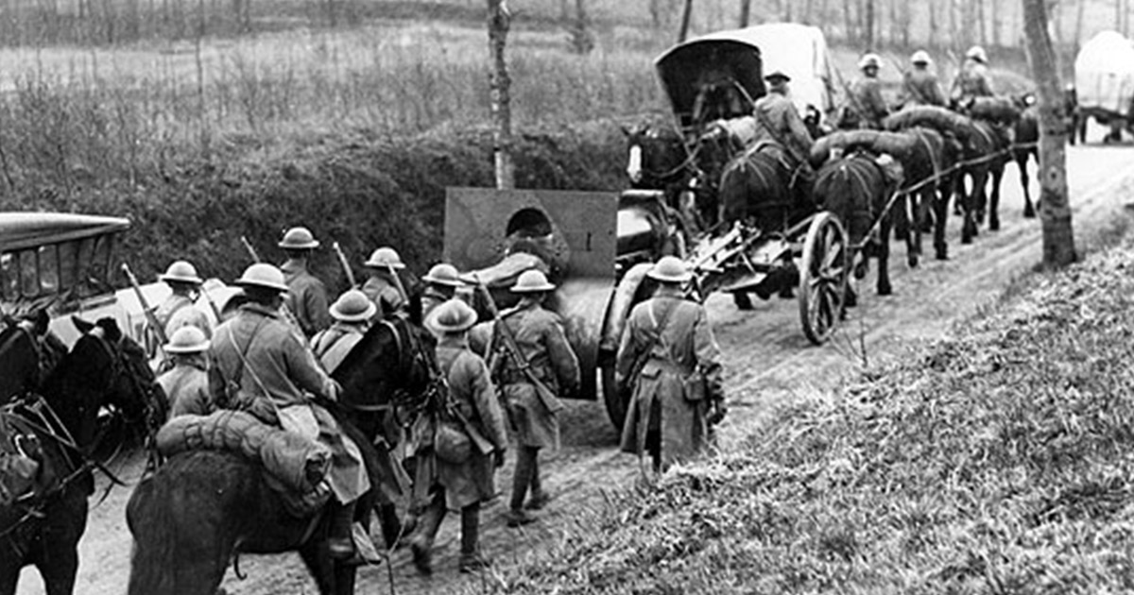
Physical Security During Expeditionary Operations
Physical Security in an Expeditionary Environment

Slide 17
Physical Security During Expeditionary Operations
Physical Security Plan
The requirements for a physical security plan can be found in ATP 3-39.32 and the plan should focus on the deployed environment/location.
Some items that should be included in the plan are:
Area Security - Define the areas, buildings and other structures considered critical. Establish priorities of protection.
Control measures
Access, vehicle, and material controls.
Barrier Plan
Lighting Plan
IDS Requirements
Security Forces
Contingency Plans
Use of Air Surveillance
In a tactical environment, the implementation of a physical security plan is based on METT-TC (through the operations order format and the higher headquarters order).
Physical Security: Physical security plans for property movement should be established during initial preparation for deployment.
The plans should provide for the security of government property from the originating installation to the port of debarkation. Division PSO and transportation personnel should assist in the development of redeployment security.
This information should be included in the unit’s physical security plan and rehearsed during training exercises.

Slide 18
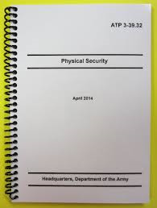
Physical Security During Expeditionary Operations
Assess the Risk/Threats
Regardless of the environment or available resources, the protection of Army personnel and assets follow the same general procedures:
Identify the asset or area to be protected.
Determine its mission criticality.
Assess the likelihood of compromise.
Assess potential threats and tactics.
Develop and implement control measures.

Slide 19
Physical Security During Expeditionary Operations
Tactical Environment Considerations
Fixed sites in tactical environments are especially vulnerable to hazards and threats. Actions against enemy threats and toward other potential emergencies (natural disasters, accidents) must be planned.
Adjustments must be made to protection and security plans. Expeditionary forces may not have initial access to sophisticated electronic security devices and may have to develop field-expedient means of intrusion detection, early warning, and other protection measures.
For these forces, the enhancement of local security and protection efforts occurs with trip flares, binoculars, night vision devices, barriers, fences, exterior security lighting, and clear fields of fire.
Establishing access control measures, installing concrete barriers and guard towers, and conducting aggressive security patrols can deny enemy access to the area immediately surrounding friendly forces.
Whether establishing a new base or occupying an existing one, military leaders should initially focus on establishing or reassessing protective measures at the perimeter of the base.

Slide 20
Physical Security During Expeditionary Operations
Layered Security Approach

Slide 21
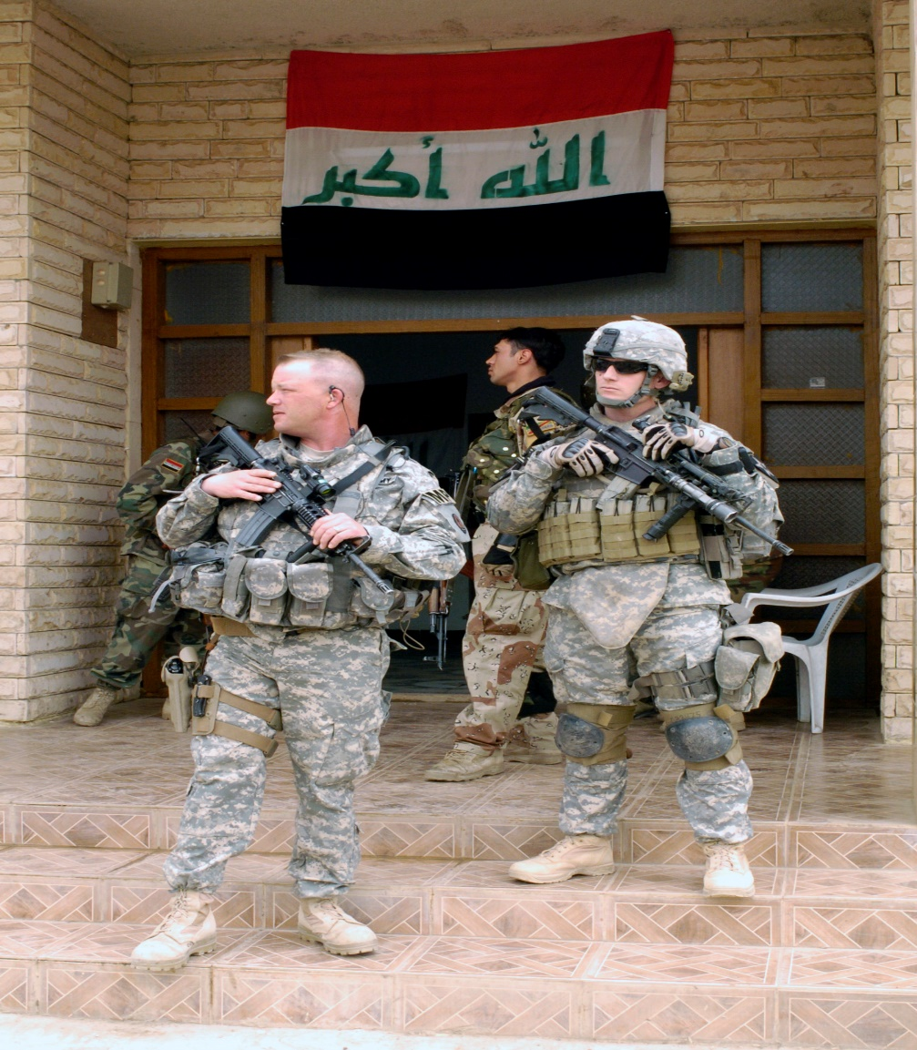
Physical Security During Expeditionary Operations
Outer/Perimeter Security Considerations
The perimeter security system is often the first line of defense, and it provides a visual deterrent to potential adversaries. The design of the perimeter security system should meet the following requirements:
Provide adequate blast standoff distances. (See UFC 4-010-01 and UFC 4-010-02.)
Limit or block the line of sight of operations from vantage points outside the perimeter.
Provide sufficient room for vehicle and pedestrian access control.
Maximize the threat ingress and egress time across the exterior site.
Enhance the ability of security forces to observe threats before they can attack.
Establish access control procedures
Ensure that the insider threat is addressed and mitigation measures are implemented.

Slide 22
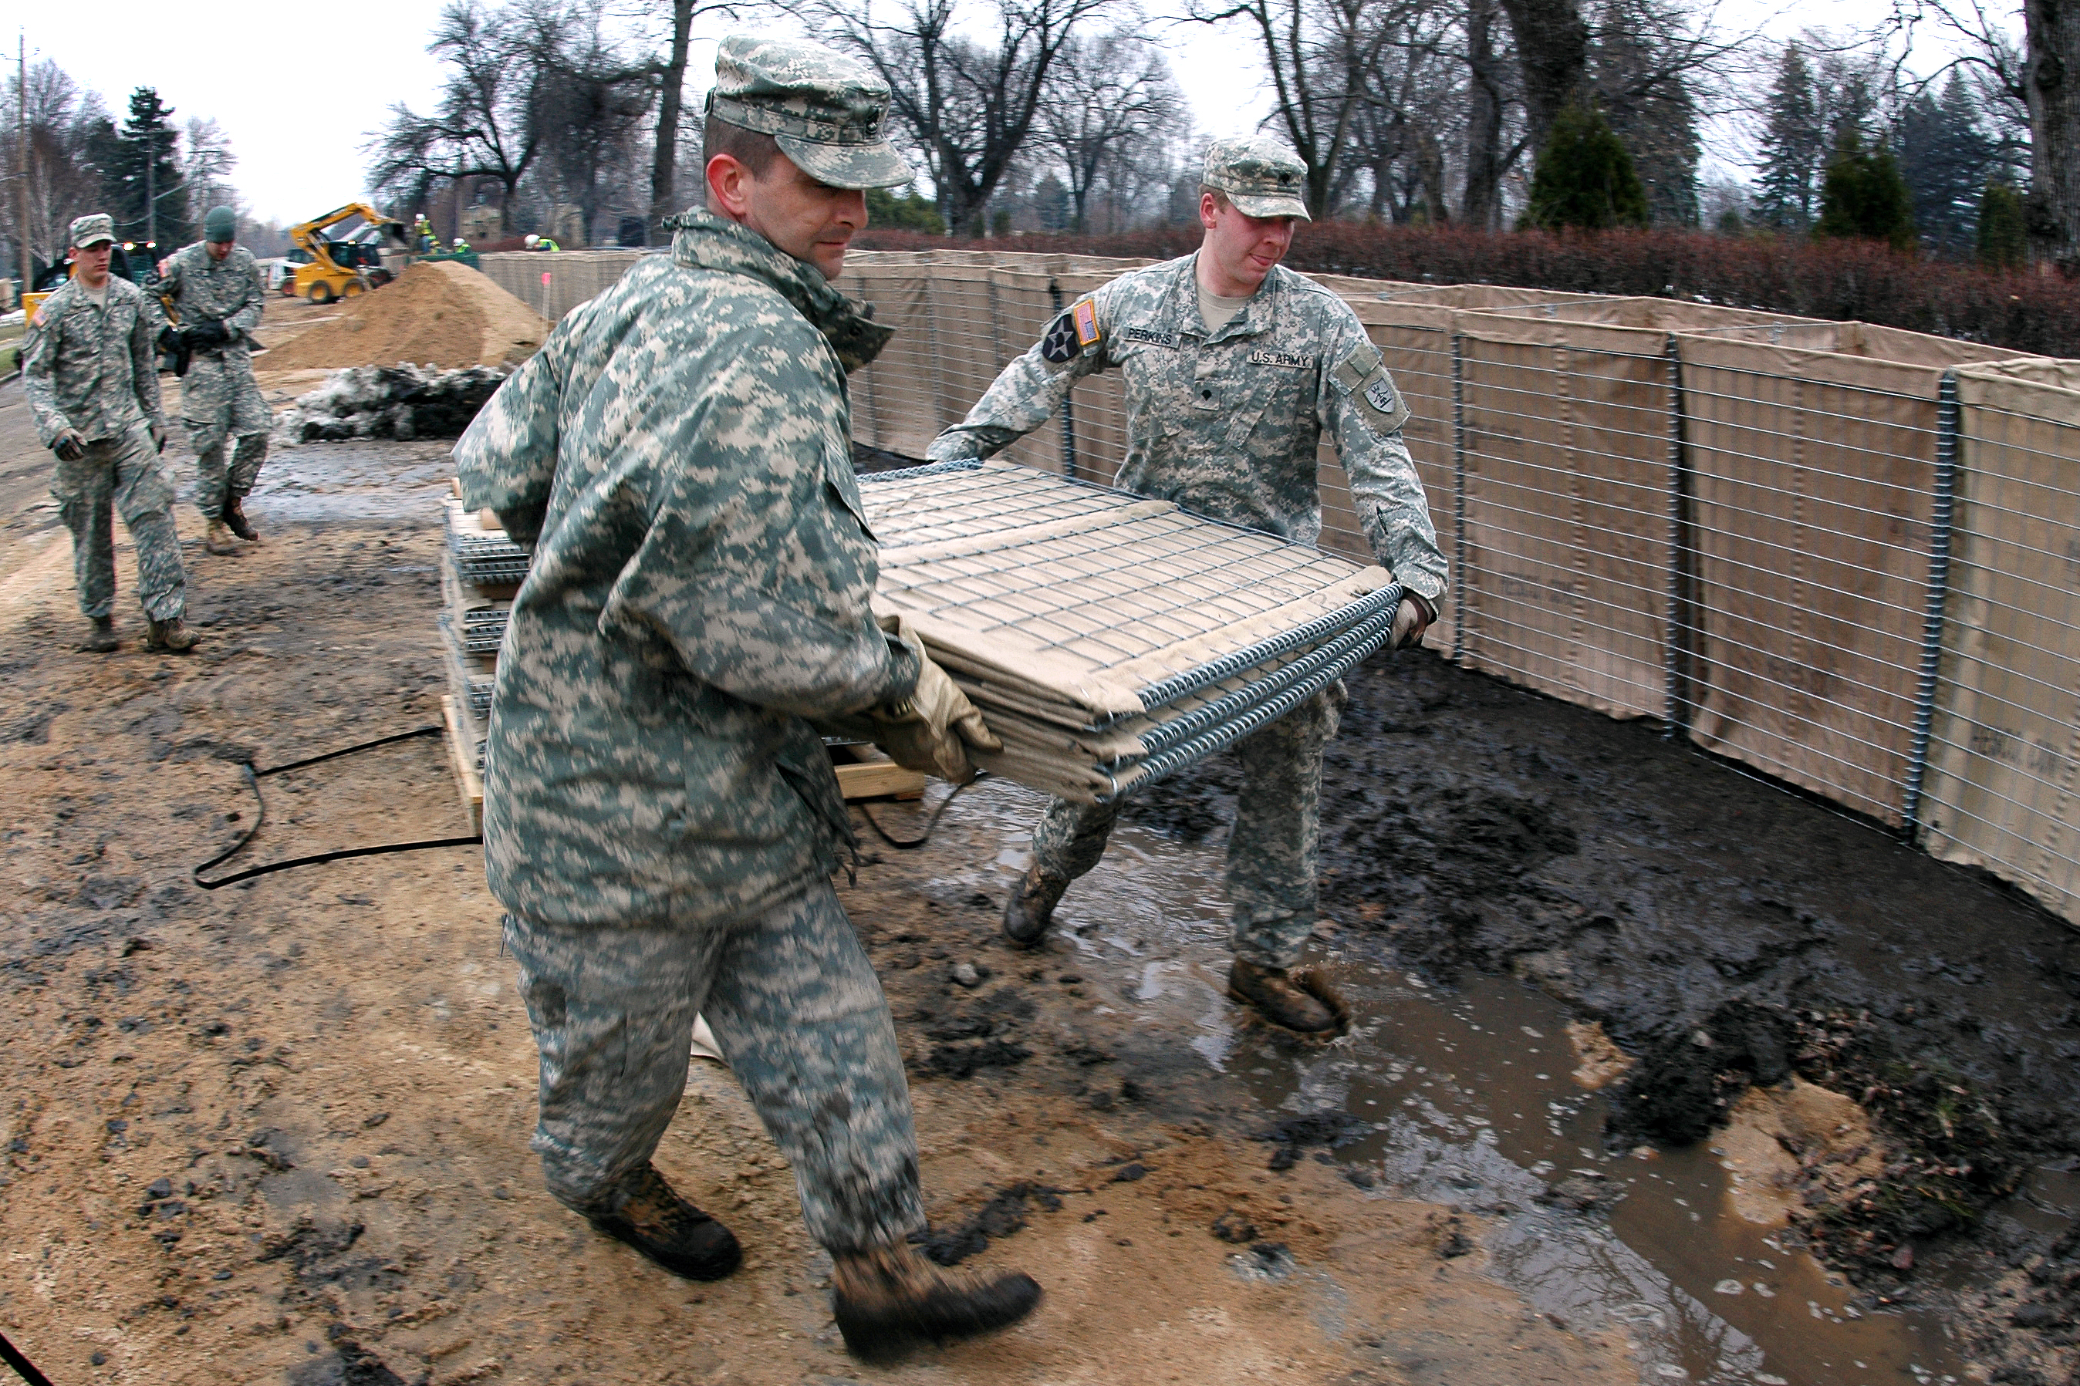
Physical Security During Expeditionary Operations
Barrier Considerations
Protective barriers form the perimeter of controlled areas and serve to facilitate the control of pedestrian and vehicle ingress and egress
Barriers have a variety of purposes, including maximizing standoff distances. Perimeter barriers should be located as far as possible from critical assets and inhabited buildings to mitigate blast effects.
Barriers offer important benefits to the overall physical security posture and have a direct impact on the number of security posts needed; however, barriers cannot be designed for all situations.
A layered approach should be used when planning for the emplacement of barriers. Combinations or layers of barriers should be separated by a minimum of 10 meters for optimum protection and control. An unobstructed area or clear zone should be maintained on both sides of and between physical barriers.

Slide 23
Physical Security During Expeditionary Operations
Vehicle Barrier Considerations
The PSO should be familiar with the provisions of UFC 4-022-01, UFC 4-022-02, UFGS-34 71 13.19, and the Access Control Point Definitive Standard Drawings and Criteria.
The PSO focuses on the requirements of the security force and the placement of supporting security systems that are integrated into the overall vehicle barrier plan.
Vehicle barriers are designed to impede, guide, or stop vehicles attempting to pass through perimeters. They can be employed against stationary or moving-vehicle bomb threats.
Vehicle barriers can be breached, but successful breaching methods require considerable time and equipment.
Vehicle barrier design and selection factors should include the following:
Explosive threat.
Weight of the threat vehicle.
Sufficient standoff distance between the planned barrier and critical structures.
Expected speed of the threat vehicle.
Ability to reduce threat vehicle speed.
Number of access points requiring vehicle barriers.
Most cost-effective barrier available that will absorb the kinetic energy developed by the threat vehicle.
Availability of security forces for constant surveillance and observation.
Temporary or permanent nature of the barrier.
Average bumper height of the vehicles.

Slide 24
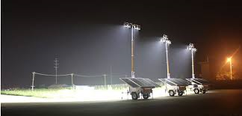
Physical Security During Expeditionary Operations
Security Lighting
The PSO Should consider the following when making security lighting decisions in the deployed environment:
Cost
Portability
Safety and grounding requirements
Manual override for blackout requirements
Durability
Functionality
Strike and restrike time
The PSO must ensure that lighting does not interfere with night vision equipment, aircraft, or other aspects of tactical operations.

Slide 25
Physical Security During Expeditionary Operations
The Access Control Point (ACP) is a corridor at the installation perimeter through which all vehicles and pedestrians must pass when entering or exiting the installation. PSO’s should consult AT and Engineer Personnel to ensure the best possible protection measures are implemented.
The ACP shall be designed in a manner which ensures that all vehicles and pedestrians are contained within the ACP corridor. There should be staging and search areas included along with clearing barrels and other safety equipment based off of METT-TC.
The factors of mission, enemy, terrain and weather, troops and support available, time available, and civil considerations (METT-TC) determine the level of self-protection needed at an ACP. Protection measures should be appropriate for the anticipated level of threat. Armored vehicles, security over-watch, and fighting positions are used when necessary.
Access Control

Slide 26
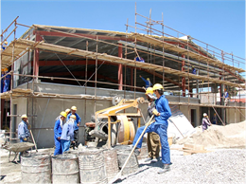
Physical Security During Expeditionary Operations
IMPROVING THE SECURITY POSTURE
Establishing the design criteria for security and antiterrorism is not something that can be done effectively by any one person. It requires a team of people to ensure that the varied interests relating to a project are considered appropriately.
Representatives of the security and law enforcement function are responsible for detecting and defeating acts of aggression against assets. They may also provide information on general security requirements and on criminal threats.
Security and antiterrorism requirements will never be the only requirements associated with a project. Even where a project is specifically for security and antiterrorism upgrades, there will still be other requirements that must be considered.
IRAQ — The U.S. Army Corps of Engineers completed more than 5,000 projects in Iraq from 2004-2011, contributing to a new government for that nation. (Photo by U.S. Army Corps of Engineers)

Slide 27
Physical Security During Expeditionary Operations
MILCON REVIEW
There will be times where one criterion is more stringent than another, in which case the more stringent one must be applied. In some cases, criteria may conflict. In those cases, those conflicts must be resolved, which may require compromise or adjustment to one or the other criteria.
Many security regulations specify protective measures, policies, and operations related to security. Regulatory requirements must be accommodated and coordinated to the extent possible to mitigate threats and vulnerabilities based off of the available resources.
Project programmers and designers also must consider issues such as life safety and fire protection, functional issues, energy conservation, seismic criteria, barrier-free handicapped access, and aesthetics.
Protective measures may enhance energy conservation or seismic survivability, but the objectives of life safety requirements or barrier-free access may conflict with the objectives of the protective system. The programmer and the planning team need to recognize conflicts and establish priorities in the programming phase to guide designers to appropriate and optimal solutions.

Slide 28
Physical Security During Expeditionary Operations
CUSTOMS
Physical Security Requirements still exist during customs inspection operations. Your S-4 or Transportation Office can assist you with customs requirements and the necessary security procedures that apply. It is imperative that considerations are taken for customs inspections during planning for security of assets while in transit. The PSO must ensure that security measures are adhered to and accountability maintained throughout the inspection process.
USTRANSCOM is the Executive Agent for DOD Customs, interface with the US Customs Service, State Customs and Agriculture officials, US Department of Agriculture (USDA), Animal and Plant Health Inspection Service, and Plant Protection and Quarantine for customs and agriculture inspections of DOD personnel, material, and equipment returning to CONUS.
The joint inspection (JI) will require opening of containers and equipment to ensure all items are secured and that no hazardous materials have been overlooked. Customs will document, seal, or re-seal equipment and containers. Customs must be present for the JI. Any prior customs inspections will be nullified by the JI because all container seals will be broken to open the containers for the JI. If the customs inspection was nullified as describe above, customs will perform their inspection or re-inspection along with the joint inspector. Customs inspection (when required) needs to be scheduled at the same time as the JI.

Slide 29
Physical Security During Expeditionary Operations
CUSTOMS
COMSEC material shipments under contingency deployment and under courier escort by U.S. military personnel must be exempt from customs inspections by any U.S. or foreign customs officials. Arrangements will be made to conduct pre-deployment inspection or screening of COMSEC material at a secure location at the home station prior to sealing containers. Once inspected, banded, sealed, and properly labeled, (certifying inspection by customs officials), the containers must not be opened until arrival at the deployment site by the CAM. AR 380–40 para 2-38a
Classified Information-In the custody of Commanders or masters of ships of United States registry, who are United States citizens. CONFIDENTIAL information shipped on ships of U.S. registry, cannot pass out of United States control. The commanders or masters must sign a receipt for the material and agree to:
Deny access to the CONFIDENTIAL material by unauthorized persons, including customs inspectors, with the understanding that CONFIDENTIAL cargo, that would be subject to customs inspection, will not be unloaded.
(2) Maintain control of the cargo until a receipt is obtained from an authorized representative of the consignee. AR 380-
5 para 8-4e
*Reference DTR 4500-9 for more specific requirements during customs.

Slide 30
Physical Security During Expeditionary Operations
Conclusion
The PSO should be an integral part of pre-deployment planning, preparation and execution and considerations outlined in the Physical Security Plan.
The Rear Detachment has a requirement to maintain a physical security program.
AA&E must be secured in all circumstances, no matter the FPCON.
Physical Security Measures must be constantly reassessed and reevaluated based off of the current operational situation, threats, vulnerabilities and identified risk.
In the plan, consideration should be given to area security, control measures, access, vehicle, and material, controls, security forces, contingency plans and the use of air surveillance in all environments.
The PSO and the Division PMO can greatly assist the unit in preparing to meet physical security requirements in the deployed environment.

Slide 31
Physical Security During Expeditionary Operations
QUESTIONS

Slide 32
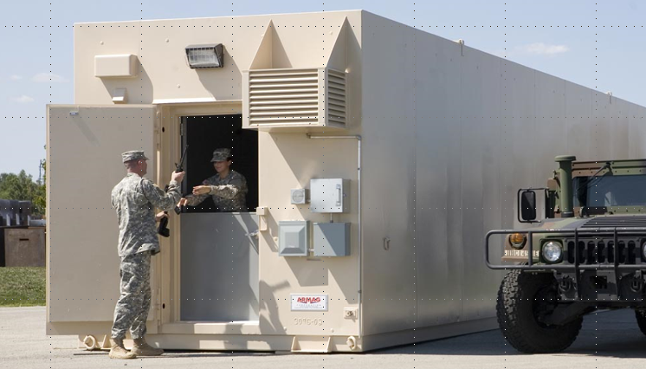
ARMS ROOM OPERATIONS
Exterior / Door Security / Documentation / Additional Property

Slide 33
Exterior
Restricted Area Warning Sign
Notes:
What should be posted outside of the arms room.

Slide 34
Exterior
RESTRICTED AREA
WARNING
THIS ACTIVITY HAS BEEN DECLARED A RESTRICTED AREA BY AUTHORITY OF THE INSTALLATION COMMANDER IN ACCORDANCE WITH THE PROVISIONS OF THE DIRECTIVE ISSUED BY THE SECRETARY OF DEFENSE ON 10 December 2005, PURSUANT TO THE PROVISIONS OF SECTION 21, INTERNAL SECURITY ACT OF 1950. UNAUTHORIZED ENTRY IS PROHIBITED. ALL PERSONS AND VEHICLES ENTERING HEREIN ARE LIABLE TO SEARCH. PHOTOGRAPHY OF THE FACILITIES IS PROHIBITED WITHOUT SPECIFIC AUTHORIZATION FROM THE COMMANDER. DEADLY FORCE IS AUTHORIZED.
Notes:
AR 190-11 Para 4-15
Must be posted at eye level outside of the arms room, and all entrances to building containing arms room.

Slide 35
Exterior
Restricted Area Warning Sign
Alarm Warning Sign
Notes:
What should be posted outside of the arms room.

Slide 36
Exterior
THIS FACILITY IS PROTECTED
BY AN
ALARM SYSTEM
UNAUTHORIZED ENTRY IS PROHIBITED
VIOLATORS WILL BE PROSECUTED
UNDER THE PROVISIONS OF THE UCMJ
OR OTHER APPLICABLE LAWS
Notes:
AR 190-11 Para 4-16
Must be posted at eye level outside of arms room

Slide 37
Exterior
Restricted Area Warning Sign
Alarm Warning Sign
Security Lighting
Notes:
What should be posted outside of the arms room.

Slide 38
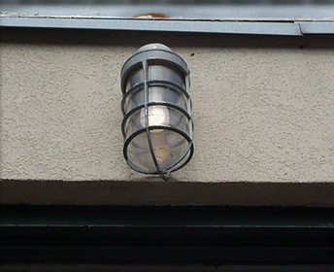
Exterior
Allows guard personnel to observe the unauthorized entry or removal of arm.
Exterior Light Must Be Covered With Wire Mesh Or Made Of A Vandal Resistant Lens.
Provide A Minimum Of 0.2 foot-candles (2lux) illumination
Switch To Light Must Be Inaccessible To Personnel
Notes:
WHEN AN ARMS ROOM IS LOCATED WITHIN ANOTHER SECURE ROOM, THE ENTRANCE TO THE SECURE ROOM WILL BE ILLUMINATED.
Iaw 190-11 5-4 a-(3) LIGHTING PROTECTION

Slide 39
Exterior
Restricted Area Warning Sign
Alarm Warning Sign
Security Lighting
Lautenberg Message (Amendment)
Notes:
What should be posted outside of the arms room.

Slide 40
Lautenberg Amendment
Exterior
Summary court-martial convictions, non-judicial punishment under Article 15, UCMJ, and deferred prosecutions in civilian court do not constitute qualifying convictions within the meaning of the Lautenberg Amendment.
The prohibitions do not preclude a soldier from operating major weapons systems or crew served weapons such as tanks, missiles, and aircraft.
The Lautenberg Amendment application includes Soldiers with privately owned firearms and ammunition stored on or off post.
Soldiers with qualifying convictions may not:
be assigned to positions that would give them access to firearms and ammunition.
attend any service school where instruction with individual weapons or ammunition is part of the curriculum.
may not reenlist and are not eligible for the indefinite reenlistment program.

Slide 41
Check-on-learning
Exterior
Q: A Soldier is given an Article 15 from his Company Commander for getting into a fight with his wife and hitting her. Is this a Lautenberg Violation?
A: No, this is non-judicial punishment and does not constitute a Lautenberg Conviction.

Slide 42
Exterior
Restricted Area Warning Sign
Alarm Warning Sign
Security Lighting
Lautenberg Message (Amendment)
SF 702 For After Hour Security Checks
Notes:
What should be posted outside of the arms room.

Slide 43

Exterior
Armed is defined as having a firearm and appropriate ammunition readily available for immediate use.
A “Whooping” stick does not constitute an armed guard!!
Arms Storage Facilities, Containers And Safes Will Be:
Protected By Ids And Will Be Checked At Least Once Every 8 Hours
or
Under 24 Hour Armed Guard Surveillance
Staff duty and charge of quarters when tasked will document these checks on standard form 702 (security container check list). (Fort Riley Regulation 190-11)

Slide 44
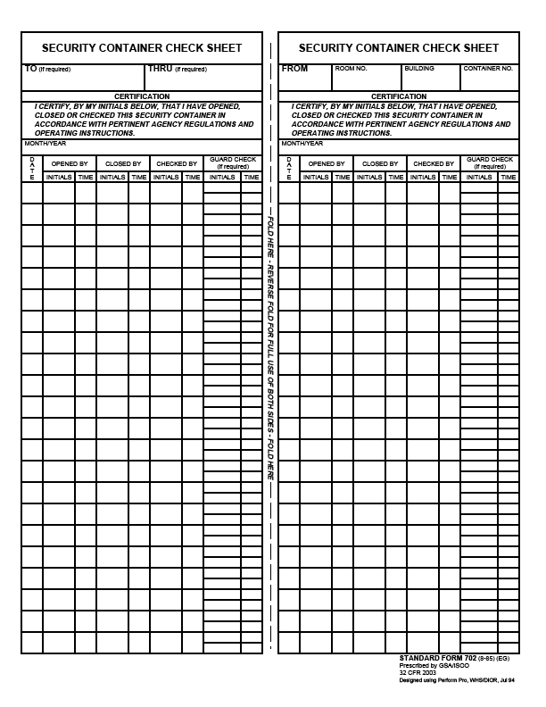
Exterior
Can be used to record opening/closing times of arms room.
SF 702
Required to be used by FR Reg 190-11 to Record After Hour Security Checks
Checking the security of building outer doors and not the vault door doe not meet regulatory requirements.
May 2016
1
LDE
0230
WHW
2230
2
WHW
0415
3
4
5
6

Slide 45
Exterior
Restricted Area Warning Sign
Alarm Warning Sign
Security Lighting
Lautenberg Message (Amendment)
SF 702 For After Hour Security Checks
FR Reg 190-1 (Outside of arms room or posted on unit bulletin board)
Notes:
What should be posted outside of the arms room.

Slide 46
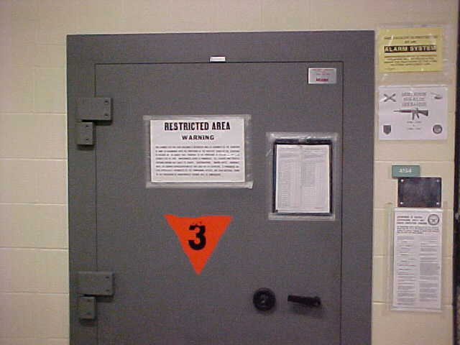
Exterior
Alarm System
Warning Sign
Restricted Area
Warning Sign
Do not post contact
Information of the armorer
Must also have one
posted on the inner
door. When door is open
sign is not visible.
Missing copy of Lautenberg Message
SF 702 Used for Security Checks
Ammunition
Placard (Only required
When storing ammo)
Notes:
Essential element of an arms storage facility
Alerts response force to possible intrusion of a restricted area so that they may respond
Detects, NOT PREVENT, penetration of a restricted area
Permits efficient use of guard personnel, because restricted areas do not have to be guarded 24 hours a day if protected by IDS
Armorers are responsible for activating and deactivating IDS upon entry and exiting of arms room.
Alert alarm monitoring station if alarm is activated for any reason other than an intrusion.
PIC and PIN issue procedures (8-11 Mon-Fri)

Slide 47
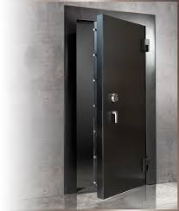
Door Security

Slide 48
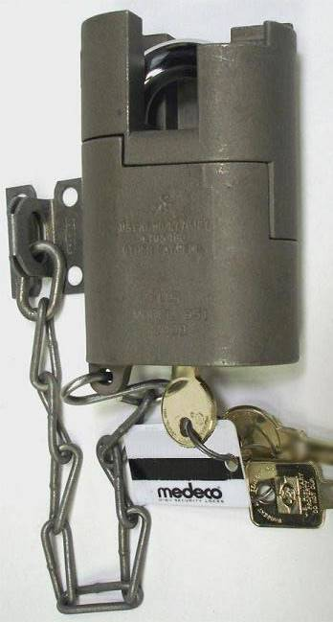
Door Security
High security padlock for approved doors
Placed on most secure Door and Exterior Issue Window (If arms room has one.)
Comes with three (3) keys, two round operational keys and one square maintenance key.
Notes:
MORE ON KEY AND LOCK CONTROL PORTION OF BRIEF.
What regulation (Reg and Paragraph number) covers this?
SHOW EXAMPLE OF HIGH SECURITY LOCK AND MENTION THAT IT COMES WITH 3 COUNT THEM 3 KEYS

Slide 49
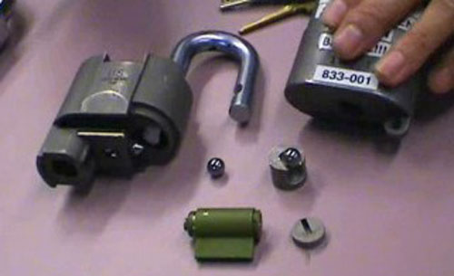
High Security Padlock
Door Security
Do Not Use The Square Maintenance Key For Daily Operations!!!!
It is used to take the lock apart in order to re-core it.
Notes:
MORE ON KEY AND LOCK CONTROL PORTION OF BRIEF.
What regulation (Reg and Paragraph number) covers this?
SHOW EXAMPLE OF HIGH SECURITY LOCK AND MENTION THAT IT COMES WITH 3 COUNT THEM 3 KEYS

Slide 50
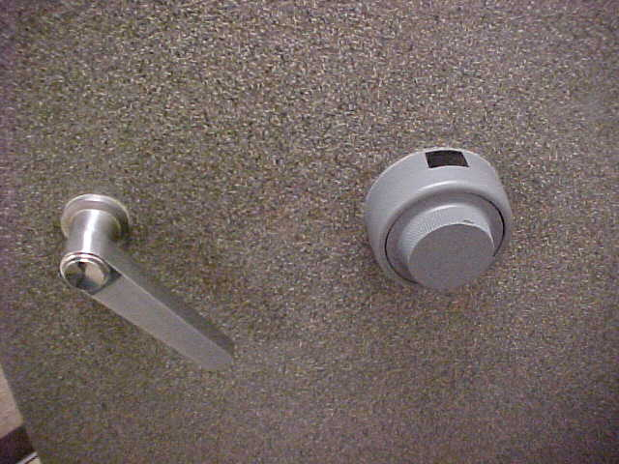
Door Security

Slide 51
Door Security
Combinations Shall Be Changed:
When first placed in use (factory default settings 50-25-50)
Whenever an individual knowing the combination no longer requires access.
When the combination has been subject to possible compromise.
At a minimum annually
Prior to transitioning out. E.g. Move to another bldg., deployment, etc.
To have your combination changed call public works service order desk at 239-0900 or check with your S-2.
Notes:
51

Slide 52
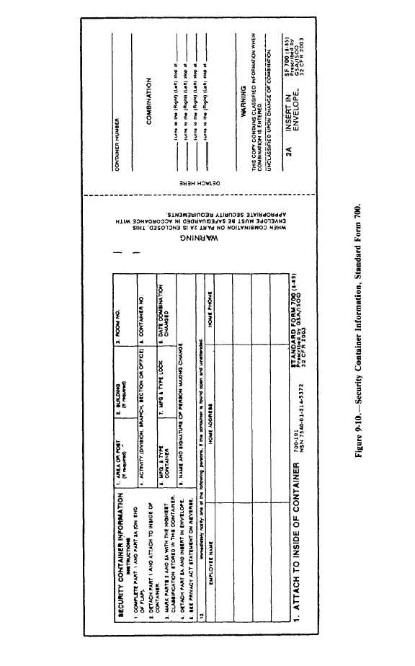
Door Security
SF 700 (security container information) shall be maintained
For each combination.
Part 1 will be completed and posted on the inside of the vault or container.
If this SF700 is for an arms room, the personnel listed here must also be on the unaccompanied access roster.
221
Arms Room
DES
1
Hamilton X-07
12 Mar 16
Joe Locksmith, PW
Jim D. Armorer
232 Milford Drive, Junction City
555-1010
I.B Dmann
111 Crazy Circle, Junction City
555-2526
Notes:
52

Slide 53
Door Security
The combination of the vault or container will be printed part 2a
Arms Room
1
221
DES
1
Hamilton X-07
12 Mar 16
22
Joe Locksmith, PW
45
76
Jim D. Armorer
232 Milford Drive, Junction City
555-1010
I.B Dmann
111 Crazy Circle, Junction City
555-2526
Notes:
53

Slide 54
Door Security
Part 2A will be detached and inserted in the envelope, (part 2)
221
Arms Room
1
DES
1
Hamilton X-07
12 Mar 16
22
Joe Locksmith, PW
45
76
Jim D. Armorer
232 Milford Drive, Junction City
555-1010
I.B Dmann
111 Crazy Circle, Junction City
555-2526
Notes:
54

Slide 55
Door Security
Part 2A will be detached and inserted in the envelope, (part 2)
221
Arms Room
1
DES
1
Hamilton X-07
12 Mar 16
Joe Locksmith, PW
22
45
76
Jim D. Armorer
232 Milford Drive, Junction City
555-1010
I.B Dmann
111 Crazy Circle, Junction City
555-2526
Notes:
55

Slide 56
Door Security
Part 2 will be stored in a different security container.
221
Arms Room
DES
1
Hamilton X-07
12 Mar 16
Joe Locksmith, PW
Jim D. Armorer
232 Milford Drive, Junction City
555-1010
I.B Dmann
111 Crazy Circle, Junction City
555-2526
Notes:
56

Slide 57

Documentation

Slide 58
Documentation
DA Form 4604 (Security Construction Statement):
Existing arms rooms inspected by qualified engineer every 5 years.(AR 190-11 2-2d)
Identifies an Waivers, Exceptions, Compensatory measures in place in order to approve vault storage.
Will be posted inside the unit arms vault.
Form will indicate highest category of weapons that may be stored in the arms room.
POC: Mr. William (Andy) Anderson 239-6672
Notes:
Security Construction Statement DA Form 4604-R
Posted on the wall of an arms room
Signifies the Arms room is constructed with the guidelines listed in AR 190-11
Valid for 5 years
Unit armorer’s responsibility to ensure it is current and valid
Reviewed during physical Security Inspections.

Slide 59
Documentation
Armorer Hand Receipt:
Commander sub-hand receipts all equipment in the arms room down to the primary armorer:
Use DA Form 3161 or system generated property receipt.
Places responsibility / accountability upon individual who has direct control of it.
Clearly identifies what the Armorer is responsible for.
Includes all property to be stored in the vault. NOT just AA&E (e.g. bayonets, compasses, etc.)

Slide 60
Documentation
Unaccompanied Access Roster
Keep the number of personnel on the roster to a minimum.
Command Oriented AA&E Security Screening and Evaluation Record (DA Form 7281) is completed before unaccompanied access is authorized
Command Oriented AA&E Security Screening And Evaluation Record
DA Form 7281
Valid for three years
Does not need to be redone when a new Commander assumes command.
Must be redone when the Soldier transfers to/from another unit.
Notes:
Commanders oriented screening per AR 190-11 para 2-11 consists of:
Commanders interview
Personnel records screening (201)
Medical Records Screening
PMO (Local Files Check)
Civilian Law Enforcement
Commanders evaluation

Slide 61
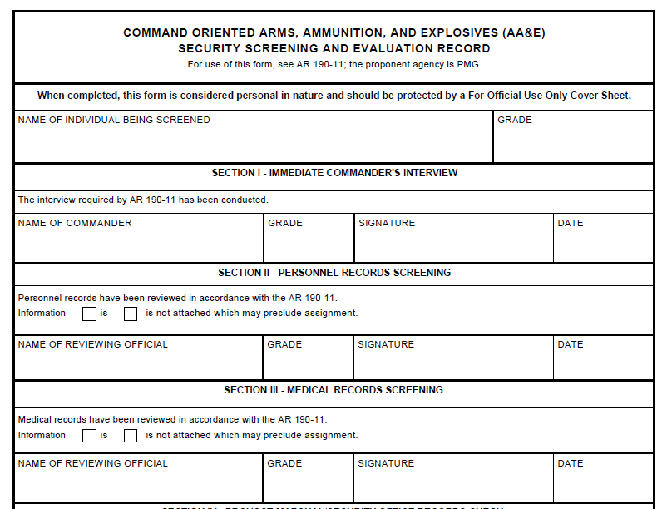
Documentation
Joe Armorer
E-4
John C. Crunch
O-3
John C. Crunch
12 May 16
X
Jane Doe
E-6
Jane Doe
17 May 16
X
Tom D. Medic
E-5
Tom D. Medic
21 May 16
Notes:
Copies of completed 7281s will be kept on file in the arms room for inspection purposes.
Discuss the fact that the Commander starts the investigation by signing Section I and finishes it by signing Section VI. The dates in section II thru V should fall between Section I and VI.

Slide 62
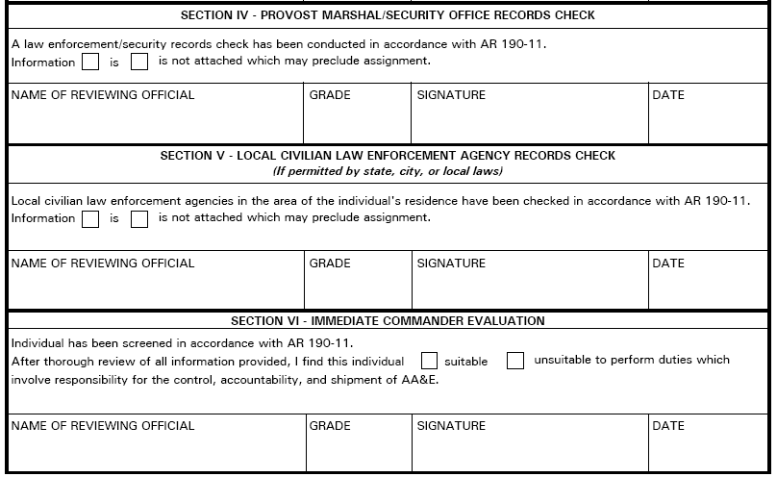
Documentation
X
Rick Dees
CIV
Rick Dees
28 May 16
X
Rick Dees
CIV
Rick Dees
28 May 16
X
John C. Crunch
O-3
John C. Crunch
29 May 16
Notes:
Copies of completed 7281s will be kept on file in the arms room for inspection purposes.
Discuss the fact that the Commander starts the investigation by signing Section I and finishes it by signing Section VI. The dates in section II thru V should fall between Section I and VI.

Slide 63
Documentation
Dates
The dates in section I and VI are the start and end dates of the investigation.
All dates in sections II thru V should fall between the start and end dates.
Notes:
The unit armorer is responsible for enforcing access control by:
Verifying authorization of personnel prior to entry. (Access Rosters)
Providing supervision of personnel while they are in the arms room.

Slide 64
Documentation
Other Access Rosters:
DES Physical Security
Inspector General
Alarm Maintenance Personnel
Notes:
The unit armorer is responsible for enforcing access control by:
Verifying authorization of personnel prior to entry. (Access Rosters)
Providing supervision of personnel while they are in the arms room.

Slide 65
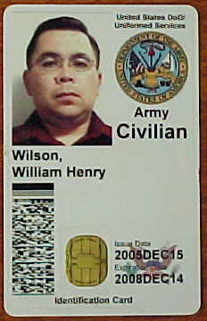

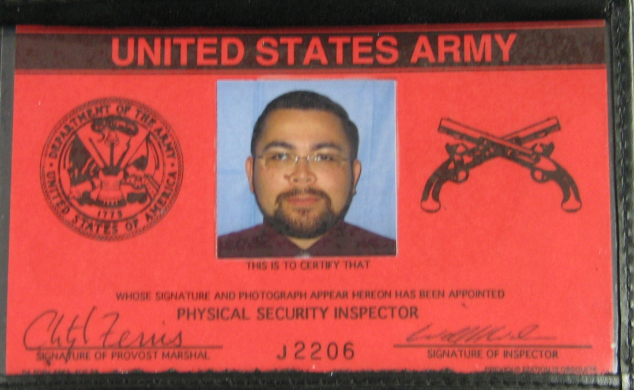

Morgan,
Dexter G.
Always Check Identification To Verify
Access Roster Information.
Notes:
The unit armorer is responsible for enforcing access control by:
Verifying authorization of personnel prior to entry. (Access Rosters)
Providing supervision of personnel while they are in the arms room.

Slide 66
Documentation
Unit must have:
Appointment orders for an AA&E Key Custodian
Two school trained Armorers
Recommended:
Physical Security Officer / NCO

Slide 67

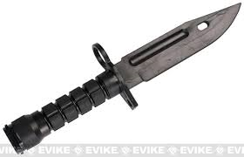
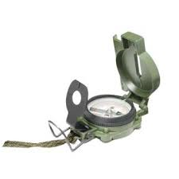
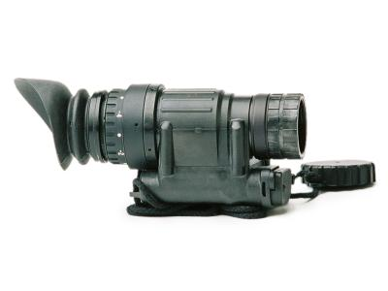
Security Of Additional Property

Slide 68
Additional Property
Tool Such As Hammers, Bolt Cutters, Chisels, Crow Bars And Similar Items Will Not - - -
Be readily accessible.
Be stored in the vicinity of the arms room
Be stored in the supply room when entry to the arms room is located within the supply room.

Slide 69
Additional Property
High-Value Items:
Will not be stored in the arms room when other secure facilities are reasonably available.
When other secure facilities are not available, the Commander must prepare an informal memorandum to the Armorer authorizing the storage of high-value, sensitive items in the arms room
NOTE: If the item is not a weapon, ammo or night vision device it must be listed on the memorandum authorizing it to be stored in the arms room.
Notes:
High Value Items include but are not limited to:
Any items stored in the arms room besides weapons and weapon parts require written authorization from the commander.
MEMORANDUM SHOULD LIST ITEMS AND QUANTITY THE COMMANDER IS AUTHORIZING TO BE STORED IN THE ARMS ROOM.

Slide 70
Additional Property
Pilferable Items:
Readily available civilian equivalent.
May or may not be sensitive items.
Typically don’t have serial numbers assigned to specific items.
Required to be inventoried at same frequency as other property stored in the arms room. (open/closing, change-of-custody, 100% serial number, etc.)
Notes:
High Value Items include but are not limited to:
Any items stored in the arms room besides weapons and weapon parts require written authorization from the commander.
MEMORANDUM SHOULD LIST ITEMS AND QUANTITY THE COMMANDER IS AUTHORIZING TO BE STORED IN THE ARMS ROOM.

Slide 71
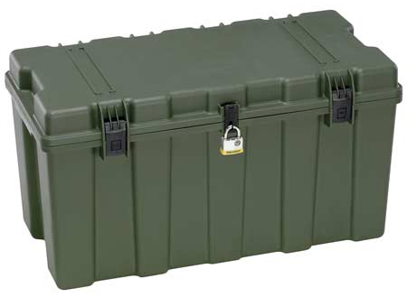
Additional Property
UNIT LETTERHEAD
OFFICE SYMBOL DATE
MEMORANDUM FOR RECORD
On (This Date), 200 M9 Bayonets were sealed in this footlocker using Seal # 12345”
Point of Contact for this memorandum is the unit armorer at 239-xxxx.
Unit Armorer Witness
Signature Block Signature Block
xxxxxxxxxxxxxxxxxxxxxxxxxxxxxxxxxxxxxxxxxxxxxxxxxxx
Recommend using Senior NCO as Witness or Commander.

Slide 72
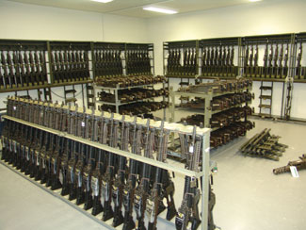
Inventory procedures
AA&E

Slide 73
Inventory Procedures
Monthly 100% serial number inventories conducted by:
Responsible Officer (Commander).
An Officer, Warrant Officer, or Senior NCO appointed by the Responsible Officer
The same person will not be appointed in consecutive months.
Personnel identified on the unaccompanied access roster will not conduct or assist in the inventory.
Notes:
Normally the inventory will be conducted by someone appointed by the commander and not the commander himself, although he is authorized to conduct the inventory.
Inventories conducted by IAW DA PAM 710-2-1 par 9-10 b

Slide 74
Inventory Procedures
Ensure the following items are included in the monthly serial number inventory:
All Privately Owned Firearms and ammunition.
All military ammunition.
All night vision devices (NVDs) and items on the High Value Storage Memorandum.
All accountable property not just sensitive items.
Notes:
Example of the memorandum can be found in the armorer’s quick reference guide (Figure 1-3)
Inventories kept on hand IAW AR 190-11 para 6-2 b(2)(b)1

Slide 75
Inventory Procedures
Inventory documentation:
Results of serial number inventories will be recorded on a memorandum.
Retain the results for 2 years if no discrepancy is noted; 4 years if a discrepancy is noted.
Ensure the person conducting the inventory signs the inventory.
Try to keep the “working copy” of the inventory in the arms room. If you are unable to obtain the “working copy” ensure memorandum is on hand.
Notes:
Example of the memorandum can be found in the armorer’s quick reference guide (Figure 1-3)
Inventories kept on hand IAW AR 190-11 para 6-2 b(2)(b)1

Slide 76
Inventory Procedures
UNIT LETTERHEAD
OFFICE SYMBOL DATE
MEMORANDUM FOR RECORD
On (This Date), I (Rank Name) conducted the monthly 100% inventory for B Btry 1-12 FA. All weapons, ammunition and sensitive items were accounted for, no discrepancies were found during the inventory.
2. The following privately owned fire arms and ammunition were also inventoried:
.50 Cal Desert Eagle SN# 12345
25 round of .50 cal ammunition.
3. Point of Contact for this memorandum is the undersigned at 239-xxxx.
Signature Block
Notes:
Example of the memorandum can be found in the armorer’s quick reference guide (Figure 1-3)
Inventories kept on hand IAW AR 190-11 para 6-2 b(2)(b)1

Slide 77
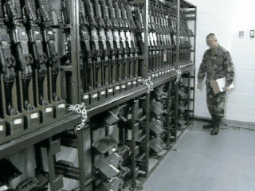
Inventory Procedures
Notes:
Change of Custody inventories IAW DA Pam 710-2-1 para 9-10 a.

Slide 78
Inventory Procedures
Opening / Closing And Change Of Custody Inventories:
Occurs when the responsibility for custody of the arms room or the arms room keys is transferred between authorized personnel.
The person receiving the keys to the arms room will receipt for all AA&E and accountable property stored in the arms room. Results of this inventory will be recorded on DA Form 2062.
The Opening/Closing as well as the Change-of-Custody inventories will be maintained on file until the next monthly 100% serial number inventory.
Notes:
Change of Custody inventories IAW DA Pam 710-2-1 para 9-10 a.

Slide 79
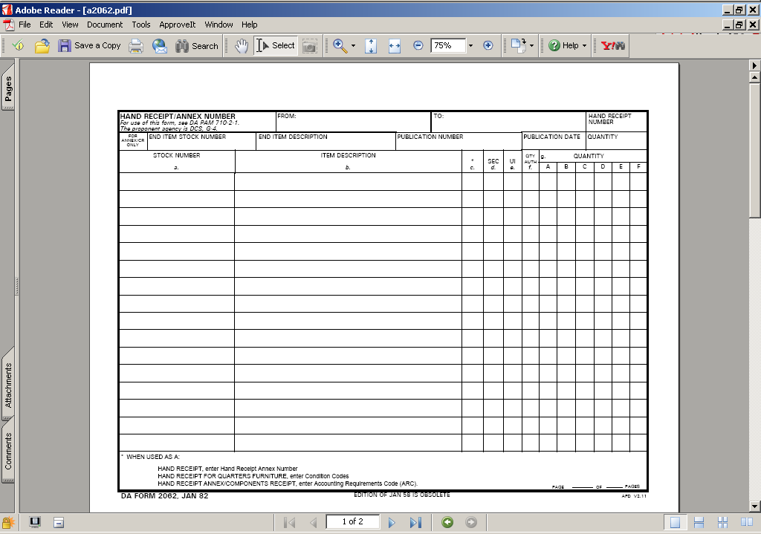
Inventory Procedures
Opening / Closing Inventory
M16A4
ea
55
53
M9
ea
65
65
MK19
ea
6
6
M249
ea
4
4
POW Ruger 9mm SN# 12345
ea
1
1
J. Smith 9 December 2016-----------------\
Notes:
Change of Custody inventories IAW DA Pam 710-2-1 para 9-10 a.

Slide 80
Inventory PE
Inventory Procedures
You are the primary Armorer for A btry 2-32 FA.
Your hand receipt shows you are signed for the following equipment from the btry Commander:
M16-A4 – qty 40
M4 – qty 20
M9 – qty 5
You also have a privately-owned firearm belonging to SPC Snuffy:
.50 cal Desert Eagle pistol serial number 12345
Privately-own ammunition – 25 .50 cal round
Establish a DA Form 2062 to use for inventories.
Notes:
Change of Custody inventories IAW DA Pam 710-2-1 para 9-10 a.

Slide 81
Inventory Procedures
Opening / Closing Inventory
M16A4
40
M4
20
M9
5
POF SPC SNUFFY SN 12345
1
POF AMMUNITION .50 CAL
25
Notes:
Change of Custody inventories IAW DA Pam 710-2-1 para 9-10 a.

Slide 82
Inventory Procedures
As the primary Armorer you are opening the arms room.
You have the following equipment on hand when you open the arms room:
M16-A4 – qty 35
M4 – qty 20
M9 – qty 4
You have a weapons card in each slot for the five missing M16’s and a DA Form 2062 signed by the btry XO for one M9.
All privately-owned weapons and ammunition are accounted for.
Complete your DA Form 2062 for your opening inventory.
Notes:
Change of Custody inventories IAW DA Pam 710-2-1 para 9-10 a.

Slide 83
Inventory Procedures
Opening / Closing Inventory
M16A4
40
35
M4
20
20
M9
5
4
POF SPC SNUFFY SN 12345
1
1
POF AMMUNITION .50 CAL
25
25
Joe D. Armorer 22 Feb 16-----------------/
Notes:
Change of Custody inventories IAW DA Pam 710-2-1 para 9-10 a.

Slide 84
Inventory Procedures
You are the primary Armorer closing the arms room later that afternoon:
All equipment that was signed out has been returned and you have the following items in the arms room:
M16-A4 – qty 40
M4 – qty 20
M9 – qty 5
All privately owned weapons and ammunition are accounted for.
Complete your DA Form 2062.
Notes:
Change of Custody inventories IAW DA Pam 710-2-1 para 9-10 a.

Slide 85
Inventory Procedures
Opening / Closing Inventory
M16A4
40
35
40
M4
20
20
20
M9
5
4
5
POF SPC SNUFFY SN 12345
1
1
1
POF AMMUNITION .50 CAL
25
25
25
Joe D. Armorer 22 Feb 16-----------------/
Joe D. Armorer 22 Feb 16-----------------/
Notes:
Change of Custody inventories IAW DA Pam 710-2-1 para 9-10 a.

Slide 86
Inventory Procedures
You are the assistant Armorer opening the arms room the next duty day.
You have the following equipment on hand in the arms room.
M16-A4 – qty 39
M4 – qty 20
M9 – qty 5
You do not find any hand receipt or weapons cards for the “missing” M16.
All privately owned weapons and ammunition are accounted for.
What do you do next?
Notes:
Change of Custody inventories IAW DA Pam 710-2-1 para 9-10 a.

Slide 87
Inventory Procedures
Opening / Closing Inventory
M16A4
40
35
40
39
M4
20
20
20
20
M9
5
4
5
5
POF SPC SNUFFY SN 12345
1
1
1
1
POF AMMUNITION .50 CAL
25
25
25
25
Joe D. Armorer 22 Feb 16-----------------/
Joe D. Armorer 22 Feb 16-----------------/
John Snuffy 23 Feb 16--------------------/
Notes:
Change of Custody inventories IAW DA Pam 710-2-1 para 9-10 a.

Slide 88
Inventory Procedures
Missing AA&E Actions:
Complete the DA Form 2062.
Stop all operations and notify Commander and 1SG that you came up a weapon short on your opening inventory.
Unit begins investigation to determine accountability of all weapons.
Notify FRPD, Initiate SIR notifications / procedures.
Notes:
Change of Custody inventories IAW DA Pam 710-2-1 para 9-10 a.

Slide 89
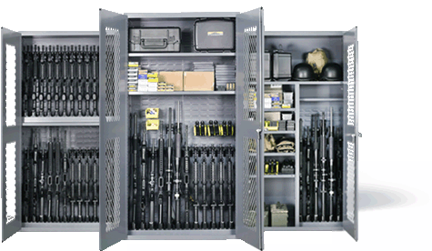
Weapons Storage / Ammunition Storage
Racks / Locks

Slide 90
Racks
When not in use, arms will be stored in banded crates, metal containers, approved standard issue racks or locally fabricated arms racks, and secured in approved weapons storage facilities. Standard issue approved metal wall lockers or metal cabinets may be used (when certified).

Slide 91
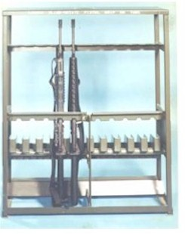
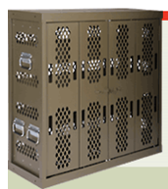
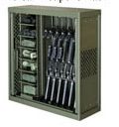
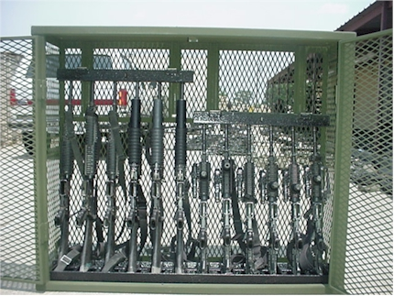
Racks
STANDARD ISSUE
Marvel
Space Saver
War-Tec

Slide 92
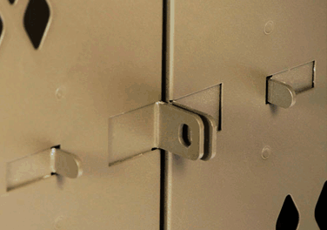
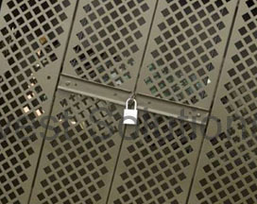
Racks
Marvel
“Push Together”
Space Saver
“Swing Arms”

Slide 93
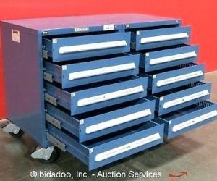
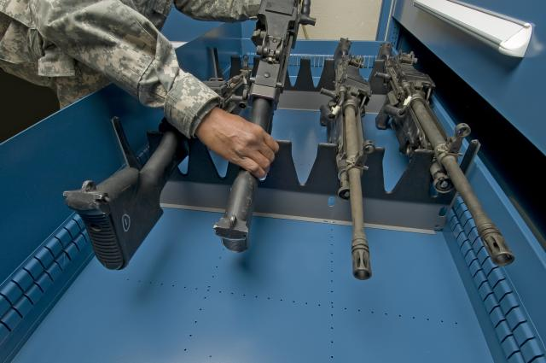
Racks
Stanley-Vidmar
Based on four (4) specific configurations.
Salesman will sell you any configuration.
Approved configurations will have NSN.

Slide 94
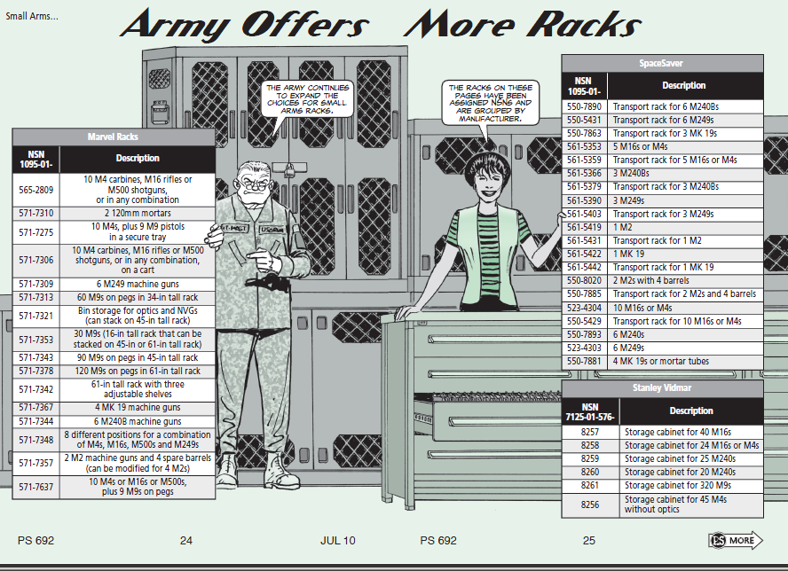
Racks
Authorized Weapons Racks:
Space Saver
Marvel
Stanley Vidmar (limited)
War-Tac

Slide 95
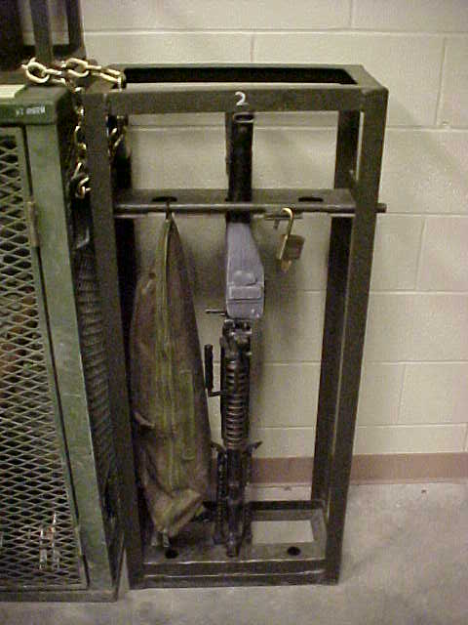
Racks
The use of locally fabricated racks is prohibited unless certified by TACOM as security equivalent to standard issue racks.

Slide 96

Racks
GSA: General Services Administration
Includes all GOV agencies (e.g. Forestry Service, IRS, etc.)
Not a guarantee of meeting DA standards.
Notes:
Iaw AR 190-11 4-2C2

Slide 97
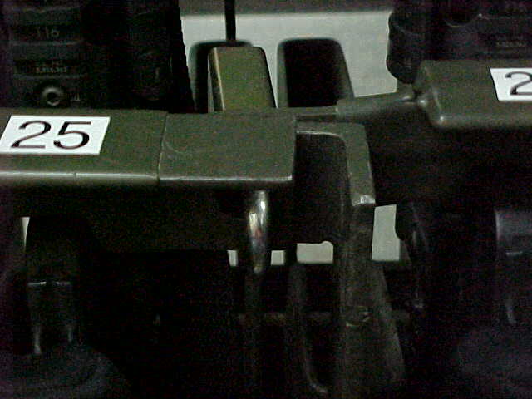
Racks
Incorrect
Notes:
Iaw AR 190-11 4-2C2

Slide 98
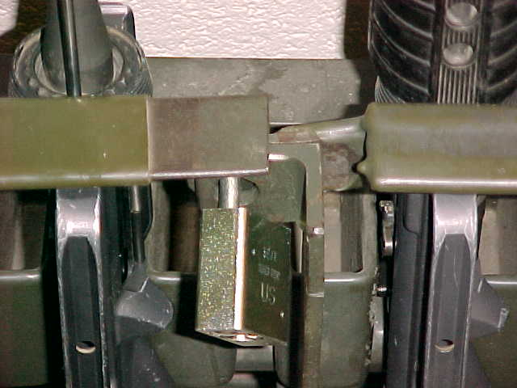
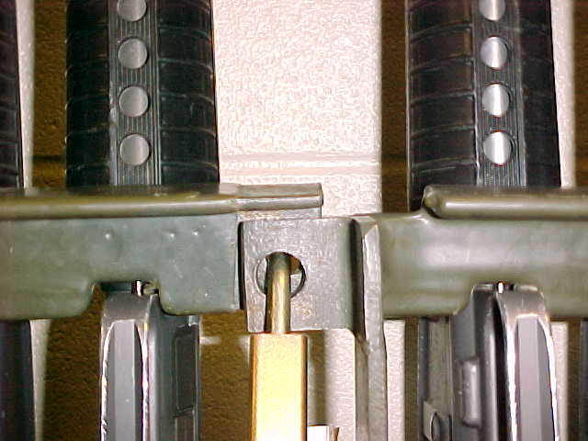
Racks
Correct
Notes:
Iaw AR 190-11 4-2C2

Slide 99

Racks
Naval Universal Racks Modification Required Certification Packet Required

Slide 100


Racks
Re-enforced Door
Locking Shackle (5/16” Hardened Steel)

Slide 101
Arms Rack Certification:
Racks
The Tank and Armament Command (TACOM) based out of Rock Island, IL is responsible for certifying all weapon racks and containers.
Pre-inspection conducted by TACOM Reps.
Unit Completes Paper Work and Forwards to Rock Island, IL
Packets are returned to local TACOM reps
Final Inspection Conducted /Serial Numbers Issued.

Slide 102
Racks
TACOM Local Area Representatives (LARs)
1 ABCT - William “Larry” Saddler – 240-5600 william.l.saddler.civ@mail.mil
2 ABCT - Gary Crippens – 240-0491
Gary.l.crippen.civ@mail.mil
CAB - Steve Baudoin – 240-6016
etienne.j.baudoin.civ@mail.mil
LSE - Randy Garcia– 240-0500 randolph.m.garcia.civ@mail.mil

Slide 103

Racks
Arms racks and containers weighing less than 500 pounds will be secured to the structure with bolts or chains, or fastened together in groups totaling more than 500 pounds. (IAW AR 190-11 para 4-2c(2)
Racks secured together in groups of four is the general “rule of thumb” to meet this standard.
Notes:
HEAVY DUTY HARDENED STEEL, WELDED, STRAIGHT LINKS STEEL, GALVANIZED OF AT LEAST 5/16-INCH THICKNESS.

Slide 104

Racks
Approved Chain to Secure Arms Racks is heavy duty hardened steel, welded, straight links steel, galvanized of at least 5/16–inch thickness.
*NOTE: Steel Cable cannot be used as it is composed of smaller fibers of cable that can be easily cut.
General Rule To Follow:
The chain must be at least as thick as the shackle of your low security secondary padlock. (5200 Series) (Weakest Link Theory)
Notes:
HEAVY DUTY HARDENED STEEL, WELDED, STRAIGHT LINKS STEEL, GALVANIZED OF AT LEAST 5/16-INCH THICKNESS.

Slide 105


Racks
Marvel and Space Saver Weapon Racks
Use Nuts and Bolts that will fit existing holes.
DO NOT widen or drill holes to make them bigger.
Notes:
HEAVY DUTY HARDENED STEEL, WELDED, STRAIGHT LINKS STEEL, GALVANIZED OF AT LEAST 5/16-INCH THICKNESS.

Slide 106


Racks
DA Approved Universal Arms Rack – NSN 1095-01-454-6320
Rack meets the 500lbs weight requirement. Do not cut rack to thread chain.
1 container – cannot store Govt. property AND privately-owned weapons / ammo at the same time.
FYSA – tendency to stack equipment several rows deep. Lax inventory procedures combine to increase larceny risks.

Slide 107

Racks
Ensure You Secure Your Arms Racks And Security Containers Prior To Leaving The Arms Room.
Notes:
Iaw AR 190-11 4-2C2

Slide 108


Racks
Lessons Learned
Motor Pool Gate Found Unsecured By Police Patrol
Three Different Locks “Daisy Chained” Together
Notes:
Iaw AR 190-11 4-2C2

Slide 109
Racks
Chain of Events:
Police Patrol Began Clearing Motor Pool and Found Building Door Unsecured.
Police Patrol Then Began Clearing Unsecured Building
Police Patrol Pulled on Vault Door To Arms Room and Arms Room Door Opened. Combination Dial was not “Spun” to Secure Door!
ICIDS Alarm Sounded (ICIDS Was Activated)
Upon Entering “Unsecured” Arms Room the Following Was Found:
Notes:
Iaw AR 190-11 4-2C2

Slide 110



Racks
Weapons Stored On Top of Weapon’s Racks
All Weapon’s Racks Unsecured
Notes:
Iaw AR 190-11 4-2C2

Slide 111

Issue and turn-in procedures

Slide 112
Issue / Turn-In Procedures
The Armorer must maintain a Master Authorization List (MAL)
The MAL will at minimum list:
Name of the Soldier.
Type and serial number of the primary equipment assigned to the Soldier.
The Armorer will keep the MAL updated to reflect all personnel changes. (living document)
Notes:
MAL – IAW DA Pam 710-2-1 PARA 5-6d(1)

Slide 113



Issue / Turn-In Procedures
Weapon Issue Less Than 24 Hours
Soldier Hands Weapon’s Card To Armorer
Soldier
Armorer

Slide 114

Issue / Turn-In Procedures
Before a weapon is issued, check DA Form 3749 against the MAL to ensure an authorized and correct issue is being made.
HHC 1 ID M16 MAL
Rank Name Rack # Serial #
PFC Jones, J 3 2211
SGT Fielder, M 5 3456
SSG Kruger, F 8 3422
PFC Smith, J 1 1123
1SG Johnson, S 2 2345
SSG Gabriel, R 9 9965
PVT Ubetcha, P 4 8878
HHC 1 ID
1
510-11-322-5565
1123
M16A4
Arms Room
Smith, John
SPC

Slide 115

Issue / Turn-In Procedures
Weapon Issue Less Than 24 Hours
Armorer issues weapons to soldier
Soldier
Armorer

Slide 116
Issue / Turn-In Procedures
Greater Than 24 Hours
Follow Same Procedures As Above
Soldier Must Also Make Entry On Weapon Control Log
(FR Form 43-1)
Armorer
Soldier

Slide 117

Issue / Turn-In Procedures
Weapon Control Log FR 43-1
M16A4
1123
0
9 Dec 16 / 0900
PFC J. Smith
J. Smith
JA

Slide 118
Issue / Turn-In Procedures
Lost Weapons Card
Use hand receipt procedures (DA Form 2062)
Armorer
Soldier

Slide 119
Issue / Turn-In Procedures
Joe D. Armorer
PFC J. Smith
210-01-111-1111
M16A4 SN# 1123
ea
1
1
J. Smith 9 December 2016

Slide 120
Issue / Turn-In Procedures
Lost Weapons Card
Use hand receipt procedures (DA Form 2062)
Soldier must also make entry on weapon control log (FR form 43-1)
Armorer
Soldier

Slide 121
Issue / Turn-In Procedures
Do not use only the FR 43-1 for weapons issue.
It is not a hand receipt. It is only a Control Log for tracking purposes!
The FR 43-1 does not assign responsibility to the soldier.

Slide 122
Issue / Turn-In Procedures
M16A4
1123
0
0
10 Dec 16 / 1010
9 Dec 16 / 0900
PFC J. Smith
J. Smith
JA
J. Smith
JA
M16A4
9083
0
9 Dec 16 / 0905
SGT R. Smith
Roy Smith
JA
M16A4
9873
0
0
10 Dec 16 / 1015
9 Dec 06 / 0906
SGT G. Poe
Grace Poe
JA
Grace Poe
JA
M16A4
6765
0
0
10 Dec 16 / 1017
9 Dec 16 / 0910
SGT W. Wilson
William Wilson
JA
William Wilson
JA
M16A4
3343
0
0
10 Dec 16 / 1019
9 Dec 16 / 0911
SGT J. Fielder
Judy Fielder
JA
Judy Fielder
JA
Completed Control Logs (FR 43-1) are kept on file until the next monthly 100% serial number inventories are complete.
Do not destroy the FR 43-1 if there is still an open entry.

Slide 123
Issue / Turn-In Procedures
Additional Issue Situations
Equipment not assigned to a single, specific individual:
DA Form 2062 and Weapons Control Log.
When a single weapon is needed for issue to more than one Soldier (ex. Squad assigned weapon):
DA Form 3749 for each person authorized to withdraw it and Weapons Control Log.

Slide 124
Check on Learning
Issue / Turn-In Procedures
Q: How would you issue an M4 to a soldier who will be attending Warrior Leaders Course for Two Weeks?
A: Soldier Turns In Weapons Card (DA Form 3749) or Hand Receipt (DA Form 2062), and soldier makes an entry on weapon control log (FR Form 43-1)

Slide 125
Issue / Turn-In Procedures
Check on Learning
Q: How would you issue the Commander’s M9 to his driver so that his driver may clean the Commander’s weapon?
A: Commander’s Driver turn in a hand receipt (DA Form 2062) and makes an entry on the weapons control log since the weapon is not assigned to him on the MAL.

Slide 126
Simple Vs. Complicated * Simple Issue – Only DA Form 3749 (Less Than 24 Hours) * Complicated Issue – Weapons Control Log (FR 43-1) Some Type of Hand Receipt
Issue / Turn-In Procedures

Slide 127

Privately owned Weapons
Storage and Control of POW’s

Slide 128


Privately Owned Weapons
Firearm
Any revolver, pistol, rifle, shotgun, or other device designed for or capable of propelling a bullet or other projectile by means of an explosive or compressed charge.
Weapon
Anything designed or used for inflicting bodily harm or physical damage.
Privately-Owned Weapon
Any weapon in the possession of an individual, other than authorized military weapons in an individual’s possession as part of official military duties.
Notes:
128
Cross bows, Bows, Knives, Swords, Slingshots are not required to be registered on the installation.

Slide 129
Privately Owned Weapons
Applicable Regulations:
AR 190-11 para 4-5: prohibits POFs unless policy designated in writing by Senior Commander.
FR 190-1 (Dated: 3 Apr 2018): Fort Riley specific regulation titled Privately Owned Weapons, Explosives and Ammunition.
Unit Requirements:
FR Form 102 maintained on file until the Soldier/Family Member departs the organization.
Have policies, plans and procedures in place for storing privately owned weapons. Plan tailored by the CDR for their specific situation based on mission, facility space, etc.…
NEW REGULATION
APR 2018!
Notes:
Are POFs store in a separate container from government weapons?
Is private ammo stored separate from GOV ammo?
Does the current CDR/1SG know who has POFs?
Does the armorer have a list of who in the unit have authorized POFs registered and store elsewhere? Quarters, BEQ, BOQ.
You can not require a Soldier to register POF on post if the firearm is never brought on the installation.
You can not authorize a Soldier in the barracks to store his POF elsewhere on the Installation besides the Arms Room.
Transported directly to and from authorized activities. Range, hunting, dog training area, others to be designated by SMC

Slide 130
Privately Owned Weapons
Compliance:
Military personnel who fail to comply with this regulation are subject to judicial or non-judicial action under the Uniform Code of Military Justice (UCMJ), or appropriate administrative action.
Government employees and civilians who violate this regulation may be subject to prosecution in the United States District Court, barred from post, referred to civilian authorities, and/or subject to disciplinary and administrative action according to federal laws and regulations.
Weapons used, possessed, transported, or stored in violation of FR 190-1 may be temporarily seized or permanently confiscated.
Legally owning National Firearms Act (Class III) weapons does not mean they can be used on post – review FR 190-1 for clarification
It is unlawful for any person to:
(1) Fail to register, store, or transport a firearm on Fort Riley in accordance with FR 190-1.
(2) Possess an item on Fort Riley that is prohibited by FR 190-1.
Any violations will be investigated and forwarded to the appropriate authorities for action.

Slide 131

Privately Owned Weapons
Three Step Registration Process
Validate POF is legal (5 Day Temporary Registration)
Obtain Commander’s permission by completing FR form 102
Complete registration process at Visitor Control Center (Henry ACP, I-70 exit 301)
Notes:
Are POFs store in a separate container from government weapons?
Is private ammo stored separate from GOV ammo?
Does the current CDR/1SG know who has POFs?
Does the armorer have a list of who in the unit have authorized POFs registered and store elsewhere? Quarters, BEQ, BOQ.
You can not require a Soldier to register POF on post if the firearm is never brought on the installation.
You can not authorize a Soldier in the barracks to store his POF elsewhere on the Installation besides the Arms Room.
Transported directly to and from authorized activities. Range, hunting, dog training area, others to be designated by SMC

Slide 132
Privately Owned Weapons
Transporting Firearms:
The carrying or transportation of a loaded firearm is prohibited. Any weapon with any ammunition in the breech, chamber, cylinder, magazine, or other loading mechanism attached to the weapon shall be considered loaded for the purposes of this regulation.
A muzzle loader is considered unloaded when the firing cap or priming powder is removed, rendering it unable to fire.
Firearms will be transported in a compartment of the vehicle that is inaccessible to all passengers in the vehicle. If no inaccessible area exists, the firearm will be transported in a closed case that is in open view and the ammunition stored separately. A glove compartment or center console is not considered a closed case. In all circumstances, ammunition will be separate from the firearm.
Firearms used for authorized recreational activities North of Vinton School Road may be transported in the passenger compartment of a vehicle as long as they are unloaded and cased, and only while the possessor of the firearm(s) is actively engaged in hunting, as defined in FR Reg 210-15.
Firearms left in an unattended and unsecure vehicle may be confiscated by law enforcement personnel.

Slide 133


Privately Owned Weapons
After Obtaining/Purchasing Firearms:
Anyone entering the installation in possession of a firearm (registered or not registered) must declare possession at the gate.
Guards will assist with unregistered firearms by issuing a 5 day temporary registration.
Patrons who purchase a firearm at PX will also be issued a 5 day temporary registration.
Soldiers who have firearms shipped in their household goods can stop by the police station to obtain a form that will authorize transporting the unregistered firearms to bldg 219.
Commanders must know who has registered firearms and maintain a completed copy of FR 102.
Notes:
Are POFs store in a separate container from government weapons?
Is private ammo stored separate from GOV ammo?
Does the current CDR/1SG know who has POFs?
Does the armorer have a list of who in the unit have authorized POFs registered and store elsewhere? Quarters, BEQ, BOQ.
You can not require a Soldier to register POF on post if the firearm is never brought on the installation.
You can not authorize a Soldier in the barracks to store his POF elsewhere on the Installation besides the Arms Room.
Transported directly to and from authorized activities. Range, hunting, dog training area, others to be designated by SMC

Slide 134
Privately Owned Weapons
Other Firearms:
Paintball and Airsoft do not have to be registered. Crossbows, swords, bows and other such items are not firearms and are not registered, but are weapons. No weapons, ammunition, or explosives are authorized to be stored in the barracks.
BB and Pellet guns MUST be registered, stored, and transported as a firearm.
Firearms Authorized to Register/Store but not to use on Fort Riley.
Automatic firearms and machine guns are required to be registered but are prohibited to be used on Fort Riley. They are defined as any weapon which shoots, is designed to shoot, or can be readily restored to shoot, automatically more than one shot, without manual reloading, by a single function of the trigger.
The term shall also include the frame or receiver of any such weapon, any part designed and intended solely and exclusively, or combination of parts designed and intended, for use in converting a weapon into a machine gun, and any combination of parts from which a machine gun can be assembled if such parts are in the possession or under the control of a person.

Slide 135
Privately Owned Weapons
Prohibited Items/Practices:
Any "brass knuckles" or "knucks.“ Blackjacks, saps, cudgel type weapons or clubs, nightsticks, riot batons, homemade clubs, and expandable batons. Nunchakus, throwing stars, throwing spikes, shurikins, swords, kung fu sticks, garrotes, or other related martial arts weapons.
Personnel may possess or use nunchaku and kung fu sticks only in connection with martial arts training, practice, and exhibitions. They will not be used in a threatening manner and may never be carried in a concealed manner. Personnel residing in the barracks will store such item(s) in the unit arms room.
Any Taser, stun gun, cattle prod or other device designed to deliver an electrical shock.
Any razor, ice pick, or letter opener carried in a concealed manner. This includes the following items: sword canes, sword umbrellas, penknives, lipstick knives, and any other blade that is disguised to resemble everyday items.
Dummy hand grenades/IEDs. (Military training aids are exempted and are required to be maintained by and at military organizations in a controlled environment)

Slide 136
Privately Owned Weapons
Prohibited Items/Practices cont.:
Any poisonous gases, pyrotechnics, explosives or incendiary devices of any type (other than ammunition for firearms) including simulators, exploding targets (Tannerite), fireworks, and grenades, except when authorized for military use.
Any type of weapon by whatever name known which will, or which may be readily converted to, expel a projectile by the action of an explosive or other propellant, the barrel or barrels of which have a bore of more than one-half inch in diameter, except a shotgun or shotgun shell which the Director finds is generally recognized as particularly suitable for sporting purposes
Any combination of parts either designed or intended for use in converting any device into a destructive device and from which a destructive device may be readily assembled. No destructive device, to include gunpowder and primers for reloading / muzzle loading will be maintained in barracks.
Armor-piercing ammunition as defined by the ATF. Any ammunition that has been designed, manufactured, or adapted for the purpose of defeating metal armor of any type or soft body armor, such as worn by law enforcement personnel..
Note: In family housing on Fort Riley (not barracks) gunpowder for legitimate reloading or muzzle loading weapons are authorized as ammunition. Possession and storage of reasonable amounts not more than 1 lb (0.454 kg) of commercially manufactured sporting black powder or 20 pounds (9 kg) of smokeless powder for hand loading of small arms ammunition for personal use is authorized. May not be stored in Arms Rooms

Slide 137



Privately Owned Weapons
Prohibited Items/Practices cont.:
The open carry of any weapon within the Fort Riley cantonment area is prohibited except at authorized ranges and authorized areas.
The carrying of a concealed weapon on Fort Riley is prohibited regardless of whether a state or county permit has been obtained.
State Policies:
KS / MO – No state registration / Constitutional Carry
Ok – Reciprocal based on residency
CO, NE – Reciprocal based on CC license
Check local laws for specifics

Slide 138
Privately Owned Weapons
QUICK REFERENCE:
For a summary of which category a specific item falls, whether it requires registration, and if it can be brought onto Fort Riley, reference FR 190-1 Appendix E.
For all Fort Riley forms, regulations, pamphlets, supplements, and the CG Policy Letters go to: http://www.riley.army.mil/News/Article-Display/Article/472159/fort-riley-publications/
Select the item you wish to view and log in. The FR 102 can be found under forms and the 190-1 under regulations.

Slide 139
Privately Owned Weapons
FR 102-2 (MAR 2018)
Register up to 5 firearms per form
Valid for 5 calendar days
Required in order to receive permanent registration. (Commanders should not approve 102-1 without verifying the approved 102-2)

Slide 140
Privately Owned Weapons
FR 102-1 (MAR 2018)
Register up to 6 firearms per form
Valid for 3 years (All)
Commander must maintain copies of the forms for personnel within the organization. (Generally maintained by the Unit Armorer)

Slide 141
Privately Owned Weapons
Commanders Responsibilities:
Brief all newly assigned personnel on this regulation and ensure that members of their command are briefed on any changes to this regulation, Federal laws, state laws, or local ordinances.
Establish in and out-processing procedures at the unit level to identify if Soldiers in the command and Family Members they sponsor who reside on the installation own or possess a firearm requiring storage on the installation or those who reside off the installation have a need to bring a firearm on the installation. Establish unit SOP for POFs.
Make decisions on the appropriate storage location of firearms on request approvals by appropriate annotation on FR 102-1.
Ensure POFs and ammunition in the arms room are inventoried at the same frequency as military weapons and ammunition. (Add to monthly serial number inventory)
Provide written authorization to store and remove POFs, ammunition and other privately owned weapons in the arms room.
Notes:
141

Slide 142
Privately Owned Weapons
Commanders Responsibilities cont.:
Maintain records of all approved FR 102-1 of Soldiers in the command and their immediate Family members. Once the firearms are registered through DES, the Soldier will return the FR 102-1 to the Commander. (Generally maintained by the Unit Armorer)
Establish and identify individual limits on the quantity and type of privately owned ammunition that may be stored in the arms room, based upon availability of space and safety considerations. Limits must be annotated in the unit arms room standing operating procedures (SOP).
Ensure the security and control of privately-owned firearms that are stored in the unit arms room.
Secure privately owned weapons and ammunition in unit arms rooms in locked containers separate from military arms, ammunition, and explosives.
Conduct unannounced inspections of their unit areas to include parking areas to ensure that proper storage of weapons and registration of firearms is being accomplished.
Immediately notify the Military Police (MP) Desk Sergeant upon discovery of a loss of accountability for privately owned firearms stored in the unit arms room.

Slide 143
Privately Owned Weapons
Armorers Responsibilities:
Meet the storage requirements of FR 190-1 Appendix B.
Sign for POF from owner and give owner hand receipt. Issue owner DA Form 3749 (equipment receipt) in order for owner to draw POF in the future.
Ensure written permission is received from the unit commander prior to issuing the POF.
Ensure same issuance procedures are followed when issuing a POF as you would when issuing a military weapon.
Ensure POFs and civilian ammunition are stored separately from military weapons and ammunition. The are required to be stored in an approved container for AA&E.
Inventory POFs and other privately owned weapons at the same frequency as Government owned AA&E
Maintain accountability of temporary release authorization documents for 90 days and permanent removal documentation for 2 years.
Notes:
143
IAW AR 190-11 4-5 a(1)

Slide 144
Privately Owned Weapons
Check on Learning
Q: I have a state issued concealed carry permit. Can I conceal carry on Fort Riley?
A: No. The only people authorized to conceal carry are Law Enforcement Officers on the installation, while in the performance of official duties. FR Reg 190-1
Notes:
144
IAW AR 190-11 4-5 a(1)

Slide 145

Privately Owned Weapons
Check on Learning
Q: Can I possess and utilize a suppressor / silencer on Fort Riley?
A: Yes. Suppressor’s and Silencers are authorized under FR 190-1. However, the owner/user must have valid stamps / Registrations / Permits.
Notes:
145
IAW AR 190-11 4-5 a(1)

Slide 146
Privately Owned Weapons
Check on Learning
Q: My Company Commander has given me permission to carry because of a specific threat to me and my family. Is that memorandum OK?
A: No. The Senior Commander (DIV CDR) is the approving authority.
Notes:
146
IAW AR 190-11 4-5 a(1)

Slide 147

Privately Owned Weapons
QUESTIONS?

Slide 148
Day 3 Pre-View
Key Control
PS Equipment
Crime Prevention
Course Review

Slide 149


QUESTIONS?
COMMENTS?
CONCERNS?

