Slide 1


PHYSICAL SECURITY OFFICERS (PSO) COURSE
DAY 3
Presented by:
Fort Riley Security Branch
Notes:
Introduction to Class

Slide 2
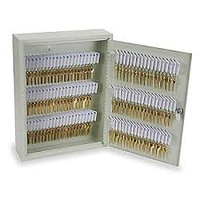
KEY, LOCK, AND COMBINATION CONTROL
Administrative and AA&E

Slide 3
Fact or Fiction
The serial number on the lock cannot be the same as the serial number on the key.
FICTION
AR 190- 51, app D and AR 190-11, para 3-8 n. state, “Padlocks and keys which do not have a serial number will be given one. This number will be inscribed on the lock or key as appropriate.” New Master locks have the same serial number on both the lock and key.

Slide 4
Fact or Fiction
The key ring used must be a solid braised (welded) metal key ring.
FICTION
Neither AR 190-51 (admin) nor AR 190-11 (AA&E) require keys be on any type of ring, string or cable.

Slide 5
Fact or Fiction
Staff Duty or the S2 is the key and lock control custodian for the unit.
FICTION
Staff Duty is only the keeper of the locked ammo can during non-duty hours. In the case of the S2, they are only securing the locked and sealed container with the spare keys in them.

Slide 6
Fact or Fiction
I cannot list where the locks are located at in the arms room on the DA Form 5513. (Ex. Key Number #1, goes to lock #1 which is on M16 rack #2)
FICTION
AR 190-51, app D and AR 190-11 para 3-8 n state, “A key and lock inventory will contain a record of keys, locks, key serial numbers, lock serial numbers, location, and the number of keys maintained for each lock. This record will be secured in the key depository.”

Slide 7
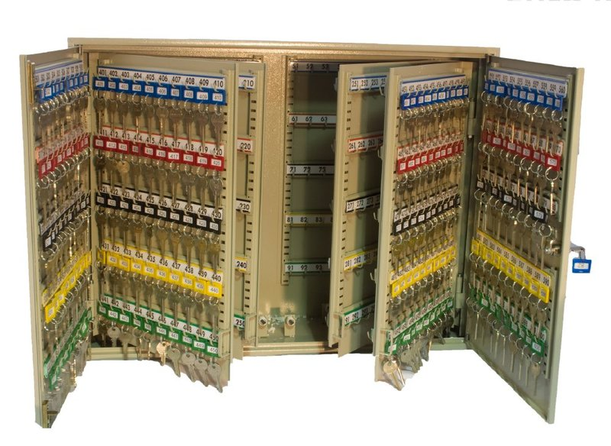
Administrative Key Control

Slide 8
Admin Key Control
Primary or alternate key custodian
Be appointed in writing
Ensure individuals designated to issue, receive, and account for keys clearly understand key control procedures
Maintain a key control register at all time to ensure continuous accountability
Be listed on an access roster

Slide 9
Admin Key Control
Key Control Register
Keys will be signed out to authorized personnel as needed.
DA Form 5513 is approved for use.
Kept in a locked container when not in use not storing classified material.
Key Depository (Key Box)
Lockable container such as a safe or filing cabinet
Key depository made of at least 26 gauge steel
Permanently affixed to a wall
Located in a room kept under 24 hour surveillance or locked when unoccupied

Slide 10
Admin Key Control
Accountability
Keys will be reconciled at the end of the duty day.
Inventory by serial number semi-annually.
Inquiry will be conducted when key is lost or missing.
*Padlocks will be replaced or re-cored immediately.
A key and lock inventory will be maintained which includes a list of all of the following:
Keys
Locks
Key Serial number
Lock Serial Number
Location of locks
Number of keys maintained for each lock

Slide 11
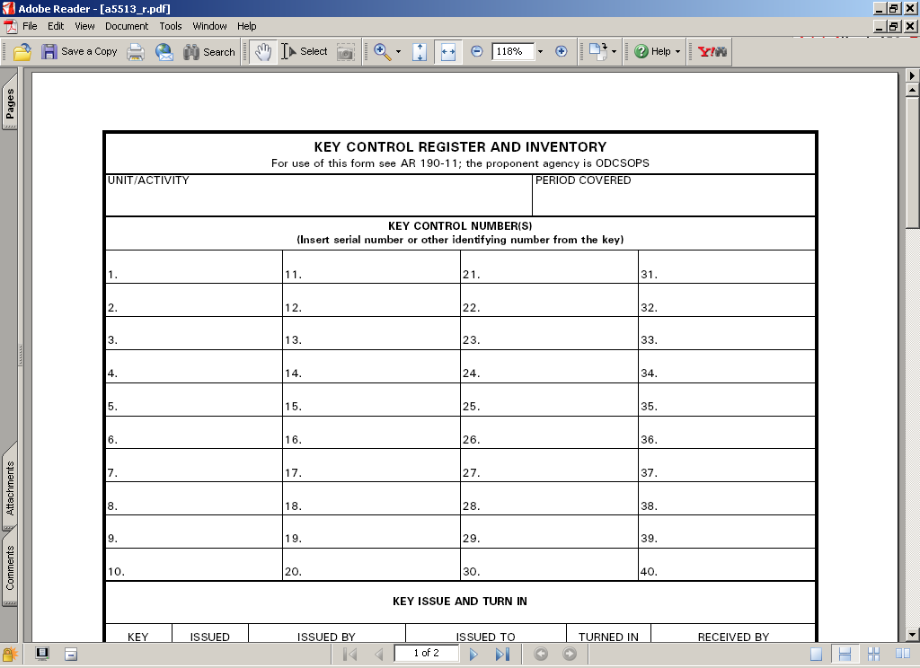
Admin Key Control
Example
Keys
HHT Sample Unit
Locks
Key Serial Numbers
5513H (4)
Supply Room
Lock Serial Numbers
9908H (4)
1SG Office
Location of Locks
45674 (4)
Commander’s Office
Number of Keys

Slide 12
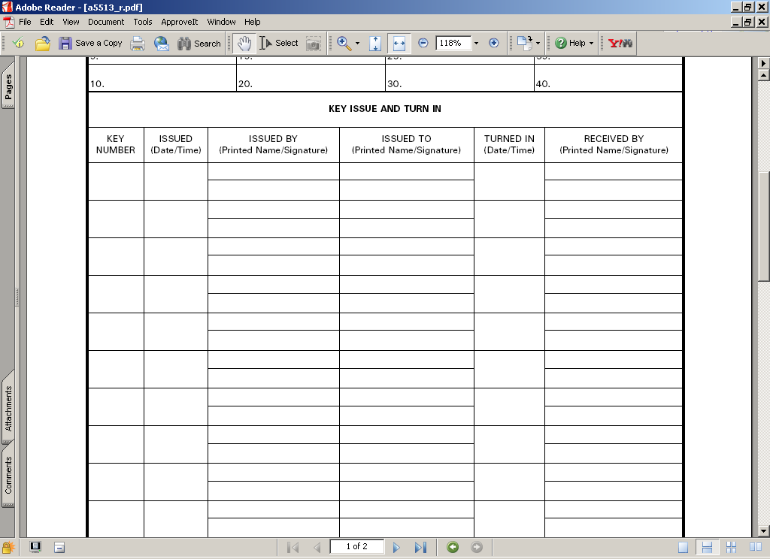
Issuing Keys
Admin Key Control
2,3
5 Aug 16
1430
Key Control Custodian
1SG Emmit Smith
Key Control Custodian
Emmit Smith
2
5 Aug 16
1530
Key Control Custodian
SSG Duncan
Key Control Custodian
SSG Duncan

Slide 13

Admin Key Control
Inspecting Key Control
Inspector verifies all keys are accounted for.
Total keys – keys signed out = keys retained in key box.
Random sampling from key box
100% validation
Verify all information is recorded on the register
Printed and signed name
Date and time issued
Date, time and individual accepting return
Verify inventories conducted.
FLIPL’s initiated for any keys missing?
Replacement locks for those compromised?

Slide 14
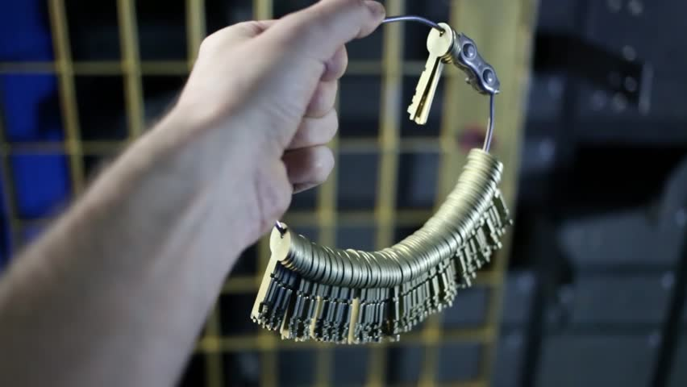
AA&E Key Control

Slide 15
AA&E Key Control
AA&E Key Control Custodian
Required to have a DA Form 7281-R completed prior to assuming duties as AA&E Key Custodian.
Be appointed in writing to issue and receive keys and account for keys.
Issues primary keys to Armorer and spare set to HHQ (S-2)
Ensure that individuals who are designated to issue keys in their absence, clearly understand key control procedures.
Maintain a key control register at all times to ensure continuous accountability for keys of locks used to secure Government property.
Inventory Keys at a minimum Semi-annually.
Conduct an inquiry when a key is lost or stolen.

Slide 16
AA&E Key Control
UNIT: HHT 1-4 CAV
44322 High Security Padlock Main Door
1234H M16 Rack 1
5678H M16 Rack 2
1122B M9 Rack 1
Key Serial Number
Lock Location
Input Unit Information
Lock Number 1
Number of Keys
HHT 1-4 CAV
44322
(3)
Arms Room Door
1234H
(2)
M16 Rack 1
5678H
(2)
M16 Rack 2
1122B
(2)
M9 Rack 1

Slide 17





Issuing AA&E Keys
AA&E Key Control
Primary Keys
Armorer
AA&E
Key Custodian
Spare Keys
BN S-2

Slide 18
AA&E Key Control
1-24
0900
14 Jul 16
Key Custodian Print
Armorer Print
Key Custodian Sign
Armorer Sign
Seal#
12345
0920
14 Jul 16
Key Custodian Print
S-2 Print
Key Custodian Sign
S-2 Sign
Primary Keys Issued To Armorer
Spare Keys Issued To S-2
All Keys Are Now Issued and Accounted For Properly!

Slide 19
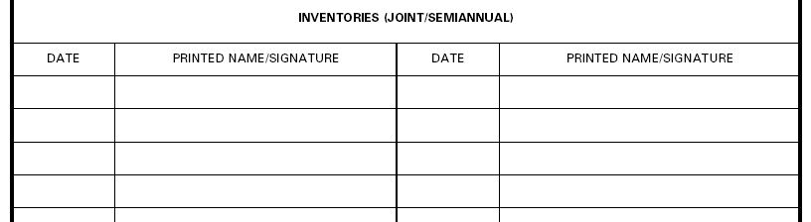
AA&E Key Control
14 Jul 16
Key Control Custodian Sign
Key Custodian Signs and Dates When Keys Are First Inventoried. This Is The Benchmark For Future Semi-Annual Inventories.

Slide 20
AA&E Key Control
Unit Armorer Responsibilities:
Sign For Operational Set Of Keys
Ensure Keys Are Never Left Unattended.
Ensure Keys Are Never Taken Off-post (Off The Installation) Unless They Are Being Secured At Another Location
Report Immediately All Lost, Misplaced, Broken Or Stolen Keys To The AA&E Key Lock Custodian.
Ensure Keys Are Properly Secured At The Close Of Business Each Day.
Ensure Keys Signed for at all times.
NOTE: Getting keys from Staff Duty is NOT signing for the keys.
Notes:
20

Slide 21
Armorer’s DA Form 5513 Setup.

Slide 22
AA&E Key Control
Armorer’s DA Form 5513 Inside Ammo Can
HHT 1-4 CAV
44322
Arms Room Door
1234H
M16 Rack 1
5678H
M16 Rack 2
1122B
M9 Rack 1

Slide 23
Transfer of Arms Room Keys
AA&E Key Control
0900
14 Jul 16
Primary Armorer Print
Alt Armorer Print
0900
14 Jul 16
Primary Armorer Print
1-4
Primary Armorer Sign
Alt Armorer Sign
Primary Armorer Sign
1-4
Primary Armorer Print
Primary Armorer Sign
Used When Arms Room Keys are Transferred Between Two Authorized Personnel
Coincides with opening and closing inventories.
Notes:
Example of 5513 when custody of keys is transferred between authorized personnel. Alt Armorer signs for keys when taking the vault.
When identified that keys are sign by other Armorer…must take possession back by signing for them.
Pre-sign in the event their not present for next time.

Slide 24
AA&E Key Control
Key Turn-In Procedures
Keys signed back in to AA&E Key Custodian on DA Form 5513.
or
Keys placed in a locked ammo can, and the locked ammo can is signed for on DA Form 5513 to Staff Duty or CQ as “Key Box”. Staff Duty/CQ not authorized to sign for actual keys.

Slide 25
AA&E Key Control
DA Form 5513 At Staff Duty Desk
HHT 1-4 CAV
Locked Ammo Can
Staff Duty is Only Maintaining a Locked Ammo Can (Contents Unknown)

Slide 26

Issuing Locked Key Box to Staff Duty
AA&E Key Control
Staff Duty
Primary Keys
Armorer
Primary Key Box

Slide 27
Signing for Ammo Can
AA&E Key Control
1
0700
14 Jul 16
Staff Duty Print
Armorer Print
1700
14 Jul 16
Staff Duty Print
Staff Duty Sign
Armorer Sign
Staff Duty Sign
Picking Up Keys From Staff Duty
Returning Keys To Staff Duty
Key to AA&E “lock box” / “ammo can”
May be “permanently” issued. Not required to turn in at EODD.
Is considered an Admin Key and issued by Admin Key Custodian.

Slide 28
AA&E Key Control
Authorized storage locations of AA&E keys
20 Gauge Steel Key box equipped with a low security padlock. Same as standard key box. Requires hasp addition for lock.
Located in a room that is secured when unoccupied
GSA Class 5 or Class 6 container with a built in 3 position changeable combination lock.
Container will not contain classified material
If the container weighs less than 500 lbs it will be chained to the floor or building
Typical storage of spare keys at S-2
Keys stored in an ammo can (20 gauge steel) with low security padlock and
Chained to an eyebolt in the floor at the staff duty / CQ desk
or secured in safe

Slide 29
AA&E Key Control
Case Study
Unit Rear-d Armorer With Access To Exterior Arms Vault
Brought Aa&e Keys With Him To Lunch Off The Installation
Could Not Locate Keys After Lunch
Searched Car, Barracks Room, Subway Could Not Locate Keys
Retrieved Spare Set Of Keys From S2, Spare Keys Did Not Work. They Were Never Shown Any “Love”
Called Pw To Gain Access To Vault. Pw USED PLASMA CUTTER

Slide 30

AA&E Key Control
Cost Break Down:
$2500 To Cut High Security Hasp And Padlock Off Vault Door And Have Door Recertified
$700 For High Security Padlock
35 Low Security Padlocks At $8 Each -- $360
Total Cost: $3,560
Cost Of A Good AA&E Key Control Program: Priceless!!!!

Slide 31
Hands On Key Control Practical Exercise.

Slide 32
AA&E Key Control
Practical Exercise # 1
SFC Roy Jones Is The AA&E Key Custodian For
B Btry 1-12 FA
The Following Keys Are Used In The Arms Room:
23456 - High Security Padlock
2322H - Inner Door
5443B - M16 Rack 1
2722H - M16 Rack 2
6788B - M9 Rack 1
6777G - M9 Rack 2
1233G - POF Locker
2233P - Ammo Can Lock
Seal #12388
*You are the Primary Armorer
*SGT Ricky Steamboat is the S2

Slide 33
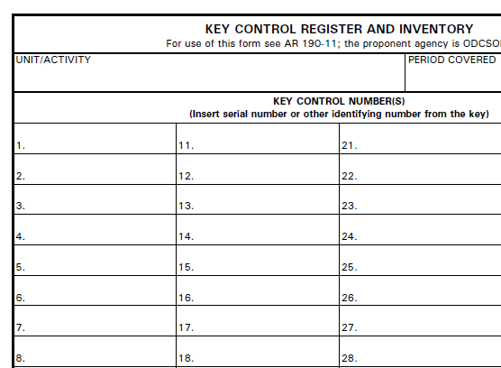
AA&E Key Control
B Btry 1-12 FA
23456 (3)
High Security Padlock
2322 H(2)
Arms Room Inner Door
5443B (2)
M16 Rack 1
2722H (2)
M16 Rack 2
6788B (2)
M9 Rack 1
6777G (2)
M9 Rack 2
1233G (2)
POF Locker
2233P (2)
Ammo Can
Admin Key!! Not Added to AA&E DA Form 5513

Slide 34
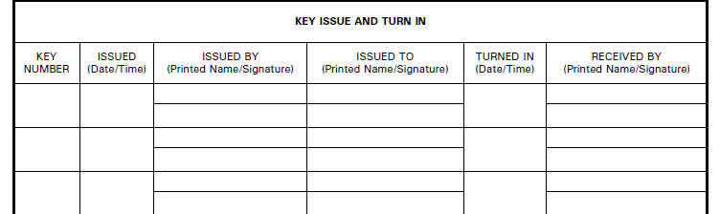
Answers
1500
1 Apr 2016
Jones, Roy
Primary Armorer
1-7
Roy Jones
Primary Armorer
Seal #
12388
1530
1 Apr 2016
Jones, Roy
Steamboat, Ricky
Roy Jones
Ricky Steamboat

Slide 35
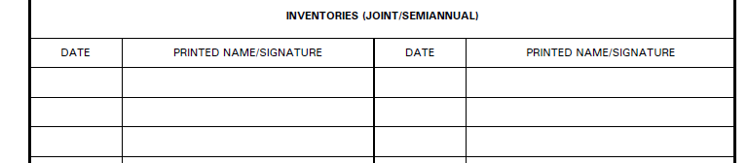
Answers
1 Apr 2016
Roy Jones

Slide 36
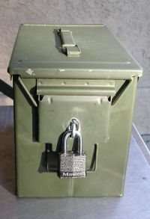
AA&E Key Control
Practical Exercise # 2
Q: When Signing for the Spare Set of AA&E Keys, The S-2 Signs for the “Ring” Containing All of the Spare Keys?
A: NO. The S-2 Signs for a LOCKED and SEALED Container of Keys, NOT a “Ring” of Keys or the Keys Themselves.

Slide 37
AA&E Key Control
AA&E KEYS | ADMIN KEYS
DA Form 7281 Required | No DA Form 7281 Needed
20 Gauge Steel Key Box | 26 Gauge Steel Key Box
Low Security Padlock | Tumbler Type Locking Device
Ammo Can Secured in Safe | Affixed To The Wall

Slide 38
AA&E Key Control
Common Deficiencies:
No DA Form 7281 completed for AA&E Key Custodian
No appointment orders / orders issued prior to DA Form 7281 completed
AA&E keys not issued to Armorer from Key Custodian
AA&E keys not inventoried
Armorer’s not conducting Change-of-Custody procedures to include keys

Slide 39
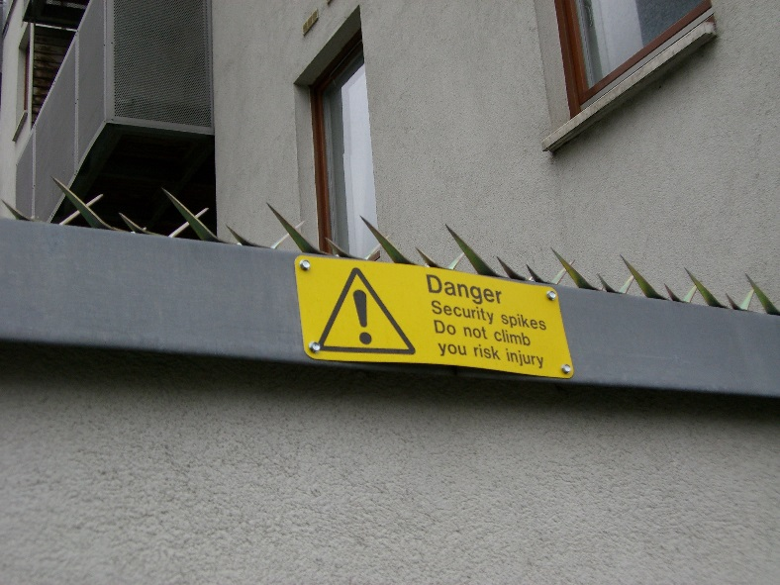
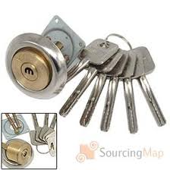
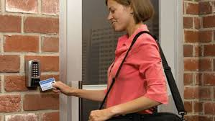
Security Equipment

Slide 40
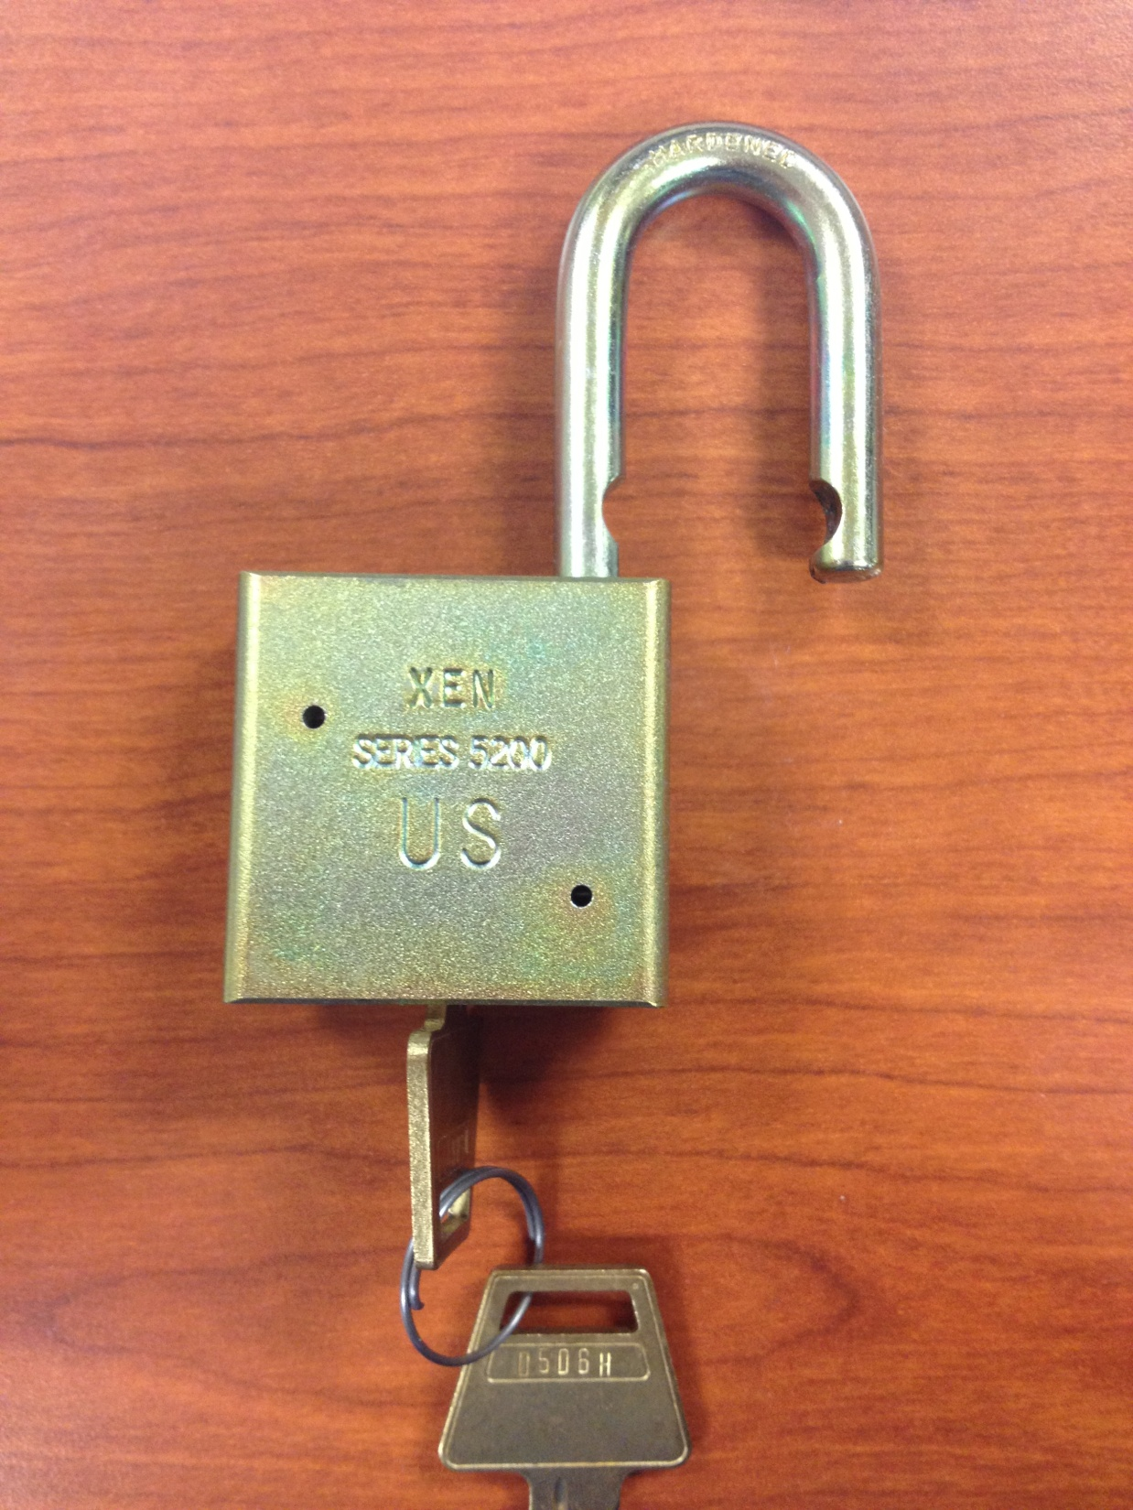
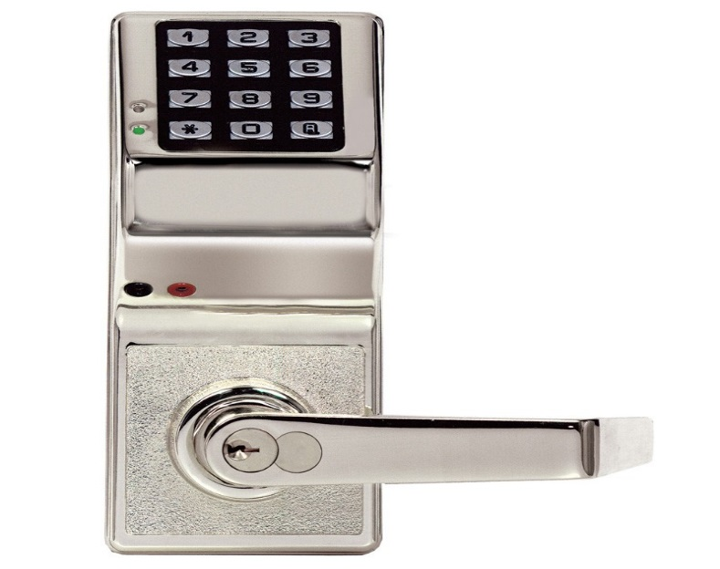

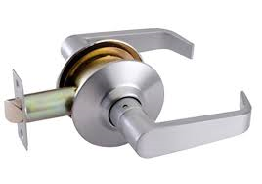
Locks
Notes:
Iaw AR 190-11 4-2C2

Slide 41
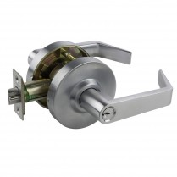
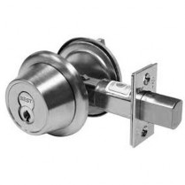
Locks
Cylindrical locksets are the general door locks utilized in most facilities. These are considered low security devices and provide a simple delaying mechanism to potential criminals or adversaries.
*When issued, these locks will come with 4 keys.
U.S. Government key–operated, pin–locking deadbolts
which project at least 1 inch into the door frame will
be used to safeguard unclassified, non-sensitive Army
supplies and equipment if a lock is required.
*Select appropriate locking mechanisms based off of the risk analysis and other threat/vulnerability indicators.

Slide 42
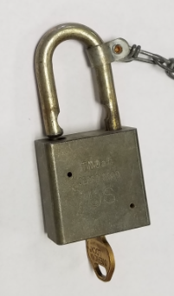
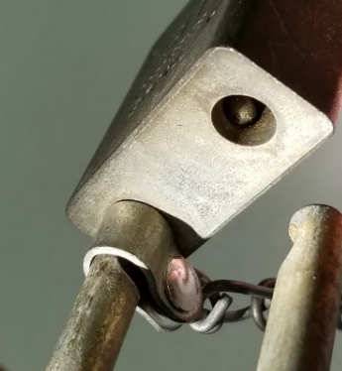
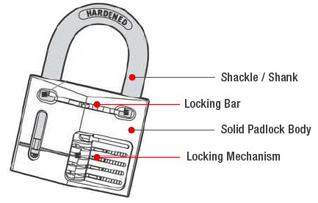
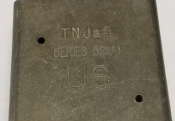
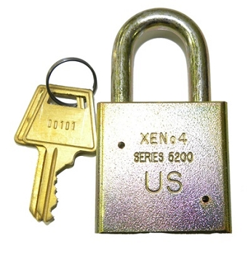


Locks
Only approved secondary padlocks (low security) will be used to secure government equipment
Series 200/5200 padlocks are approved for this purpose
Hardened steel
Double bit
Key retainability
Stamped with US or US SET
5/16th Inch shackle thickness
Notes:
Iaw AR 190-11 4-2C2

Slide 43
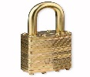

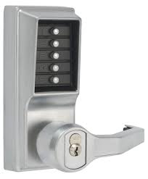

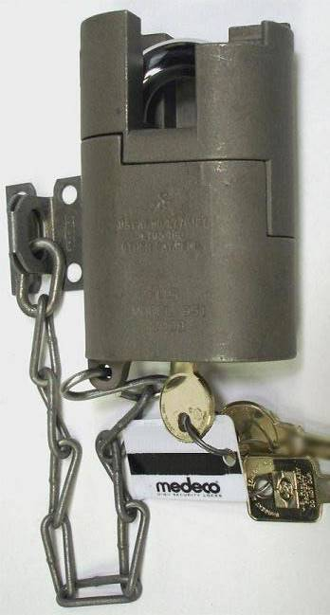
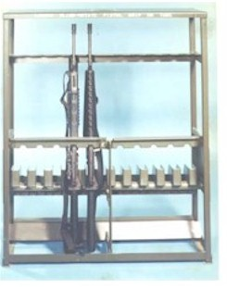
Locks
Use Appropriate Locking Mechanisms Based Off Of The Risk Analysis
Supply Room
OCIE Lockers
Admin Office
Exterior door
1 inch throw
Interior Door
(Cylindrical Lockset)
Exterior Door
1 Inch Throw
Interior Door
(AACS)
Readiness Bay
Exterior AACS used in lieu of lock during
Operating hours
Arms Room
Interior Door
(AACS)
Admin Office
Commo Storage

Slide 44
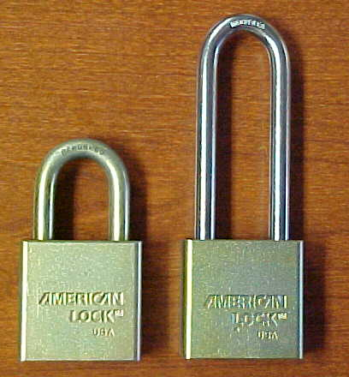
Locks
Are these approved padlocks?
YES
AMERICAN 5200 Series
Long and Short Shackle
Notes:
Iaw AR 190-11 4-2C2

Slide 45
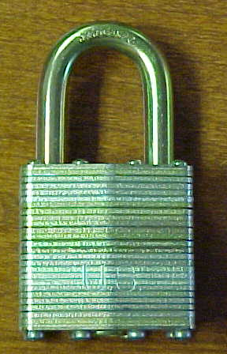
Locks
Is this an approved padlock?
YES
US Master Lock
Notes:
Iaw AR 190-11 4-2C2

Slide 46
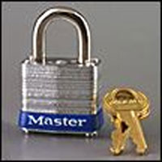
Locks
Is this an approved padlock?
NO
Does Not Have Key Retention Ability
Notes:
Iaw AR 190-11 4-2C2

Slide 47
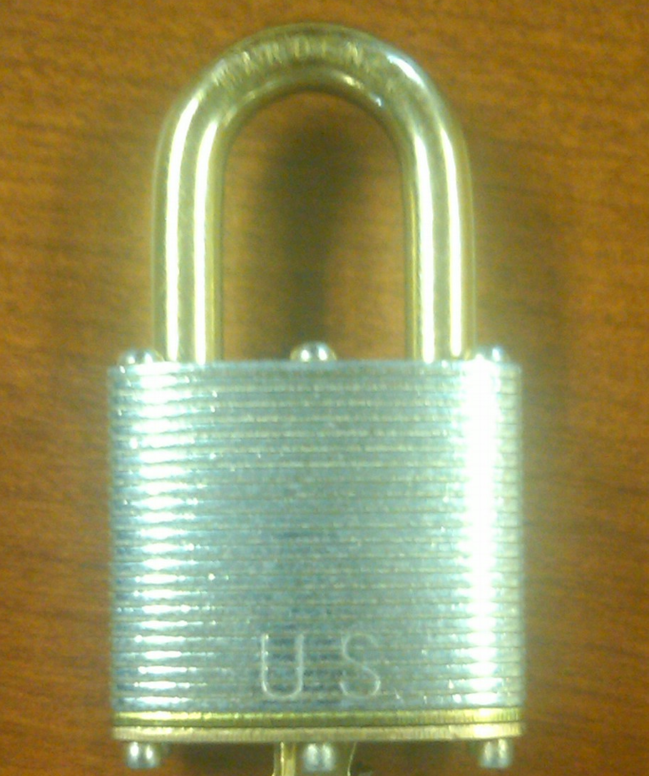
Locks
Is this an approved padlock?
YES
Pacific Lock Company
Notes:
Iaw AR 190-11 4-2C2

Slide 48


Locks
Laminated Steel
(Stacked Plates)
Solid Steel
Same NSN will get you either Master Lock, American Lock or Pacific Lock

Slide 49
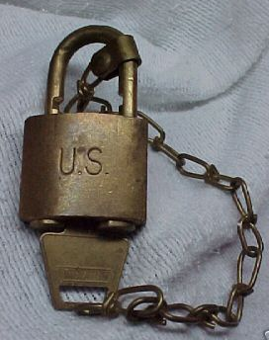
Locks
Is this an approved padlock?
YES
Non-Sparking Brass Padlock
Notes:
Iaw AR 190-11 4-2C2

Slide 50

Locks
Is this an approved padlock?
YES
Brass Padlock
¼” shackle
Shiny Brass Color
Stamped with US SET
US set locks come in sets of 2-10,000 locks per set
Notes:
50
Iaw AR 190-11 4-2C2

Slide 51
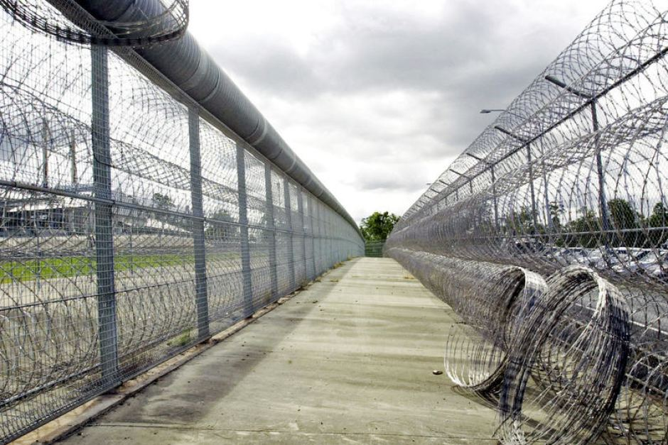
Perimeter Barriers

Slide 52
Perimeter Barriers
Security in Depth: To start the layering of security (hardening the target), you may consider the use of protective barriers. ATTP 3-19.30 can help you determine what protective barriers may best suit the asset you are protecting.
Natural barriers: terrain feature that is difficult to traverse.
Structural Barriers: man-made, either permanent or temporary

Slide 53
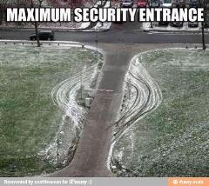
Perimeter Barriers
Natural: Cliff, Desert, Rivers, etc.
Structural: Fence, Wall, etc.
Preferred/Optimal use: In Combination

Slide 54
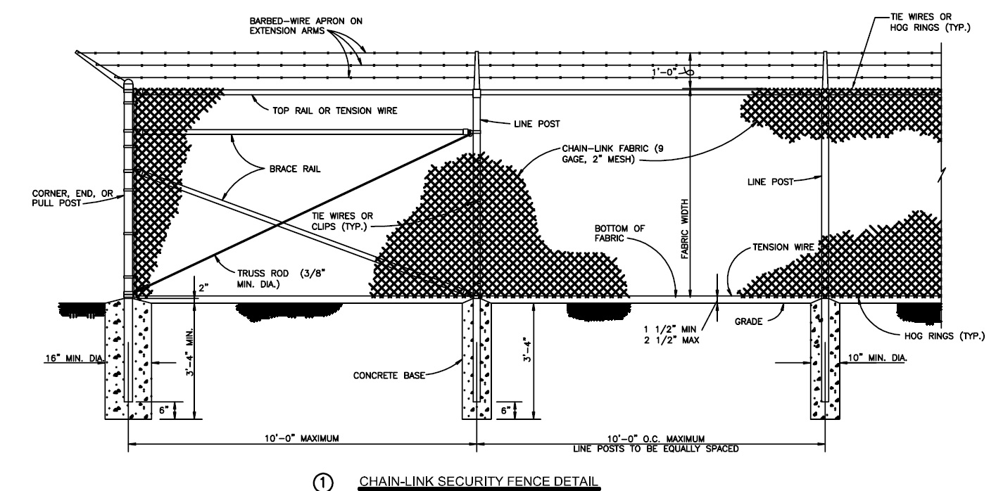
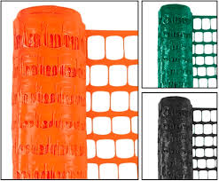
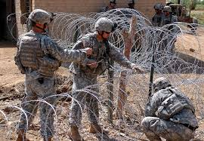
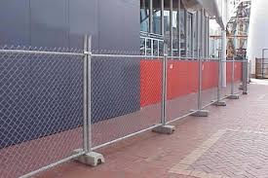
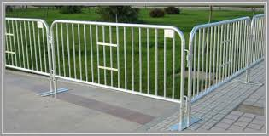
Perimeter Barriers
Fence
Chain Link
Concertina (C-wire/razor wire)
Panel Fencing
Safety Fencing

Slide 55
Perimeter Barriers
Three types of fencing are authorized for use in protecting restricted areas:
chain link
barbed wire
barbed tape or concertina
Generally, chain-link fencing will be used for protecting permanent limited and exclusion areas. All three types of fencing may be used to augment or increase the security of existing fences that protect restricted areas
It is important to recognize that fencing provides very little delay when it comes to motivated aggressors. They can act as a psychological deterrent— especially when integrated with other security systems, such as:
Security Lights
Electronic Surveillance
Frequent Patrolling/Guard Checks

Slide 56
Chain Link Fencing
Construction Standards:
Existing construction must be constructed of a minimum of 6-foot material, excluding the top guard.
New construction must be constructed of a minimum of 7-foot material, excluding the top guard.
Must be constructed with 9-gauge or heavier wire, be zinc coated, and have a mesh opening not larger than 2 inches per side
Must have twisted and barbed top selvages and knuckled bottom selvage Fence fabric should be mounted on steel posts.
Tension wires will either be interwoven or clipped along the top and bottom row of fabric diamonds.
Fences will be built to STD 872-90-03

Slide 57
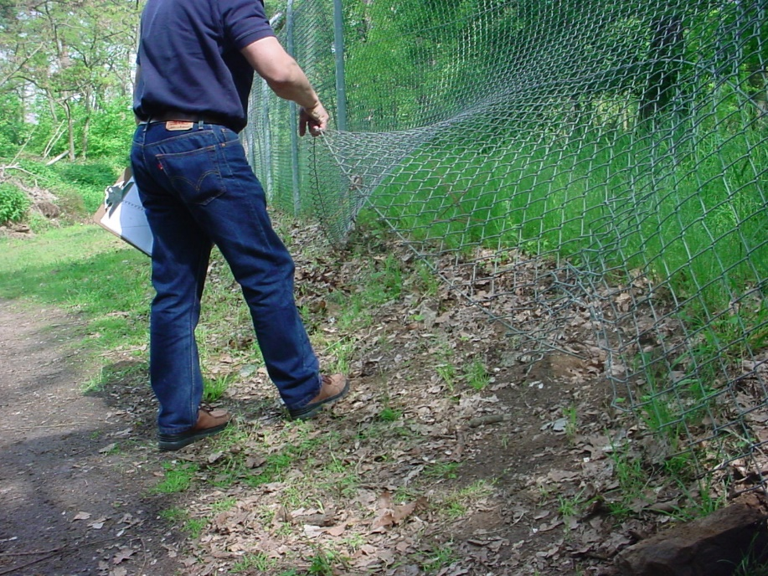
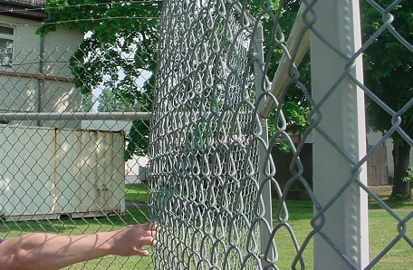
Chain Link Fencing
Deviation >2”
Wire must be taut and securely fastened to rigid metal posts set in concrete and must reach within 2 inches of hard ground or pavement.
Baseline
Baseline
Deviation >2”

Slide 58
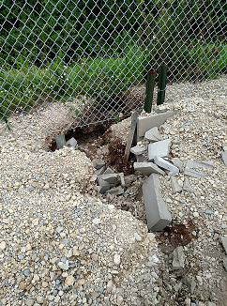
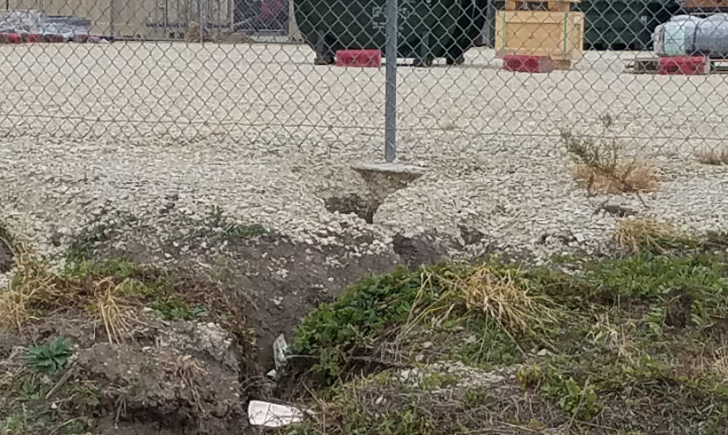
Chain Link Fencing
On soft ground, the wire must reach below the surface deep enough to compensate for shifting soil or sand, and proper erosion control measures should be considered.

Slide 59
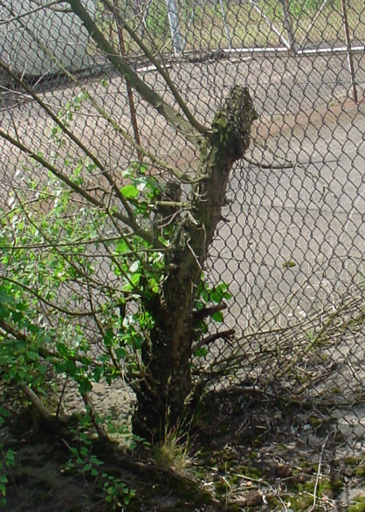
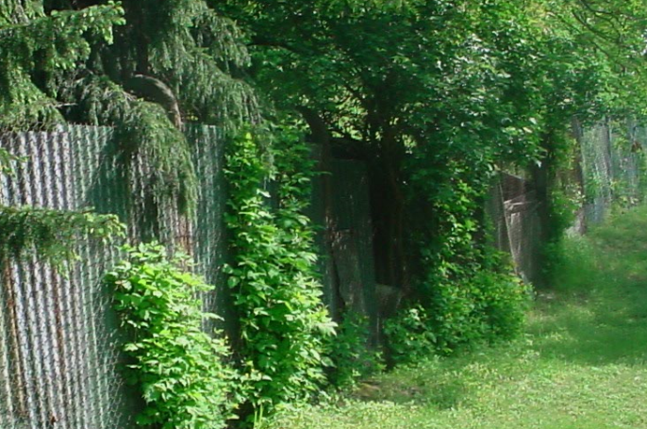
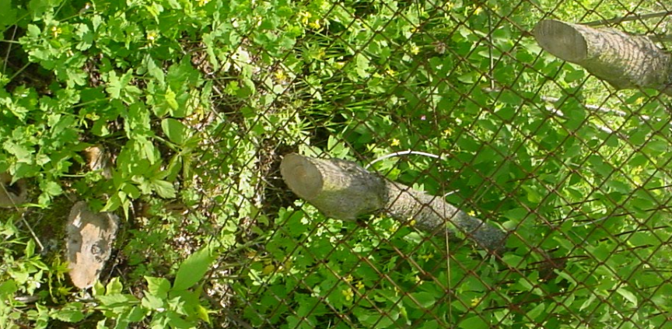
Chain Link Fencing
Chain Link Fence Vulnerabilities:
As a result of weather (rusting) or failure to keep it fastened to the post that affects the desired tightness.
Damage to the fence and fence fabric may be the result of allowing vegetation and trees to grow on or near the fence.
Interaction between fence and overgrowth leads to damage and reduces the integrity and continuity as a perimeter boundary and barrier.

Slide 60
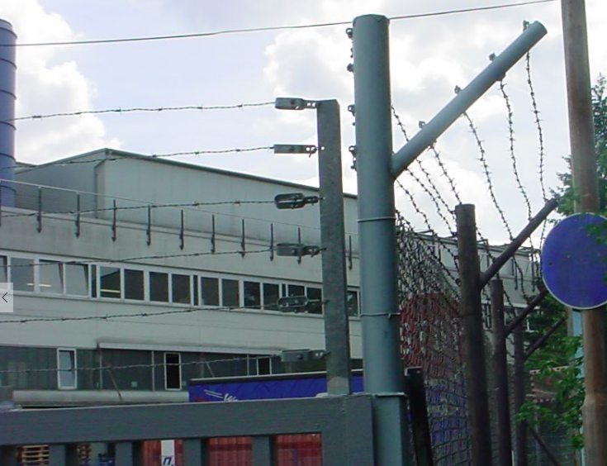
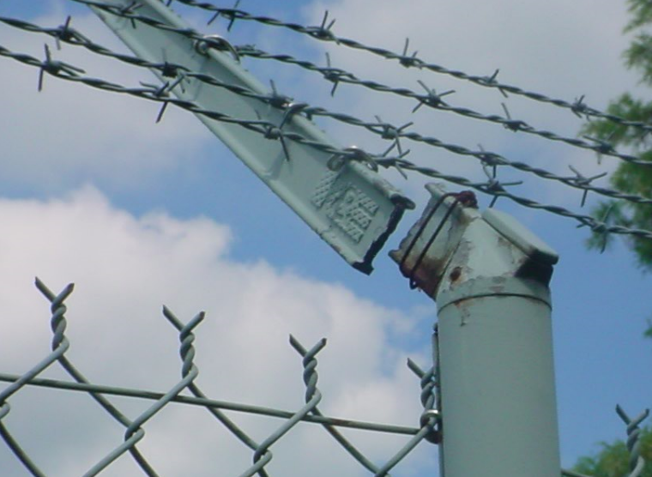
Top Guard
A top guard is an overhang of barbed wire or tape along the top of a fence, facing outward and upward at about a 45-degree angle.
Placing barbed wire or tape above it can further enhance the top guard.
Should contain at least 3 strands of barbed wire and add 1 foot to the fence height.
Over gates the Top Guard is vertical.

Slide 61
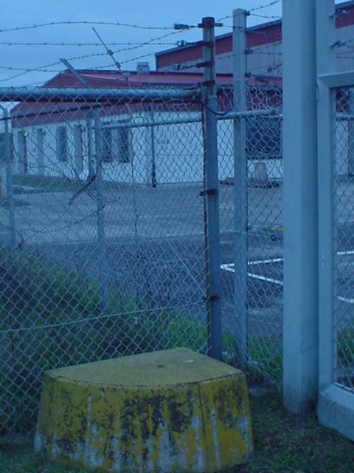
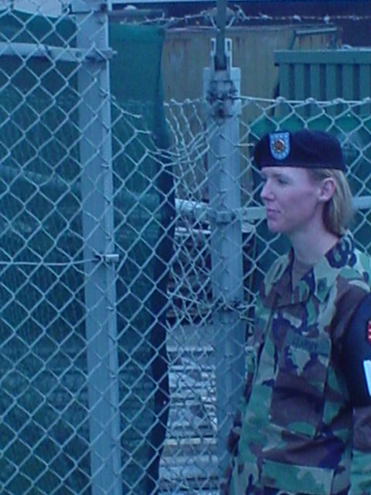
Damage from climbing
Damage from climbing
5’7”
Step

Slide 62

Barbed-Wire Fencing
Barbed-wire fences (including gates) intended to prevent human trespassing should not be less than 6 feet high and must be affixed firmly to posts not more than 6 feet apart.
The ends should be staggered or fastened together, and the base wire should be picketed to the ground.
All material and construction should meet UFGS 32 31 13.53.

Slide 63

Barbed-Tape/Concertina Fencing
Key Factors / Specifications
A barbed-tape obstacle deploys tangle-free for fast installation.
It may be recovered and reused.
Fifty feet (plus or minus 2 inches) can be covered by 101 coil loops.
Handling barbed tape requires the use of heavy barbed-tape gauntlets instead of standard barbed-wire gauntlets.
Reinforced barbed-tape concertina consists of a single strand of spring-steel wire and a single strand of barbed tape. When opened, it is 50 feet long and 3 feet in diameter.
The sections between barbs of the barbed tape are securely clinched around the wire.

Slide 64
Barbed-Tape/Concertina Fencing
Common Errors
Spacing engineer stakes too far apart (>50’)
Not using intermediate short pickets
Neglecting to add horizontal wire
Failing to tie the concertina together
Stretching beyond designed limits
Not utilizing the correct safety gear when working with concertina.

Slide 65

Barbed-Tape/Concertina Fencing
Triple Strand:
This type of fence uses three rolls of stacked concertina securely attached to pickets placed on both sides of the two rolls resting on the ground at two paces (approximately 5 feet) from the anchor picket and five paces (approximately 12.5 feet) from the supporting pickets.
Standard for FLMSA.
Not as mobile.

Slide 66


Additional / Supplemental Barriers
Part of the physical security plan may require the use of additional barriers. Purpose of these additional barriers is:
Restrict large capacity threats (pilferage, VBED)
Restrict personnel movement

Slide 67









Additional / Supplemental Barriers
Aircraft Cable
Bollards
Jersey Barriers
Crash Arms
Hedgehog Barriers
HESCO
Rotating Wedges (Nasatka)

Slide 68
Additional / Supplemental Barriers
Additional Options:
Field Expedient Barriers: locally constructed from metal beams, posts, or angled iron.
Change Approach: S-Curves; Care must be used to ensure the serpentine is tight enough to properly slow smaller vehicles, but also that it will accommodate larger vehicles that frequently use the access point.
Standoff Distance: Can be increased to reduce damage from explosions.

Slide 69

Security Lighting

Slide 70
Security Lighting
Security lighting is used for those sensitive areas or structures such as arms vaults, motor pools, vital buildings, and storage areas that are under observation. Its purpose is to discourage or deter attempts at entry by intruders, and facilitate the detection of unauthorized persons approaching or attempting malicious acts within the area.
Specific requirements for Army security lighting are described in AR 190-11 for AA&E, AR 190-51 for Army property at unit and installation level, and UFC 3-530-01. ATTP 3-19.32 can guide you in determining the type of lighting for the asset you are protecting.

Slide 71

Security Lighting
Continuous Lighting is the most common type of security lighting. The two primary methods of deploying Continuous Lighting are:
Glare Projection: Placed slightly inside and directed outward. It is considered a deterrent because it makes it difficult to see inside the protected area.
Controlled Lighting: Used to light specific locations, doors, equipment, etc. Unfortunately this method often silhouettes the guard forces as they perform their duties.

Slide 72
Security Lighting
Security lighting should provide proper illumination to:
Discourage or deter attempts at entry by intruders.
Lead a potential intruder to believe detection is inevitable.
Make detection likely if entry is attempted.
Prevent glare that may temporarily blind the guards.
Be designed and used in a manner that does not impede the use of closed-circuit television (CCTV) systems or other automated monitoring systems.

Slide 73
Security Lighting
The volume and intensity of lighting will vary with the surfaces to be illuminated.
Dark, dirty surfaces or surfaces painted with camouflage paint require more illumination.
Clean concrete, light brick, or glass surfaces require less illumination.
Rough, uneven terrain with dense underbrush requires more illumination to achieve a constant level of brightness.

Slide 74


Clear Zones

Slide 75

Clear Zones
Perimeter
A clear zone of 20 feet or more should exist between the perimeter barrier and exterior structures, parking areas, and natural or man-made features.
When it is impossible to have adequate clear zones because of property lines or natural or man made features, it may be necessary to increase the height of the perimeter barrier, increase security patrol coverage, add more security lighting, or install an IDS along that portion of the perimeter.

Slide 76

Clear Zones
Facilities
Clear Zones include stand-off distances. Certain facilities and occupied buildings require an increase in distance between themselves and other objects.
Parking
Trash Receptacles
Vegetation
UFC 4-010-01 and UFC 4-020-20 provide guidance on appropriate stand-off and clear zone guidance

Slide 77



Additional / Supplemental Barriers
Notes:
Barriers, Planters, etc can increase distance to facilities reducing cost of hardening structure / visual vs. blast walls

Slide 78


Access Control

Slide 79
Access Control
Essential to prevent unauthorized access to Restricted Areas
Executed two ways:
Physical – Guard Forces
PS Procedures (Measures)
Manpower Intensive
Automated – Automated Access Control System (AACS)
PS Equipment
Expensive

Slide 80

Guard Forces
Security Forces:
All security equipment requires security procedures
Essential to Detect and Response fundamentals (Evaluation)
Two Primary Types:
Military
MPs
Assigned Unit Personnel
Civilian
DoD Civilian / LE
Contractor
Two Styles / Missions
Fixed Post
Continuous surveillance of security assets
Manpower intensive
Mobile Patrol
Cover larger areas – multiple security assets
Can be dispatched for quick response to multiple assets

Slide 81


Guard Forces
Guard Force Specific Equipment:
Communications
Radio
Telephone
Transportation
Tactical/GSA
Style/Mission dependent
Defense
Firearms
Non-lethal (pepper spray, Taser, etc.)
Detection
Metal detector
Explosive detector

Slide 82
Guard Forces
Training. Guard force training is a continuous program. It is important that the guard force trains and maintains proficiency. Guard force training should cover the following:
Certification Training
Responsibility and authority.
OPSEC.
Physical Security
IDS Operations.
First Aid and fire control.
Weapons qualification / maintenance.
Use of force.
Daily Training
Responsibilities & Assignments.
Signals / Duress
Actions on Contact / Battle drills
SOP Refresher
Hosted Events / BOLOs

Slide 83

Automated Access Control System
An Automated Access Control System (AACS) has many capabilities depending on the security requirements. An AACS can log and archive all entry attempts made into a controlled area and can alert authorities of unauthorized entry attempts. Most AACS is simply an access control device and does not constitute a locking device.
AACS can interface with a closed circuit television (CCTV) system to assist in assessing unauthorized entry attempts or to verify the identity of entrants before manually granting access.
AACS can also interface with an intrusion detection system (IDS) to alert central monitoring station if someone makes an unauthorized entry or entry attempt.

Slide 84



Automated Access Control System
Automated access control systems fall into three general types: Coded Devices, Credential Devices, and Biometric Devices.
Credential Device
Coded Device
Biometric Device

Slide 85
Automated Access Control System
With coded devices, you must enter a recognized code or PIN on a keypad to access a controlled area. Cipher locks (pictured) are a common type of coded device.
Devices are reliable and compact.
User-friendly, and easy to maintain, repair, or replace.
Much less expensive than other types of AACS.
Security Risks with Keypad Devices
Codes can be easily passed onto unintended or unwelcome visitors.
Can be viewed by others and then used for unapproved entry.
Keypad devices have a limited number of allowable unique codes.

Slide 86
AUTOMATED ACCESS CONTROL SYSTEM
Credential devices allow an individual to access a controlled area after swiping a recognized credential in or near the device.
There are four types of credentials.
Smart Card or Microchip Card. A DoD CAC is an example of this type of credential.
The other three types are the magnetic stripe card, the proximity card, and the Weigand, or embedded wire card.
Disadvantages of Credential Devices
Cards can be lost or stolen and
Some types of cards are easy to duplicate.
Mechanical wear on cards that are swiped or inserted

Slide 87

AUTOMATED ACCESS CONTROL SYSTEM
Biometric devices allow individuals access to a controlled area after they display a specific biological characteristic into the device, which compares it to a stored characteristic.
Biological characteristics that are used to identify individuals include: Hand Geometry, Fingerprint, Facial Recognition, Iris Pattern, Voice Verification, and Retinal Scanning. Biometric devices are the most reliable AACS.
Disadvantages of Biometric Devices
Cost more than other types of devices.
Take longer to verify/validate an individual for access.
Require special housings, and some of them are not appropriate for outdoor use.

Slide 88


Closed Circuit TV - CCTV

Slide 89


Closed Circuit TV - CCTV
Closed Circuit Television. An additional layer of security can be obtained by adding a closed circuit television (CCTV) system.
The CCTV system can stand alone
Or used in conjunction with an existing IDS.
CCTV is designed for a limited audience, the security manager and/or a few guard force members.
A thorough knowledge of component parts, camera movement capability, and lighting requirements is essential to effectively select and employ CCTV. Security managers should also address the legal considerations of installing CCTV.

Slide 90



Equipment Procurement

Slide 91
Equipment Procurement
Requesting equipment or funds for equipment requires several steps:
Following Risk Assessment establish clear need for equipment.
Validate equipment selection through higher headquarters and Installation Security Branch
Need
Approved type/manufacture
Submit request for PS equipment up to DIV for inclusion in Schedule 75 process

Slide 92

Security Alarms
Integrated Commercial Intrusion Detection System (ICIDS)

Slide 93

Intrusion Detection System
INTRUSION DETECTION
Although the Intrusion Detection System (IDS) contributes to many factors in the overall Security Plan, it’s main role is to detect.

Slide 94
Intrusion Detection System
Unless continuously manned or under constant surveillance (guard), the arms room will be protected by an operational intrusion detection system (IDS).
IDS will be tested Monthly by contacting the Alarms Monitor (239-5469) IAW AR 190-11 para 3-6 m(1).
All alarms and tests will be recorded on DA Form 4930 (alarm / intrusion detection record).
Fort Riley uses ICIDS IV as its IDS for record.
Notes:
Essential element of an arms storage facility
Alerts response force to possible intrusion of a restricted area so that they may respond
Detects, NOT PREVENT, penetration of a restricted area
Permits efficient use of guard personnel, because restricted areas do not have to be guarded 24 hours a day if protected by IDS
Armorers are responsible for activating and deactivating IDS upon entry and exiting of arms room.
Alert alarm monitoring station if alarm is activated for any reason other than an intrusion.
PIC and PIN issue procedures (8-11 Mon-Fri)

Slide 95

Intrusion Detection System
Remote Area Data Collector RADC
The RADC is the brain of your ICIDS IV SYSTEM
It compiles a list of data and changes
and reports to the Primary Monitor Console
(Alarm Monitors).
If a RADC triggers an event, the
system alarms and notifies the operator.

Slide 96





Intrusion Detection System
Ensure your sensors are not blocked by boxes or arms racks
Motion Sensors should have an unobstructed view of the door
Two types of sensors required, one of which must be a volumetric sensor
Motion Sensors (Volumetric Sensor)
Point of Entry Sensor
BMS – Balanced Magnetic Switch
PIR – Passive Infrared
USM – Ultra-Sonic Motion

Slide 97



Intrusion Detection System
Duress Switch
Unit is a silent application that sounds the alarm when
personnel are under duress.

Slide 98

Intrusion Detection System
Reasons for Activation
Unauthorized Entry Attempts
Tampering
Power Loss
Communications Failure
Duress
Nuisance
Test

Slide 99
Intrusion Detection System
PIC/PIN
PIC-Personal Identification Cipher (6 Digit #)
PIN-Personal Identification Number (4 Digit #)
Shows who accessed or secured the system and at what time.
No logging out of the system required.
PIC/PIN will work in other arms rooms if you are listed on the unaccompanied access roster.

Slide 100

Intrusion Detection System
Complete your Command Screening (DA Form 7281)
Obtain your updated Unaccompanied Access Roster
Bring the completed documents to ICIDS PIC/PIN Office located in BLDG 221
Numbers are issued daily from 0800 – 1600 in Bldg 221

Slide 101


Intrusion Detection System
A CO, 123rd CSSB/ FORT RILEY
BLDG 7803-1
4
Monthly Test
Called Alarms Monitor
RAB
JDA
23 Jul 16
1003
1013
HOT
BLDG 7803-1
3
Mouse in Arms Room
Activated PIR
JDA
1 Aug 16
0200
0330
HOT
Reset Alarm
Enter Alarms
Monitor Initials and
Your Initials
Ensure you annotate All False and Nuisance Alarms As Well On This Form. This Information Is Used By The Alarm Tech To Trouble Shoot The System.
Enter What You
Did
Enter Bldg Number and
“Room” Number
Enter Date
Enter Start and
Stop Time
Enter Weather
Conditions
Completed DA Form 4930 must be maintained on file for 90 Days.
Notes:
Essential element of an arms storage facility
Alerts response force to possible intrusion of a restricted area so that they may respond
Detects, NOT PREVENT, penetration of a restricted area
Permits efficient use of guard personnel, because restricted areas do not have to be guarded 24 hours a day if protected by IDS
Armorers are responsible for activating and deactivating IDS upon entry and exiting of arms room.
Alert alarm monitoring station if alarm is activated for any reason other than an intrusion.
PIC and PIN issue procedures (8-11 Mon-Fri)

Slide 102
Intrusion Detection System
Access rosters not utilizing the proper format will not be accepted
Proper room number and zone number listed on access roster
Ensure the DoD ID Number is used, not SSN
Building number and phone number of duty hour and non-duty hour POCs
Email address of Commander and 1SG at a minimum.

Slide 103
Intrusion Detection System
Alarm sign must be placed at eye level on exterior of alarmed facility
THIS FACILITY IS PROTECTED
BY AN
ALARM SYSTEM
UNAUTHORIZED ENTRY IS PROHIBITED
VIOLATORS WILL BE PROSECUTED
UNDER THE PROVISIONS OF THE UCMJ
OR OTHER APPLICABLE LAWS
Fort Riley Regulation 190-11 Requires You to Secure Your ICIDS System Whenever Your Arms Room Is Unoccupied For Any Amount of Time.

Slide 104

Armed Guard
Intrusion Detection System
If your ICIDS IV fails or is inoperable for any reason for any amount of time, there must be an armed guard present until service is restored.

Slide 105

Intrusion Detection System

Slide 106

Intrusion Detection System

Slide 107

Intrusion Detection System
Alarm Monitoring 239-5469

Slide 108

Crime prevention AR 190-13, para 2-4

Slide 109
Crime Prevention
Barracks / BEQ / BOQ
Workplace
Home
Vehicle
Personal
Identity Theft
Cyber

Slide 110

Barracks / BOQ / BEQ
Crime Prevention

Slide 111
Crime Prevention
Security Tips:
IDENTIFY
Photograph
Engraving
RECORD
FS FM 774 (Personal Property Record) “high value item sheet”
Keep receipts
SECURE
Windows, Doors, Adjoining Bathroom Doors!
Even for short periods of time

Slide 112
Crime Prevention
Place work orders immediately.
Secure all OCIE stored in the barracks.
Secure windows with a rod if locks do not work.
Be Alert. Be Aware. Watch for suspicious behavior, actions, strangers, etc.
Don’t advertise valuable property

Slide 113

Workplace Security
Crime Prevention

Slide 114

Crime Prevention
Security Tips:
Monitor Visitors
Log off Computer
Secure Passwords
Lock File Cabinets/Desk Drawers
SF 701 – End of Day Procedures
Secure Personal Property

Slide 115

End of Day Security Checks (SF 701)
Crime Prevention

Slide 116

Home Security
Crime Prevention

Slide 117
Crime Prevention
Always lock your doors and window(s), no matter how long you are going to be away
Ask a neighbor or friend to watch your residence while you are away
Keep valuable away from exterior windows
Consider keeping doors and windows locked even when home
Secure your garage doors and windows
HOME WATCH Program

Slide 118

Vehicle Security
Crime Prevention

Slide 119
Crime Prevention
Items typically left unsecure or in plain view in vehicles
TA-50/OCIE
Cash
Purses
Medication
Keys in ignition
IPOD’s and IPAD’s
Radar detectors
GPS devices (commercial)
Cameras
Laptop computers
Cell phones
Golfing gear

Slide 120
Crime Prevention
Park your car in well lit areas.
Secure windows and doors (even for short periods of time).
Remove personal property from view if you can’t take it with you (money, cell phones, CDs, etc.).
Do not leave OCIE items in the vehicle, secure the items properly.
Consider steering wheel locks / alarms.
Before leaving your vehicle unlocked consider how much personal information regarding you and your family is in your vehicle (letters, insurance forms, bills, etc.).

Slide 121

Personal Security
Crime Prevention

Slide 122
Crime Prevention
Secure vehicle at all times even when moving
Use the interior light and check vehicle before entering
Park close to entrance of building or under a parking lot light
When shopping late, ask for an escort from store to vehicle
Don’t let your fuel level get below ¼ of a tank
Learn your route before leaving (Google Maps, etc.)

Slide 123

Identity Theft
Crime Prevention

Slide 124
Crime Prevention
Definition: The unauthorized use or attempted use of existing accounts, the unauthorized use or attempted use of personal information to open a new account, and the misuse or attempted use of personal information for a fraudulent purpose.

Slide 125
Crime Prevention
More than 10 Million victims per year.
Costing more than $15 Billion per year.
Averages more than 1 incident every 3 seconds.
More than 50 percent of victims are actively detecting fraud using financial alerts, credit monitoring or identity protection services and by monitoring their accounts.
Households headed by persons ages 18–24 and households with expendable incomes were the most likely victims of identity theft.
More than 1.5 million consumers were victims of familiar fraud, which is fraud when victims know the fraudster.
Victimized households spent at least one month resolving problems resulting from Identity theft.
Average time of misuse only 48 days.

Slide 126
Crime Prevention
DoD Instruction - 1000.30 dated 1 Aug 2012
Establishes policy and assigns responsibilities for SSN use reduction in the Department of Defense in accordance with the authority in DoD Directive 5124.02
POLICY. It is DoD policy that:
a. All DoD personnel shall reduce or eliminate the use of SSNs wherever possible.
b. SSNs shall not be used in spreadsheets, hard copy lists, electronic reports…

Slide 127
Crime Prevention
Don’t carry your Social Security card, birth certificate, or passport with you, unless absolutely necessary.
Don’t put your telephone number or Social Security number on checks.
Pay attention to your billing cycles.
Obtain a copy of your credit report twice a year.
Don’t give out personal information over the phone.
Shred all documents, especially those containing credit card offers or other personal information.
Don’t use your mother’s maiden name or combination of birth day #’s as a password.
Minimize the identification information and the number of cards you carry.

Slide 128
Crime Prevention
You should check your credit report at least twice a year. The three major credit bureaus are
Equifax: www.equifax.com
Trans Union: www.transunion.com
Experian: www.experian.com
The Fair Credit Reporting Act allows you to get one free credit report from each of the credit bureaus once per year.
For more information visit www.annualcreditreport.com

Slide 129
Day 4 Pre-View
Physical Security Plans / SOPs
Motor Pool Site Review
Practical Exam
Written Exam

Slide 130

Motor Pool – Site Review
4th st
L st

Slide 131

Practical Exam
1843F
2nd st
G st
4th st

Slide 132


QUESTIONS?
COMMENTS?
CONCERNS?

