Slide 1


Armorer’s Course
Day 1
DES
Security Branch
Physical Security
Version Number
As of 22 Feb 2022

Slide 2
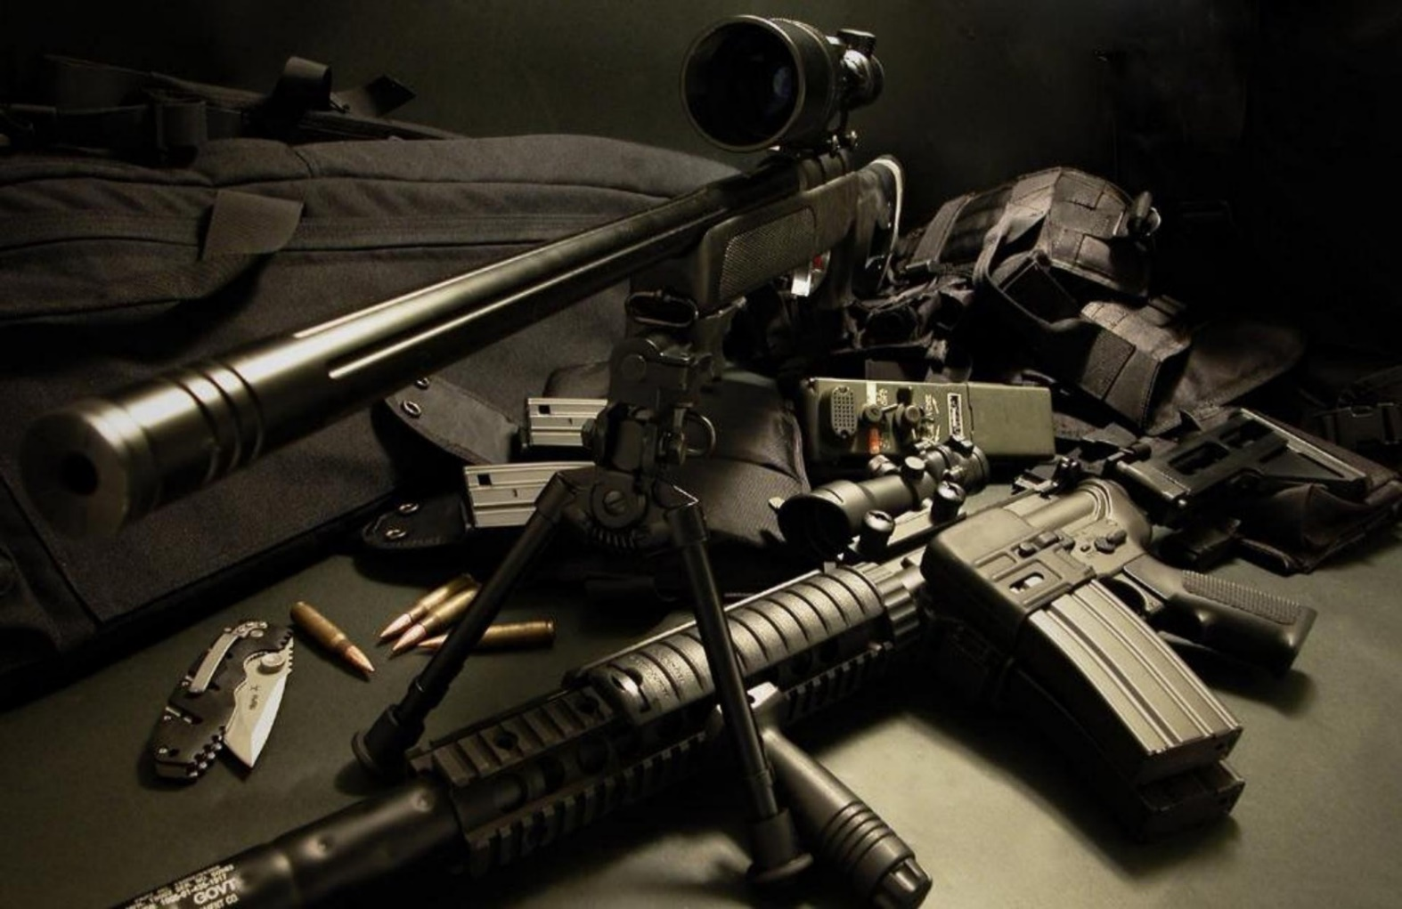
Day One Course Topics
Intro to PS, the Program, and Inspections
Exterior Arms Room
Door Security
Documentation
Inventory Procedures
AA&E Key Program
Racks
Locks
Storage of Ammo
Issuing Procedures

Slide 3
Introduction to Physical Security
Purpose – Prevention and Protection
Defined – Active and Passive measures designed to deter intruders
Prevent unauthorized access, including theft and damage, to assets such as personnel, equipment, installations, materials, and information
Safeguard against threats such as espionage, sabotage, terrorism, damage, and criminal activity.
In simplest terms:
ASSET PROTECTION

Slide 4
Introduction to Physical Security
Security-in-Depth (SID)

Slide 5
Introduction to Physical Security
Four Fundamentals of Physical Security
DETER
PHYSICAL
SECURITY
DETECT
DELAY
RESPOND

Slide 6
The Physical Security Program
Integrated approach to physical security designed to provide risk-based protection to Army installations from threats to readiness
Protecting Army personnel, information, equipment, facilities, activities, and operations. (PIEFAO)
Commanders and directors at every level are responsible for the physical security of the Army resources under their care.
Physical security programs and plans will include multiple security components that complement each other to produce a comprehensive approach to security matters, including: physical security plans; physical security inspections and surveys; participation in antiterrorism committees and fusion cells; validated task critical assets; and a continuing assessment of the installation’s or command’s physical security posture.

Slide 7
The Physical Security Program
The intent of the program is to counter threats against the Army mission, resources, and capabilities in all aspects of operations by means of policies that set minimum physical protective measures and security procedures.
The program counters threats by addressing the full spectrum of aggressors, and their tactics and tools, based on historical and current use.
Physical security plans, processes, and procedures will synchronize with other protection programs such as antiterrorism, information security, personnel security, and with related efforts such as continuity of operations, information assurance, emergency management, and resource management.
Physical security includes protective measures such as equipment and devices, personnel, and procedures.

Slide 8

Regulatory Resources
Regardless of the environment or available resources, the protection of Army personnel and assets follow the same general procedures:
Identify the asset or area to be protected.
Determine its mission criticality.
Assess the likelihood of compromise.
Assess potential threats and tactics.
Develop and implement control measures.
References:
AR 190-13 – PS program
AR 190-11 – AA&E
AR 710-2
DA PAM 710-2-1
UFC 4-010-01
UFC 4-010-03
UFC 4-020-04
AR 190-14
AR 190-51- Un-classified
DA PAM 190-51 – RA
ATTP 3-39.32 – Ex Ops PS
UFC 4-010-02
UFC 4-020-02
UFC 4-022-03
FR 190-1 – FRKS POFs

Slide 9

Physical Security Plan / Supplemental Plan

Slide 10
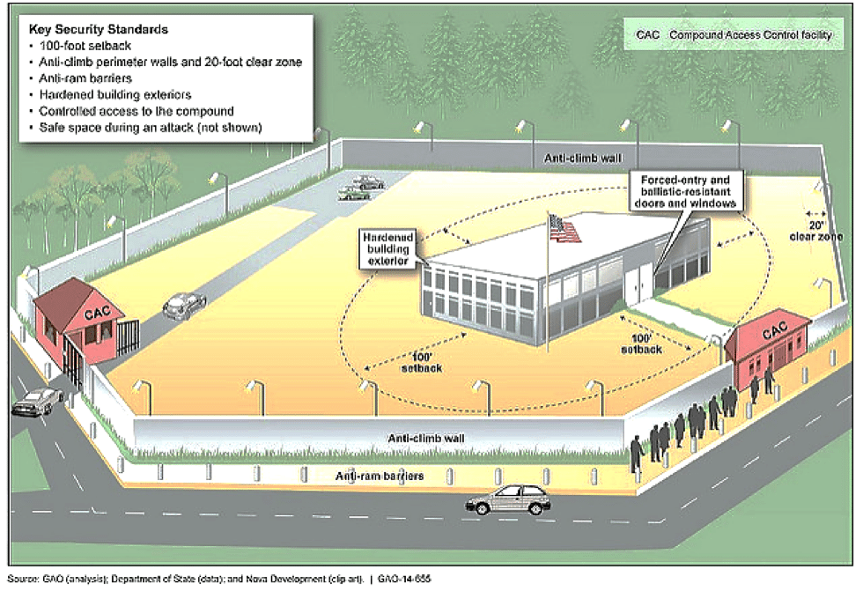
Physical Security Plan
The plan will contain sufficiently detailed organizational processes and procedures to ensure that practical, effective, and common sense measures are employed in a risk-based method across the command.
The plan will be specific enough that subordinate organizations can clearly determine their roles, responsibilities, timelines, and other related requirements. The physical security plan is a stand-alone document or an annex to a protection plan or operational order.
The plan will be reviewed annually and revise as required. A brief statement affirming currency will be placed on the front page in this format: Certified current by the commander/director (principal official) (date).
Plan annexes may be separated from the basic plan for operational efficiency. The publication containing the separated annexes will be cited in the physical security plan as a cross reference.

Slide 11

Physical Security Plan
Established IAW AR 190-13, Appendix B
Must Address:
Establish security procedures for all operational environments
Expeditionary operations
Transition (pre-deployment / re-deployment)
Program assurance at all phases
Establish a Crime Prevention Program
End-of-day checks
Personal and personnel security
Reduce crime within the organization
Establish security plans to restrict access
Barrier Plan
FPCON upgrade

Slide 12
Physical Security Plan
Cont.:
Instructions on individual responsibilities for securing military weapons during garrison and field operations.
Procedures for armed guards (IDS failure, AHA guard, transport of bulk AA&E, etc.)
Monthly IDS testing and protection of PIC/PIN’s.
Address Privately Owned Firearms (POF) registration procedures, weekends and holidays, storage requirements, control of POF, and the disposition of POF for unit deployments
Procedures to ensure the security of unit assets outside the arms room (e.g. Admin areas, Supply, PII, etc.)
Key control procedures.
Note: Annex's are apart of the Plan, but not all may apply to your unit. Reference app B, AR 190-13 https://www.cdse.edu/multimedia/shorts/active-shooter/story_html5.html
Contingency plans should include provisions for increasing physical protective measures and security procedural during periods of natural disasters, natural emergencies, or periods of increased threat from terrorist or criminal elements. i.e. COVID-19

Slide 13
Supplemental Plans / SOPs
The higher headquarters physical security plan may not cover the specific security measures that the unit Commander is required or would like to have in place. In that case, the unit should develop a supplemental physical security plan or SOP.
In most circumstances the unit Commander can also add requirements to the higher headquarters plan as they deem necessary.
The Commanders are responsible for developing security procedures to protect unit assets under their control.
Procedures will be reviewed, revised and certified as current annually
Procedures will be distributed to unit personnel
Procedures for the control of privately owned firearms will be included in this SOP and will include:
Withdrawal and issue of privately owned firearms from the arms room.
Storage and inventory procedures
Limits on how much privately owned ammunition can be stored
Notes:
COMMANDERS DO NOT HAVE TO DEVELOP AN SOP, BUT GUIDANCE WILL BE REVIEWED ANNUALLY.
Fort Riley Reg 190-1 States that POW procedures will be in the form of an SOP.

Slide 14
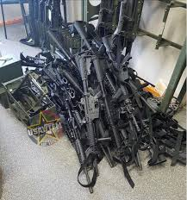
Supplemental Plans / SOPs
Company supplemental plans must address Arms Room Operations if it is not addressed in the BN PS Plan. The Commander must ensure the following items are covered:
Commander’s Responsibilities
Arms Room Officer (Physical Security Officer) Responsibilities
Armorer’s Responsibilities
Inventory Procedures (Opening/Closing, Monthly)
Weapon Issue Procedures
Weapon Security During FTX’s
Notes:
COMMANDERS DO NOT HAVE TO DEVELOP AN SOP, BUT GUIDANCE WILL BE REVIEWED ANNUALLY.
Fort Riley Reg 190-1 States that POW procedures will be in the form of an SOP.

Slide 15
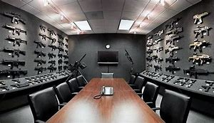
Supplemental Plans / SOPs
Consolidated Arms Rooms
Door lock
Separate key containers
One Armorer vs. Multiple
One Access Roster
DA Form 7708
Updating personnel changes
Armed Guard Requirements
MOA signed by CURRENT Commanders
Consolidated Facilities
Motor Pool
Building (co-located) with Contractor / other Unit

Slide 16

Inspections
Physical Security vs ICI / SCI

Slide 17
DES PS vs. UNIT
Inspections
Physical Security Inspections
Regulatory Driven (DA)
Announced
Annual (18 / 24 months)
Re-Inspection (6 months)
Occur during a change in unit status such as deployment, redeployment etc.
Upon establishment of a unit or rear detachment
Un-announced
Command Requested
Command Directed
15-6 / FLIPL
HHQ / PSO Inspections
Driven and/or conducted by your next higher element (BN, BDE, DIV)
Occur during a change in unit status such as deployment, redeployment etc.
Confirm the PHYSEC Program is maintained
Constant inspections, always ongoing through on the spot corrections, security culture within the organization

Slide 18

Inspections
Inspection Reporting:
Inspection results go to:
Commander
Next Higher Command
Must be maintained on file until next inspection
Recurring deficiencies will be tracked on reports until corrected
Commander required to submit Corrective Actions Plan within 30 days of receiving report. Re-inspections cannot be conducted until the CAP is submitted.
Unit will remain Not Adequate.
CAP submitted to both next HHQ and the FRSB Office.
Not Adequate rating requires a re-inspection within 6 months (once the Corrective Actions Plan is received). Further, within our new SMS reporting system units will continue to be re-inspected until they receive a “Adequate” rating.

Slide 19
Inspections
Inspection Areas
Administrative Security
CO / BTRY / TRP level
BN / BDE level
DIV / Directorate level
Admin Keys and Combinations
Supply Room Security
Arms Room Operations
AA&E Key Control
Motor Pool (Tactical Vehicle Storage)
POL Storage
ICIDS
Tool Security
High-value items storage
FP measures
Airfield Security
POF’s and Privately Owned Ammunition
OCIE Storage
Subsistence Facilities
PLL Storage

Slide 20
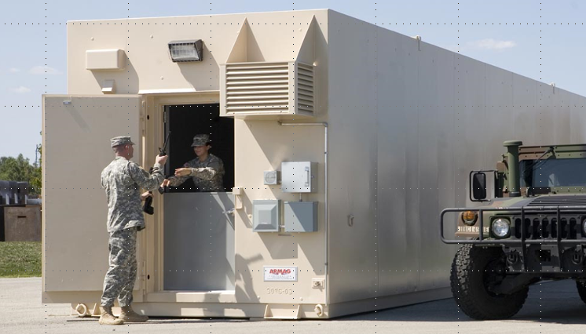
ARMS ROOM OPERATIONS

Slide 21
Exterior
Restricted Area Warning Sign
Notes:
What should be posted outside of the arms room.

Slide 22
Exterior
RESTRICTED AREA
WARNING
THIS ACTIVITY HAS BEEN DECLARED A RESTRICTED AREA BY AUTHORITY OF THE INSTALLATION COMMANDER IN ACCORDANCE WITH THE PROVISIONS OF THE DIRECTIVE ISSUED BY THE SECRETARY OF DEFENSE ON 10 December 2005, PURSUANT TO THE PROVISIONS OF SECTION 21, INTERNAL SECURITY ACT OF 1950. UNAUTHORIZED ENTRY IS PROHIBITED. ALL PERSONS AND VEHICLES ENTERING HEREIN ARE LIABLE TO SEARCH. PHOTOGRAPHY OF THE FACILITIES IS PROHIBITED WITHOUT SPECIFIC AUTHORIZATION FROM THE COMMANDER. DEADLY FORCE IS AUTHORIZED.
Notes:
AR 190-11 Para 4-15
Must be posted at eye level outside of the arms room, and all entrances to building containing arms room.

Slide 23
Exterior
Restricted Area Warning Sign
Alarm Warning Sign (Metal Sign)
Notes:
What should be posted outside of the arms room.

Slide 24
Exterior
THIS FACILITY IS PROTECTED
BY AN
ALARM SYSTEM
UNAUTHORIZED ENTRY IS PROHIBITED
VIOLATORS WILL BE PROSECUTED
UNDER THE PROVISIONS OF THE UCMJ
OR OTHER APPLICABLE LAWS
Notes:
AR 190-11 Para 4-16
Must be posted at eye level outside of arms room

Slide 25
Exterior
Restricted Area Warning Sign
Alarm Warning Sign
Security Lighting
Notes:
What should be posted outside of the arms room.

Slide 26
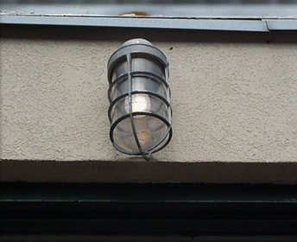
Exterior
Allows guard personnel to observe the unauthorized entry or removal of arm.
Exterior Light Must Be Covered With Wire Mesh Or Made Of A Vandal Resistant Lens.
Provide A Minimum Of 0.2 foot-candles (2lux) illumination
Switch To Light Must Be Inaccessible To Personnel
Notes:
WHEN AN ARMS ROOM IS LOCATED WITHIN ANOTHER SECURE ROOM, THE ENTRANCE TO THE SECURE ROOM WILL BE ILLUMINATED.
Iaw 190-11 5-4 a-(3) LIGHTING PROTECTION

Slide 27
Exterior
Restricted Area Warning Sign
Alarm Warning Sign
Security Lighting
Notes:
What should be posted outside of the arms room.

Slide 28
Exterior
Restricted Area Warning Sign
Alarm Warning Sign
Security Lighting
SF 702 For After Hour Security Checks
Notes:
What should be posted outside of the arms room.

Slide 29

Exterior
Armed is defined as having a firearm and appropriate ammunition readily available for immediate use.
A “Whooping” stick does not constitute an armed guard!!
Arms Storage Facilities, Containers And Safes Will Be:
Protected By Ids And Will Be Checked At Least Once Every 8 Hours
or
Under 24 Hour Armed Guard Surveillance
Staff duty and charge of quarters when tasked will document these checks on standard form 702 (security container check list). (Fort Riley Regulation 190-11)

Slide 30
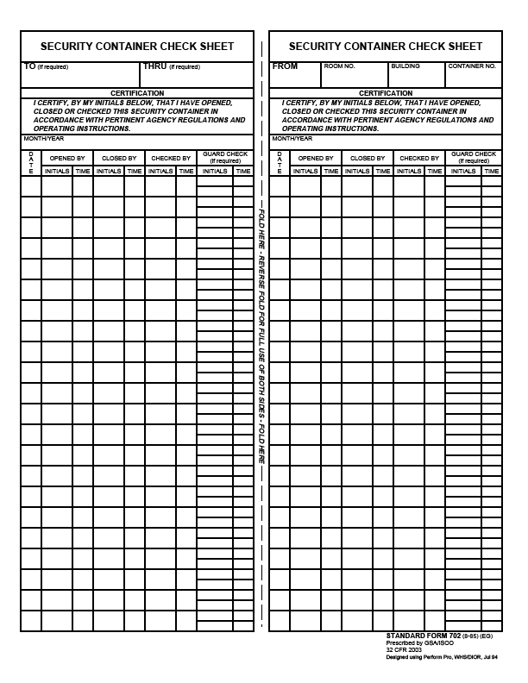
Exterior
Can be used to record opening/closing times of arms room.
SF 702
Required to be used by FR Reg. 190-11 to Record After Hour Security Checks
Checking the security of building outer doors and not the vault door doe not meet regulatory requirements.
May 2016
1
LDE
0230
WHW
2230
2
WHW
0415
3
4
5
6

Slide 31
Exterior
Restricted Area Warning Sign
Alarm Warning Sign
Security Lighting
SF 702 For After Hour Security Checks
FR Reg. 190-1 (Outside of arms room or posted on unit bulletin board)
Notes:
What should be posted outside of the arms room.

Slide 32
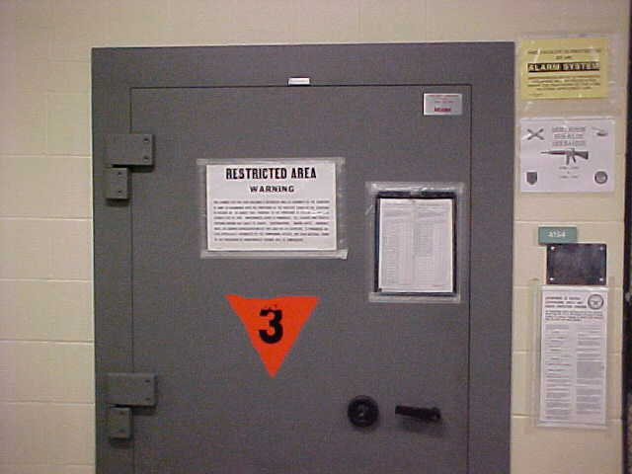
Exterior
Alarm System
Warning Sign
Restricted Area
Warning Sign
Do not post contact
Information of the armorer
Must also have one
posted on the inner
door. When door is open
sign is not visible.
SF 702 Used for Security Checks
Ammunition
Placard (Only required
When storing ammo)
Notes:
Essential element of an arms storage facility
Alerts response force to possible intrusion of a restricted area so that they may respond
Detects, NOT PREVENT, penetration of a restricted area
Permits efficient use of guard personnel, because restricted areas do not have to be guarded 24 hours a day if protected by IDS
Armorers are responsible for activating and deactivating IDS upon entry and exiting of arms room.
Alert alarm monitoring station if alarm is activated for any reason other than an intrusion.
PIC and PIN issue procedures (8-11 Mon-Fri)

Slide 33
Lautenberg Amendment
Exterior
Summary court-martial convictions, non-judicial punishment under Article 15, UCMJ, and deferred prosecutions in civilian court do not constitute qualifying convictions within the meaning of the Lautenberg Amendment.
The prohibitions do not preclude a soldier from operating major weapons systems or crew served weapons such as tanks, missiles, and aircraft.
The Lautenberg Amendment application includes Soldiers with privately owned firearms and ammunition stored on or off post.
Soldiers with qualifying convictions may not:
be assigned to positions that would give them access to firearms and ammunition.
attend any service school where instruction with individual weapons or ammunition is part of the curriculum.
may not reenlist and are not eligible for the indefinite reenlistment program.

Slide 34
Check-on-learning
Exterior
Q: A Soldier is given an Article 15 from his Company Commander for getting into a fight with his wife and hitting her. Is this a Lautenberg Violation?
A: No, this is non-judicial punishment and does not constitute a Lautenberg Conviction.

Slide 35
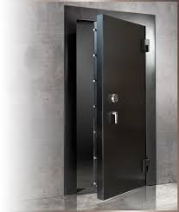
Door Security

Slide 36
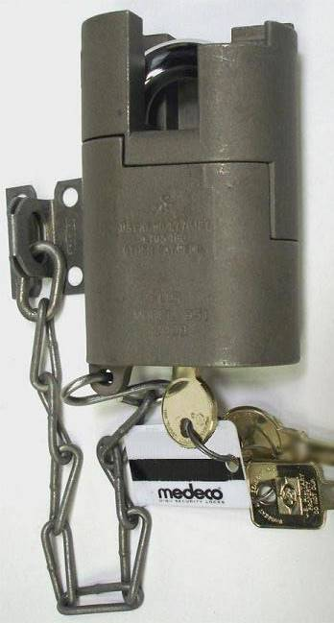
Door Security
High security padlock for approved doors
Placed on most secure Door and Exterior Issue Window (If arms room has one.)
Comes with three (3) keys, two round operational keys and one square maintenance key.
Notes:
MORE ON KEY AND LOCK CONTROL PORTION OF BRIEF.
What regulation (Reg and Paragraph number) covers this?
SHOW EXAMPLE OF HIGH SECURITY LOCK AND MENTION THAT IT COMES WITH 3 COUNT THEM 3 KEYS

Slide 37
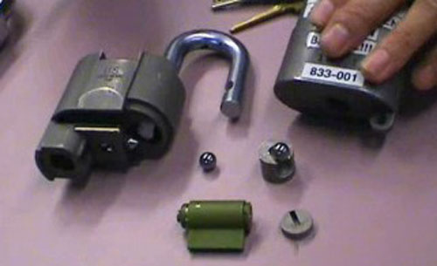
High Security Padlock
Door Security
Do Not Use The Square Maintenance Key For Daily Operations!!!!
It is used to take the lock apart in order to re-core it.
Notes:
MORE ON KEY AND LOCK CONTROL PORTION OF BRIEF.
What regulation (Reg and Paragraph number) covers this?
SHOW EXAMPLE OF HIGH SECURITY LOCK AND MENTION THAT IT COMES WITH 3 COUNT THEM 3 KEYS

Slide 38
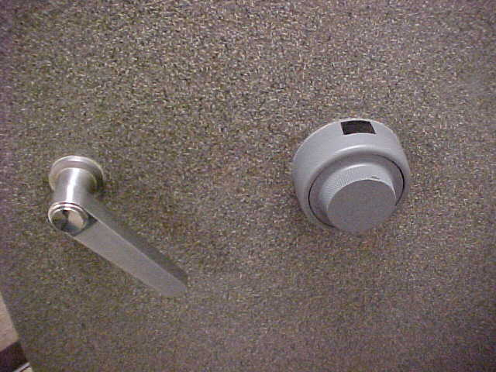
Door Security

Slide 39
Door Security
Combinations Shall Be Changed:
When first placed in use (factory default settings 50-25-50)
Whenever an individual knowing the combination no longer requires access.
When the combination has been subject to possible compromise.
At a minimum annually
Prior to transitioning out. e.g. move to another bldg., deployment, etc.
To have your combination changed call public works service order desk at 239-0900 or check with your S-2.
https://www.cdse.edu/resources/physical-security.html for information on how to change combinations on the X-07, X-09, X-10, S&G 2740B & S&G 2740.
Notes:
39

Slide 40
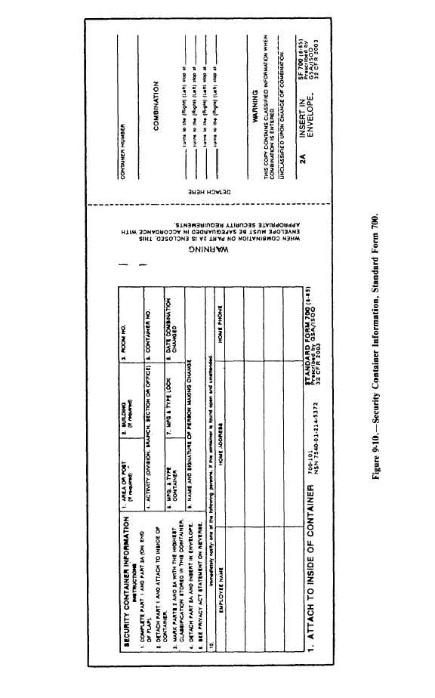
Door Security
SF 700 (security container information) shall be maintained
For each combination.
Part 1 will be completed and posted on the inside of the vault or container.
If this SF700 is for an arms room, the personnel listed here must also be on the unaccompanied access roster.
219
Arms Room
DES
1
Hamilton X-07
7 Sep 21
Joe Locksmith, PW
Jim D. Armorer
232 Milford Drive, Junction City
555-1010
I.B Dmann
111 Crazy Circle, Junction City
555-2526
Notes:
40

Slide 41
Door Security
The combination of the vault or container will be printed part 2a
Arms Room
1
219
DES
1
Hamilton X-07
7 Sep 21
22
Joe Locksmith, PW
45
76
Jim D. Armorer
232 Milford Drive, Junction City
555-1010
I.B Dmann
111 Crazy Circle, Junction City
555-2526
Notes:
41

Slide 42
Door Security
Part 2A will be detached and inserted in the envelope, (part 2)
219
Arms Room
1
DES
1
Hamilton X-07
7 Sep 21
22
Joe Locksmith, PW
45
76
Jim D. Armorer
232 Milford Drive, Junction City
555-1010
I.B Dmann
111 Crazy Circle, Junction City
555-2526
Notes:
42

Slide 43
Door Security
Part 2A will be detached and inserted in the envelope, (part 2)
219
Arms Room
1
DES
1
Hamilton X-07
7 Sep 21
Joe Locksmith, PW
22
45
76
Jim D. Armorer
232 Milford Drive, Junction City
555-1010
I.B Dmann
111 Crazy Circle, Junction City
555-2526
Notes:
43

Slide 44
Door Security
Part 2 will be stored in a different security container.
219
Arms Room
DES
1
Hamilton X-07
7 Sep 21
Joe Locksmith, PW
Jim D. Armorer
232 Milford Drive, Junction City
555-1010
I.B Dmann
111 Crazy Circle, Junction City
555-2526
Notes:
44

Slide 45

Documentation

Slide 46
Documentation
DA Form 4604 (Security Construction Statement):
Existing arms rooms inspected by qualified engineer every 5 years.(AR 190-11 2-2d)
Identifies an Waivers, Exceptions, Compensatory measures in place in order to approve vault storage.
Will be posted inside the unit arms vault.
Form will indicate highest category of weapons that may be stored in the arms room.
POC: Mrs. Kim Hunninghake - 239-6672/ 239-6148
Notes:
Security Construction Statement DA Form 4604-R
Posted on the wall of an arms room
Signifies the Arms room is constructed with the guidelines listed in AR 190-11
Valid for 5 years
Unit armorer’s responsibility to ensure it is current and valid
Reviewed during physical Security Inspections.

Slide 47
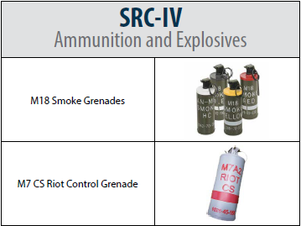
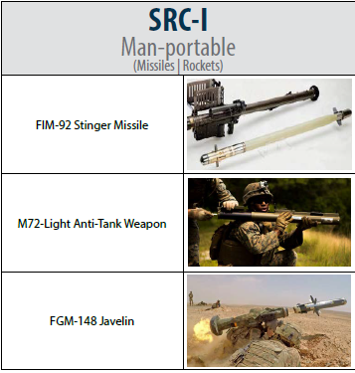
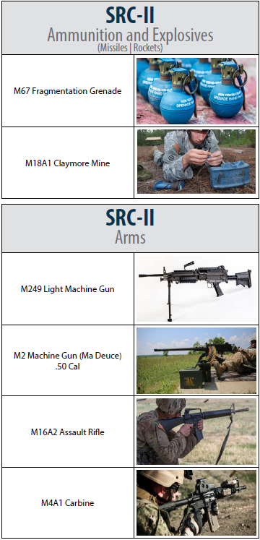
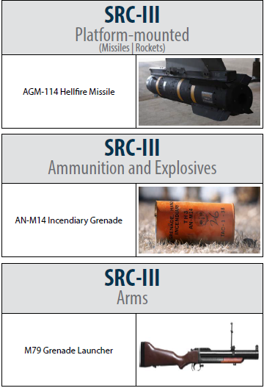
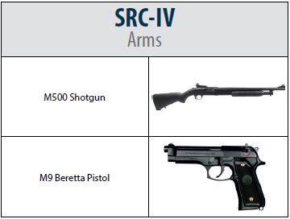
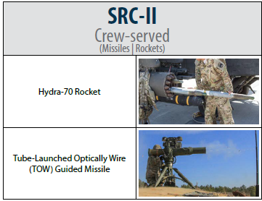
Documentation
Security Risk Categories (SRC)
NVDs are SRC-IV, too!
Notes:
Security Construction Statement DA Form 4604-R
Posted on the wall of an arms room
Signifies the Arms room is constructed with the guidelines listed in AR 190-11
Valid for 5 years
Unit armorer’s responsibility to ensure it is current and valid
Reviewed during physical Security Inspections.

Slide 48
Documentation
Armorer Hand Receipt:
Commander sub-hand receipts all equipment in the arms room down to the primary armorer:
Use DA Form 3161 or system generated property receipt.
Places responsibility / accountability upon individual who has direct control of it.
Clearly identifies what the Armorer is responsible for.
Includes all property to be stored in the vault. NOT just AA&E (e.g. bayonets, compasses, etc.)
Must be signed for with in 30 days of appointment. (IAW Supply regulations)

Slide 49
Documentation
Unaccompanied Access Roster
Keep the number of personnel on the roster to a minimum.
Personnel Reliability Screening And Evaluation (DA Form 7708) is completed before unaccompanied access is authorized
Personnel Reliability Screening And Evaluation
DA Form 7708
Valid for one year
Continuing Periodic Evaluation required
Does not need to be redone when a new Commander assumes command.
Must be redone when the Soldier transfers to/from another unit.
Notes:
Commanders oriented screening per AR 190-11 para 2-11 consists of:
Commanders interview
Personnel records screening (201)
Medical Records Screening
PMO (Local Files Check)
Civilian Law Enforcement
Commanders evaluation

Slide 50
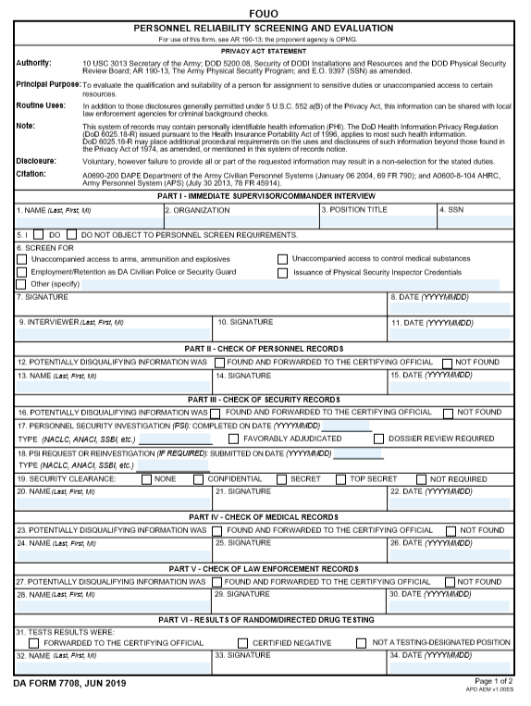
PERSONNEL RELIABILITY SCREENING AND EVALUATION
Commander of the candidate will conduct the initial interview than print, sign and date.
Armorer, Tony
111th Signal Company
Armorer
000-00-0000
X
X
The candidate will sign and date.
Tony D. Armorer
20191001
Commander, Best, D
Best D. Commander
20191001

Slide 51
PERSONNEL RELIABILITY SCREENING AND EVALUATION
Completed by S-1
X
Jackson, Andrew, T
Andrew T. Jackson
20210907
Commanders Discretion if Not Required Completed by Commander. Clearance validation completed by S-2
Completed by DES ADMIN through email (Will take 24 to 72 hours turnaround)
X
Commander, Best, D
Best D. Commander
20210908
X
Jefferson, Thomas, T
Thomas T. Jefferson
20210909
usarmy.riley.ID-Readiness.mbx.police-records@army.mil
Completed by Medical Facility / Provider
DES No Record
X
Washington, George D
George D. Washington
20210910
Completed at Unit by Commander of Candidate
X
Commander, Best, D
Best D. Commander
20210907

Slide 52
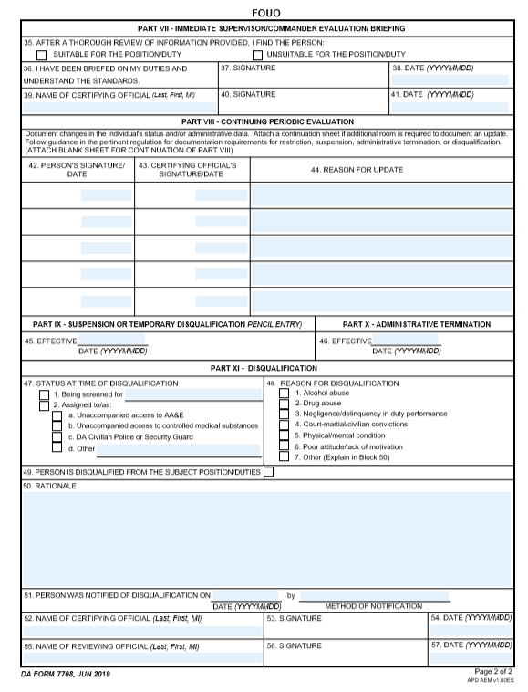
PERSONNEL RELIABILITY SCREENING AND EVALUATION
Candidate screened will acknowledge being briefed on duties, sign and date.
X
Tony D. Armorer
20210910
Commander, Best, D
Best D. Commander
20210910
Commander validates Candidate suitable or unsuitable selection with, printed name, signature and date.
Annual periodic Evaluations

Slide 53
PERSONNEL RELIABILITY SCREENING AND EVALUATION

Slide 54
Documentation
Dates
The dates in section I and VII are the start and end dates of the investigation. Both signed by the CDR (NOT at the same time).
All dates in sections II thru VI (section checks) should fall between the start and end dates.
Appointment orders must be dated after the form is finalized in section VII.
Must be Evaluated Periodically in section VIII (Minimum Annually).
Notes:
The unit armorer is responsible for enforcing access control by:
Verifying authorization of personnel prior to entry. (Access Rosters)
Providing supervision of personnel while they are in the arms room.

Slide 55
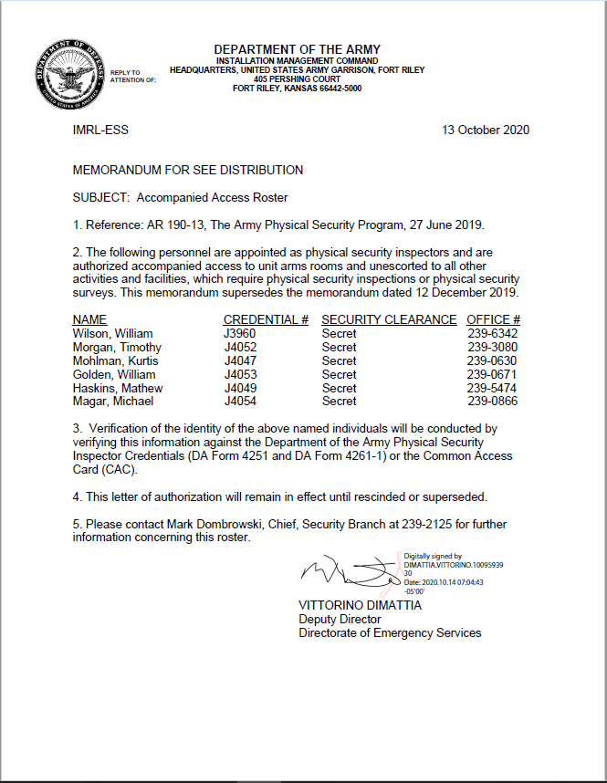
Documentation
Accompanied Access Rosters:
DES Physical Security
DIV / BDE / BN S-2
Alarm Maintenance Personnel
Notes:
The unit armorer is responsible for enforcing access control by:
Verifying authorization of personnel prior to entry. (Access Rosters)
Providing supervision of personnel while they are in the arms room.

Slide 56
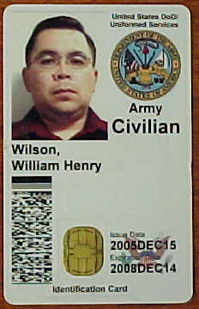

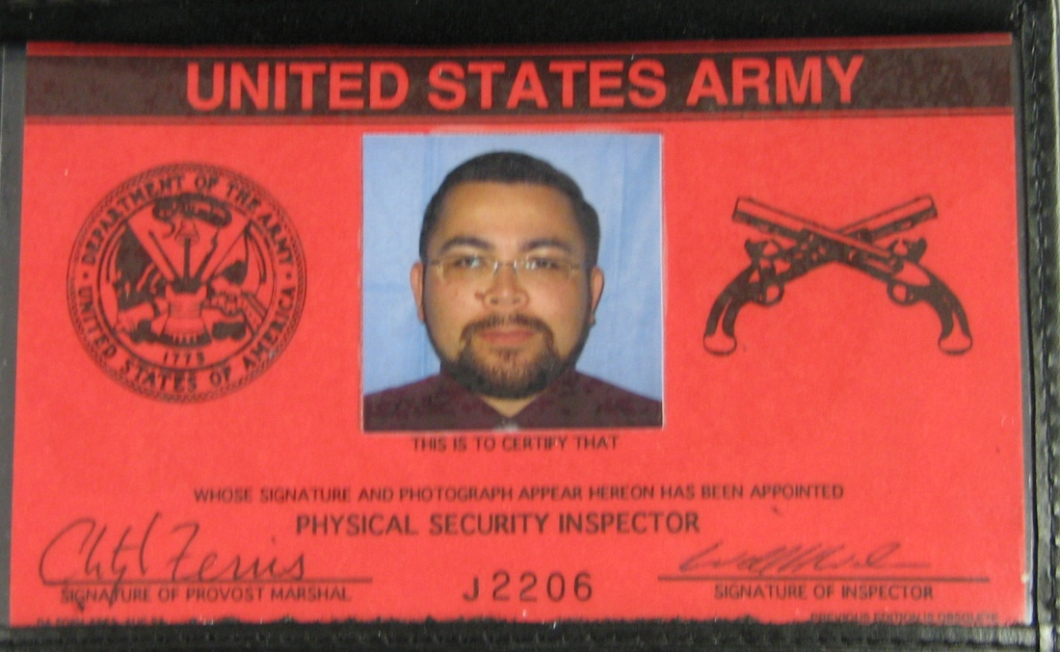

Documentation
Morgan,
Dexter G.
Always Check Identification To Verify
Access Roster Information.
Notes:
The unit armorer is responsible for enforcing access control by:
Verifying authorization of personnel prior to entry. (Access Rosters)
Providing supervision of personnel while they are in the arms room.

Slide 57
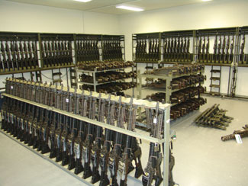
Inventory procedures
AA&E

Slide 58
Inventory Procedures
Monthly 100% serial number inventories conducted by:
Responsible Officer (Commander).
An Officer, Warrant Officer, or NCO appointed by the Responsible Officer
The same person will not be appointed in consecutive months.
Personnel identified on the unaccompanied access roster will not conduct or assist in the inventory.
Notes:
Normally the inventory will be conducted by someone appointed by the commander and not the commander himself, although he is authorized to conduct the inventory.
Inventories conducted by IAW DA PAM 710-2-1 par 9-10 b

Slide 59
Inventory Procedures
Ensure the following items are included in the monthly serial number inventory:
All Privately Owned Firearms and ammunition.
All military ammunition.
All night vision devices (NVDs) and items on the High Value Storage Memorandum.
All accountable property not just sensitive items.
Notes:
Example of the memorandum can be found in the armorer’s quick reference guide (Figure 1-3)
Inventories kept on hand IAW AR 190-11 para 6-2 b(2)(b)1

Slide 60
Inventory Procedures
Inventory documentation:
Results of serial number inventories will be recorded on a memorandum.
Retain the results for 2 years if no discrepancy is noted; 4 years if a discrepancy is noted.
Ensure the person conducting the inventory signs the inventory.
Try to keep the “working copy” of the inventory in the arms room. If you are unable to obtain the “working copy” ensure memorandum is on hand.
Notes:
Example of the memorandum can be found in the armorer’s quick reference guide (Figure 1-3)
Inventories kept on hand IAW AR 190-11 para 6-2 b(2)(b)1

Slide 61
Inventory Procedures
UNIT LETTERHEAD
OFFICE SYMBOL DATE
MEMORANDUM FOR RECORD
On (This Date), I (Rank Name) conducted the monthly 100% inventory for B Btry 1-12 FA. All weapons, ammunition and sensitive items were accounted for, no discrepancies were found during the inventory.
2. The following privately owned fire arms and ammunition were also inventoried:
.50 Cal Desert Eagle SN# 12345
25 round of .50 cal ammunition.
3. Point of Contact for this memorandum is the undersigned at 239-xxxx.
Signature Block
Notes:
Example of the memorandum can be found in the armorer’s quick reference guide (Figure 1-3)
Inventories kept on hand IAW AR 190-11 para 6-2 b(2)(b)1

Slide 62
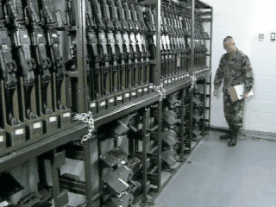
Inventory Procedures
Notes:
Change of Custody inventories IAW DA Pam 710-2-1 para 9-10 a.

Slide 63
Inventory Procedures
Opening / Closing And Change Of Custody Inventories:
Occurs when the responsibility for custody of the arms room or the arms room keys is transferred between authorized personnel.
The person receiving the keys to the arms room will receipt for all AA&E and accountable property stored in the arms room. Results of this inventory will be recorded on DA Form 2062.
The Opening/Closing as well as the Change-of-Custody inventories will be maintained on file until the next monthly 100% serial number inventory.
Notes:
Change of Custody inventories IAW DA Pam 710-2-1 para 9-10 a.

Slide 64
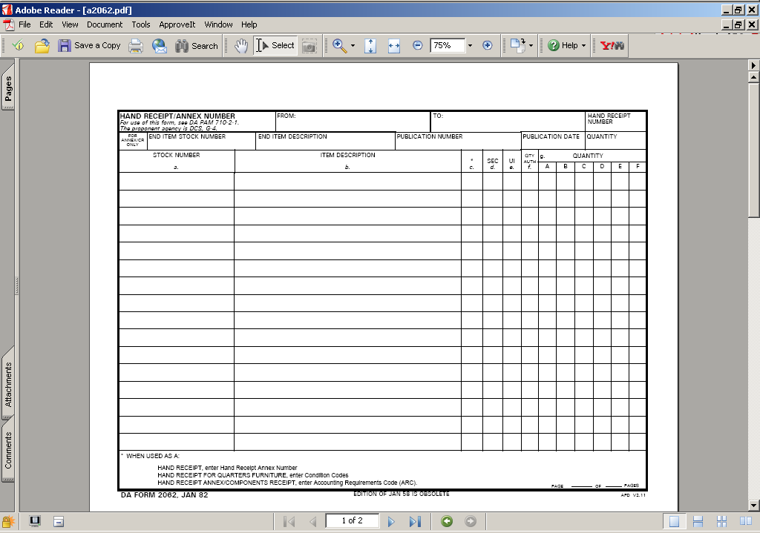
Inventory Procedures
Opening / Closing Inventory
M16A4
EA
55
53
EA
65
M9
65
MK19
EA
6
6
M249
EA
4
4
POW Ruger 9mm SN# 12345
EA
1
1
J. Smith 7 September 2021-----------------\
Notes:
Change of Custody inventories IAW DA Pam 710-2-1 para 9-10 a.

Slide 65
Inventory PE
Inventory Procedures
You are the primary Armorer for A BTRY 2-32 FA.
Your hand receipt shows you are signed for the following equipment from the BTRY Commander:
M16-A4 – QTY 40
M4 – QTY 20
M9 – QTY 5
You also have a privately-owned firearm belonging to SPC Jones:
.50 Cal Desert Eagle pistol serial number 12345
Privately-own ammunition – 25 .50 Cal round
Establish a DA Form 2062 to use for inventories.
Notes:
Change of Custody inventories IAW DA Pam 710-2-1 para 9-10 a.

Slide 66
Inventory Procedures
Opening / Closing Inventory
M16A4
EA
40
EA
M4
20
M9
EA
5
POF SPC Jones SN 12345
EA
1
POF AMMUNITION .50 CAL
EA
25
Notes:
Change of Custody inventories IAW DA Pam 710-2-1 para 9-10 a.

Slide 67
Inventory Procedures
As the primary Armorer you are opening the arms room.
You have the following equipment on hand when you open the arms room:
M16-A4 – QTY 35
M4 – QTY 20
M9 – QTY 4
You have a weapons card in each slot for the five missing M16’s and a DA Form 2062 signed by the BTRY XO for one M9.
All privately-owned weapons and ammunition are accounted for.
Complete your DA Form 2062 for your opening inventory.
Notes:
Change of Custody inventories IAW DA Pam 710-2-1 para 9-10 a.

Slide 68
Inventory Procedures
Opening / Closing Inventory
M16A4
EA
40
35
EA
M4
20
20
M9
EA
4
5
POF SPC Jones SN 12345
EA
1
1
POF AMMUNITION .50 CAL
EA
25
25
Joe D. Armorer 7 September 2021---------/
Notes:
Change of Custody inventories IAW DA Pam 710-2-1 para 9-10 a.

Slide 69
Inventory Procedures
You are the primary Armorer closing the arms room later that afternoon:
All equipment that was signed out has been returned and you have the following items in the arms room:
M16-A4 – QTY 40
M4 – QTY 20
M9 – QTY 5
All privately owned weapons and ammunition are accounted for.
Complete your DA Form 2062.
Notes:
Change of Custody inventories IAW DA Pam 710-2-1 para 9-10 a.

Slide 70
Inventory Procedures
Opening / Closing Inventory
M16A4
EA
40
35
40
EA
M4
20
20
20
M9
EA
5
5
4
POF SPC Jones SN 12345
EA
1
1
1
POF AMMUNITION .50 CAL
EA
25
25
25
Joe . Armorer 7 September 2021-----------/
Joe D. Armorer 7 September 2021---------/
Notes:
Change of Custody inventories IAW DA Pam 710-2-1 para 9-10 a.

Slide 71
Inventory Procedures
You are the assistant Armorer opening the arms room the next duty day.
You have the following equipment on hand in the arms room.
M16-A4 – QTY 39
M4 – QTY 20
M9 – QTY 5
You do not find any hand receipt or weapons cards for the “missing” M16.
All privately owned weapons and ammunition are accounted for.
What do you do next?
Notes:
Change of Custody inventories IAW DA Pam 710-2-1 para 9-10 a.

Slide 72
Inventory Procedures
Opening / Closing Inventory
M16A4
EA
40
35
40
39
EA
M4
20
20
20
20
M9
EA
5
4
5
5
POF SPC Jones SN 12345
EA
1
1
1
1
POF AMMUNITION .50 CAL
EA
25
25
25
25
Joe D. Armorer 7 September 2021--------/
Joe D. Armorer 7 September 2021--------/
John Snuffy 8 September 2021-----------/
Notes:
Change of Custody inventories IAW DA Pam 710-2-1 para 9-10 a.

Slide 73
Inventory Procedures
Missing AA&E Actions:
Complete the DA Form 2062.
Stop all operations and notify Commander and 1SG that you came up a weapon short on your opening inventory.
Unit begins investigation to determine accountability of all weapons.
Notify FRPD, Initiate SIR notifications / procedures.
Notes:
Change of Custody inventories IAW DA Pam 710-2-1 para 9-10 a.

Slide 74

AA&E Key Control

Slide 75
True or False
The serial number on the lock cannot be the same as the serial number on the key.
False
AR 190-11, para 3-8 n. states, “Padlocks and keys which do not have a serial number will be given one. This number will be inscribed on the lock or key as appropriate.” New Master locks have the same serial number on both the lock and key.

Slide 76
True or False
The key ring used must be a solid braised (welded) metal key ring.
False
AR 190-11 does not specify the type of key ring that must be used.

Slide 77
True or False
Staff Duty or the S2 is the key and lock control custodian for the unit.
False
Staff Duty is only the keeper of the locked ammo can during non-duty hours. In the case of the S2, they are only securing the locked and sealed container with the spare keys in them.

Slide 78
True or False
I cannot list where the locks are located at in the arms room on the DA Form 5513. (Ex. Key Number #1, goes to lock #1 which is on M16 rack #2)
False
AR 190-11 para 3-8 n states, “A key and lock inventory will contain a record of keys, locks, key serial numbers, lock serial numbers, location, and the number of keys maintained for each lock. This record will be secured in the key depository.”

Slide 79
AA&E Key Control
AA&E Key Control Custodian
Required to have a DA Form 7708 Personnel Reliability Screening And Evaluation completed prior to assuming duties as AA&E Key Custodian.
Be appointed in writing to issue and receive keys and account for keys.
Issues primary keys to Armorer and Sealed container (spare set) to HHQ (S-2) who places them in a GSA approved class 5 or 6 safe.
Ensure that individuals who are designated to issue keys in their absence, clearly understand key control procedures.
Maintain a key control register (DA Form 5513) at all times to ensure continuous accountability for keys of locks used to secure Government property.
Inventory Keys at a minimum Semi-annually (AA&E Key Custodian & Disinterested individual).
Conduct an inquiry when a key is lost or stolen.
Attend refresher training annually.

Slide 80
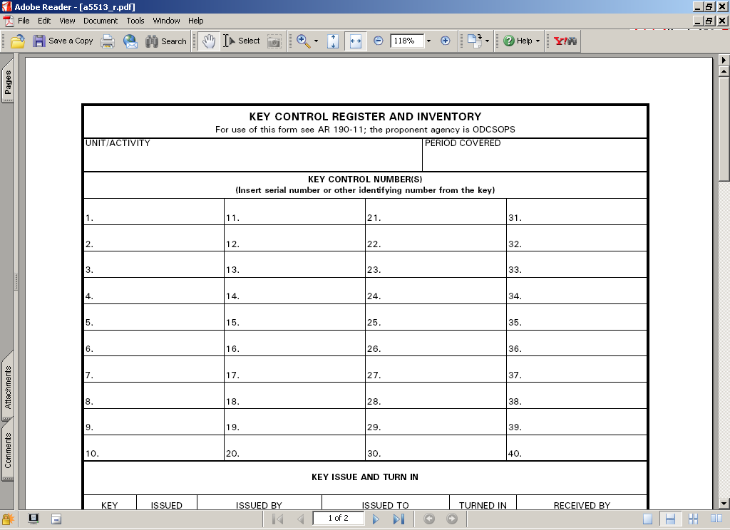
AA&E Key Control
UNIT: HHT 1-4 CAV
44322 High Security Padlock Main Door
1234H M16 Rack 1
5678H M16 Rack 2
1122B M9 Rack 1
Key Serial Number
Lock Location
Input Unit Information
Lock Number 1
Number of Keys
HHT 1-4 CAV
44322
(3)
Arms Room Door
1234H
(2)
M16 Rack 1
5678H
(2)
M16 Rack 2
1122B
(2)
M9 Rack 1

Slide 81





Issuing AA&E Keys
AA&E Key Control
Primary Keys
Armorer
AA&E
Key Custodian
Spare Keys
BN S-2

Slide 82
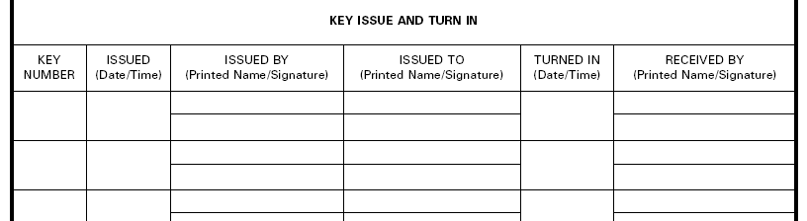
AA&E Key Control
1-24
0900
7 Sep 21
Key Custodian Print
Armorer Print
Key Custodian Sign
Armorer Sign
Seal#
12345
0920
7 Sep 21
Key Custodian Print
S-2 Print
Key Custodian Sign
S-2 Sign
Primary Keys Issued To Armorer
Spare Keys Issued To S-2
All Keys Are Now Issued and Accounted For Properly!

Slide 83
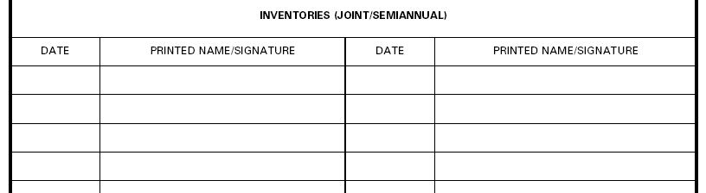
AA&E Key Control
7 Sep 21
AA&E Key Control Custodian
7 Sep 21
Disinterested Party
AA&E Key Custodian and Disinterested Party Signs and Dates When Keys Are First Inventoried. This Is The Benchmark For Future Semi-Annual Inventories.

Slide 84
AA&E Key Control
Unit Armorer Responsibilities:
Sign For Operational Set Of Keys
Ensure Keys Are Never Left Unattended.
Ensure Keys Are Never Taken Off-post (Off The Installation) Unless They Are Being Secured At Another Location
Report Immediately All Lost, Misplaced, Broken Or Stolen Keys To The AA&E Key Lock Custodian.
Ensure Keys Are Properly Secured At The Close Of Business Each Day.
Ensure Keys Signed for at all times.
NOTE: Getting locked ammo can from Staff Duty is NOT signing for the keys.
Notes:
84

Slide 85
AA&E Key Control
Armorer’s DA Form 5513 Setup.

Slide 86
AA&E Key Control
Armorer’s DA Form 5513 Inside Ammo Can
HHT 1-4 CAV
44322
Arms Room Door
1234H
M16 Rack 1
5678H
M16 Rack 2
1122B
M9 Rack 1

Slide 87
Transfer of Arms Room Keys
AA&E Key Control
0930
7 Sep 21
Primary Armorer Print
Alt Armorer Print
0930
8 Sep 21
Primary Armorer Print
1-4
Primary Armorer Sign
Alt Armorer Sign
Primary Armorer Sign
1-4
Primary Armorer Print
Primary Armorer Sign
Used When Arms Room Keys are Transferred Between Two Authorized Personnel
Coincides with opening and closing inventories.
Notes:
Example of 5513 when custody of keys is transferred between authorized personnel. Alt Armorer signs for keys when taking the vault.
When identified that keys are sign by other Armorer…must take possession back by signing for them.
Pre-sign in the event their not present for next time.

Slide 88
AA&E Key Control
Key Turn-In Procedures
Keys signed back in to the AA&E Key Custodian on DA Form 5513 before PCS/ETS.
or
Keys placed in a locked ammo can, and the locked ammo can is signed for on DA Form 5513 to Staff Duty or CQ as “Key Box”. Staff Duty/CQ not authorized to sign for actual keys.

Slide 89
AA&E Key Control
DA Form 5513 At Staff Duty Desk
HHT 1-4 CAV
Locked Ammo Can
Staff Duty is Only Maintaining a Locked Ammo Can (Contents Unknown)

Slide 90

Issuing Locked Key Box to Staff Duty
AA&E Key Control
Staff Duty
Primary Keys
Armorer
Primary Key Box

Slide 91
Signing for Ammo Can
AA&E Key Control
1
0700
7 Sep 21
Staff Duty Print
Armorer Print
1700
7 Sep 21
Staff Duty Print
Staff Duty Sign
Armorer Sign
Staff Duty Sign
Picking Up Keys From Staff Duty
Returning Keys To Staff Duty
Key to AA&E “lock box” / “ammo can”
May be “permanently” issued. Not required to turn in at EODD.
Is considered an Admin Key and issued by Admin Key Custodian.

Slide 92
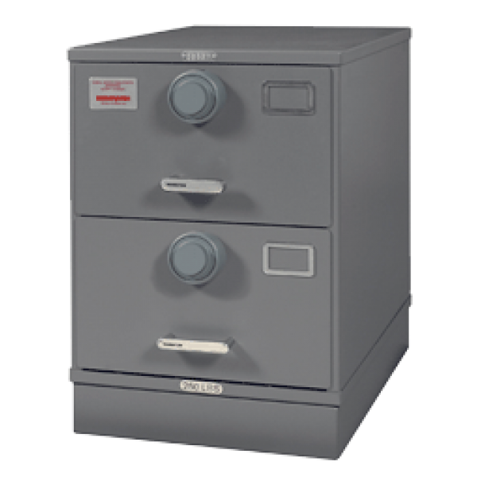

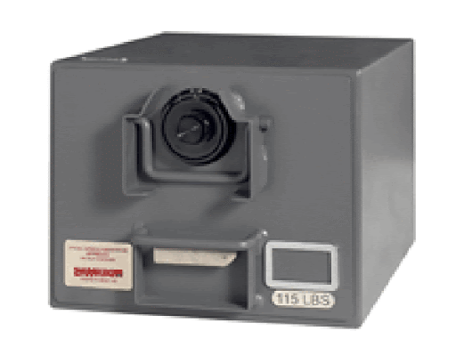
AA&E Key Control
Authorized storage locations of AA&E keys For SRC I and II
GSA Class 5 container with a built in 3 position changeable combination lock.
Container will not contain classified material
If the container weighs less than 500 lbs. it will be chained to the floor or building

Slide 93
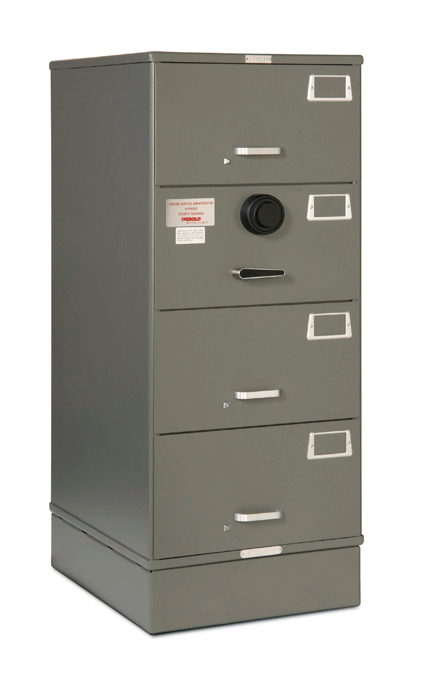
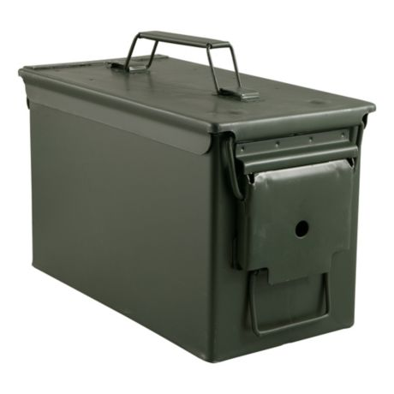


AA&E Key Control
Authorized storage locations of AA&E keys For SRC III and IV.
12 Gauge Steel Key box equipped with a low security padlock. Same as standard key box. Requires hasp addition for lock.
Located in a room that is secured when unoccupied
GSA Class 5 or Class 6 container with a built in 3 position changeable combination lock.
Container will not contain classified material
If the container weighs less than 500 lbs. it will be chained to the floor or building
Typical storage of spare keys at S-2
Keys stored in an ammo can (12 gauge steel) with low security padlock and
Chained to an eyebolt in the floor at the staff duty / CQ desk
or secured in safe

Slide 94
AA&E Key Control
Case Study
Unit Rear-D Armorer With Access To Exterior Arms Vault
Brought AA&E Keys With Him To Lunch Off The Installation
Could Not Locate Keys After Lunch
Searched Car, Barracks Room, Subway Could Not Locate Keys
Retrieved Spare Set Of Keys From S2, Spare Keys Did Not Work. They Were Never Shown Any “Love”
Called Pw To Gain Access To Vault. Pw USED PLASMA CUTTER

Slide 95

AA&E Key Control
Cost Break Down:
$3200 To Cut High Security Hasp And Padlock Off Vault Door And Have Door Recertified
$1300 For High Security Padlock
35 Low Security Padlocks At $12-20 Each -- $420-700
Total Cost: $4,920-5,200
Cost Of A Good AA&E Key Control Program: Priceless!!!!

Slide 96
AA&E Key Control
Hands On Key Control Practical Exercise.

Slide 97
AA&E Key Control
Practical Exercise # 1
SPC Roy Jones is the Primary Armorer for B Btry 1-12 FA.
The Following Keys Are Used In The Arms Room:
23456 - High Security Padlock
2322H - Inner Door
5443B - M16 Rack 1
2722H - M16 Rack 2
6788B - M9 Rack 1
6777G - M9 Rack 2
1233G - POF Locker
2233P - Ammo Can Lock
Seal #12388
*You are the AA&E Key Custodian
*SGT Ricky Steamboat is the S2

Slide 98
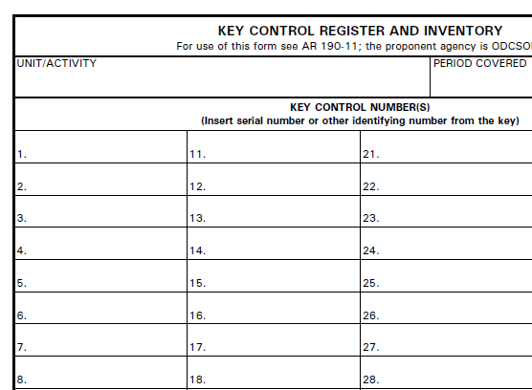
AA&E Key Control
B Btry 1-12 FA
23456 (3)
High Security Padlock
2322 H(2)
Arms Room Inner Door
5443B (2)
M16 Rack 1
2722H (2)
M16 Rack 2
6788B (2)
M9 Rack 1
6777G (2)
M9 Rack 2
1233G (2)
POF Locker
2233P (2)
Ammo Can
Admin Key!! Not Added to AA&E DA Form 5513

Slide 99
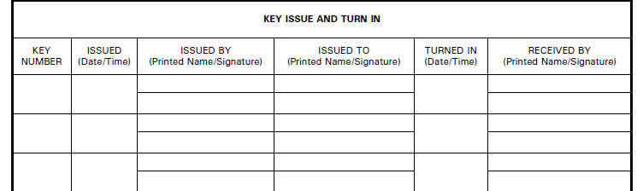
Answers
1500
7 Sep 21
You
Primary Armorer
1-7
You
Primary Armorer
Seal #
12388
1530
7 Sep 21
You
Steamboat, Ricky
You
Ricky Steamboat

Slide 100
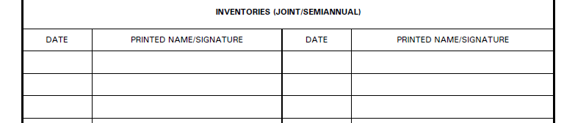
Answers
7 Sep 21
AA&E Custodian
7 Sep 21
Disinterested Party

Slide 101
AA&E Key Control
Practical Exercise # 2
Q: When Signing for the Spare Set of AA&E Keys, The S-2 Signs for the “Ring” Containing All of the Spare Keys?
A: NO. The S-2 Signs for a SEALED Container of Keys, NOT a “Ring” of Keys or the Keys Themselves.

Slide 102

AA&E Key Control
Common Deficiencies:
No DA Form 7708 completed for AA&E Key Custodian
No appointment orders / orders issued prior to DA Form 7708 completed
AA&E keys not issued to Armorer from Key Custodian
AA&E keys not inventoried
Armorer’s not conducting Change-of-Custody procedures to include keys

Slide 103
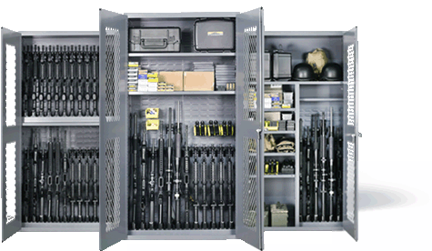
Weapons Storage / Ammunition Storage
Racks / Locks

Slide 104
Racks
When not in use, arms will be stored in banded crates, metal containers, approved standard issue racks or locally fabricated arms racks, and secured in approved weapons storage facilities. Standard issue approved metal wall lockers or metal cabinets may be used (when certified).

Slide 105
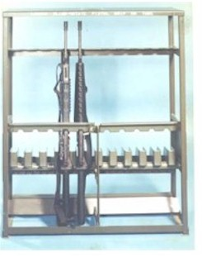
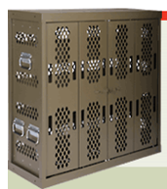
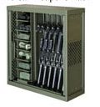
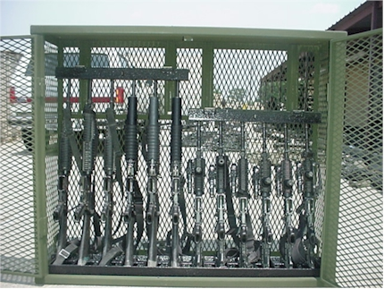
Racks
STANDARD ISSUE
Marvel
Space Saver
War-Tec

Slide 106
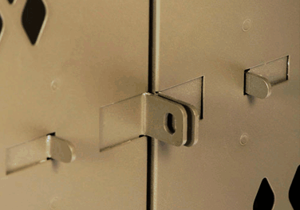
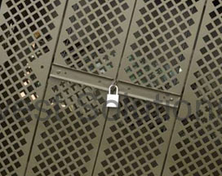
Racks
Marvel
“Push Together”
Space Saver
“Swing Arms”

Slide 107
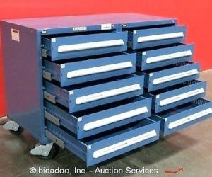
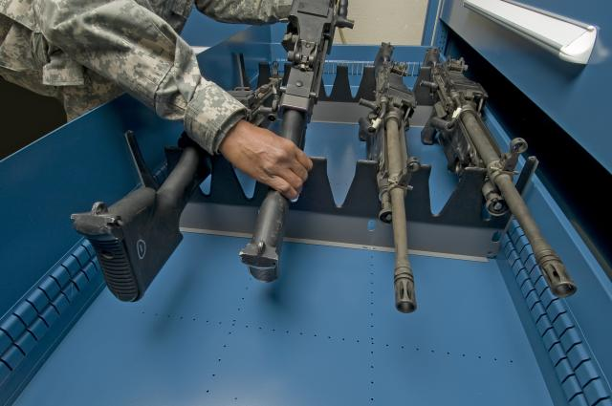
Racks
Stanley-Vidmar
Based on four (4) specific configurations.
Salesman will sell you any configuration.
Approved configurations will have NSN.

Slide 108
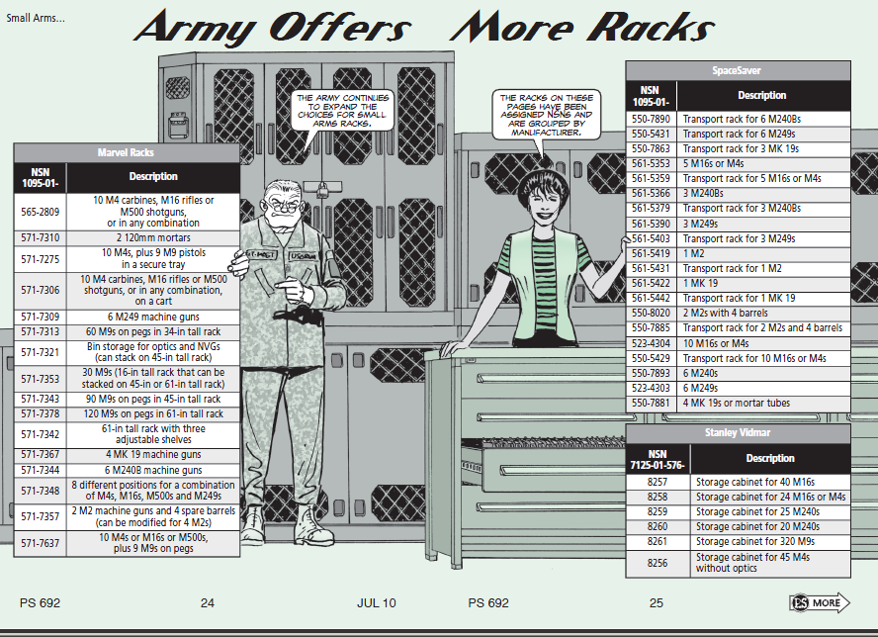
Racks
Authorized Weapons Racks:
Space Saver
Marvel
Stanley Vidmar (limited)
War-Tac

Slide 109
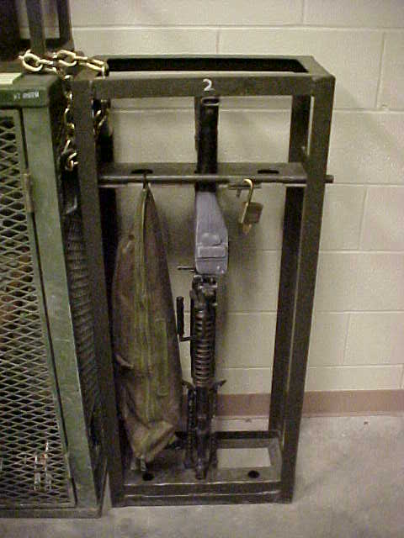
Racks
The use of locally fabricated racks is prohibited unless certified by TACOM as security equivalent to standard issue racks.

Slide 110

Racks
GSA: General Services Administration
Includes all GOV agencies (e.g. Forestry Service, IRS, etc.)
Not a guarantee of meeting DA standards.
Notes:
Iaw AR 190-11 4-2C2

Slide 111
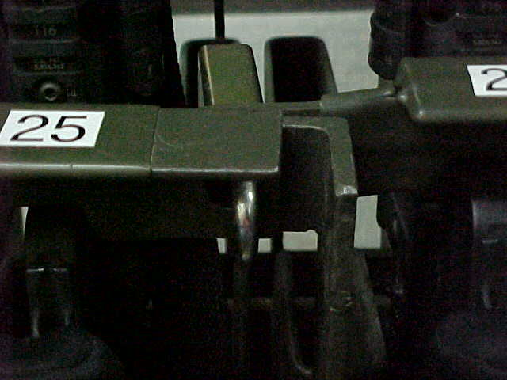
Racks
Incorrect
Notes:
Iaw AR 190-11 4-2C2

Slide 112
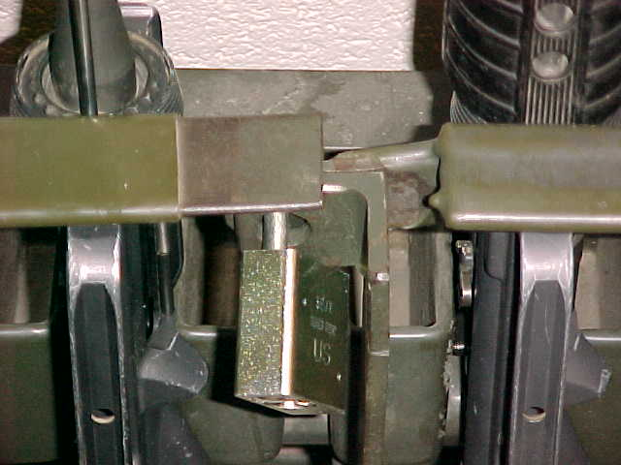

Racks
Correct
Notes:
Iaw AR 190-11 4-2C2

Slide 113
Racks
First Generation Marvel
First Generation Space Saver
Modification: Hinge pins spot welded or crimped and certified by TACOM
Modification Required Certification Packet Required

Slide 114

Racks
Naval Universal Racks Modification Required Certification Packet Required

Slide 115


Racks
Locking Shackle (5/16” Hardened Steel)
Re-enforced Door

Slide 116
Arms Rack Certification:
Racks
The Tank and Armament Command (TACOM) based out of Rock Island, IL is responsible for certifying all weapon racks and containers.
Pre-inspection conducted by TACOM Reps.
Unit Completes Paper Work and Forwards to Rock Island, IL
Packets are returned to local TACOM reps
Final Inspection Conducted /Serial Numbers Issued.

Slide 117
Racks
TACOM Local Area Representatives (LARs)
1 ABCT - William “Larry” Saddler – 240-5600 william.l.saddler.civ@mail.mil
2 ABCT – Richard Wills – 240-0494
Gary.l.crippen.civ@mail.mil
CAB – Terry Blount – 240-6016
etienne.j.baudoin.civ@mail.mil
LSE – Richard Wills– 240-0494 randolph.m.garcia.civ@mail.mil

Slide 118

Racks
Arms racks and containers weighing less than 500 pounds will be secured to the structure with bolts or chains, or fastened together in groups totaling more than 500 pounds. (IAW AR 190-11 para 4-2c(2)
Racks secured together in groups of four is the general “rule of thumb” to meet this standard.
Notes:
HEAVY DUTY HARDENED STEEL, WELDED, STRAIGHT LINKS STEEL, GALVANIZED OF AT LEAST 5/16-INCH THICKNESS.

Slide 119

Racks
Approved Chain to Secure Arms Racks is heavy duty hardened steel, welded, straight links steel, galvanized of at least 5/16–inch thickness.
NOTE: Steel Cable cannot be used as it is composed of smaller fibers of cable that can be easily cut.
General Rule To Follow:
The chain must be at least as thick as the shackle of your low security secondary padlock. (5200 Series) (Weakest Link Theory)
Notes:
HEAVY DUTY HARDENED STEEL, WELDED, STRAIGHT LINKS STEEL, GALVANIZED OF AT LEAST 5/16-INCH THICKNESS.

Slide 120


Racks
Marvel and Space Saver Weapon Racks
Use Nuts and Bolts that will fit existing holes.
DO NOT widen or drill holes to make them bigger.
Notes:
HEAVY DUTY HARDENED STEEL, WELDED, STRAIGHT LINKS STEEL, GALVANIZED OF AT LEAST 5/16-INCH THICKNESS.

Slide 121


Racks
DA Approved Universal Arms Rack – NSN 1095-01-454-6320
Rack meets the 500lbs weight requirement. Do not cut rack to thread chain.
1 container – cannot store Govt. property AND privately-owned weapons / ammo at the same time.
FYSA – tendency to stack equipment several rows deep. Lax inventory procedures combine to increase larceny risks.

Slide 122

Racks
Ensure You Secure Your Arms Racks And Security Containers Prior To Leaving The Arms Room.
Notes:
Iaw AR 190-11 4-2C2

Slide 123


Racks
Lessons Learned
Motor Pool Gate Found Unsecured By Police Patrol
Three Different Locks “Daisy Chained” Together
Notes:
Iaw AR 190-11 4-2C2

Slide 124
Racks
Chain of Events:
Police Patrol Began Clearing Motor Pool and Found Building Door Unsecured.
Police Patrol Then Began Clearing Unsecured Building
Police Patrol Pulled on Vault Door To Arms Room and Arms Room Door Opened. Combination Dial was not “Spun” to Secure Door!
ICIDS Alarm Sounded (ICIDS Was Activated)
Upon Entering “Unsecured” Arms Room the Following Was Found:
Notes:
Iaw AR 190-11 4-2C2

Slide 125



Racks
Weapons Stored On Top of Weapon’s Racks
All Weapon’s Racks Unsecured
Notes:
Iaw AR 190-11 4-2C2

Slide 126




Locks
https://www.cdse.edu/multimedia/shorts/dod-approved-locks/story_html5.html
Notes:
Iaw AR 190-11 4-2C2

Slide 127



Slide 128






Locks
Only approved secondary padlocks (low security) will be used to secure government equipment
Series 200/5200 padlocks are approved for this purpose
Key retain-ability
Stamped with US or US SET
*NOTE* -- Lock sets have limited use and are prohibited from being used in the arms room. They are a form of Master Keyed System.
Notes:
Iaw AR 190-11 4-2C2

Slide 129



Locks
AMERICAN 5200 Series
Long and Short Shackle
Pacific Lock Company
US Master Lock
Notes:
Iaw AR 190-11 4-2C2

Slide 130


Locks
Laminated Steel
(Stacked Plates)
Solid Steel
Same NSN will get you either Master Lock, American Lock or Pacific Lock

Slide 131

Locks
Is this an approved padlock?
NO
Does Not Have Key Retention Ability or is it Stamped “US”
Notes:
Iaw AR 190-11 4-2C2

Slide 132




Use and Control of Protective Seals
For AA&E or classified materiel shipments, security seals types 9, 11, 12, or 13 are required.
Type 9 – Ball Seal (Low Strength Seal)
“Not a Lock”
Type 11 – One Piece Cable (High Strength Seal)
“Not a Lock”
Type 12 – Cable Piece Cable (High Strength Seal)
Type 13 – Unthreaded Bolt (High Strength Seal)

Slide 133

Use and Control of Protective Seals
UNIT LETTERHEAD
OFFICE SYMBOL DATE
MEMORANDUM FOR RECORD
On (This Date), 200 M9 Bayonets were sealed in this footlocker using Seal # 12345”
Point of Contact for this memorandum is the unit armorer at 239-xxxx.
Unit Armorer Witness
Signature Block Signature Block
xxxxxxxxxxxxxxxxxxxxxxxxxxxxxxxxxxxxxxxxxxxxxxxxxxx
NOTE: Recommend using Senior NCO as Witness or Commander.

Slide 134

STORAGE OF AMMUNITION
Notes:
134

Slide 135
IS AMMUNITION AUTHORIZED TO BE STORED IN THE ARMS ROOM?
YES
With An Approved Ammunition Site License
Notes:
135

Slide 136
Ammunition Storage
Must Have a Ammunition Site License To Store Operational Load Ammunition
NOTE: Each unit MUST maintain an operational load on hand in the event that the IDS fails
AR 190-11, para. 4-2 a.(3)
OPLOAD Ammunition Must Be Included In all Inventories (Opening / Closing, Change of Custody, Monthly 100% etc)

Slide 137
Ammunition Storage
Installation Safety Office has implemented a digital site licensing process.
Entire packet is emailed from POC to POC (Eliminates the need for unit armorers to hand carry packet from location to location)

Slide 138
Ammunition Storage
Ammunition Site License
Ammo Storage Authorization Memo (Form 1)
Notes:
138
Operational load : 100 rounds IAW FR PAM 710-16 para 9-2 a, b
Training Ammo IS not authorized for storage in arms room (FR Pam 710-16)
Blank ammunition is excluded from this requirement IAW Ar 190-11 para 1-1c (2) (c)
NOTE: Blank ammo will be on a memo for high value items.

Slide 139

Ammunition Storage

Slide 140
Ammunition Storage
Ammunition Site License
Ammo Storage Authorization Memo (Form 1)
Explosive Site License Worksheet (Form 2)
Notes:
140
Operational load : 100 rounds IAW FR PAM 710-16 para 9-2 a, b
Training Ammo IS not authorized for storage in arms room (FR Pam 710-16)
Blank ammunition is excluded from this requirement IAW Ar 190-11 para 1-1c (2) (c)
NOTE: Blank ammo will be on a memo for high value items.

Slide 141



Slide 142
Ammunition Storage
Ammunition Site License
Ammo Storage Authorization Memo (Form 1)
Explosive Site License Worksheet (Form 2)
Risk Assessment Worksheet (FR Form 108)(Form3)
Notes:
142
Operational load : 100 rounds IAW FR PAM 710-16 para 9-2 a, b
Training Ammo IS not authorized for storage in arms room (FR Pam 710-16)
Blank ammunition is excluded from this requirement IAW Ar 190-11 para 1-1c (2) (c)
NOTE: Blank ammo will be on a memo for high value items.

Slide 143


Slide 144
Ammunition Storage
Ammunition Site License
Ammo Storage Authorization Memo (Form 1)
Explosive Site License Worksheet (Form 2)
Risk Assessment Worksheet (FR Form 108)(Form 3)
Quantity Distance Verification (FORSCOM Form 133-R)
Security Construction Statement (DA Form 4604 – R)
POC: TOM ANDERSON – Garrison SAFETY OFFICE
239-2245 / 2514
thomas.g.anderson5.civ@mail.mil
Notes:
144
Operational load : 100 rounds IAW FR PAM 710-16 para 9-2 a, b
Training Ammo IS not authorized for storage in arms room (FR Pam 710-16)
Blank ammunition is excluded from this requirement IAW Ar 190-11 para 1-1c (2) (c)
NOTE: Blank ammo will be on a memo for high value items.

Slide 145
Ammunition Storage
Operational Load Will Not Exceed:
100 Rounds of Ball Ammunition*
2280 Round of Blank Ammunition
*Commanders must identify Operational necessity. Military, DA Police, Field Artillery Battalions and Specific Units On The Air Field have already identified increased Operational load ammunition quantities.
Notes:
145

Slide 146
Ammunition Storage
DA Pam 710-2-1 - Establishes Proper Hand Receipt Procedures. Ammo will be inventoried whenever sensitive items are inventoried.
DA Form 581 – Original draw document at BN, each CO will maintain a copy that should be “visible”
DA Form 5515 - This document assigns responsibility from the individual drawing the ammo to the user (Hand Receipt) (TRAINING AMMO)
DA Form 5203 - IMCOM Regulations requires units to track the issuing and receiving of ammunition from the arms room on this form. (Ammunition version of the Fort Riley Form 43-1 weapons control log)

Slide 147
Ammunition Storage
Chain of Custody
Ammunition Drawn from ASP by BN Rep using DA Form 581
BN Rep issues OPLOAD ammo to Supply SGT using DA Form 2062 (Must Ensure copy of DA Form 581 is Attached)
Supply SGT will issue OPLOAD ammo to Armorer using DA Form 2062 (Ensure copies of all DA Form 2062 and DA Form 581 Maintained in Arms Room Unless OPLOAD Ammo is on Property Book)

Slide 148



Ammunition Storage
Seals Used by ASP “Unauthorized”

Slide 149

Issue and turn-in procedures

Slide 150
Issue / Turn-in Procedures
The Armorer must maintain a Master Authorization List (MAL)
The MAL will at minimum list:
Name of the Soldier.
Type and serial number of the primary equipment assigned to the Soldier.
The Armorer will keep the MAL updated to reflect all personnel changes. (living document)
Notes:
MAL – IAW DA Pam 710-2-1 PARA 5-6d(1)

Slide 151
Issue / Turn-in Procedures
Hand Receipts
DA Form 3749 – Equipment Receipt (Weapons Card)
Continuous Use Hand Receipt (Can be used Multiple Times)
DA Form 2062 – Hand Receipt
Limited Use Hand Receipt (Six Columns A-F = Six Uses)
No Expiration – Valid Until Equipment is Returned
DA Form 3161 – Request for Issue or Turn-In
Temporary Hand Receipt (Up to 30 Days - “Temporary Hand Receipt” Written in Block 1.)
Notes:
MAL – IAW DA Pam 710-2-1 PARA 5-6d(1)

Slide 152


Issue / Turn-in Procedures
Weapon Issue Less Than 24 Hours
Soldier Hands Weapon’s Card To Armorer
Soldier
Armorer

Slide 153

Issue / Turn-in Procedures
Before a weapon is issued, check DA Form 3749 against the MAL to ensure an authorized and correct issue is being made.
HHC 1 ID M16 MAL
Rank Name Rack # Serial #
PFC Jones, J 3 2211
SGT Fielder, M 5 3456
SSG Kruger, F 8 3422
PFC Smith, J 1 1123
1SG Johnson, S 2 2345
SSG Gabriel, R 9 9965
PVT Ubetcha, P 4 8878
HHC 1 ID
1
510-11-322-5565
1123
M16A4
Arms Room
Smith, John
SPC

Slide 154

Issue / Turn-in Procedures
Weapon Issue Less Than 24 Hours
Armorer issues weapons to soldier
Soldier
Armorer

Slide 155
Issue / Turn-in Procedures
Greater Than 24 Hours
Follow Same Procedures As Above
Soldier Must Also Make Entry On Weapon Control Log
(FR Form 43-1)
Armorer
Soldier

Slide 156

Issue / Turn-in Procedures
Weapon Control Log FR 43-1
M16A4
1123
0
7 Sep 21 / 0900
PFC J. Smith
J. Smith
JA

Slide 157
Issue / Turn-in Procedures
Lost Weapons Card
Use hand receipt procedures (DA Form 2062)
Armorer
Soldier

Slide 158
Issue / Turn-in Procedures
Joe D. Armorer
PFC J. Smith
210-01-111-1111
M16A4 SN# 1123
ea
1
1
J. Smith 1 7 September 2021

Slide 159
Issue / Turn-in Procedures
Lost Weapons Card
Use hand receipt procedures (DA Form 2062)
Soldier must also make entry on weapon control log (FR form 43-1)
Armorer
Soldier

Slide 160
Issue / Turn-in Procedures
Do not use only the FR 43-1 for weapons issue.
It is not a hand receipt. It is only a Control Log for tracking purposes!
The FR 43-1 does not assign responsibility to the soldier.

Slide 161
Issue / Turn-in Procedures
M16A4
1123
0
0
8 Sep 21 / 1010
7 Sep 21 / 0900
PFC J. Smith
J. Smith
JA
J. Smith
JA
M16A4
9083
0
7 Sep 21 / 0905
SGT R. Smith
Roy Smith
JA
M16A4
9873
0
0
8 Sep 21 / 1015
7 Sep 21 / 0906
SGT G. Poe
Grace Poe
JA
Grace Poe
JA
M16A4
6765
0
0
8 Sep 21 / 1017
7 Sep 21 / 0910
SGT W. Wilson
William Wilson
JA
William Wilson
JA
M16A4
3343
0
0
8 Sep 21 / 1019
7 Sep 21 / 0911
SGT J. Fielder
Judy Fielder
JA
Judy Fielder
JA
Completed Control Logs (FR 43-1) are kept on file until the next monthly 100% serial number inventories are complete.
Do not destroy the FR 43-1 if there is still an open entry.

Slide 162
Issue / Turn-in Procedures
Additional Issue Situations
Equipment not assigned to a single, specific individual:
DA Form 2062 and Weapons Control Log.
When a single weapon is needed for issue to more than one Soldier (ex. Squad assigned weapon):
DA Form 3749 for each person authorized to withdraw it and Weapons Control Log.

Slide 163
Check on Learning
Issue / Turn-in Procedures
Q: How would you issue an M4 to a soldier who will be attending Warrior Leaders Course for Two Weeks?
A: Soldier Turns In Weapons Card (DA Form 3749) or Hand Receipt (DA Form 2062), and soldier makes an entry on weapon control log (FR Form 43-1)

Slide 164
Issue / Turn-in Procedures
Check on Learning
Q: How would you issue the Commander’s M9 to his driver so that his driver may clean the Commander’s weapon?
A: Commander’s Driver turn in a hand receipt (DA Form 2062) and makes an entry on the weapons control log since the weapon is not assigned to him on the MAL.

Slide 165
Simple Vs. Complicated * Simple Issue – Only DA Form 3749 (Less Than 24 Hours) * Complicated Issue – Weapons Control Log (FR 43-1) Some Type of Hand Receipt
Issue / Turn-in Procedures

Slide 166

DAY One Review
Intro to PS, the Program and Inspections
Exterior Arms Room
Door Security
Documentation
Inventory Procedures
AA&E Key Program
Racks
Locks
Storage of Ammo
Issuing Procedures

Slide 167
Armorer’s Course
Day 2
DES
Security Branch
Physical Security
Version Number
As of 22 Feb 2022

Slide 168

Day Two Course Topics
IDS
Security of Additional Property
Privately Owned Firearms
Expeditionary Operations
AA&E Checklist PE
Mentorship/Guidebook Overview
Course Review
Course Exam
Exam Review / Closing Remarks

Slide 169

Security Alarms
Integrated Commercial Intrusion Detection System (ICIDS)

Slide 170
Intrusion Detection System
Unless continuously manned or under constant surveillance (guard), the arms room will be protected by an operational intrusion detection system (IDS).
IDS will be tested Monthly by contacting the Alarms Monitor (239-5469) IAW AR 190-11 para 3-6 m(1).
All alarms and tests will be recorded on DA Form 4930 (alarm / intrusion detection record).
Fort Riley uses ICIDS IV as its IDS for record.
Notes:
Essential element of an arms storage facility
Alerts response force to possible intrusion of a restricted area so that they may respond
Detects, NOT PREVENT, penetration of a restricted area
Permits efficient use of guard personnel, because restricted areas do not have to be guarded 24 hours a day if protected by IDS
Armorers are responsible for activating and deactivating IDS upon entry and exiting of arms room.
Alert alarm monitoring station if alarm is activated for any reason other than an intrusion.
PIC and PIN issue procedures (8-11 Mon-Fri)

Slide 171

Intrusion Detection System
Remote Area Data Collector RADC
The RADC is the brain of your ICIDS IV SYSTEM
It compiles a list of data and changes
and reports to the Primary Monitor Console
(Alarm Monitors).
If a RADC triggers an event, the
system alarms and notifies the operator.

Slide 172





Intrusion Detection System
Ensure your sensors are not blocked by boxes or arms racks
Motion Sensors should have an unobstructed view of the door
Two types of sensors required, one of which must be a volumetric sensor
Motion Sensors (Volumetric Sensor)
Point of Entry Sensor
BMS – Balanced Magnetic Switch
PIR – Passive Infrared
USM – Ultra-Sonic Motion

Slide 173



Intrusion Detection System
Duress Switch
Unit is a silent application that sounds the alarm when
personnel are under duress.

Slide 174

Intrusion Detection System
Reasons for Activation
Unauthorized Entry Attempts
Tampering
Power Loss
Communications Failure
Duress
Nuisance
Test

Slide 175
Intrusion Detection System
PIC/PIN
PIC-Personal Identification Cipher (6 Digit #)
PIN-Personal Identification Number (4 Digit #)
Shows who accessed or secured the system and at what time.
No logging out of the system required.
PIC/PIN will work in other arms rooms if you are listed on the unaccompanied access roster.

Slide 176

Intrusion Detection System
Complete your Command Screening (DA Form 7708)
Obtain your updated Unaccompanied Access Roster and CDR’s assumption of command orders
Bring the completed documents to ICIDS PIC/PIN Office located in BLDG 217
Numbers are issued daily from 0800 – 1600 in Bldg. 217

Slide 177


Intrusion Detection System
A CO, 123rd CSSB/ FORT RILEY
BLDG 7803-1
4
Monthly Test
Called Alarms Monitor
RAB
JDA
7 Sep 21
1003
1013
HOT
BLDG 7803-1
3
Mouse in Arms Room
Activated PIR
JDA
7 Sep 21
0200
0330
HOT
Reset Alarm
Enter Alarms
Monitor Initials and
Your Initials
Ensure you annotate All False and Nuisance Alarms As Well On This Form. This Information Is Used By The Alarm Tech To Trouble Shoot The System.
Enter What You
Did
Enter Bldg Number and
“Room” Number
Enter Date
Enter Start and
Stop Time
Enter Weather
Conditions
Completed DA Form 4930 must be maintained on file for 90 Days.
Notes:
Essential element of an arms storage facility
Alerts response force to possible intrusion of a restricted area so that they may respond
Detects, NOT PREVENT, penetration of a restricted area
Permits efficient use of guard personnel, because restricted areas do not have to be guarded 24 hours a day if protected by IDS
Armorers are responsible for activating and deactivating IDS upon entry and exiting of arms room.
Alert alarm monitoring station if alarm is activated for any reason other than an intrusion.
PIC and PIN issue procedures (8-11 Mon-Fri)

Slide 178
Intrusion Detection System
Access rosters not utilizing the proper format will not be accepted
Proper room number and zone number listed on access roster
Ensure the DoD ID Number is used, not SSN
Building number and phone number of duty hour and non-duty hour POCs
Email address of Commander and 1SG at a minimum.

Slide 179





Security Of Additional Property

Slide 180

Additional Property
Tool Such As Hammers, Bolt Cutters, Chisels, Crow Bars And Similar Items Will Not - - -
Be readily accessible.
Be stored in the vicinity of the arms room
Be stored in the supply room when entry to the arms room is located within the supply room.
Bolt cutter control and accountability
Be Secured in the Supply room.
Double barrier protection.
Issued to only the primary or alternate key control personnel.
Log book/Excel for control and accountability.
Accurate information annotated pertaining to lock being cut.
Keys controlled IAW AR 190-51.

Slide 181
Additional Property
High-Value Items:
Will not be stored in the arms room when other secure facilities are reasonably available.
When other secure facilities are not available, the Commander must prepare an informal memorandum to the Armorer authorizing the storage of high-value, sensitive items in the arms room
NOTE:
Remember the Big Four (4) AA&E and NVD’s must be secured in the Arms Room.
Notes:
High Value Items include but are not limited to:
Any items stored in the arms room besides weapons and weapon parts require written authorization from the commander.
MEMORANDUM SHOULD LIST ITEMS AND QUANTITY THE COMMANDER IS AUTHORIZING TO BE STORED IN THE ARMS ROOM.

Slide 182
Additional Property
Pilferable Items:
Readily available civilian equivalent.
May or may not be sensitive items.
Typically don’t have serial numbers assigned to specific items.
Required to be inventoried at same frequency as other property stored in the arms room. (open/closing, change-of-custody, 100% serial number, etc.)
Notes:
High Value Items include but are not limited to:
Any items stored in the arms room besides weapons and weapon parts require written authorization from the commander.
MEMORANDUM SHOULD LIST ITEMS AND QUANTITY THE COMMANDER IS AUTHORIZING TO BE STORED IN THE ARMS ROOM.

Slide 183

Additional Property
Storage of Controlled Cryptographic Items (CCI)
CCI (keyed or un-keyed) shall not be stored in vaults, security containers, or arms storage facilities containing items of monetary value (e.g., cash, jewelry, precious metals, etc), weapons, ammunition, or other sensitive items.
All CCI will have a data-plate on it identifying it as a Controlled Cryptographic Item.
CCI is anything with a CIIC (Controlled Item Inventory Code) “9”
AR 380-40, paragraph 8-8 c.
Notes:
High Value Items include but are not limited to:
Any items stored in the arms room besides weapons and weapon parts require written authorization from the commander.
MEMORANDUM SHOULD LIST ITEMS AND QUANTITY THE COMMANDER IS AUTHORIZING TO BE STORED IN THE ARMS ROOM.
FOR TEST PURPOSED CG POLICY LETTER 12-3 IS STILL IN EFFECT

Slide 184

Additional Property
Click on CIIC for More Information

Slide 185

Privately owned Weapons
Storage and Control of POW’s

Slide 186


Privately Owned Firearms
Firearm
Any revolver, pistol, rifle, shotgun, or other device designed for or capable of propelling a bullet or other projectile by means of an explosive or compressed charge.
Weapon
Anything designed or used for inflicting bodily harm or physical damage.
Privately-Owned Weapon
Any weapon in the possession of an individual, other than authorized military weapons in an individual’s possession as part of official military duties.
Notes:
186
Cross bows, Bows, Knives, Swords, Slingshots are not required to be registered on the installation.

Slide 187
Privately Owned Firearms
Applicable Regulations:
AR 190-11 para 4-5: prohibits POFs unless policy designated in writing by Senior Commander.
FR 190-1 (Dated: 3 Apr 2018): Fort Riley specific regulation titled Privately Owned Weapons, Explosives and Ammunition.
Unit Requirements:
FR Form 102-1 maintained on file until the Soldier/Family Member departs the organization.
Have policies, plans and procedures in place for storing privately owned weapons. Plan tailored by the CDR for their specific situation based on mission, facility space, etc.…
NEW REGULATION
APR 2018!
Notes:
Are POFs store in a separate container from government weapons?
Is private ammo stored separate from GOV ammo?
Does the current CDR/1SG know who has POFs?
Does the armorer have a list of who in the unit have authorized POFs registered and store elsewhere? Quarters, BEQ, BOQ.
You can not require a Soldier to register POF on post if the firearm is never brought on the installation.
You can not authorize a Soldier in the barracks to store his POF elsewhere on the Installation besides the Arms Room.
Transported directly to and from authorized activities. Range, hunting, dog training area, others to be designated by SMC

Slide 188

Privately Owned Firearms
FR 102-3 (SEP 2019)
Request permission for up to 5 firearms per form.
Valid for 24 Hours.
Firearms brought onto post or purchased on post must be registered in the ALERTS within 24 hours.
Issued at AAFES gun counter, and all ACP during VCC non business hours.
VCC authorized to issue 7 day temporary registration.

Slide 189
Privately Owned Firearms
FR 102-1 (MAR 2018)
Register up to 6 firearms per form
Valid for 3 years (All)
DES VCC will stamp the Commanders copy of the FR Form 102-1.
Commander must maintain copies of the FR Form 102-1 of personnel within the unit approved to bring firearms on post. (including family members and guest). (Generally maintained by the Unit Armorer)

Slide 190

Privately Owned Firearms
Registration Process
Validate POF is legal FR Form 102-3 (24 HR Permission for Privately Owned Firearms On Fort Riley)
Obtain Commander’s permission by completing FR form 102-1 Request for Registration of Privately Owned Firearms.
Complete registration process at Visitor Control Center (VCC). (Henry ACP, I-70 exit 301)
DES VCC personnel is the final registration authority, and will stamp the Commanders copy of the FR Form 102-1, and the ALERTS generated permanent registration form.
Notes:
Are POFs store in a separate container from government weapons?
Is private ammo stored separate from GOV ammo?
Does the current CDR/1SG know who has POFs?
Does the armorer have a list of who in the unit have authorized POFs registered and store elsewhere? Quarters, BEQ, BOQ.
You can not require a Soldier to register POF on post if the firearm is never brought on the installation.
You can not authorize a Soldier in the barracks to store his POF elsewhere on the Installation besides the Arms Room.
Transported directly to and from authorized activities. Range, hunting, dog training area, others to be designated by SMC

Slide 191
Privately Owned Firearms
Commanders Responsibilities:
Brief all newly assigned personnel on this regulation and ensure that members of their command are briefed on any changes to this regulation, Federal laws, state laws, or local ordinances.
Establish in and out-processing procedures at the unit level to identify if Soldiers in the command and Family Members they sponsor who reside on the installation own or possess a firearm requiring storage on the installation or those who reside off the installation have a need to bring a firearm on the installation. Establish unit SOP for POFs.
Make decisions on the appropriate storage location of firearms on request approvals by appropriate annotation on FR 102-1.
Ensure POFs and ammunition in the arms room are inventoried at the same frequency as military weapons and ammunition. (Add to monthly serial number inventory)
Provide written authorization to store and remove POFs, ammunition and other privately owned weapons in the arms room.
Notes:
191

Slide 192
Privately Owned Firearms
Commanders Responsibilities cont.:
Maintain records of all approved FR 102-1 of Soldiers in the command and their immediate Family members. Once the firearms are registered through DES, the Soldier will return the FR 102-1 to the Commander. (Generally maintained by the Unit Armorer)
Establish and identify individual limits on the quantity and type of privately owned ammunition that may be stored in the arms room, based upon availability of space and safety considerations. Limits must be annotated in the unit arms room standing operating procedures (SOP).
Ensure the security and control of privately-owned firearms that are stored in the unit arms room.
Secure privately owned weapons and ammunition in unit arms rooms in locked containers separate from military arms, ammunition, and explosives.
Conduct unannounced inspections of their unit areas to include parking areas to ensure that proper storage of weapons and registration of firearms is being accomplished.
Immediately notify the Military Police (MP) Desk Sergeant upon discovery of a loss of accountability for privately owned firearms stored in the unit arms room.

Slide 193
Privately Owned Firearms
Armorers Responsibilities:
Meet the storage requirements of FR 190-1 Appendix B.
Sign for POF from owner and give owner hand receipt. Issue owner DA Form 3749 (equipment receipt) in order for owner to draw POF in the future.
Ensure written permission is received from the unit commander prior to issuing the POF.
Ensure same issuance procedures are followed when issuing a POF as you would when issuing a military weapon.
Ensure POFs and civilian ammunition are stored separately from military weapons and ammunition. The are required to be stored in an approved container for AA&E.
Inventory POFs and other privately owned weapons at the same frequency as Government owned AA&E
Maintain accountability of temporary release authorization documents for 90 days and permanent removal documentation for 2 years.
Notes:
193
IAW AR 190-11 4-5 a(1)

Slide 194



Physical Security During Expeditionary Operations
“The force is often most vulnerable to an enemy or adversary surprise attack during preparation.” ADRP 3-37
Notes:
Introduction to Class

Slide 195

Physical Security During Expeditionary Operations
Rear Detachment Physical Security Requirements
There is no relief from physical security requirements for the Rear Detachment. The rear detachment area is often a haven for criminal activity.
Rear Detachment Commanders must ensure that assets are protected, inspections are conducted, and equipment is accounted for. Security checks are an important tool to accomplish this mission.
At times, this can be more difficult due to consolidated assets, including arms rooms, motor pools, and other property book adjustments.
Additionally, personal property should be included in security plans and special considerations given to “pack-in” situations in the barracks.
The PSO should assist Rear Detachments with establishing their physical security plans and battle rhythm prior to deployment, it should be planned, resourced, and rehearsed during field training and other opportunities.

Slide 196
Physical Security During Expeditionary Operations
Rear Detachment Physical Security Requirements
During the deploying unit's absence from home station, a duty officer or duty NCO will conduct a daily check of the arms room entrance.
The rear detachment armorer will test the IDS on a monthly basis. If the IDS is not operating or is malfunctioning, the rear detachment commander must post an armed guard at the arms room until all weapons and ammunition stored therein can be relocated to an alternate arms room or the IDS is repaired.
Privately owned weapons stored in unit arms room will be included on the inventory lists and stored in the arms room IAW AR 190-11 and AR 190-13.
Government property, other than AA&E, will be placed under continuous surveillance or afforded protection by other means (fenced enclosure, secured within bldg.) to preclude unauthorized access to these items.
If no rear detachment is established, all AA&E, sensitive and high value items not accompanying the unit will be turned-in to the LRC, Supply and Services Division. At no time will AA&E or sensitive items be left unattended and/or unsecured.

Slide 197

Physical Security During Expeditionary Operations
Rear Detachment Physical Security Requirements
Personal property, when removed from individual billet rooms, will be locked, sealed, and protected by controlling access to building/areas where the property is stored. Commanders will either post guards or secure the storage building (or room) and control access to the keys.
When personal property is stored in the barracks, personnel not deploying with the unit should be consolidated in the barracks. Personnel staying back will be separated from billets/rooms used as storage areas.
Checks of the storage area(s) will be conducted every eight hours and recorded on the staff duty DA 1594, Staff Journal.

Slide 198

Physical Security During Expeditionary Operations
No AA&E items will be left unattended or unsecured at any time. AR 190-11 para 7-10b
Commanders will ensure that enough security measures are taken to protect AA&E being moved by unit or organization transportation, on or off installations.
All movements of Category I and Category II AA&E require armed guards regardless of the FPCON. AR 190-11 para 7-10c
Request separate containers for AA&E and classified materials. One “sensitive items” container does not met regulatory intent in most circumstances.
Individual issued AA&E is the responsibility of that Soldier.
Notes:
Introduction to Class

Slide 199
Physical Security During Expeditionary Operations
Shipping AA&E and Sensitive Items
It is Army policy that weapons or sensitive items such as funds, jewels, precious metals, or drugs will not be stored in the same container or facility used to safeguard classified information.
When used for transporting AA&E, the doors of approved intermodal containers (MILVAN, SEAVAN, or CONEX) will be securely closed and sealed.
End-opening containers will be placed door-to-door during rail shipments.
Barriers on the rail cars will be used to protect side-opening containers and deter the opening of such cars. The AA&E will be placed in the rear of containers behind non sensitive items to reduce the opportunity of theft.
In the event of contingencies, exercises, or rotational unit movements where it is not practical to use containers,
only armored vehicles that are locked and sealed will be used to ship AA&E
The AA&E will be provided double barrier protection by placing it in separate, locked, and sealed containers, affixed to the interior of the locked/sealed armored vehicles in a manner that precludes easy removal.

Slide 200

Physical Security During Expeditionary Operations
Shipping AA&E and Sensitive Items
Army activities involved with AA&E shipments will implement a
seal control program per AR 190–51 to ensure accountability/control
of seals.
Shipments must be checked immediately upon receipt to ensure
that the seals are intact and for any signs of damage or tampering.
If there are any such signs, there must be an immediate inventory
to verify quantities received and to determine the extent of any
damage or tampering on all Category I and Category II AA&E
and classified AA&E shipments.
If the seals are intact, quantity verification must take place no later than the next working day. The
requirement to check seals and verify quantities received includes shipments of all categories of sensitive or classified AA&E and uncategorized Class A and Class B ammunition and explosives.

Slide 201
Physical Security During Expeditionary Operations
Representative Risk Categories
Category I (Missiles And Rockets).
(1) Nonnuclear man portable missiles and rockets “in a ready-to-fire” configuration; for example, Redeye, Stinger,
Dragon, Javelin, light antitank weapon (66mm), shoulder-launched multi-purpose assault weapon rocket (83mm), and AT–4 anti-armor launcher and cartridge (84mm). Also included are the tube-launched, optically-tracked, wire-guided missile (TOW) weapon and the Hellfire missile.
(2) These weapons, when jointly stored or transported with the launcher tube and/or grip stock and the explosive
round, though not in a ready-to-fire configuration will be considered Category I weapon items.
Category II. Light automatic weapons, including .50 caliber, M16A2 rifle, M4 rifle, Squad Automatic Weapon,
M240b machine gun, and 40mm MK 19 grenade launcher.
*Weapon components such as silencers, mufflers, and noise suppression devices will be treated as Category II items.
*Research your specific items in AR 190-11 APP B

Slide 202

Physical Security During Expeditionary Operations
In Transit Guard Forces
Unit equipment must be safeguarded according to governing regulations and SOPs while it is being transported to, and staged at, installations, marshaling areas, and ports of embarkation.
Certain cargo categories require care while in transit and some special cargo categories require extraordinary protection and monitoring while in transit.
Measures of protection and monitoring range from continuous surveillance to a simple seal used in shipping.
Rail movement may require rail guards, while shipments by sea may require personnel assigned as supercargo.
The threat to the particular asset can increase the specific security requirement, however, the minimums are mandatory.

Slide 203
Physical Security During Expeditionary Operations
Rail Guards
Physical Security Requirements remain during rail load operations and shipments.
The deploying unit commander coordinates with the installation transportation officer (continental United States) or the unit movement coordinator (outside the continental United States) and authorized railroad representatives on guard or escort matters.
Guards or escorts are armed at the installation commander’s discretion for CAT III and IV AA&E. When armed guards are used, all participating railroads must be notified. All armed guards must be familiar with the rules of engagement and trained in the use of force.
Cargo guards or escorts maintain surveillance over military equipment during the journey and notify railroad personnel of any problems. When outside the continental United States, host nation support is used when appropriate.
Escorts are instructed on locomotive and railroad safety. Additionally, escorts will be briefed on the rules of engagement before the train leaves the station.

Slide 204
Physical Security During Expeditionary Operations
Ship Guards
Supercargoes are unit personnel designated on orders to accompany, secure, and maintain unit cargo aboard ships.
They perform liaison during cargo reception at the seaport of embarkation, shipload and discharge operations, and seaport of debarkation port clearance operations.
Upon arrival at the seaport of embarkation, supercargos are under the operational control of the port commander. While aboard a ship, the supercargos are under the mission command of the vessel captain or first mate.
Upon arrival at the seaport of debarkation, supercargos are under the operational control of the port commander. Supercargos are normally released to the unit upon completion of port clearance operations.
Unit commanders recommend the composition of supercargos based on several factors, including the amount and type of equipment loaded aboard the ship and the number of units with equipment on the ship.

Slide 205
AA&E Checklist Review
AA&E Guide Book Review
Mentorship Review

Slide 206

Written Exam Review

Slide 207
Written Exam
Post-Test
Open Book / Open Note
70% or Better

Slide 208
Written Exam
Select the answer you believe to be correct. ONLY ONE correct answer is given for any question.
Fill in the gap completely on the answer sheet:
(A) (B) (C) (D)
Do Not:
(A) (B) (C) (D)
Or:
(A) (B) (C) (D)

Slide 209
Phys Sec POCs
Mark Dombrowski – Chief Security Branch 239-2125
Mike Magar – Lead Security Specialist 239-0866
Billy Golden – Security Specialist 239-5474
Matt Haskins – Security Specialist 239-0671
Duane Pugh – Security Specialist 240-0305
SSG White – Security Specialist 239-2775
SSG Streeter – Security Specialist 239-3295
William Wilson – Security System Administrator 239-6342
Kurt Mohlman – Access Control 239-0630
Alarm Monitoring Station (Alarm Testing) 239-5469
Notes:
Other things to check
Are off limit signs posted outside the arms room?
Is there a yellow and black sign identifying the arms room is protected by an alarm system?
Is Fort Riley Regulation 190-1 posted outside the arms room or on the unit bulletin board?
Is the Lautenberg amendment posted outside the arms room?
Are sensitive items stored in the arms room? Is there a memo signed by the commander authorizing sensitive items to be stored in the arms room?
Does the unit have guard ammo on hand for in the event ICIDS fails?

Slide 210
“We hold these Truths to be self-evident, that all Men are created equal, that they are endowed by their Creator with certain unalienable Rights, that among these are Life, Liberty, and the Pursuit of Happiness---That to secure these Rights, Governments are instituted among Men, deriving their just Powers from the Consent of the Governed, that whenever any form of Government becomes destructive of these Ends, it is the Right of the People to alter or to abolish it, and to institute new Government, laying its Foundation on such Principles, and organizing its Powers in such Form, as to them shall seem most likely to effect their Safety and Happiness”

Slide 211






Final Comments / Questions

