Slide 1


Armorer’s Course
Day 1
DES
Security Branch
Physical Security
Version Number
As of 8 Feb 2023

Slide 2
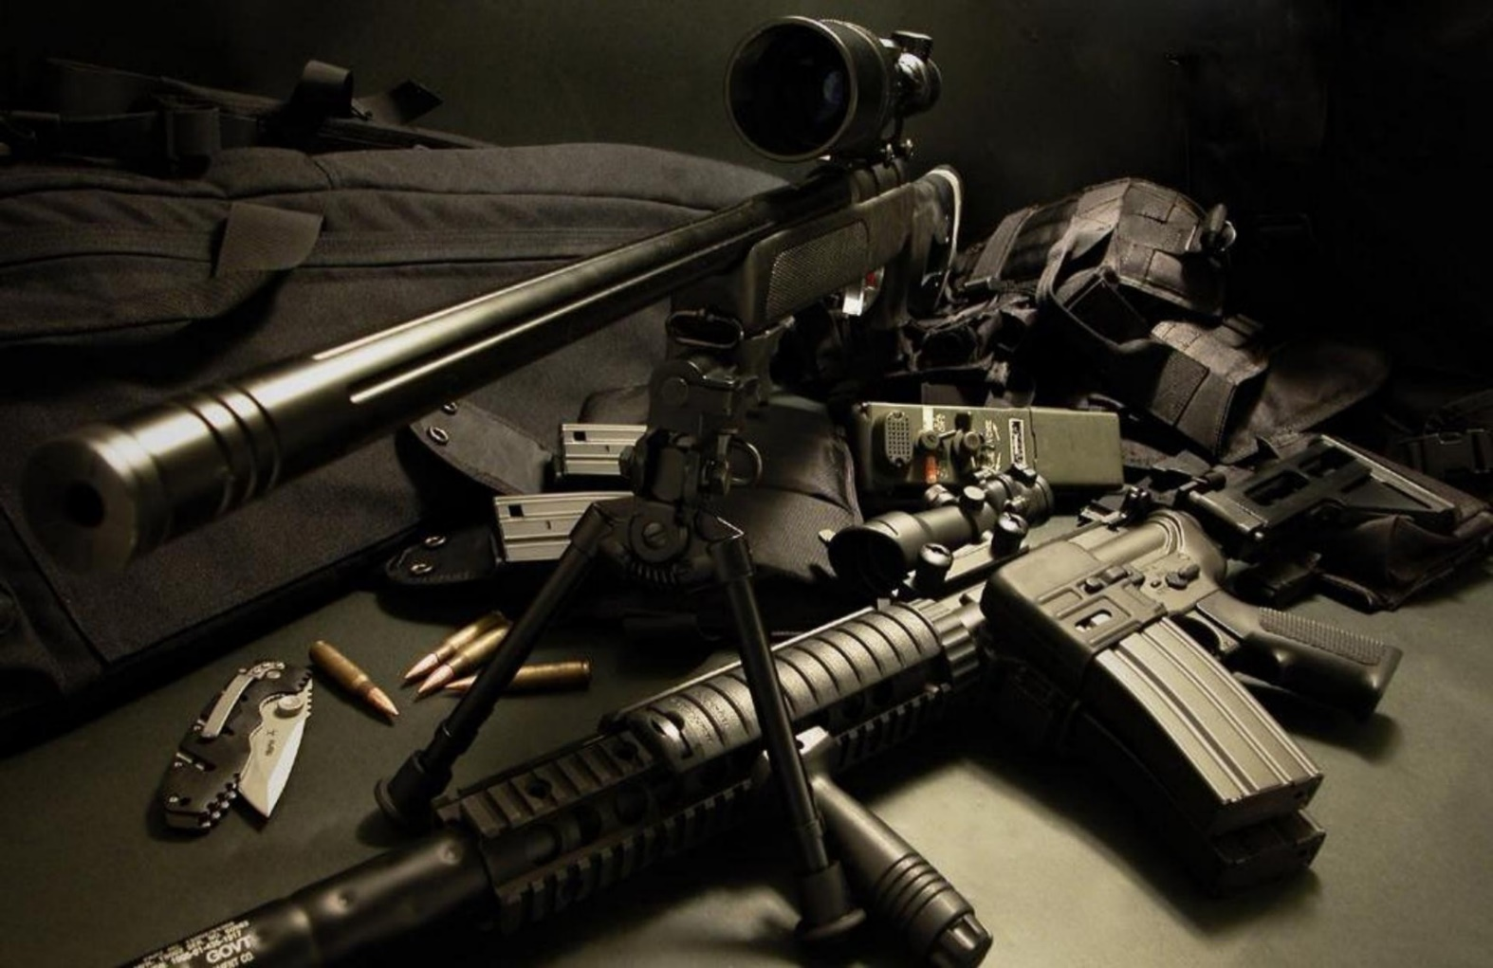
Day One Course Topics
Intro to PS, the Program, and Inspections
Exterior Arms Room
Door Security/IDS/Locks
Documentation
AA&E Key Program
Racks
Inventory Procedures
Security of Additional Property
Issuing Procedures

Slide 3
Introduction to Physical Security
Purpose – Prevention and Protection
Defined – Active and Passive measures designed to deter intruders
Prevent unauthorized access, including theft and damage, to assets such as personnel, equipment, installations, materials, and information
Safeguard against threats such as espionage, sabotage, terrorism, damage, and criminal activity.
In simplest terms:
ASSET PROTECTION

Slide 4
Introduction to Physical Security
Security-in-Depth (SID)

Slide 5
Introduction to Physical Security
Four Fundamentals of Physical Security
DETER
PHYSICAL
SECURITY
DETECT
DELAY
RESPOND

Slide 6
The Physical Security Program
Integrated approach to physical security designed to provide risk-based protection to Army installations from threats to readiness
Protecting Army personnel, information, equipment, facilities, activities, and operations. (PIEFAO)
Commanders and directors at every level are responsible for the physical security of the Army resources under their care.
Physical security programs and plans will include multiple security components that complement each other to produce a comprehensive approach to security matters, including physical security plans; physical security inspections and surveys; participation in antiterrorism committees and fusion cells; validated task critical assets; and a continuing assessment of the installation or command physical security posture.

Slide 7
The Physical Security Program
The intent of the program is to counter threats against the Army mission, resources, and capabilities in all aspects of operations by means of policies that set minimum physical protective measures and security procedures.
The program counters threats by addressing the full spectrum of aggressors, and their tactics and tools, based on historical and current use.
Physical security plans, processes, and procedures will synchronize with other protection programs such as antiterrorism, information security, personnel security, and with related efforts such as continuity of operations, information assurance, emergency management, and resource management.
Physical security includes protective measures such as equipment and devices, personnel, and procedures.

Slide 8

Regulatory Resources
Regardless of the environment or available resources, the protection of Army personnel and assets follow the same general procedures:
Identify the asset or area to be protected.
Determine its mission criticality.
Assess the likelihood of compromise.
Assess potential threats and tactics.
Develop and implement control measures.
References:
AR 190-13 – PS program
AR 190-11 – AA&E
AR 710-2
DA PAM 710-2-1
UFC 4-010-01
UFC 4-010-03
UFC 4-020-04
AR 190-14
AR 190-51- Un-classified
DA PAM 190-51 – RA
ATTP 3-39.32 – Ex Ops PS
UFC 4-010-02
UFC 4-020-02
UFC 4-022-03
FR 190-1 – FRKS POFs

Slide 9

Physical Security Plan / Supplemental Plan

Slide 10
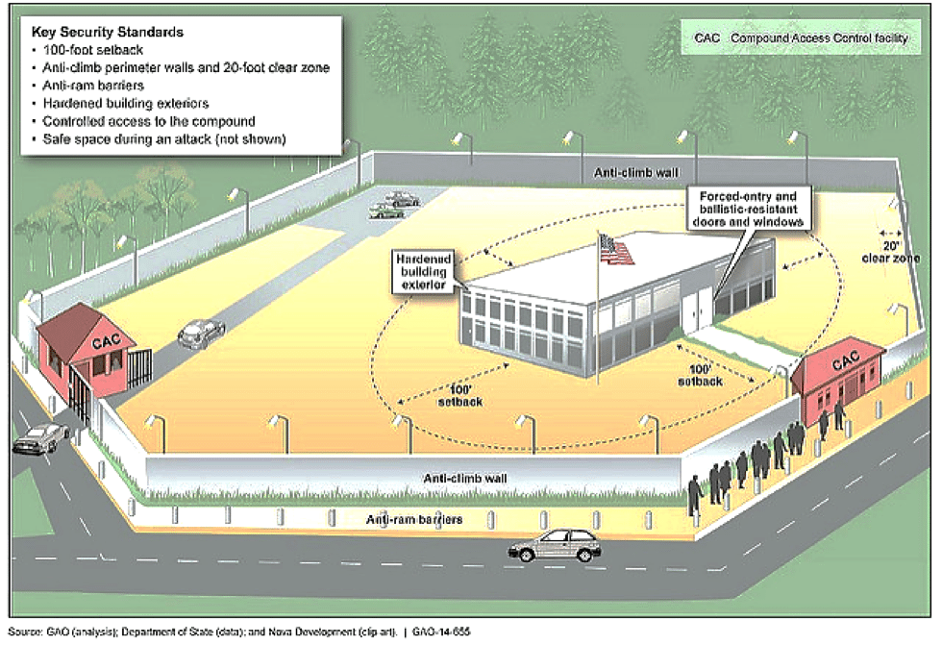
Physical Security Plan
The plan will contain sufficiently detailed organizational processes and procedures to ensure that practical, effective, and common-sense measures are employed in a risk-based method across the command.
The plan will be specific enough that subordinate organizations can clearly determine their roles, responsibilities, timelines, and other related requirements. The physical security plan is a stand-alone document or an annex to a protection plan or operational order.
The plan will be reviewed annually and revise as required. A brief statement affirming currency will be placed on the front page in this format: Certified current by the commander/director (principal official) (date).
Plan annexes may be separated from the basic plan for operational efficiency. The publication containing the separated annexes will be cited in the physical security plan as a cross reference.

Slide 11

Physical Security Plan
Established IAW AR 190-13, Appendix C
Must Address:
Establish security procedures for all operational environments
  Expeditionary operations
  Transition (pre-deployment / re-deployment)
  Program assurance at all phases
Establish a Crime Prevention Program
  End-of-day checks
  Personal and personnel security
  Reduce crime within the organization
Establish security plans to restrict access
  Barrier Plan
  FPCON upgrade

Slide 12
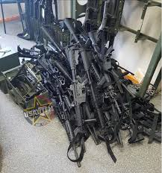
Supplemental Plans / SOPs
Company supplemental plans must address Arms Room Operations if it is not addressed in the BN PS Plan. The Commander must ensure the following items are covered:
Commander’s Responsibilities
Arms Room Officer (Physical Security Officer) Responsibilities
Armorer’s Responsibilities
Inventory Procedures (Opening/Closing, Monthly)
Weapon Issue Procedures
Weapon Security During FTX’s
Procedures for armed guards
Monthly IDS testing and protection of PIC/PIN’s.
Address Privately Owned Firearms (POF) registration procedures
AA&E Key Control Procedures
Notes:
COMMANDERS DO NOT HAVE TO DEVELOP AN SOP, BUT GUIDANCE WILL BE REVIEWED ANNUALLY.
Fort Riley Reg 190-1 States that POW procedures will be in the form of an SOP.

Slide 13
Supplemental Plans / SOPs
The Commanders are responsible for developing security procedures to protect unit assets under their control.
  Procedures will be reviewed, revised and certified as current annually
  Procedures will be distributed to unit personnel
Procedures for the control of privately owned firearms will be included in this SOP and will include:
  Withdrawal and issue of privately owned firearms from the arms room.
  Storage and inventory procedures
  Limits on how much privately owned ammunition can be stored
Notes:
COMMANDERS DO NOT HAVE TO DEVELOP AN SOP, BUT GUIDANCE WILL BE REVIEWED ANNUALLY.
Fort Riley Reg 190-1 States that POW procedures will be in the form of an SOP.

Slide 14
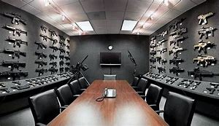
Supplemental Plans / SOPs
Consolidated Arms Rooms
Door lock
  Separate key containers
One Armorer vs. Multiple
One Access Roster
  DA Form 7708
  Updating personnel changes
Armed Guard Requirements
MOA signed by CURRENT Commanders
Note: Multiple UICs create a consolidated arms room. Weapons must be stored by unit in separate approved AA&E racks.
Consolidated Facilities
Motor Pool
Building (co-located) with Contractor / other Unit

Slide 15

Inspections
Physical Security vs ICI / SCI

Slide 16
DES PS vs. UNIT
Inspections
Physical Security Inspections
Regulatory Driven (DA)
Announced
  Initial (18 / 24 months)
  1st Re-Inspection (6 months)
  Subsequent Re-Inspection (30 Days)
  Occur during a change in unit status such as deployment, redeployment etc.
  Upon establishment of a unit or rear detachment
Un-announced
Command Requested
Command Directed
15-6 / FLIPL
HHQ / PSO Inspections
Driven and/or conducted by your next higher element (BN, BDE, DIV)
Occur during a change in unit status such as deployment, redeployment etc.
Confirm the PHYSEC Program is maintained
Constant inspections, always ongoing through on the spot corrections, security culture within the organization

Slide 17

Inspections
Inspection Reporting:
Inspection results go to:
  Commander
  Next Higher Command
Must be maintained on file until next inspection
Recurring deficiencies will be tracked on reports until corrected
Commanders will receive recommend corrective actions and mitigations via email to the deficiencies noted during the inspection and will have five (5) business to endorse. If the CDR determines to develop their own plan, they must indicate their intentions within the 5 business days. This Corrective Action Plan (CAP) must be submitted in writing within the next 30 days. Re-inspections cannot be conducted until the CAP is submitted.
  Unit will remain Not Adequate.
  CAP submitted to both next HHQ and the FRSB Office.
Not Adequate rating requires a re-inspection within 6 months. If a unit is still “not adequate” they will be re-inspected every 30 to 60 days until they receive a “Adequate” rating.

Slide 18
Inspections
Inspection Areas
  Administrative Security
    CO / BTRY / TRP level
    BN / BDE level
    DIV / Directorate level
  Admin Keys and Combinations
  Supply Room Security
  Arms Room Operations
  AA&E Key Control
  Motor Pool (Tactical Vehicle Storage)
  POL Storage
  ICIDS
  Tool Security
  High-value items storage
  FP measures
  Airfield Security
  POF’s and Privately Owned Ammunition
  OCIE Storage
  Subsistence Facilities
  PLL Storage

Slide 19
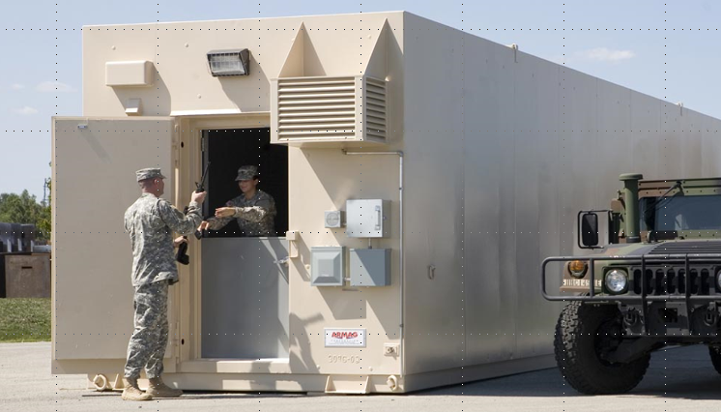
ARMS ROOM OPERATIONS

Slide 20
Exterior
Restricted Area Warning Sign
Notes:
What should be posted outside of the arms room.

Slide 21
Exterior
RESTRICTED AREA
WARNING
THIS ACTIVITY HAS BEEN DECLARED A RESTRICTED AREA BY AUTHORITY OF THE INSTALLATION COMMANDER IN ACCORDANCE WITH THE PROVISIONS OF THE DIRECTIVE ISSUED BY THE SECRETARY OF DEFENSE ON 10 December 2005, PURSUANT TO THE PROVISIONS OF SECTION 21, INTERNAL SECURITY ACT OF 1950. UNAUTHORIZED ENTRY IS PROHIBITED. ALL PERSONS AND VEHICLES ENTERING HEREIN ARE LIABLE TO SEARCH. PHOTOGRAPHY OF THE FACILITIES IS PROHIBITED WITHOUT SPECIFIC AUTHORIZATION FROM THE COMMANDER. DEADLY FORCE IS AUTHORIZED.
Notes:
AR 190-11 Para 4-15
Must be posted at eye level outside of the arms room, and all entrances to building containing arms room.

Slide 22
Exterior
Restricted Area Warning Sign
Alarm Warning Sign (Metal Sign)
Notes:
What should be posted outside of the arms room.

Slide 23
Exterior
THIS FACILITY IS PROTECTED
BY AN
ALARM SYSTEM
UNAUTHORIZED ENTRY IS PROHIBITED
VIOLATORS WILL BE PROSECUTED
UNDER THE PROVISIONS OF THE UCMJ
OR OTHER APPLICABLE LAWS
Notes:
AR 190-11 Para 4-16
Must be posted at eye level outside of arms room

Slide 24
Exterior
Restricted Area Warning Sign
Alarm Warning Sign
Security Lighting
Notes:
What should be posted outside of the arms room.

Slide 25
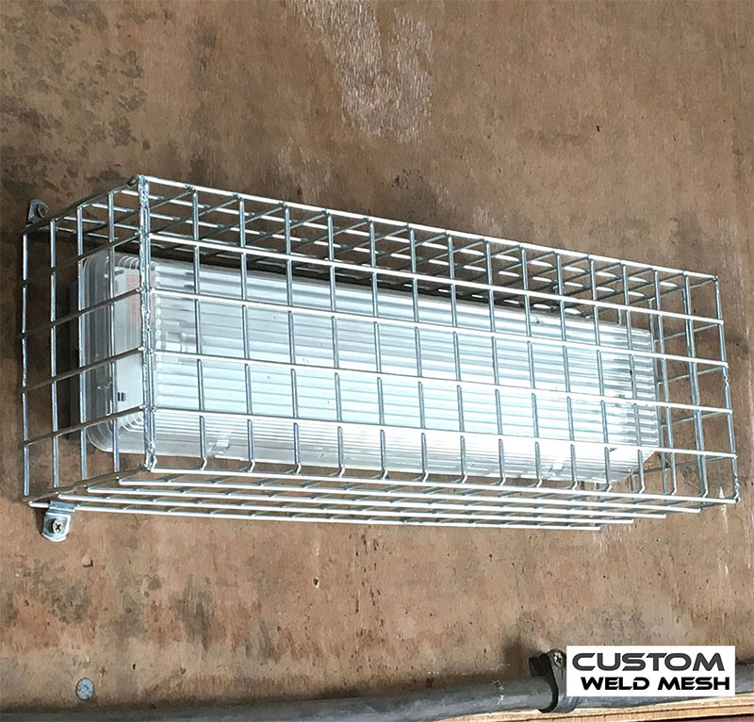
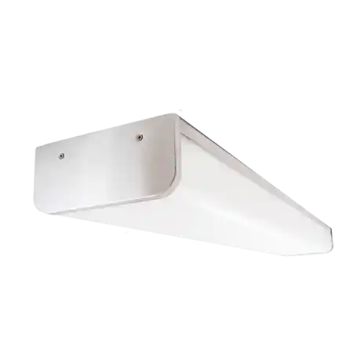
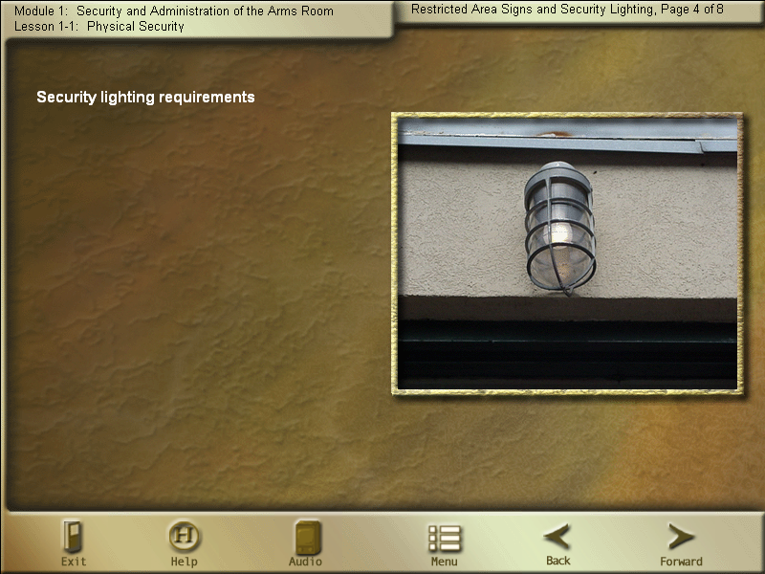
Exterior
Allows guard personnel to observe the unauthorized entry or removal of arm.
Exterior Light Must Be Covered With Wire Mesh Or Made Of A Vandal Resistant Lens.
Provide A Minimum Of 0.2 foot-candles (2lux) illumination
Switch To Light Must Be Inaccessible To Personnel
Notes:
WHEN AN ARMS ROOM IS LOCATED WITHIN ANOTHER SECURE ROOM, THE ENTRANCE TO THE SECURE ROOM WILL BE ILLUMINATED.
Iaw 190-11 5-4 a-(3) LIGHTING PROTECTION

Slide 26
Exterior
Restricted Area Warning Sign
Alarm Warning Sign
Security Lighting
SF 702 For After Hour Security Checks
Notes:
What should be posted outside of the arms room.

Slide 27

Exterior
Armed is defined as having a firearm and appropriate ammunition readily available for immediate use.
A “Whooping” stick does not constitute an armed guard!!
Arms Storage Facilities, Containers And Safes Will Be:
Protected By Ids And Will Be Checked At Least Once Every 8 Hours
or
Under 24 Hour Armed Guard Surveillance
Staff duty and charge of quarters when tasked will document these checks on standard form 702 (security container check list).

Slide 28
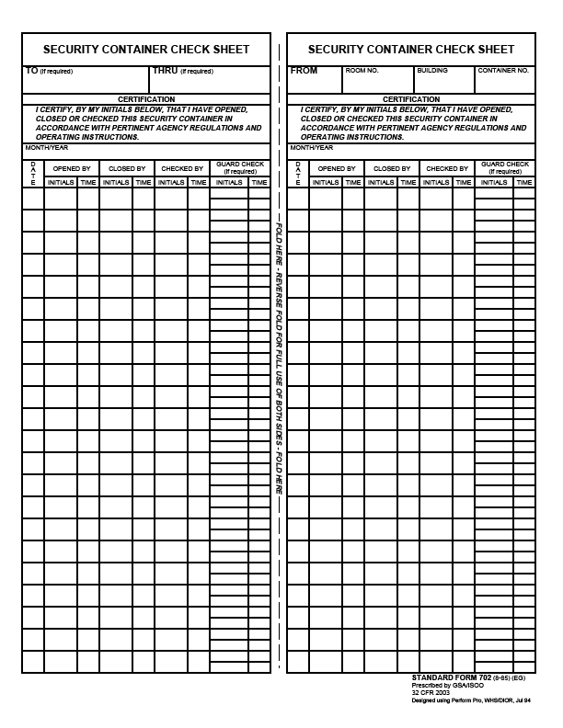
Exterior
Can be used to record opening/closing times of arms room.
SF 702
Checking the security of building outer doors and not the vault door doe not meet regulatory requirements.
May 2016
1
LDE
0230
WHW
2230
2
WHW
0415
3
4
5
6

Slide 29
Exterior
Restricted Area Warning Sign
Alarm Warning Sign
Security Lighting
SF 702 For After Hour Security Checks
FR Reg. 190-1 (Outside of arms room or posted on unit bulletin board)
Notes:
What should be posted outside of the arms room.

Slide 30
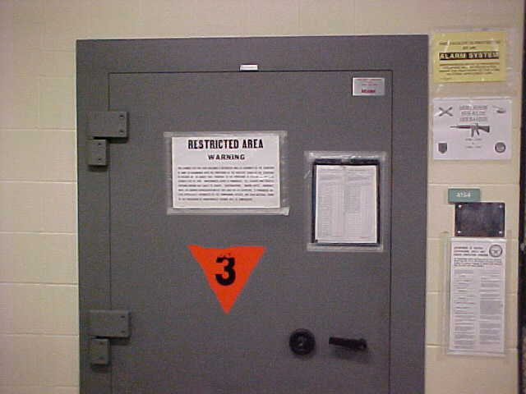
Exterior
Alarm System
Warning Sign
Restricted Area
Warning Sign
Do not post contact
Information of the armorer
Must also have one
posted on the inner
door. When door is open
sign is not visible.
SF 702 Used for Security Checks
Ammunition
Placard (Only required
When storing ammo)
Notes:
Essential element of an arms storage facility
Alerts response force to possible intrusion of a restricted area so that they may respond
Detects, NOT PREVENT, penetration of a restricted area
Permits efficient use of guard personnel, because restricted areas do not have to be guarded 24 hours a day if protected by IDS
Armorers are responsible for activating and deactivating IDS upon entry and exiting of arms room.
Alert alarm monitoring station if alarm is activated for any reason other than an intrusion.
PIC and PIN issue procedures (8-11 Mon-Fri)

Slide 31
Lautenberg Amendment
Exterior
Summary court-martial convictions, non-judicial punishment under Article 15, UCMJ, and deferred prosecutions in civilian court do not constitute qualifying convictions within the meaning of the Lautenberg Amendment.
The prohibitions do not preclude a soldier from operating major weapons systems or crew served weapons such as tanks, missiles, and aircraft.
The Lautenberg Amendment application includes Soldiers with privately owned firearms and ammunition stored on or off post.
Soldiers with qualifying convictions may not:
  be assigned to positions that would give them access to firearms and ammunition.
  attend any service school where instruction with individual weapons or ammunition is part of the curriculum.
  may not reenlist and are not eligible for the indefinite reenlistment program.

Slide 32
Check-on-learning
Exterior
Q: A Soldier is given an Article 15 from his Company Commander for getting into a fight with his wife and hitting her. Is this a Lautenberg Violation?
A: No, this is non-judicial punishment and does not constitute a Lautenberg Conviction.

Slide 33
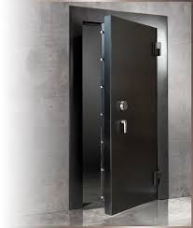
Door Security

Slide 34
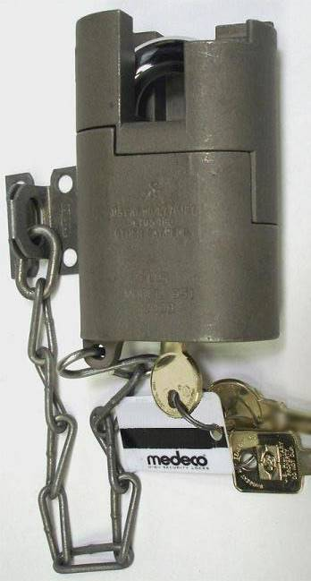
Door Security
High security padlock for approved doors
  Placed on most secure Door and Exterior Issue Window (If arms room has one.)
  Comes with three (3) keys, two round operational keys and one square maintenance key.
  MIL–DTL–43607J, NSN 5340–01–510–2351
Notes:
MORE ON KEY AND LOCK CONTROL PORTION OF BRIEF.
What regulation (Reg and Paragraph number) covers this?
SHOW EXAMPLE OF HIGH SECURITY LOCK AND MENTION THAT IT COMES WITH 3 COUNT THEM 3 KEYS

Slide 35
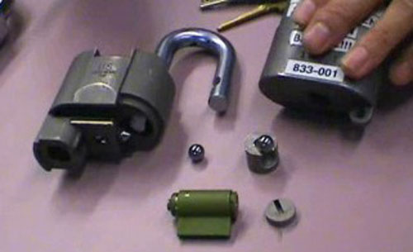
High Security Padlock
Door Security
Do Not Use The Square Maintenance Key For Daily Operations!!!!
It is used to take the lock apart in order to re-core it.
Notes:
MORE ON KEY AND LOCK CONTROL PORTION OF BRIEF.
What regulation (Reg and Paragraph number) covers this?
SHOW EXAMPLE OF HIGH SECURITY LOCK AND MENTION THAT IT COMES WITH 3 COUNT THEM 3 KEYS

Slide 36
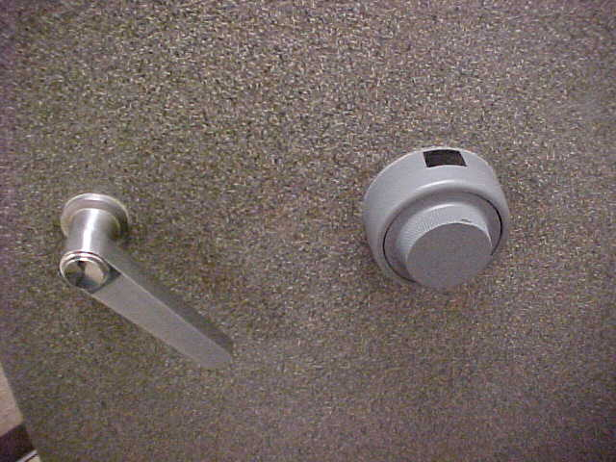
Door Security

Slide 37
Door Security
Combinations Shall Be Changed:
When first placed in use (factory default settings 50-25-50)
Whenever an individual knowing the combination no longer requires access.
When the combination has been subject to possible compromise.
At a minimum annually
Prior to transitioning out. e.g., move to another bldg., deployment, etc.
To have your combination to the vault door changed call public works service order desk at 239-0900 or check with your S-2.
Use the following link to assist with stand alone safes: https://www.cdse.edu/resources/physical-security.html which contains information on how to change combinations on the X-07, X-09, X-10, S&G 2740B & S&G 2740.
Notes:
37

Slide 38
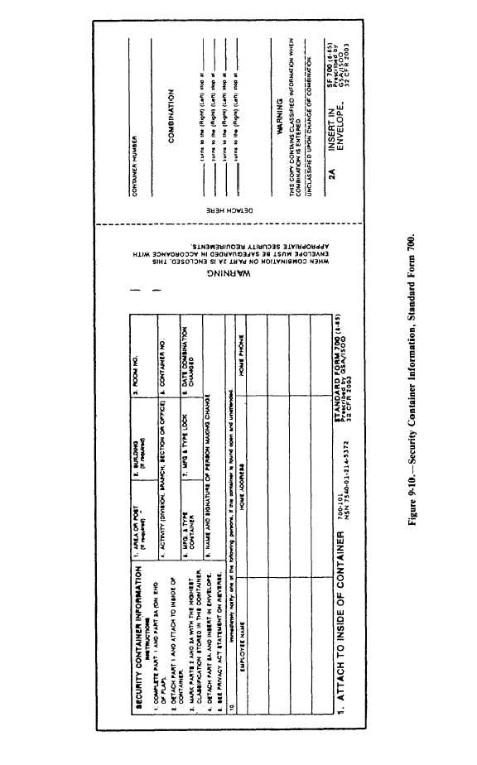
Door Security
SF 700 (security container information) shall be maintained
For each combination.
  Part 1 will be completed and posted on the inside of the vault or container.
If this SF700 is for an arms room, the personnel listed here must also be on the unaccompanied access roster.
219
Arms Room
DES
1
Hamilton X-07
21 DEC 22
Joe Locksmith, PW
Jim D. Armorer
232 Milford Drive, Junction City
555-1010
I.B Dmann
111 Crazy Circle, Junction City
555-2526
Notes:
38

Slide 39
Door Security
  The combination of the vault or container will be printed part 2a
Arms Room
1
219
DES
1
Hamilton X-07
21 DEC 22
22
Joe Locksmith, PW
45
76
Jim D. Armorer
232 Milford Drive, Junction City
555-1010
I.B Dmann
111 Crazy Circle, Junction City
555-2526
Notes:
39

Slide 40
Door Security
  Part 2A will be detached and inserted in the envelope, (part 2)
219
Arms Room
1
DES
1
Hamilton X-07
21 DEC 22
22
Joe Locksmith, PW
45
76
Jim D. Armorer
232 Milford Drive, Junction City
555-1010
I.B Dmann
111 Crazy Circle, Junction City
555-2526
Notes:
40

Slide 41
Door Security
  Part 2A will be detached and inserted in the envelope, (part 2)
219
Arms Room
1
DES
1
Hamilton X-07
21 DEC 22
Joe Locksmith, PW
22
45
76
Jim D. Armorer
232 Milford Drive, Junction City
555-1010
I.B Dmann
111 Crazy Circle, Junction City
555-2526
Notes:
41

Slide 42
Door Security
  Part 2 will be stored in a different security container.
219
Arms Room
DES
1
Hamilton X-07
21 DEC 22
Joe Locksmith, PW
Jim D. Armorer
232 Milford Drive, Junction City
555-1010
I.B Dmann
111 Crazy Circle, Junction City
555-2526
Notes:
42

Slide 43
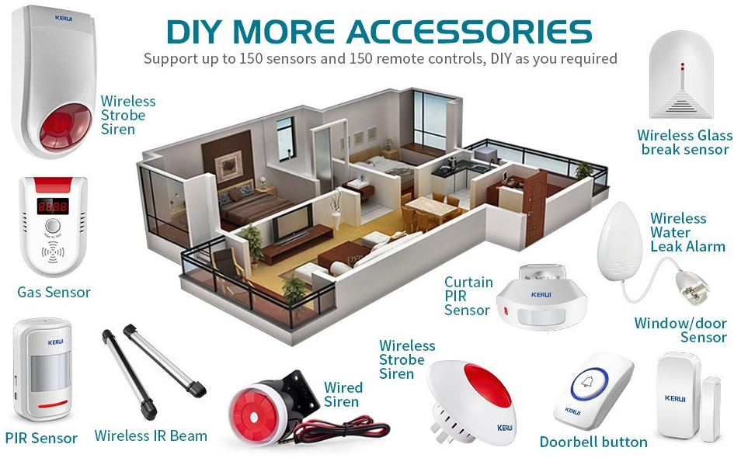
Security Alarms
Integrated Commercial Intrusion Detection System (ICIDS)

Slide 44
Intrusion Detection System
Unless continuously manned or under constant surveillance (guard), the arms room will be protected by an operational intrusion detection system (IDS).
IDS will be tested Monthly by contacting the Alarms Monitor (239-5469) IAW AR 190-11 para 3-6 m(1).
All alarms and tests will be recorded on DA Form 4930 (alarm / intrusion detection record).
Fort Riley uses ICIDS V as its IDS for record.
Notes:
Essential element of an arms storage facility
Alerts response force to possible intrusion of a restricted area so that they may respond
Detects, NOT PREVENT, penetration of a restricted area
Permits efficient use of guard personnel, because restricted areas do not have to be guarded 24 hours a day if protected by IDS
Armorers are responsible for activating and deactivating IDS upon entry and exiting of arms room.
Alert alarm monitoring station if alarm is activated for any reason other than an intrusion.
PIC and PIN issue procedures (8-11 Mon-Fri)

Slide 45
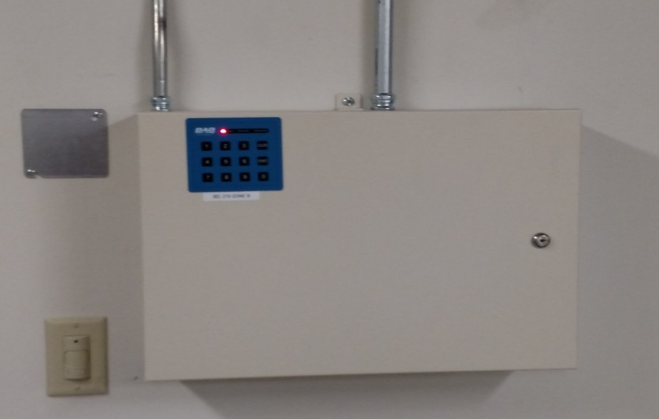
Intrusion Detection System
Remote Area Data Collector
RADC
The RADC is the brain of your ICIDS V SYSTEM
It compiles a list of data and changes
and reports to the Primary Monitor Console
(Alarm Monitors).
If a RADC triggers an event, the
system alarms and notifies the operator.
Red Light on RADAC = Access Mode
Green Light on RADAC = Armed Mode

Slide 46
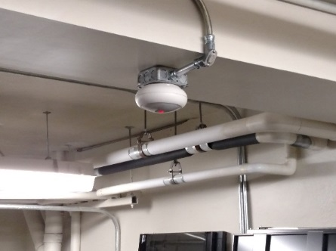
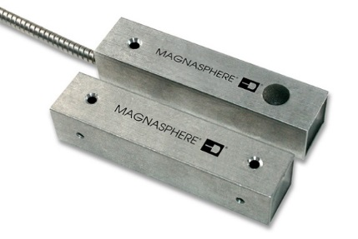
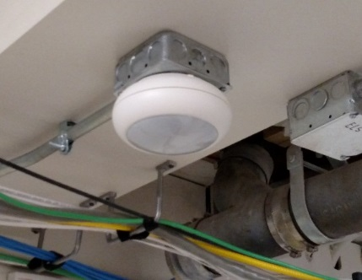
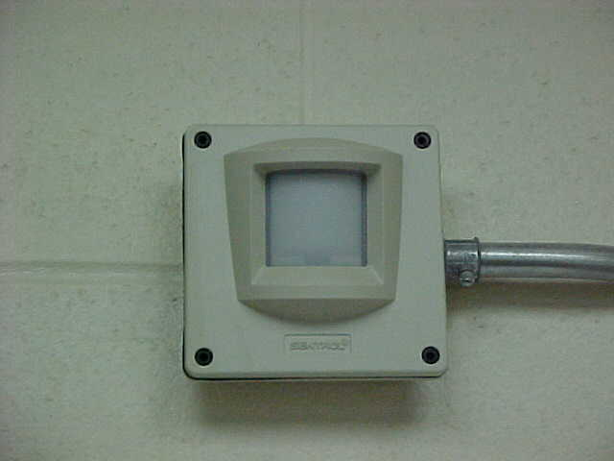
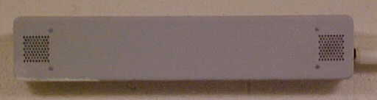
Intrusion Detection System
Ensure your sensors are not blocked by boxes or arms racks
Motion Sensors should have an unobstructed view of the door
Two types of sensors required, one of which must be a volumetric sensor
Motion Sensors (Volumetric Sensor)
Point of Entry Sensor
BMS – Balanced Magnetic Switch
PIR – Passive Infrared
USM – Ultra-Sonic Motion

Slide 47
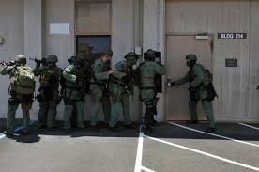
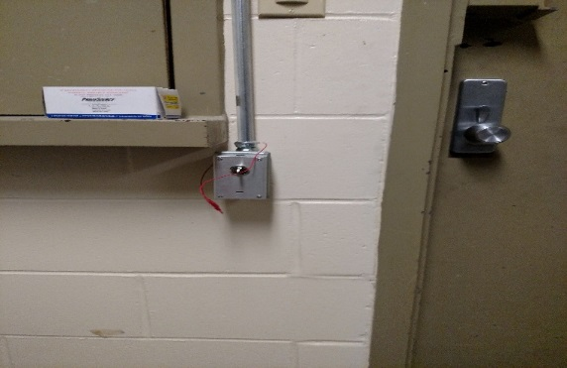
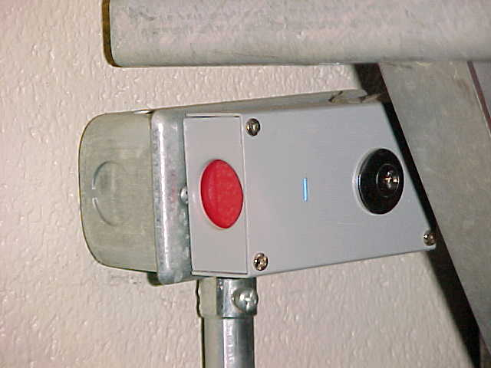
Intrusion Detection System
Duress Switch
Unit is a silent application that sounds the alarm when
personnel are under duress.

Slide 48

Intrusion Detection System
Reasons for Activation
Unauthorized Entry Attempts
Tampering
Power Loss
Communications Failure
Duress
Nuisance
Test

Slide 49
Intrusion Detection System
PIC/PIN
PIC-Personal Identification Cipher (6 Digit #)
PIN-Personal Identification Number (4 Digit #)
Shows who accessed or secured the system and at what time.
No logging out of the system required.
PIC/PIN will work in other arms rooms if you are listed on the unaccompanied access roster.

Slide 50
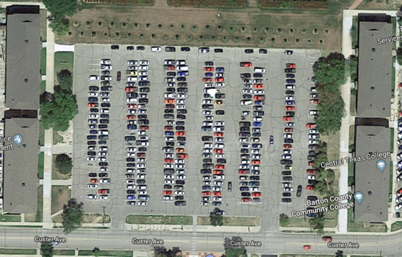
Intrusion Detection System
Complete your Command Screening (DA Form 7708)
Obtain your updated Unaccompanied Access Roster and CDR’s assumption of command orders
Bring the completed documents to ICIDS PIC/PIN Office located in BLDG 217
Numbers are issued daily from 0800 – 1600 in Bldg. 217

Slide 51
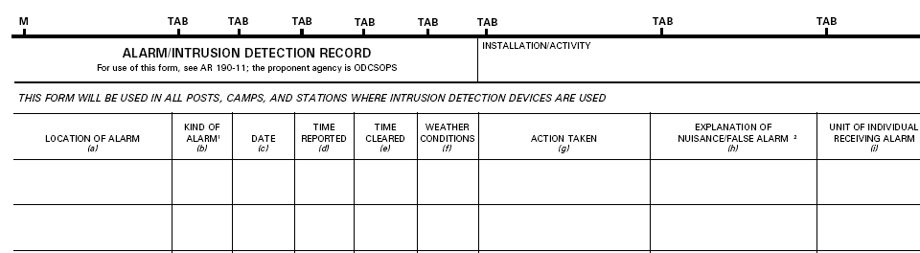
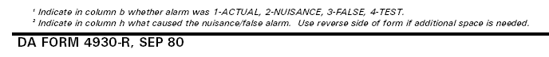
Intrusion Detection System
A CO, 123rd CSSB/ FORT RILEY
BLDG 7803-1
4
Monthly Test
Called Alarms Monitor
RAB
JDA
7 Sep 21
1003
1013
HOT
BLDG 7803-1
3
Mouse in Arms Room
Activated PIR
JDA
7 Sep 21
0200
0330
HOT
Reset Alarm
Enter Alarms
Monitor Initials and
Your Initials
Ensure you annotate All False and Nuisance Alarms As Well On This Form. This Information Is Used By The Alarm Tech To Trouble Shoot The System.
Enter What You
Did
Enter Bldg Number and
“Room” Number
Enter Date
Enter Start and
Stop Time
Enter Weather
Conditions
Completed DA Form 4930 must be maintained on file for 90 Days.
Notes:
Essential element of an arms storage facility
Alerts response force to possible intrusion of a restricted area so that they may respond
Detects, NOT PREVENT, penetration of a restricted area
Permits efficient use of guard personnel, because restricted areas do not have to be guarded 24 hours a day if protected by IDS
Armorers are responsible for activating and deactivating IDS upon entry and exiting of arms room.
Alert alarm monitoring station if alarm is activated for any reason other than an intrusion.
PIC and PIN issue procedures (8-11 Mon-Fri)

Slide 52
Intrusion Detection System
Access rosters not utilizing the proper format will not be accepted
  Proper room number and zone number listed on access roster
  Ensure the DoD ID Number is used, not SSN
  Building number and phone number of duty hour and non-duty hour POCs
  Email address of Commander and 1SG at a minimum.

Slide 53
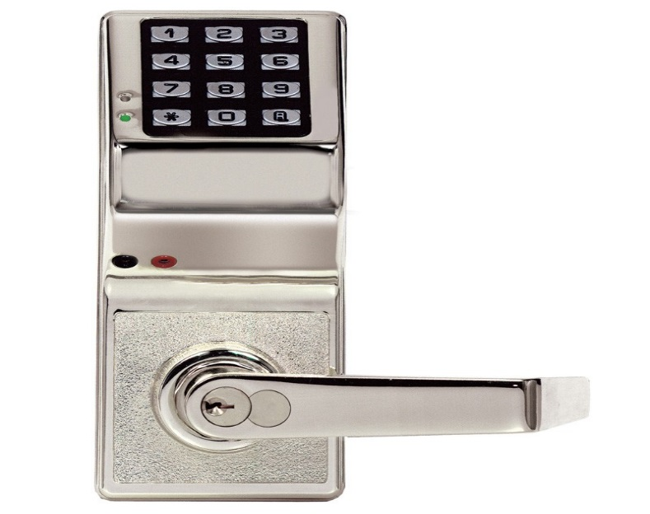
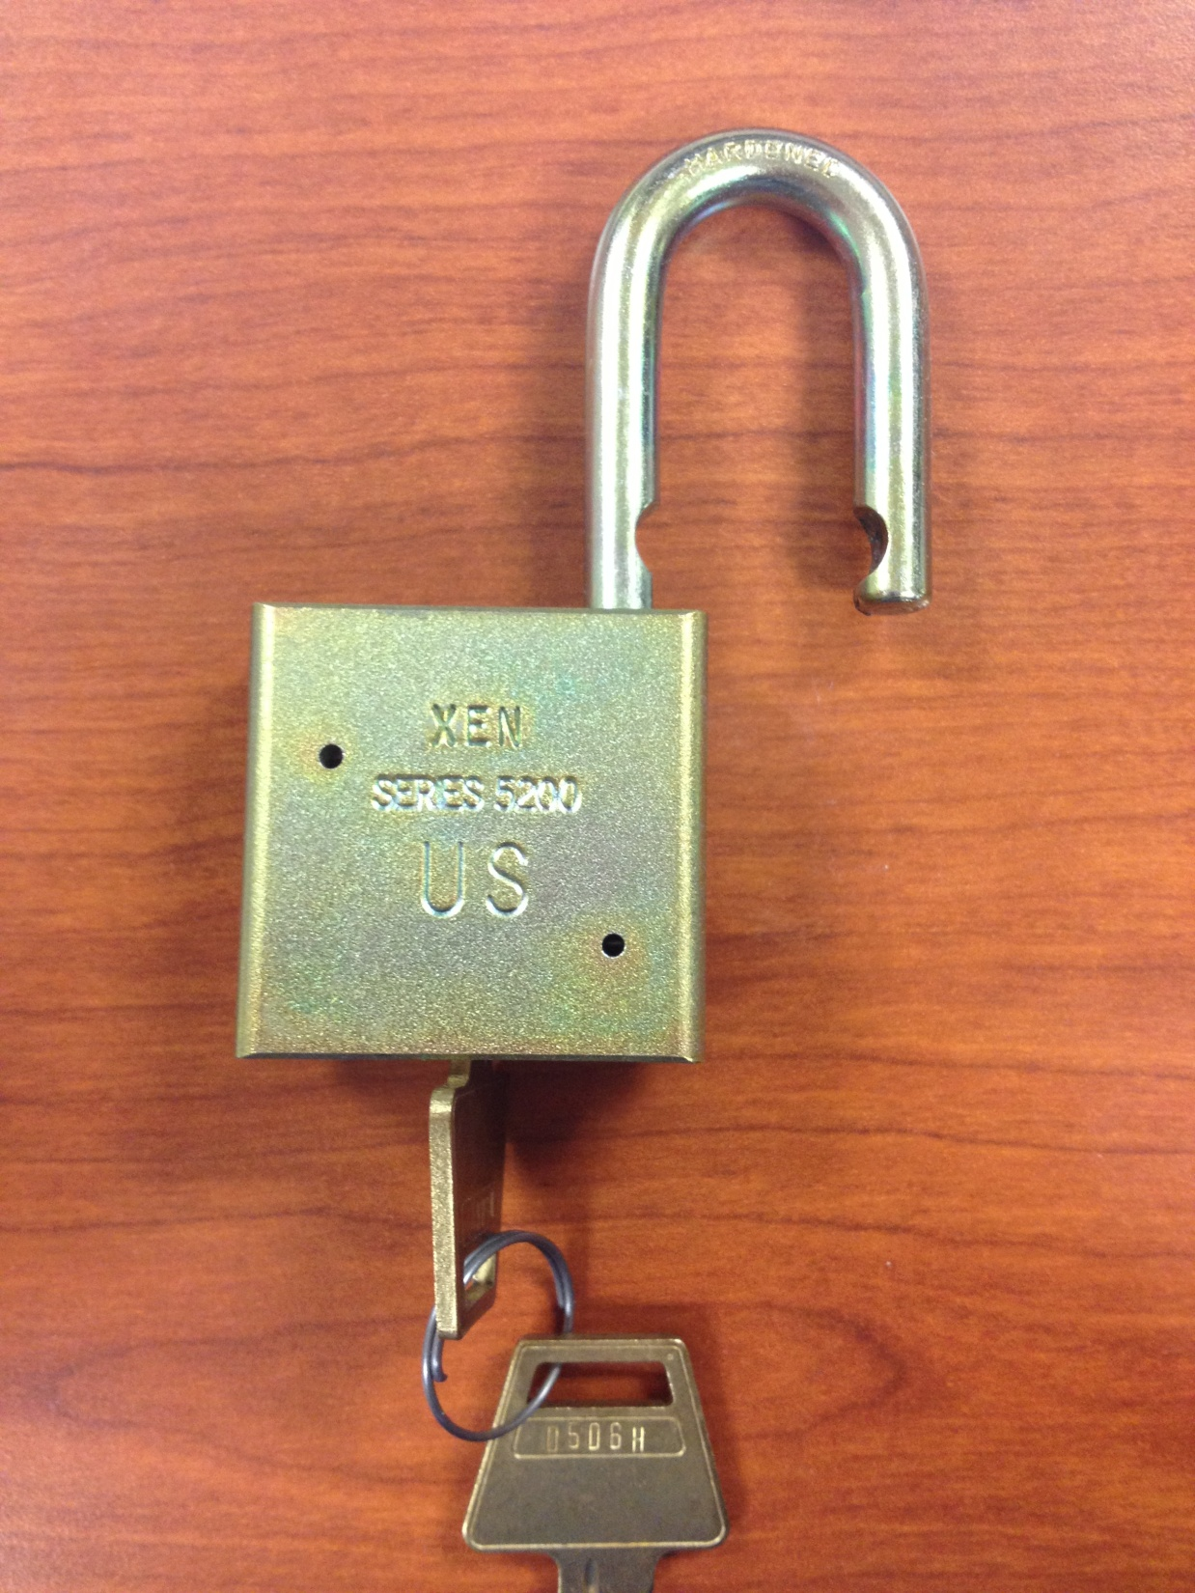

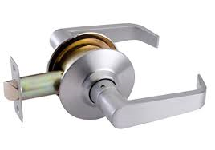
Locks
https://www.cdse.edu/multimedia/shorts/dod-approved-locks/story_html5.html
Notes:
Iaw AR 190-11 4-2C2

Slide 54
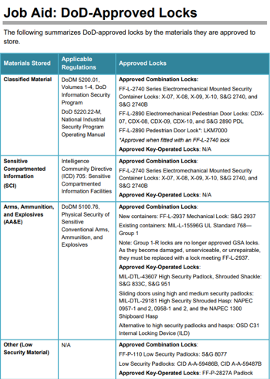
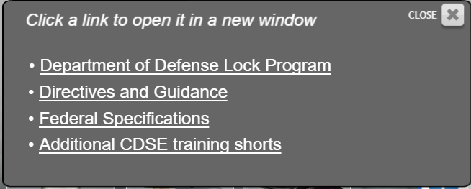

Slide 55
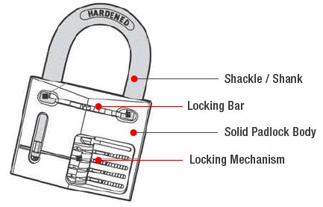
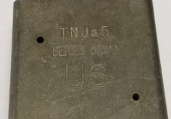
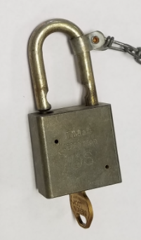
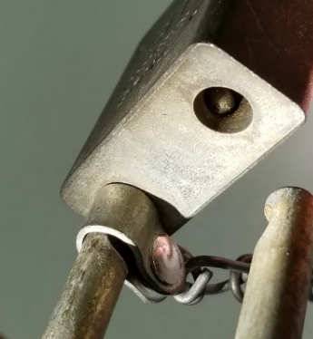
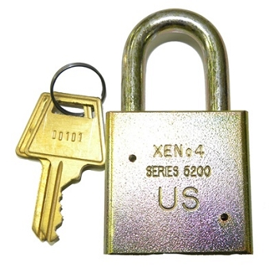

Locks
Only approved secondary padlocks (low security) will be used to secure government equipment
Series 200/5200 padlocks are approved for this purpose.
Two Main Characteristics are:
Key retain-ability
Stamped with US
*NOTE* -- Lock sets labeled “US Set” are prohibited from being used in the arms room. They are a form of Master Keyed System.
Notes:
Iaw AR 190-11 4-2C2

Slide 56
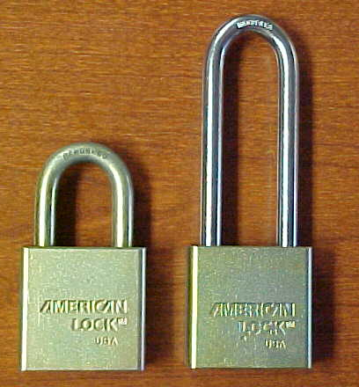

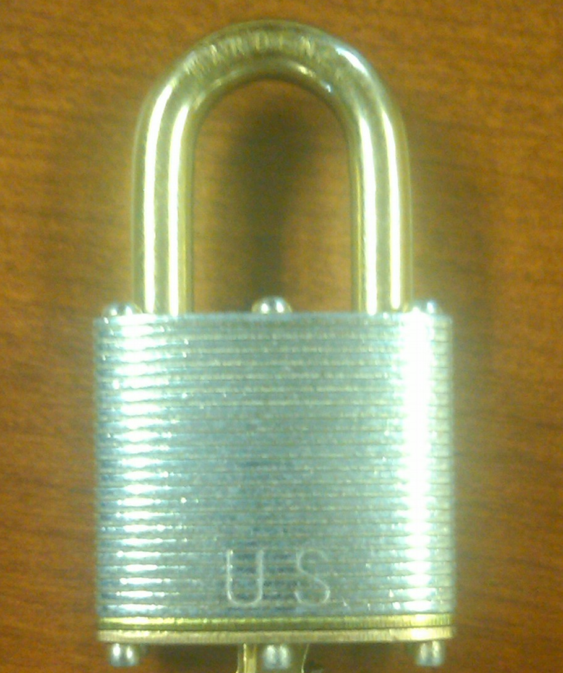
Locks
AMERICAN 5200 Series
Long and Short Shackle
Pacific Lock Company
US Master Lock
Notes:
Iaw AR 190-11 4-2C2

Slide 57


Locks
NSN 5340–00–158–3805; with chain, NSN 5340–00–158–3807.
Commercial item description A–A–1927, hardened steel shackle and case, without chain
Laminated Steel
(Stacked Plates)
Solid Steel
Same NSN will get you either Master Lock, American Lock or Pacific Lock.

Slide 58

Locks
Is this an approved padlock?
NO
Does Not Have Key Retention Ability or is it Stamped “US”
Notes:
Iaw AR 190-11 4-2C2

Slide 59
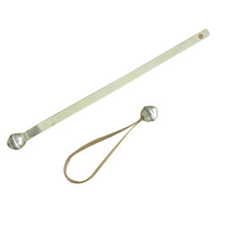
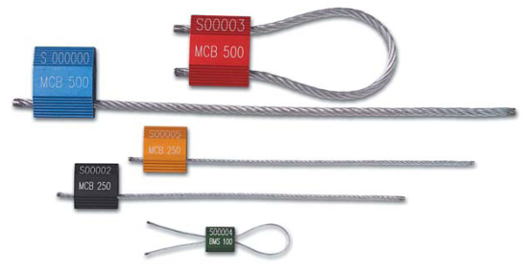

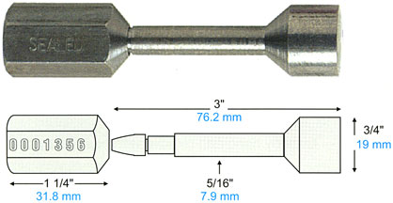
Use and Control of Protective Seals
For AA&E or classified materiel shipments, security seals types 9, 11, 12, or 13 are required.
Type 9 – Ball Seal (Low Strength Seal)
“Not a Lock”
Type 11 – One Piece Cable (High Strength Seal)
“Not a Lock”
Type 12 – Cable Piece Cable (High Strength Seal)
Type 13 – Unthreaded Bolt (High Strength Seal)

Slide 60
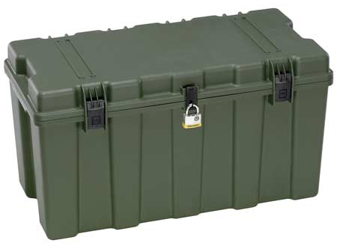
Use and Control of Protective Seals
UNIT LETTERHEAD
OFFICE SYMBOL DATE
MEMORANDUM FOR RECORD
On (This Date), 200 M9 Bayonets were sealed in this footlocker using Seal # 12345”
Point of Contact for this memorandum is the unit armorer at 239-xxxx.
Unit Armorer Witness
Signature Block Signature Block
xxxxxxxxxxxxxxxxxxxxxxxxxxxxxxxxxxxxxxxxxxxxxxxxxxx
NOTE: Recommend using Senior NCO as Witness or Commander.

Slide 61

Documentation

Slide 62
Documentation
DA Form 4604 (Security Construction Statement):
Existing arms rooms inspected by qualified engineer every 5 years.(AR 190-11 2-2d)
Identifies a Waivers, Exceptions, Compensatory measures in place in order to approve vault storage.
Will be posted inside the unit arms vault.
Form will indicate highest category of weapons that may be stored in the arms room.
POC: Mrs. Kim Hunninghake - 239-6672/ 239-6148
Notes:
Security Construction Statement DA Form 4604-R
Posted on the wall of an arms room
Signifies the Arms room is constructed with the guidelines listed in AR 190-11
Valid for 5 years
Unit armorer’s responsibility to ensure it is current and valid
Reviewed during physical Security Inspections.

Slide 63
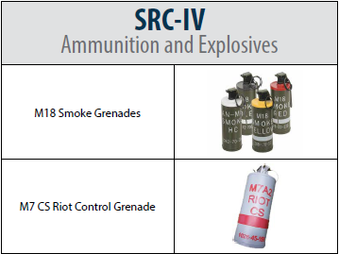
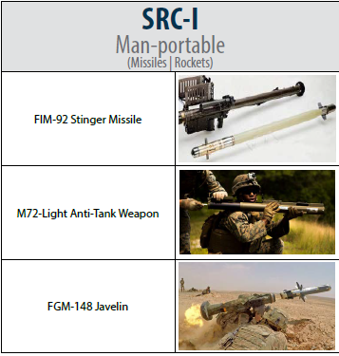
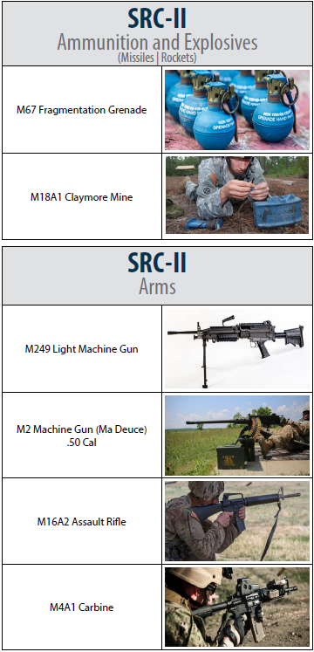
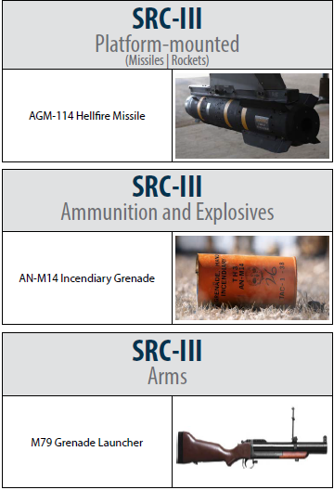
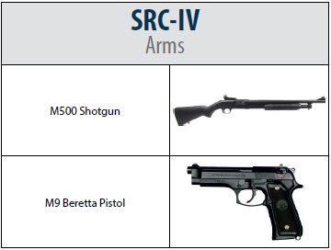
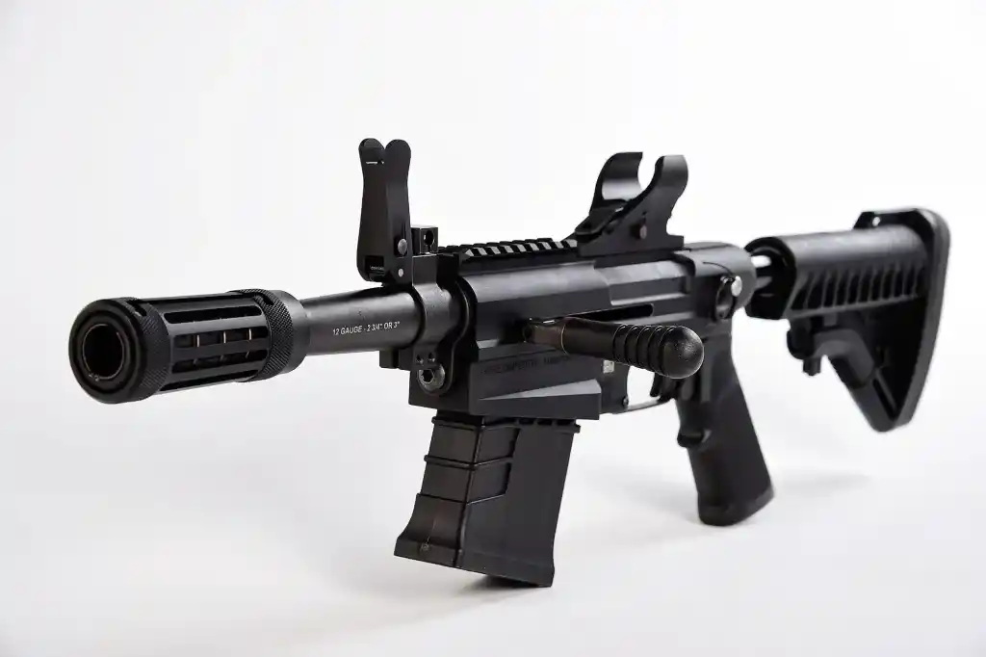



Documentation
Security Risk Categories (SRC)
M26 Shotgun
M17 Pistol
NVDs are SRC-IV, too!
M320 Grenade Launcher
Notes:
Security Construction Statement DA Form 4604-R
Posted on the wall of an arms room
Signifies the Arms room is constructed with the guidelines listed in AR 190-11
Valid for 5 years
Unit armorer’s responsibility to ensure it is current and valid
Reviewed during physical Security Inspections.

Slide 64
Documentation
Armorer Hand Receipt:
Commander sub-hand receipts all equipment in the arms room down to the primary armorer:
  Use DA Form 3161 or system generated property receipt.
  Places responsibility / accountability upon individual who has direct control of it.
  Clearly identifies what the Armorer is responsible for.
  Includes all property to be stored in the vault. NOT just AA&E (e.g., bayonets, compasses, etc.)
  Must be signed for with in 30 days of appointment. (IAW Supply regulations)

Slide 65
Documentation
Unaccompanied Access Roster
Keep the number of personnel on the roster to a minimum.
Personnel Reliability Screening And Evaluation (DA Form 7708) is completed before unaccompanied access is authorized
Personnel Reliability Screening And Evaluation
  DA Form 7708
  Valid for one year
  Continuing Periodic Evaluation required
  Does not need to be redone when a new Commander assumes command.
  Must be redone when the Soldier transfers to/from another unit.
  Must be scanned to DES, no pictures!
Notes:
Commanders oriented screening per AR 190-11 para 2-11 consists of:
Commanders interview
Personnel records screening (201)
Medical Records Screening
PMO (Local Files Check)
Civilian Law Enforcement
Commanders evaluation

Slide 66

PERSONNEL RELIABILITY SCREENING AND EVALUATION
Commander of the candidate will conduct the initial interview than print, sign and date.
Armorer, Tony
111th Signal Company
Armorer
000-00-0000
X
X
The candidate will sign and date.
Tony D. Armorer
20191001
Commander, Best, D
Best D. Commander
20191001

Slide 67
PERSONNEL RELIABILITY SCREENING AND EVALUATION
Completed by S-1
X
Jackson, Andrew, T
Andrew T. Jackson
20210907
Commanders Discretion if Not Required Completed by Commander. Clearance validation completed by S-2
Completed by DES ADMIN through email (Will take 24 to 72 hours turnaround)
X
Commander, Best, D
Best D. Commander
20210908
X
Jefferson, Thomas, T
Thomas T. Jefferson
20210909
usarmy.riley.ID-Readiness.mbx.police-records@army.mil
Completed by Medical Facility / Provider
DES No Record
X
Washington, George D
George D. Washington
20210910
Completed at Unit by Commander of Candidate
X
Commander, Best, D
Best D. Commander
20210907

Slide 68

PERSONNEL RELIABILITY SCREENING AND EVALUATION
Candidate screened will acknowledge being briefed on duties, sign and date.
X
Tony D. Armorer
20210910
Commander, Best, D
Best D. Commander
20210910
Commander validates Candidate suitable or unsuitable selection with, printed name, signature and date.
Annual periodic Evaluations

Slide 69
PERSONNEL RELIABILITY SCREENING AND EVALUATION

Slide 70
Documentation
Dates
The dates in section I and VII are the start and end dates of the investigation. Both signed by the CDR (NOT at the same time).
All dates in sections II thru VI (section checks) should fall between the start and end dates.
Appointment orders must be dated after the form is finalized in section VII.
Must be Evaluated Periodically in section VIII (Minimum Annually).
Notes:
The unit armorer is responsible for enforcing access control by:
Verifying authorization of personnel prior to entry. (Access Rosters)
Providing supervision of personnel while they are in the arms room.

Slide 71

Documentation
Accompanied Access Rosters:
DES Physical Security
DIV / BDE / BN S-2
Alarm Maintenance Personnel
Notes:
The unit armorer is responsible for enforcing access control by:
Verifying authorization of personnel prior to entry. (Access Rosters)
Providing supervision of personnel while they are in the arms room.

Slide 72




Documentation
Morgan,
Dexter G.
Always Check Identification To Verify
Access Roster Information.
Notes:
The unit armorer is responsible for enforcing access control by:
Verifying authorization of personnel prior to entry. (Access Rosters)
Providing supervision of personnel while they are in the arms room.

Slide 73

AA&E Key Control

Slide 74
True or False
The serial number on the lock cannot be the same as the serial number on the key.
False
AR 190-11, para 3-8 n. states, “Padlocks and keys which do not have a serial number will be given one. This number will be inscribed on the lock or key as appropriate.” New Master locks have the same serial number on both the lock and key.

Slide 75
True or False
The key ring used must be a solid braised (welded) metal key ring.
False
AR 190-11 does not specify the type of key ring that must be used.

Slide 76
True or False
Staff Duty or the S2 is the key and lock control custodian for the unit.
False
Staff Duty is only the keeper of the locked ammo can during non-duty hours. In the case of the S2, they are only securing the locked and sealed container with the spare keys in them.

Slide 77
True or False
I cannot list where the locks are located at in the arms room on the DA Form 5513. (Ex. Key Number #1, goes to lock #1 which is on M16 rack #2)
False
AR 190-11 para 3-8 n states, “A key and lock inventory will contain a record of keys, locks, key serial numbers, lock serial numbers, location, and the number of keys maintained for each lock. This record will be secured in the key depository.”

Slide 78
AA&E Key Control
AA&E Key Control Custodian
Required to have a DA Form 7708 Personnel Reliability Screening And Evaluation completed prior to assuming duties as AA&E Key Custodian.
Be appointed in writing to issue and receive keys and account for keys.
Issues primary keys to Armorer and Sealed container (spare set) to HHQ (S-2) who places them in a GSA approved class 5 or 6 safe.
Ensure that individuals who are designated to issue keys in their absence, clearly understand key control procedures.
Maintain a key control register (DA Form 5513) at all times to ensure continuous accountability for keys of locks used to secure Government property.
Inventory Keys at a minimum Semi-annually (AA&E Key Custodian & Disinterested individual).
Conduct an inquiry when a key is lost or stolen.
Attend refresher training annually.

Slide 79

AA&E Key Control
UNIT: HHT 1-4 CAV
44322 High Security Padlock Main Door
1234H M16 Rack 1
5678H M16 Rack 2
1122B M9 Rack 1
Key Serial Number
Lock Location
Input Unit Information
Lock Number 1
Number of Keys
HHT 1-4 CAV
44322
(3)
Arms Room Door
1234H
(2)
M16 Rack 1
5678H
(2)
M16 Rack 2
1122B
(2)
M9 Rack 1

Slide 80





Issuing AA&E Keys
AA&E Key Control
Primary Keys
Armorer
AA&E
Key Custodian
Spare Keys
BN S-2

Slide 81

AA&E Key Control
1-24
0900
7 Sep 21
Key Custodian Print
Armorer Print
Key Custodian Sign
Armorer Sign
Seal#
12345
0920
7 Sep 21
Key Custodian Print
S-2 Print
Key Custodian Sign
S-2 Sign
Primary Keys Issued To Armorer
Spare Keys Issued To S-2
All Keys Are Now Issued and Accounted For Properly!

Slide 82

AA&E Key Control
7 Sep 21
AA&E Key Control Custodian
7 Sep 21
Disinterested Party
AA&E Key Custodian and Disinterested Party Signs and Dates When Keys Are First Inventoried. This Is The Benchmark For Future Semi-Annual Inventories.

Slide 83
AA&E Key Control
Unit Armorer Responsibilities:
Sign For Operational Set Of Keys from the AA&E Key Custodian
Ensure Keys Are Never Left Unattended.
Ensure Keys Are Never Taken Off-post (Off The Installation) Unless They Are Being Secured At Another Location
Report Immediately All Lost, Misplaced, Broken Or Stolen Keys To The AA&E Key Lock Custodian.
Ensure Keys Are Properly Secured At The Close Of Business Each Day.
Ensure Keys Signed for at all times.
NOTE: Getting locked ammo can from Staff Duty is NOT signing for the keys.
Notes:
83

Slide 84
AA&E Key Control
Armorer’s DA Form 5513 Setup.

Slide 85
AA&E Key Control
Armorer’s DA Form 5513 Inside Ammo Can
HHT 1-4 CAV
44322
Arms Room Door
1234H
M16 Rack 1
5678H
M16 Rack 2
1122B
M9 Rack 1

Slide 86
Transfer of Arms Room Keys
AA&E Key Control
0930
7 Sep 21
Primary Armorer Print
Alt Armorer Print
0930
8 Sep 21
Primary Armorer Print
1-4
Primary Armorer Sign
Alt Armorer Sign
Primary Armorer Sign
1-4
Primary Armorer Print
Primary Armorer Sign
Used When Arms Room Keys are Transferred Between Two Authorized Personnel
Coincides with opening and closing inventories.
Notes:
Example of 5513 when custody of keys is transferred between authorized personnel. Alt Armorer signs for keys when taking the vault.
When identified that keys are sign by other Armorer…must take possession back by signing for them.
Pre-sign in the event their not present for next time.

Slide 87
AA&E Key Control
Key Turn-In Procedures
Keys signed back to the AA&E Key Custodian on DA Form 5513 before PCS/ETS.
or
Keys placed in a locked ammo can, and the locked ammo can is signed for on DA Form 5513 to Staff Duty or CQ as “Key Box”. Staff Duty/CQ not authorized to sign for actual keys.

Slide 88
AA&E Key Control
DA Form 5513 At Staff Duty Desk
HHT 1-4 CAV
Locked Ammo Can
Staff Duty is Only Maintaining a Locked Ammo Can (Contents Unknown)

Slide 89

Issuing Locked Key Box to Staff Duty
AA&E Key Control
Staff Duty
Primary Keys
Armorer
Primary Key Box

Slide 90
Signing for Ammo Can
AA&E Key Control
1
0700
7 Sep 21
Staff Duty Print
Armorer Print
1700
7 Sep 21
Staff Duty Print
Staff Duty Sign
Armorer Sign
Staff Duty Sign
Picking Up Keys From Staff Duty
Returning Keys To Staff Duty
Key to AA&E “lock box” / “ammo can”
May be “permanently” issued. Not required to turn in at EODD.
Is considered an Admin Key and issued by Admin Key Custodian.

Slide 91



AA&E Key Control
Authorized storage locations of AA&E keys For SRC I and II
GSA Class 5 container with a built in 3 position changeable combination lock.
  Container will not contain classified material
  If the container weighs less than 500 lbs. it will be chained to the floor or building

Slide 92




AA&E Key Control
Authorized storage locations of AA&E keys For SRC III and IV.
12 Gauge Steel Key box equipped with a low security padlock. Same as standard key box. Requires hasp addition for lock.
  Located in a room that is secured when unoccupied
GSA Class 5 or Class 6 container with a built in 3 position changeable combination lock.
  Container will not contain classified material
  If the container weighs less than 500 lbs. it will be chained to the floor or building
  Typical storage of spare keys at S-2
Keys stored in an ammo can (12-gauge steel) with low security padlock and
  Chained to an eyebolt in the floor at the staff duty / CQ desk
  or secured in safe

Slide 93
AA&E Key Control
Case Study
Unit Rear-D Armorer With Access To Exterior Arms Vault
Brought AA&E Keys With Him To Lunch Off The Installation
Could Not Locate Keys After Lunch
Searched Car, Barracks Room, Subway Could Not Locate Keys
Retrieved Spare Set Of Keys From S2, Spare Keys Did Not Work. They Were Never Shown Any “Love”
Called Pw To Gain Access To Vault. Pw USED PLASMA CUTTER

Slide 94

AA&E Key Control
Cost Break Down:
$3200 To Cut High Security Hasp And Padlock Off Vault Door And Have Door Recertified
$1300 For High Security Padlock
35 Low Security Padlocks At $12-20 Each -- $420-700
Total Cost: $4,920-5,200
Cost Of A Good AA&E Key Control Program: Priceless!!!!

Slide 95
AA&E Key Control
Hands On Key Control Practical Exercise.

Slide 96
AA&E Key Control
Practical Exercise # 1
SPC Roy Jones is the Primary Armorer for B Btry 1-12 FA.
The Following Keys Are Used In The Arms Room:
23456 - High Security Padlock
2322H - Inner Door
5443B - M16 Rack 1
2722H - M16 Rack 2
6788B - M9 Rack 1
6777G - M9 Rack 2
1233G - POF Locker
2233P - Ammo Can Lock
Seal #12388
*You are the AA&E Key Custodian
*SGT Ricky Steamboat is the S2

Slide 97

AA&E Key Control
B Btry 1-12 FA
23456 (3)
High Security Padlock
2322 H(2)
Arms Room Inner Door
5443B (2)
M16 Rack 1
2722H (2)
M16 Rack 2
6788B (2)
M9 Rack 1
6777G (2)
M9 Rack 2
1233G (2)
POF Locker
2233P (2)
Ammo Can
Admin Key!! Not Added to AA&E DA Form 5513

Slide 98

Answers
1500
7 Sep 21
You
Primary Armorer
1-7
You
Primary Armorer
Seal #
12388
1530
7 Sep 21
You
Steamboat, Ricky
You
Ricky Steamboat

Slide 99

Answers
7 Sep 21
AA&E Custodian
7 Sep 21
Disinterested Party

Slide 100
AA&E Key Control
Practical Exercise # 2
Q: When Signing for the Spare Set of AA&E Keys, The S-2 Signs for the “Ring” Containing All of the Spare Keys?
A: NO. The S-2 Signs for a SEALED Container of Keys, NOT a “Ring” of Keys or the Keys Themselves.

Slide 101

AA&E Key Control
Common Deficiencies:
No DA Form 7708 completed for AA&E Key Custodian
No appointment orders / orders issued prior to DA Form 7708 completed
AA&E keys not issued to Armorer from Key Custodian
AA&E keys not inventoried
Armorer’s not conducting Change-of-Custody procedures to include keys

Slide 102

Weapons Storage / Ammunition Storage
Racks

Slide 103
Racks
When not in use, arms will be stored in banded crates, metal containers, approved standard issue racks or locally fabricated arms racks, and secured in approved weapons storage facilities. Standard issue approved metal wall lockers or metal cabinets may be used (when certified).

Slide 104




Racks
STANDARD ISSUE
Marvel
Space Saver
War-Tec

Slide 105


Racks
Marvel
“Push Together”
Space Saver
“Swing Arms”

Slide 106


Racks
Stanley-Vidmar
Based on four (4) specific configurations.
Salesman will sell you any configuration.
Approved configurations will have NSN.
Smalls Arms Repair facilities

Slide 107

Racks
Authorized Weapons Racks:
Space Saver
Marvel
Stanley Vidmar (limited)
War-Tac

Slide 108

Racks
    The use of locally fabricated racks is prohibited unless certified by TACOM as security equivalent to standard issue racks.

Slide 109

Racks
GSA: General Services Administration
Includes all GOV agencies (e.g., Forestry Service, IRS, etc.)
Not a guarantee of meeting DA standards.
Notes:
Iaw AR 190-11 4-2C2

Slide 110

Racks
Incorrect
Notes:
Iaw AR 190-11 4-2C2

Slide 111


Racks
Correct
Notes:
Iaw AR 190-11 4-2C2

Slide 112
Racks
First Generation Marvel
First Generation Space Saver
Modification: Hinge pins spot welded or crimped and certified by TACOM
If modified a Certification Packet is required.

Slide 113

Racks
Naval Universal Racks
Modifications are required for certifications.

Slide 114


Racks
Locking Shackle
(5/16” Hardened Steel)
Re-enforced Door

Slide 115
Racks
TACOM Local Area Representatives (LARs)
Ron Kontowsky Jr - 240-0499
Ron.a.kontowsky2.civ@army.mil
Andrew Montague - 240-6057
andrew.w.montague.civ@army.mil

Slide 116

Racks
Arms racks and containers weighing less than 500 pounds empty will be secured to the structure with bolts or chains or fastened together in groups totaling more than 500 pounds. (IAW AR 190-11 para 4-2c(2)
Racks secured together in groups of four is the general “rule of thumb” to meet this standard.
Notes:
HEAVY DUTY HARDENED STEEL, WELDED, STRAIGHT LINKS STEEL, GALVANIZED OF AT LEAST 5/16-INCH THICKNESS.

Slide 117

Racks
Chains used to secure racks or containers will be of heavy-duty, hardened steel chain, welded, straight-link steel. The steel will be galvanized of at least 5/16–inch thickness or of equal resistance required to force, to cut, or break an approved low security padlock.
General Rule To Follow:
The chain must be at least as thick as the shackle of your low security secondary padlock. (5200 Series) (Weakest Link Theory)
Notes:
HEAVY DUTY HARDENED STEEL, WELDED, STRAIGHT LINKS STEEL, GALVANIZED OF AT LEAST 5/16-INCH THICKNESS.

Slide 118


Racks
Marvel and Space Saver Weapon Racks
Use Nuts and Bolts that will fit existing holes.
DO NOT widen or drill holes to make them bigger.
Notes:
HEAVY DUTY HARDENED STEEL, WELDED, STRAIGHT LINKS STEEL, GALVANIZED OF AT LEAST 5/16-INCH THICKNESS.

Slide 119


Racks
DA Approved Universal Arms Rack – NSN 1095-01-454-6320
Rack meets the 500lbs weight requirement. Do not cut rack to thread chain.
1 container – cannot store Govt. property AND privately-owned weapons / ammo at the same time.
FYSA – tendency to stack equipment several rows deep. Lax inventory procedures combine to increase larceny risks.

Slide 120

High-Value Asset Security Cage
AR 190-51, Appendix E
The HVASC is available from the U.S. Army Integrated Logistics Support Center.
The HVASC was developed to provide a secure, efficient means to store high-value items in a place such as a supply room rather than using arms room space.
The HVASC meets the double barrier requirement in this regulation if high-value resources are stored in a properly locked HVASC located in a locked room.
In this case, a locked room does not require the construction standards in appendix B of this regulation.
Containers weighing less than 500 pounds will be fastened to the structure (or fastened together in groups totaling more than 500 pounds) with bolts or chains equipped with secondary padlocks
Containers weighting more than 500 pounds but have attached wheels or are easily moveable will be fastened to the structure with bolts or chains equipped with secondary padlocks.

Slide 121

Racks
Ensure You Secure Your Arms Racks And Security Containers Prior To Leaving The Arms Room.
Notes:
Iaw AR 190-11 4-2C2

Slide 122


Racks
Lessons Learned
Motor Pool Gate Found Unsecured By Police Patrol
Three Different Locks “Daisy Chained” Together
Notes:
Iaw AR 190-11 4-2C2

Slide 123
Racks
Chain of Events:
Police Patrol Began Clearing Motor Pool and Found Building Door Unsecured.
Police Patrol Then Began Clearing Unsecured Building
Police Patrol Pulled on Vault Door To Arms Room and Arms Room Door Opened. Combination Dial was not “Spun” to Secure Door!
ICIDS Alarm Sounded (ICIDS Was Activated)
Upon Entering “Unsecured” Arms Room the Following Was Found:
Notes:
Iaw AR 190-11 4-2C2

Slide 124



Racks
Weapons Stored On Top of Weapon’s Racks
All Weapon’s Racks Unsecured
Notes:
Iaw AR 190-11 4-2C2

Slide 125

Inventory procedures
AA&E

Slide 126
Inventory Procedures
Monthly 100% serial number inventories conducted by:
Responsible Officer (Commander).
An Officer, Warrant Officer, or NCO appointed by the Responsible Officer
The same person will not be appointed in consecutive months.
Personnel identified on the unaccompanied access roster will not conduct or assist in the inventory.
Notes:
Normally the inventory will be conducted by someone appointed by the commander and not the commander himself, although he is authorized to conduct the inventory.
Inventories conducted by IAW DA PAM 710-2-1 par 9-10 b

Slide 127

Inventory Procedures
Ensure the following items are included in the monthly serial number inventory:
All Privately Owned Firearms and ammunition.
All military ammunition.
All night vision devices (NVDs)
All items on the High Value Storage Memorandum.
All accountable property not just sensitive items.
Notes:
Example of the memorandum can be found in the armorer’s quick reference guide (Figure 1-3)
Inventories kept on hand IAW AR 190-11 para 6-2 b(2)(b)1

Slide 128
Inventory Procedures
Inventory documentation:
Results of serial number inventories will be recorded on a memorandum.
Retain the results for 2 years if no discrepancy is noted; 4 years if a discrepancy is noted.
  Printed or digital copy.
Ensure the person conducting the inventory signs the inventory.
Try to keep the “working copy” of the inventory in the arms room. If you are unable to obtain the “working copy” ensure memorandum is on hand.
Notes:
Example of the memorandum can be found in the armorer’s quick reference guide (Figure 1-3)
Inventories kept on hand IAW AR 190-11 para 6-2 b(2)(b)1

Slide 129
Inventory Procedures
UNIT LETTERHEAD
OFFICE SYMBOL DATE
MEMORANDUM FOR RECORD
On (This Date), I (Rank Name) conducted the monthly 100% inventory for B Btry 1-12 FA. All weapons, ammunition and sensitive items were accounted for, no discrepancies were found during the inventory.
2. The following privately owned firearms and ammunition were also inventoried:
.50 Cal Desert Eagle SN# 12345
25 round of .50 cal. ammunition.
3. Point of Contact for this memorandum is the undersigned at 239-xxxx.
Signature Block
Notes:
Example of the memorandum can be found in the armorer’s quick reference guide (Figure 1-3)
Inventories kept on hand IAW AR 190-11 para 6-2 b(2)(b)1

Slide 130

Inventory Procedures
Notes:
Change of Custody inventories IAW DA Pam 710-2-1 para 9-10 a.

Slide 131
Inventory Procedures
Opening / Closing And Change Of Custody Inventories:
Occurs when the responsibility for custody of the arms room or the arms room keys is transferred between authorized personnel.
The person receiving the keys to the arms room will receipt for all AA&E and accountable property stored in the arms room. Results of this inventory will be recorded on DA Form 2062.
The Opening/Closing as well as the Change-of-Custody inventories will be maintained on file until the next monthly 100% serial number inventory.
Notes:
Change of Custody inventories IAW DA Pam 710-2-1 para 9-10 a.

Slide 132

Inventory Procedures
Opening / Closing Inventory
M16A4
EA
55
53
EA
65
M9
65
MK19
EA
6
6
M249
EA
4
4
POW Ruger 9mm SN# 12345
EA
1
1
J. Smith 7 September 2021-----------------\
Notes:
Change of Custody inventories IAW DA Pam 710-2-1 para 9-10 a.

Slide 133
Inventory PE
Inventory Procedures
You are the primary Armorer for A BTRY 2-32 FA.
Your hand receipt shows you are signed for the following equipment from the BTRY Commander:
M16-A4 – QTY 40
M4 – QTY 20
M9 – QTY 5
You also have a privately-owned firearm belonging to SPC Jones:
.50 Cal Desert Eagle pistol serial number 12345
Privately-own ammunition – 25 .50 Cal round
Establish a DA Form 2062 to use for inventories.
Notes:
Change of Custody inventories IAW DA Pam 710-2-1 para 9-10 a.

Slide 134
Inventory Procedures
Opening / Closing Inventory
M16A4
EA
40
EA
M4
20
M9
EA
5
POF SPC Jones SN 12345
EA
1
POF AMMUNITION .50 CAL
EA
25
Notes:
Change of Custody inventories IAW DA Pam 710-2-1 para 9-10 a.

Slide 135
Inventory Procedures
As the primary Armorer you are opening the arms room.
You have the following equipment on hand when you open the arms room:
M16-A4 – QTY 35
M4 – QTY 20
M9 – QTY 4
You have a weapons card in each slot for the five missing M16’s and a DA Form 2062 signed by the BTRY XO for one M9.
All privately-owned weapons and ammunition are accounted for.
Complete your DA Form 2062 for your opening inventory.
Notes:
Change of Custody inventories IAW DA Pam 710-2-1 para 9-10 a.

Slide 136
Inventory Procedures
Opening / Closing Inventory
M16A4
EA
40
35
EA
M4
20
20
M9
EA
4
5
POF SPC Jones SN 12345
EA
1
1
POF AMMUNITION .50 CAL
EA
25
25
Joe D. Armorer 7 September 2021---------/
Notes:
Change of Custody inventories IAW DA Pam 710-2-1 para 9-10 a.

Slide 137
Inventory Procedures
You are the primary Armorer closing the arms room later that afternoon:
All equipment that was signed out has been returned and you have the following items in the arms room:
M16-A4 – QTY 40
M4 – QTY 20
M9 – QTY 5
All privately owned weapons and ammunition are accounted for.
Complete your DA Form 2062.
Notes:
Change of Custody inventories IAW DA Pam 710-2-1 para 9-10 a.

Slide 138
Inventory Procedures
Opening / Closing Inventory
M16A4
EA
40
35
40
EA
M4
20
20
20
M9
EA
5
5
4
POF SPC Jones SN 12345
EA
1
1
1
POF AMMUNITION .50 CAL
EA
25
25
25
Joe . Armorer 7 September 2021-----------/
Joe D. Armorer 7 September 2021---------/
Notes:
Change of Custody inventories IAW DA Pam 710-2-1 para 9-10 a.

Slide 139
Inventory Procedures
You are the assistant Armorer opening the arms room the next duty day.
You have the following equipment on hand in the arms room.
M16-A4 – QTY 39
M4 – QTY 20
M9 – QTY 5
You do not find any hand receipt or weapons cards for the “missing” M16.
All privately owned weapons and ammunition are accounted for.
What do you do next?
Notes:
Change of Custody inventories IAW DA Pam 710-2-1 para 9-10 a.

Slide 140
Inventory Procedures
Opening / Closing Inventory
M16A4
EA
40
35
40
39
EA
M4
20
20
20
20
M9
EA
5
4
5
5
POF SPC Jones SN 12345
EA
1
1
1
1
POF AMMUNITION .50 CAL
EA
25
25
25
25
Joe D. Armorer 7 September 2021--------/
Joe D. Armorer 7 September 2021--------/
John Snuffy 8 September 2021-----------/
Notes:
Change of Custody inventories IAW DA Pam 710-2-1 para 9-10 a.

Slide 141
Inventory Procedures
Missing AA&E Actions:
Conduct recount.
Contact the other Armorer(s).
Complete the DA Form 2062.
Stop all operations and notify Commander and 1SG that you came up a weapon short on your opening inventory.
Unit begins investigation to determine accountability of all weapons.
Notify FRPD, Initiate SIR notifications / procedures.
Notes:
Change of Custody inventories IAW DA Pam 710-2-1 para 9-10 a.

Slide 142





Security Of Additional Property

Slide 143
Additional Property
High-Value Items:
Will not be stored in the arms room when other secure facilities are reasonably available.
When other secure facilities are not available, the Commander must prepare an informal memorandum to the Armorer authorizing the storage of high-value, sensitive items in the arms room
NOTE:
Remember the Big Four (4) AA&E and NVD’s must be secured in the Arms Room.
Notes:
High Value Items include but are not limited to:
Any items stored in the arms room besides weapons and weapon parts require written authorization from the commander.
MEMORANDUM SHOULD LIST ITEMS AND QUANTITY THE COMMANDER IS AUTHORIZING TO BE STORED IN THE ARMS ROOM.

Slide 144
Additional Property
Pilferable Items:
Readily available civilian equivalent.
May or may not be sensitive items.
Typically, don’t have serial numbers assigned to specific items.
Required to be inventoried at same frequency as other property stored in the arms room. (open/closing, change-of-custody, 100% serial number, etc.)
Notes:
High Value Items include but are not limited to:
Any items stored in the arms room besides weapons and weapon parts require written authorization from the commander.
MEMORANDUM SHOULD LIST ITEMS AND QUANTITY THE COMMANDER IS AUTHORIZING TO BE STORED IN THE ARMS ROOM.

Slide 145

Additional Property
Storage of Controlled Cryptographic Items (CCI)
CCI (keyed or un-keyed) shall not be stored in vaults, security containers, or arms storage facilities containing items of monetary value (e.g., cash, jewelry, precious metals, etc), weapons, ammunition, or other sensitive items.
All CCI will have a data-plate on it identifying it as a Controlled Cryptographic Item.
CCI is anything with a CIIC (Controlled Item Inventory Code) “9”
AR 380-40, paragraph 8-7 c.
Notes:
High Value Items include but are not limited to:
Any items stored in the arms room besides weapons and weapon parts require written authorization from the commander.
MEMORANDUM SHOULD LIST ITEMS AND QUANTITY THE COMMANDER IS AUTHORIZING TO BE STORED IN THE ARMS ROOM.
FOR TEST PURPOSED CG POLICY LETTER 12-3 IS STILL IN EFFECT

Slide 146

Additional Property
Click on CIIC for More Information

Slide 147

Additional Property
Tool Such As Hammers, Bolt Cutters, Chisels, Crow Bars And Similar Items Will Not - - -
  Be readily accessible.
  Be stored in the vicinity of the arms room
  Be stored in the supply room when entry to the arms room is located within the supply room.
Bolt cutter control and accountability
  Be Secured in the Supply room.
  Double barrier protection.
  Issued to only the primary or alternate key control personnel.
  Logbook/Excel for control and accountability.
  Accurate information annotated pertaining to lock being cut.
  Keys controlled IAW AR 190-51.

Slide 148

Issue and turn-in procedures

Slide 149
Issue / Turn-in Procedures
The Armorer must maintain a Master Authorization List (MAL)
The MAL will at minimum list:
    Name of the Soldier.
    Type and serial number of the primary equipment assigned to the Soldier.
The Armorer will keep the MAL updated to reflect all personnel changes. (living document)
Notes:
MAL – IAW DA Pam 710-2-1 PARA 5-6d(1)

Slide 150
Issue / Turn-in Procedures
Hand Receipts
  DA Form 3749 – Equipment Receipt (Weapons Card)
    Continuous Use Hand Receipt (Can be used Multiple Times)
  DA Form 2062 – Hand Receipt
    Limited Use Hand Receipt (Six Columns A-F = Six Uses)
    No Expiration – Valid Until Equipment is Returned
Notes:
MAL – IAW DA Pam 710-2-1 PARA 5-6d(1)

Slide 151


Issue / Turn-in Procedures
Weapon Issue Less Than 24 Hours
Soldier Hands Weapon’s Card To Armorer
Soldier
Armorer

Slide 152

Issue / Turn-in Procedures
Before a weapon is issued, check DA Form 3749 against the MAL to ensure an authorized and correct issue is being made.
HHC 1 ID M16 MAL
Rank Name Rack # Serial #
PFC Jones, J 3 2211
SGT Fielder, M 5 3456
SSG Kruger, F 8 3422
PFC Smith, J 1 1123
1SG Johnson, S 2 2345
SSG Gabriel, R 9 9965
PVT Ubetcha, P 4 8878
HHC 1 ID
1
510-11-322-5565
1123
M16A4
Arms Room
Smith, John
SPC

Slide 153

Issue / Turn-in Procedures
Weapon Issue Less Than 24 Hours
Armorer issues weapons to soldier
Soldier
Armorer

Slide 154
Issue / Turn-in Procedures
Greater Than 24 Hours
Follow Same Procedures As Above
Soldier Must Also Make Entry On Weapon Control Log
(FR Form 43-1)
Armorer
Soldier

Slide 155

Issue / Turn-in Procedures
Weapon Control Log FR 43-1
M16A4
1123
0
7 Sep 21 / 0900
PFC J. Smith
J. Smith
JA

Slide 156
Issue / Turn-in Procedures
Lost Weapons Card
Use hand receipt procedures (DA Form 2062)
Armorer
Soldier

Slide 157
Issue / Turn-in Procedures
Joe D. Armorer
PFC J. Smith
210-01-111-1111
M16A4 SN# 1123
ea
1
1
J. Smith 1 7 September 2021

Slide 158
Issue / Turn-in Procedures
Lost Weapons Card
Use hand receipt procedures (DA Form 2062)
Soldier must also make entry on weapon control log (FR form 43-1)
Armorer
Soldier

Slide 159
Issue / Turn-in Procedures
  Do not use only the FR 43-1 for weapons issue.
  It is not a hand receipt. It is only a Control Log for tracking purposes!
  The FR 43-1 does not assign responsibility to the soldier.

Slide 160
Issue / Turn-in Procedures
M16A4
1123
0
0
8 Sep 21 / 1010
7 Sep 21 / 0900
PFC J. Smith
J. Smith
JA
J. Smith
JA
M16A4
9083
0
7 Sep 21 / 0905
SGT R. Smith
Roy Smith
JA
M16A4
9873
0
0
8 Sep 21 / 1015
7 Sep 21 / 0906
SGT G. Poe
Grace Poe
JA
Grace Poe
JA
M16A4
6765
0
0
8 Sep 21 / 1017
7 Sep 21 / 0910
SGT W. Wilson
William Wilson
JA
William Wilson
JA
M16A4
3343
0
0
8 Sep 21 / 1019
7 Sep 21 / 0911
SGT J. Fielder
Judy Fielder
JA
Judy Fielder
JA
Completed Control Logs (FR 43-1) are kept on file until the next monthly 100% serial number inventories are complete.
Do not destroy the FR 43-1 if there is still an open entry.

Slide 161
Issue / Turn-in Procedures
Additional Issue Situations
Equipment not assigned to a single, specific individual:
  DA Form 2062 and Weapons Control Log.
When a single weapon is needed for issue to more than one Soldier (ex. Squad assigned weapon):
  DA Form 3749 for each person authorized to withdraw it and Weapons Control Log.

Slide 162
Check on Learning
Issue / Turn-in Procedures
Q: How would you issue an M4 to a soldier who will be attending Warrior Leaders Course for Two Weeks?
A: Soldier Turns In Weapons Card (DA Form 3749) or Hand Receipt (DA Form 2062), and soldier makes an entry on weapon control log (FR Form 43-1)

Slide 163
Issue / Turn-in Procedures
Check on Learning
Q: How would you issue the Commander’s M9 to his driver so that his driver may clean the Commander’s weapon?
A: Commander’s Driver turn in a hand receipt (DA Form 2062) and makes an entry on the weapons control log since the weapon is not assigned to him on the MAL.

Slide 164
Simple Vs. Complicated
* Simple Issue – Only DA Form 3749 (Less Than 24 Hours)
* Complicated Issue – Weapons Control Log (FR 43-1)
Some Type of Hand Receipt
Issue / Turn-in Procedures

Slide 165

DAY One Review
Intro to PS, the Program and Inspections
Exterior Arms Room
Door Security/Locks/IDS
Documentation
AA&E Key Program
Racks
Inventory Procedures
Security of Additional Property
Issuing Procedures

Slide 166
Armorer’s Course
Day 2
DES
Security Branch
Physical Security
Version Number
As of 8 Feb 2023

Slide 167

Day Two Course Topics
Privately Owned Firearms
Expeditionary Operations
Storage of Ammo
AA&E Checklist PE
Mentorship/Guidebook Overview
Course Review
Course Exam
Exam Review / Closing Remarks

Slide 168

Privately owned Weapons
Storage and Control of POW’s

Slide 169


Privately Owned Firearms
Firearm
Any revolver, pistol, rifle, shotgun, or other device designed for or capable of propelling a bullet or other projectile by means of an explosive or compressed charge.
Weapon
Anything designed or used for inflicting bodily harm or physical damage.
Privately-Owned Weapon
Any weapon in the possession of an individual, other than authorized military weapons in an individual’s possession as part of official military duties.
Notes:
169
Cross bows, Bows, Knives, Swords, Slingshots are not required to be registered on the installation.

Slide 170
Privately Owned Firearms
Applicable Regulations:
AR 190-11 para 4-5: prohibits POFs unless policy designated in writing by Senior Commander.
FR 190-1 (Dated: 3 Apr 2018): Fort Riley specific regulation titled Privately Owned Weapons, Explosives and Ammunition.
Unit Requirements:
FR Form 102-1 maintained on file until the Soldier/Family Member departs the organization.
Have policies, plans and procedures in place for storing privately owned weapons. Plan tailored by the CDR for their specific situation based on mission, facility space, etc.…
NEW REGULATION
APR 2018!
Notes:
Are POFs store in a separate container from government weapons?
Is private ammo stored separate from GOV ammo?
Does the current CDR/1SG know who has POFs?
Does the armorer have a list of who in the unit have authorized POFs registered and store elsewhere? Quarters, BEQ, BOQ.
You can not require a Soldier to register POF on post if the firearm is never brought on the installation.
You can not authorize a Soldier in the barracks to store his POF elsewhere on the Installation besides the Arms Room.
Transported directly to and from authorized activities. Range, hunting, dog training area, others to be designated by SMC

Slide 171

Privately Owned Firearms
FR 102-3 (SEP 2019)
Request permission for up to 5 firearms per form.
Valid for 24 Hours.
Firearms brought onto post or purchased on post must be registered in the ALERTS within 24 hours.
Issued at AAFES gun counter, and all ACP during VCC non-business hours.
VCC authorized to issue 7-day temporary registration.

Slide 172
Privately Owned Firearms
FR 102-1 (MAR 2018)
Register up to 6 firearms per form
Valid for 3 years (All)
DES VCC will stamp the Commanders copy of the FR Form 102-1.
Commander must maintain copies of the FR Form 102-1 of personnel within the unit approved to bring firearms on post. (including family members and guest). (Generally maintained by the Unit Armorer)

Slide 173

Privately Owned Firearms
Registration Process
    Validate POF is legal FR Form 102-3 (24 HR Permission for Privately Owned Firearms On Fort Riley)
    Obtain Commander’s permission by completing FR form 102-1 Request for Registration of Privately Owned Firearms.
    Complete registration process at Visitor Control Center (VCC). (Henry ACP, I-70 exit 301)
    DES VCC personnel is the final registration authority and will stamp the Commanders copy of the FR Form 102-1, and the ALERTS generated permanent registration form.
Notes:
Are POFs store in a separate container from government weapons?
Is private ammo stored separate from GOV ammo?
Does the current CDR/1SG know who has POFs?
Does the armorer have a list of who in the unit have authorized POFs registered and store elsewhere? Quarters, BEQ, BOQ.
You can not require a Soldier to register POF on post if the firearm is never brought on the installation.
You can not authorize a Soldier in the barracks to store his POF elsewhere on the Installation besides the Arms Room.
Transported directly to and from authorized activities. Range, hunting, dog training area, others to be designated by SMC

Slide 174
Privately Owned Firearms
Commanders Responsibilities:
Brief all newly assigned personnel on this regulation and ensure that members of their command are briefed on any changes to this regulation, Federal laws, state laws, or local ordinances.
Establish in and out-processing procedures at the unit level to identify if Soldiers in the command and Family Members they sponsor who reside on the installation own or possess a firearm requiring storage on the installation or those who reside off the installation have a need to bring a firearm on the installation. Establish unit Arms Room SOP which includes procedures for POFs.
Make decisions on the appropriate storage location of firearms on request approvals by appropriate annotation on FR 102-1.
Ensure POFs and ammunition in the arms room are inventoried at the same frequency as military weapons and ammunition. (Add to monthly serial number inventory)
Provide written authorization to store and remove POFs, ammunition and other privately owned weapons in the arms room.
Notes:
174

Slide 175
Privately Owned Firearms
Commanders Responsibilities cont.:
Maintain records of all approved FR 102-1 of Soldiers in the command and their immediate Family members. Once the firearms are registered through DES, the Soldier will return the FR 102-1 to the Commander. (Generally maintained by the Unit Armorer)
Establish and identify individual limits on the quantity and type of privately owned ammunition that may be stored in the arms room, based upon availability of space and safety considerations. Limits must be annotated in the unit arms room standing operating procedures (SOP).
Ensure the security and control of privately-owned firearms that are stored in the unit arms room.
Secure privately owned weapons and ammunition in unit arms rooms in locked containers separate from military arms, ammunition, and explosives.
Conduct unannounced inspections of their unit areas to include parking areas to ensure that proper storage of weapons and registration of firearms is being accomplished.
Immediately notify the Military Police (MP) Desk Sergeant upon discovery of a loss of accountability for privately owned firearms stored in the unit arms room.

Slide 176
Privately Owned Firearms
Armorers Responsibilities:
Meet the storage requirements of FR 190-1 Appendix B.
Sign for POF from owner and give owner hand receipt. Issue owner DA Form 3749 (equipment receipt) so owner may draw POF in the future.
Ensure written permission is received from the unit commander prior to issuing the POF.
Ensure same issuance procedures are followed when issuing a POF as you would when issuing a military weapon.
Ensure POFs and civilian ammunition are stored separately from military weapons and ammunition. They are required to be stored in an approved container for AA&E.
Inventory POFs and other privately owned weapons at the same frequency as Government owned AA&E
Maintain accountability of temporary release authorization documents for 90 days and permanent removal documentation for 2 years.
Notes:
176
IAW AR 190-11 4-5 a(1)

Slide 177



Physical Security During Expeditionary Operations
“The force is often most vulnerable to an enemy or adversary surprise attack during preparation.” ADRP 3-37
Notes:
Introduction to Class

Slide 178

Physical Security During Expeditionary Operations
Rear Detachment Physical Security Requirements
There is no relief from physical security requirements for the Rear Detachment. The rear detachment area is often a haven for criminal activity.
Rear Detachment Commanders must ensure that assets are protected, inspections are conducted, and equipment is accounted for. Security checks are an important tool to accomplish this mission.
At times, this can be more difficult due to consolidated assets, including arms rooms.
The PSO should assist Rear Detachments with establishing their physical security plans and battle rhythm prior to deployment, it should be planned, resourced, and rehearsed during field training and other opportunities.

Slide 179
Physical Security During Expeditionary Operations
Rear Detachment Physical Security Requirements
During the deploying unit's absence from home station, a duty officer or duty NCO will conduct a daily check of the arms room entrance.
The rear detachment armorer will test the IDS on a monthly basis. If the IDS is not operating or is malfunctioning, the rear detachment commander must post an armed guard at the arms room until all weapons and ammunition stored therein can be relocated to an alternate arms room or the IDS is repaired.
Privately owned weapons stored in unit arms room will be included on the inventory lists and stored in the arms room IAW AR 190-11 and AR 190-13.
If no rear detachment is established, all AA&E, sensitive and high value items not accompanying the unit will be turned-in to the LRC, Supply and Services Division. At no time will AA&E or sensitive items be left unattended and/or unsecured.

Slide 180

Physical Security During Expeditionary Operations
Rear Detachment Physical Security Requirements (Cont.)
If the units consolidate their AA&E within the Battalion and no longer have it stored in their arms room, the unit should deactivate their arms room. To deactivate it, you must do the following:
  Ensure all AA&E, to include spare barrels and non-operational weapons are removed from the arms room.
  Create and submit a deactivation memo and assumption of command orders to Fire Lake (Bldg. 217).
  Contact DPW to change the vault combination to default (50-25-50)

Slide 181

Physical Security During Expeditionary Operations
No AA&E items will be left unattended or unsecured at any time. AR 190-11 para 7-10b
Commanders will ensure that enough security measures are taken to protect AA&E being moved by unit or organization transportation, on or off installations.
All movements of Category I and Category II AA&E require armed guards regardless of the FPCON. AR 190-11 para 7-10c
Request separate containers for AA&E and classified materials. One “sensitive items” container does not meet regulatory intent in most circumstances.
Individual issued AA&E is the responsibility of that Soldier.
Notes:
Introduction to Class

Slide 182
Physical Security During Expeditionary Operations
Shipping AA&E and Sensitive Items
It is Army policy that weapons or sensitive items such as funds, jewels, precious metals, or drugs will not be stored in the same container or facility used to safeguard classified information.
When used for transporting AA&E, the doors of approved intermodal containers (MILVAN, SEAVAN, or CONEX) will be securely closed and sealed.
End-opening containers will be placed door-to-door during rail shipments.
Barriers on the rail cars will be used to protect side-opening containers and deter the opening of such cars. The AA&E will be placed in the rear of containers behind non sensitive items to reduce the opportunity of theft.
In the event of contingencies, exercises, or rotational unit movements where it is not practical to use containers,
only armored vehicles that are locked and sealed will be used to ship AA&E
The AA&E will be provided double barrier protection by placing it in separate, locked, and sealed containers, affixed to the interior of the locked/sealed armored vehicles in a manner that precludes easy removal.

Slide 183

Physical Security During Expeditionary Operations
Shipping AA&E and Sensitive Items
Army activities involved with AA&E shipments will implement a
seal control program per AR 190–51 to ensure accountability/control
of seals.
Shipments must be checked immediately upon receipt to ensure
that the seals are intact and for any signs of damage or tampering.
If there are any such signs, there must be an immediate inventory
to verify quantities received and to determine the extent of any
damage or tampering on all Category I and Category II AA&E
and classified AA&E shipments.
If the seals are intact, quantity verification must take place no later than the next working day. The
requirement to check seals and verify quantities received includes shipments of all categories of sensitive or classified AA&E and uncategorized Class A and Class B ammunition and explosives.

Slide 184

STORAGE OF AMMUNITION
Notes:
184

Slide 185
IS AMMUNITION AUTHORIZED TO BE STORED IN THE ARMS ROOM?
YES
With An Approved Ammunition Site License
Notes:
185

Slide 186
Ammunition Storage
Must Have an Ammunition Site License To Store Operational Load Ammunition
NOTE: Each unit MUST maintain an operational load on hand if the IDS fails
AR 190-11, para. 4-2 a.(3)
OPLOAD Ammunition Must Be Included In all Inventories (Opening / Closing, Change of Custody, Monthly 100% etc.)

Slide 187
Ammunition Storage
Installation Safety Office has implemented a digital site licensing process.
Entire packet is emailed from POC to POC (Eliminates the need for unit armorers to hand carry packet from location to location)

Slide 188
Ammunition Storage
Ammunition Site License
    Ammo Storage Authorization Memo (Form 1)
Notes:
188
Operational load : 100 rounds IAW FR PAM 710-16 para 9-2 a, b
Training Ammo IS not authorized for storage in arms room (FR Pam 710-16)
Blank ammunition is excluded from this requirement IAW Ar 190-11 para 1-1c (2) (c)
NOTE: Blank ammo will be on a memo for high value items.

Slide 189

Ammunition Storage

Slide 190
Ammunition Storage
Ammunition Site License
    Ammo Storage Authorization Memo (Form 1)
    Explosive Site License Worksheet (Form 2)
Notes:
190
Operational load : 100 rounds IAW FR PAM 710-16 para 9-2 a, b
Training Ammo IS not authorized for storage in arms room (FR Pam 710-16)
Blank ammunition is excluded from this requirement IAW Ar 190-11 para 1-1c (2) (c)
NOTE: Blank ammo will be on a memo for high value items.

Slide 191



Slide 192
Ammunition Storage
Ammunition Site License
    Ammo Storage Authorization Memo (Form 1)
    Explosive Site License Worksheet (Form 2)
    Risk Assessment Worksheet (FR Form 108)(Form3)
Notes:
192
Operational load : 100 rounds IAW FR PAM 710-16 para 9-2 a, b
Training Ammo IS not authorized for storage in arms room (FR Pam 710-16)
Blank ammunition is excluded from this requirement IAW Ar 190-11 para 1-1c (2) (c)
NOTE: Blank ammo will be on a memo for high value items.

Slide 193


Slide 194
Ammunition Storage
Ammunition Site License
    Ammo Storage Authorization Memo (Form 1)
    Explosive Site License Worksheet (Form 2)
    Risk Assessment Worksheet (FR Form 108)(Form 3)
    Quantity Distance Verification (FORSCOM Form 133-R)
    Security Construction Statement (DA Form 4604 – R)
POC: TOM ANDERSON – Garrison SAFETY OFFICE
239-2245 / 2514
thomas.g.anderson5.civ@mail.mil
Notes:
194
Operational load : 100 rounds IAW FR PAM 710-16 para 9-2 a, b
Training Ammo IS not authorized for storage in arms room (FR Pam 710-16)
Blank ammunition is excluded from this requirement IAW Ar 190-11 para 1-1c (2) (c)
NOTE: Blank ammo will be on a memo for high value items.

Slide 195
Ammunition Storage
Operational Load Will Not Exceed:
100 Rounds of Ball Ammunition*
2280 Round of Blank Ammunition
*Commanders must identify Operational necessity. Military, DA Police, Field Artillery Battalions and Specific Units On The Airfield have already identified increased Operational load ammunition quantities.
Notes:
195

Slide 196
Ammunition Storage
DA Pam 710-2-1 - Establishes Proper Hand Receipt Procedures. Ammo will be inventoried whenever sensitive items are inventoried.
DA Form 581 – Original draw document at BN, each CO will maintain a copy that should be “visible”
DA Form 5203 - IMCOM Regulations requires units to track the issuing and receiving of ammunition from the arms room on this form. (Ammunition version of the Fort Riley Form 43-1 weapons control log)

Slide 197
Ammunition Storage
Chain of Custody
Ammunition Drawn from ASP by BN Rep using DA Form 581
BN Rep issues OPLOAD ammo to Supply SGT using DA Form 2062 (Must Ensure copy of DA Form 581 is Attached)
Supply SGT will issue OPLOAD ammo to Armorer using DA Form 2062 (Ensure copies of all DA Form 2062 and DA Form 581 Maintained in Arms Room Unless OPLOAD Ammo is on Property Book)

Slide 198



Ammunition Storage
Seals Used by ASP “Unauthorized”

Slide 199
DAY Two Review
Privately Owned Firearms
Expeditionary Operations
Storage of Ammo

Slide 200

AA&E Checklist Review
AA&E Guide-Book Review
Mentorship Review

Slide 201

Written Exam Review

Slide 202

Written Exam
Post-Test
  Open Book / Open Note
  70% or Better

Slide 203

Written Exam
Select the answer you believe to be correct.
ONLY ONE correct answer is given for any question.
Fill in the gap completely on the answer sheet:
If you change your answer, erase the original selection.
Do Not:

Slide 204
Phys Sec POCs
Mark Dombrowski – Chief Security Branch 239-2125
Mike Magar – Lead Security Specialist 239-0866
Billy Golden – Security Specialist 240-4996
Matt Haskins – Security Specialist 239-0671
Duane Pugh – Security Specialist 240-0305
SSG Streeter – Security Specialist 239-3295
SGT Moon – Security Specialist 239-2975
William Wilson – Security System Administrator 239-6342
Kurt Mohlman – Access Control 239-0630
Alarm Monitoring Station (Alarm Testing) 239-5469
Notes:
Other things to check
Are off limit signs posted outside the arms room?
Is there a yellow and black sign identifying the arms room is protected by an alarm system?
Is Fort Riley Regulation 190-1 posted outside the arms room or on the unit bulletin board?
Is the Lautenberg amendment posted outside the arms room?
Are sensitive items stored in the arms room? Is there a memo signed by the commander authorizing sensitive items to be stored in the arms room?
Does the unit have guard ammo on hand for in the event ICIDS fails?

Slide 205






Final Comments / Questions

