Slide 1
LUBRICATION

Slide 2
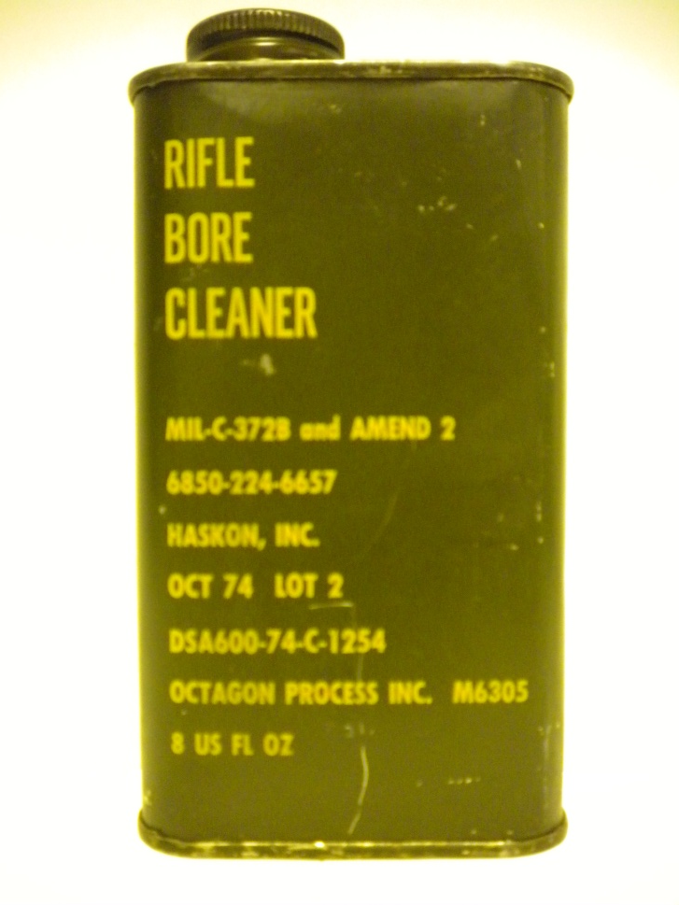
Rifle Bore Cleaner (RBC)
Cleaner only, not a lubricant
Must be followed by some lubricant
2oz bottle, 8oz &1gal can available
NSN 6850-00-224-6577

Slide 3
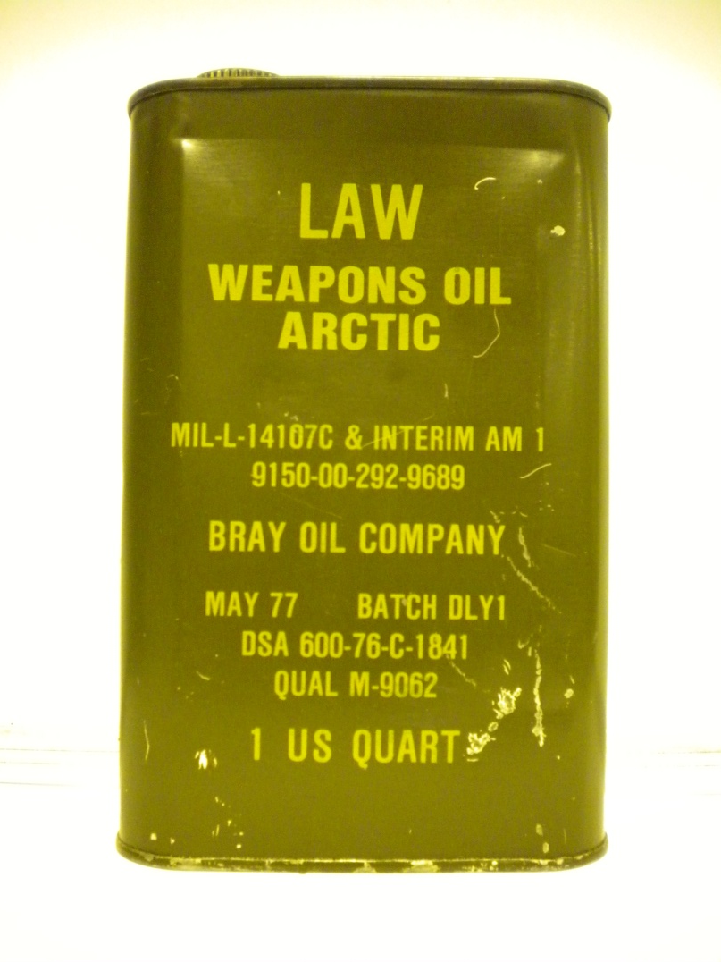
Lubricating Oil, Arctic, Weapons (LAW)
Temperature must be below 10⁰ F
1qt can available
NSN 9150-00-292-9689

Slide 4
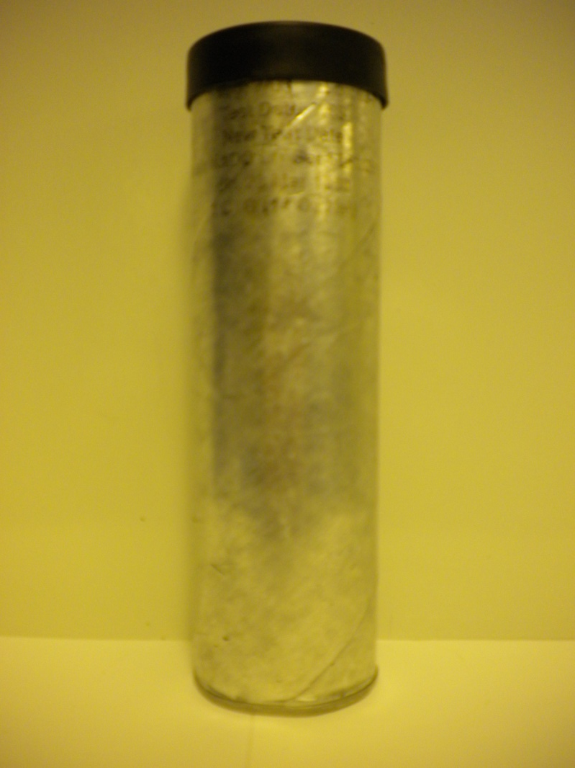
Grease, Molybdenum Disulfide (GMD)
Recommended for MK19
14oz tube, 6.5lb & 35lb can available
NSN 9150-00-935-4018

Slide 5
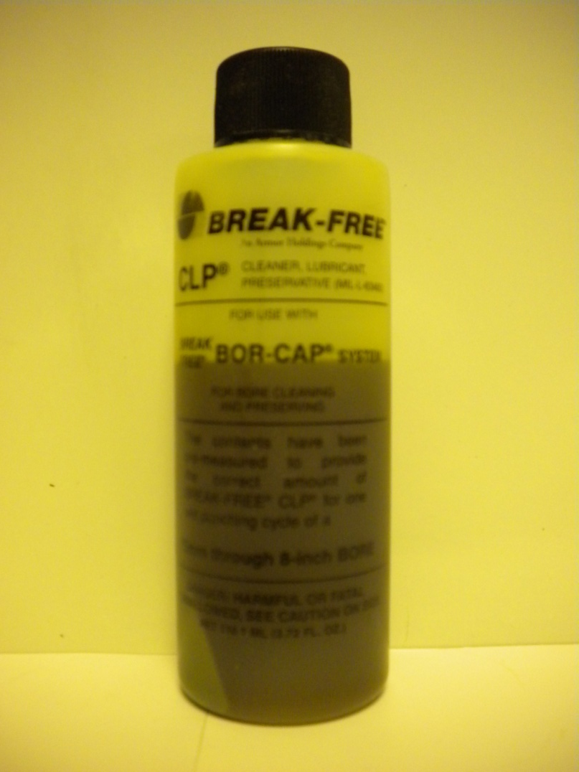
Cleaner, Lubricant, Preservative (CLP)
Do not use on MK19
Only lube used on M249
Do not mix with any other lubricant
½oz & 4oz bottles, 1pt, 1gal available
NSN 9150-01-079-6124

Slide 6
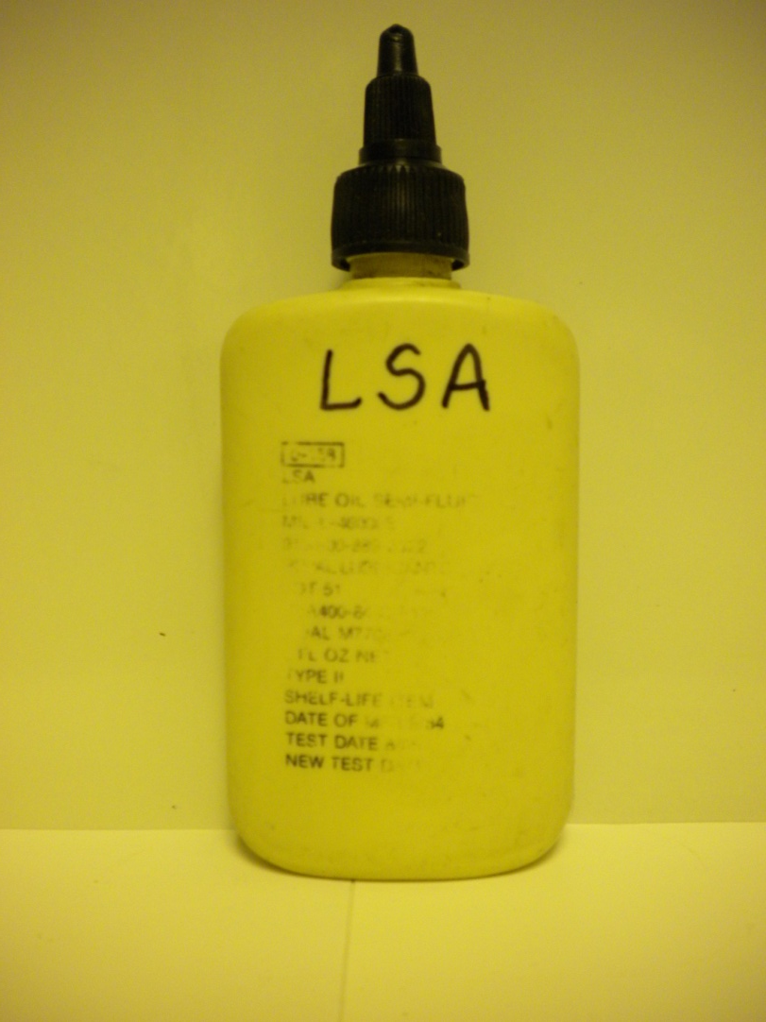
Lubricant, Semi-Fluid, Automatic Weapon (LSA)
Never mix with CLP
Clean weapon with cleaning compound solvent MIL-PRF-680 if CLP was used
Use on MK19 if GMD in unavailable
2oz, 4oz & 32oz bottles, 1gal can available
NSN 9150-00-889-3522

Slide 7
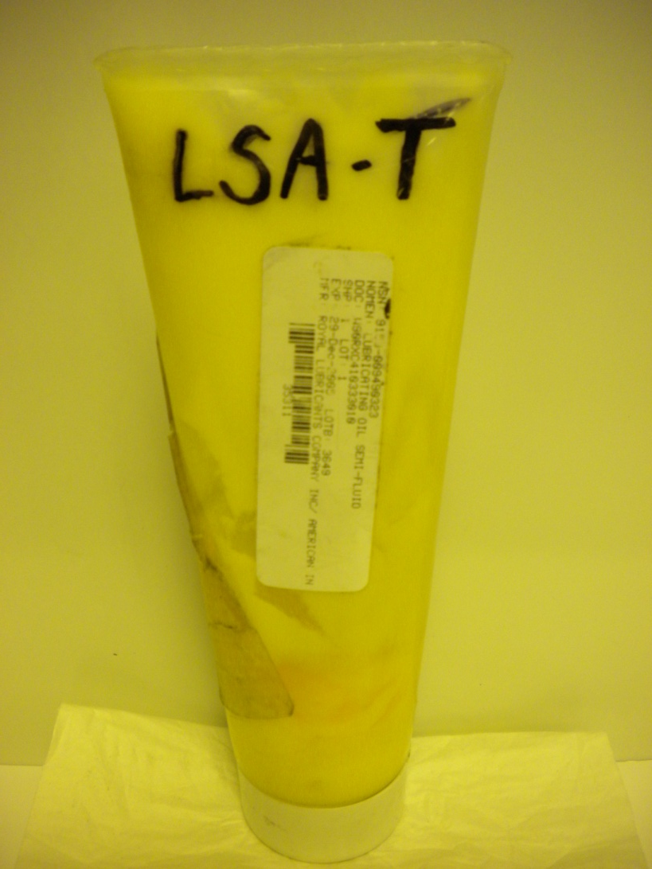
Lubricant, Semi-Fluid, Automatic Weapon W/Teflon (LSA-T)
Do not mix with CLP
Clean weapon with cleaning compound solvent MIL-PRF-680 if CLP was used
Use on MK19 if GMD is unavailable
8oz tube, 1lb can available
NSN 9150-00-949-0323

Slide 8
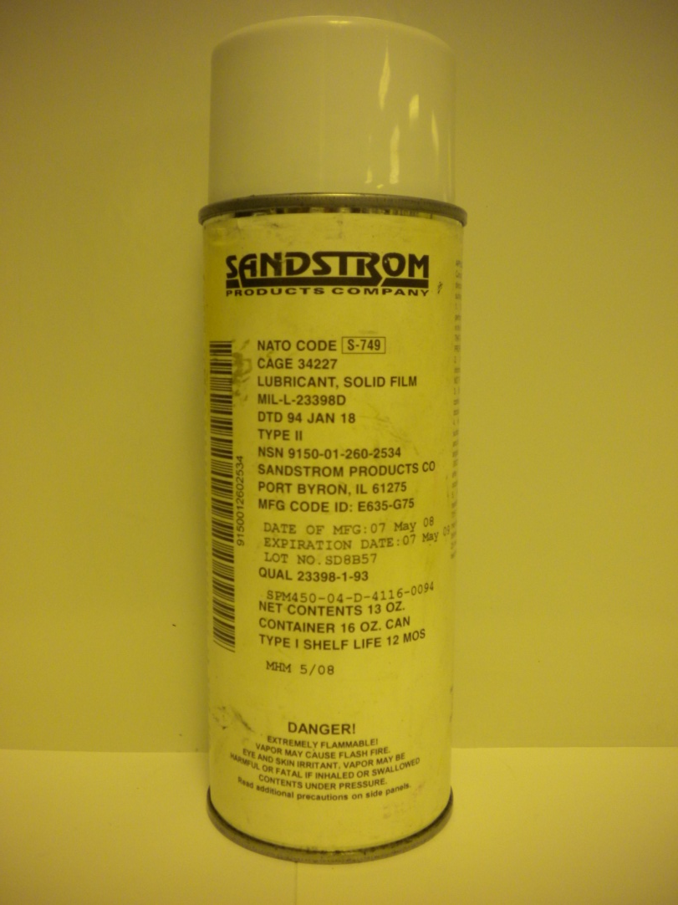
Solid Film Lubricant (SFL)
Touch up to 1/3 weapon exterior
Weapon must be cleaned with cleaning compound solvent MIL-PRF-680 first before use
16oz aerosol can, 1qt & 1gal can available
NSN 9150-01-260-2534

Slide 9
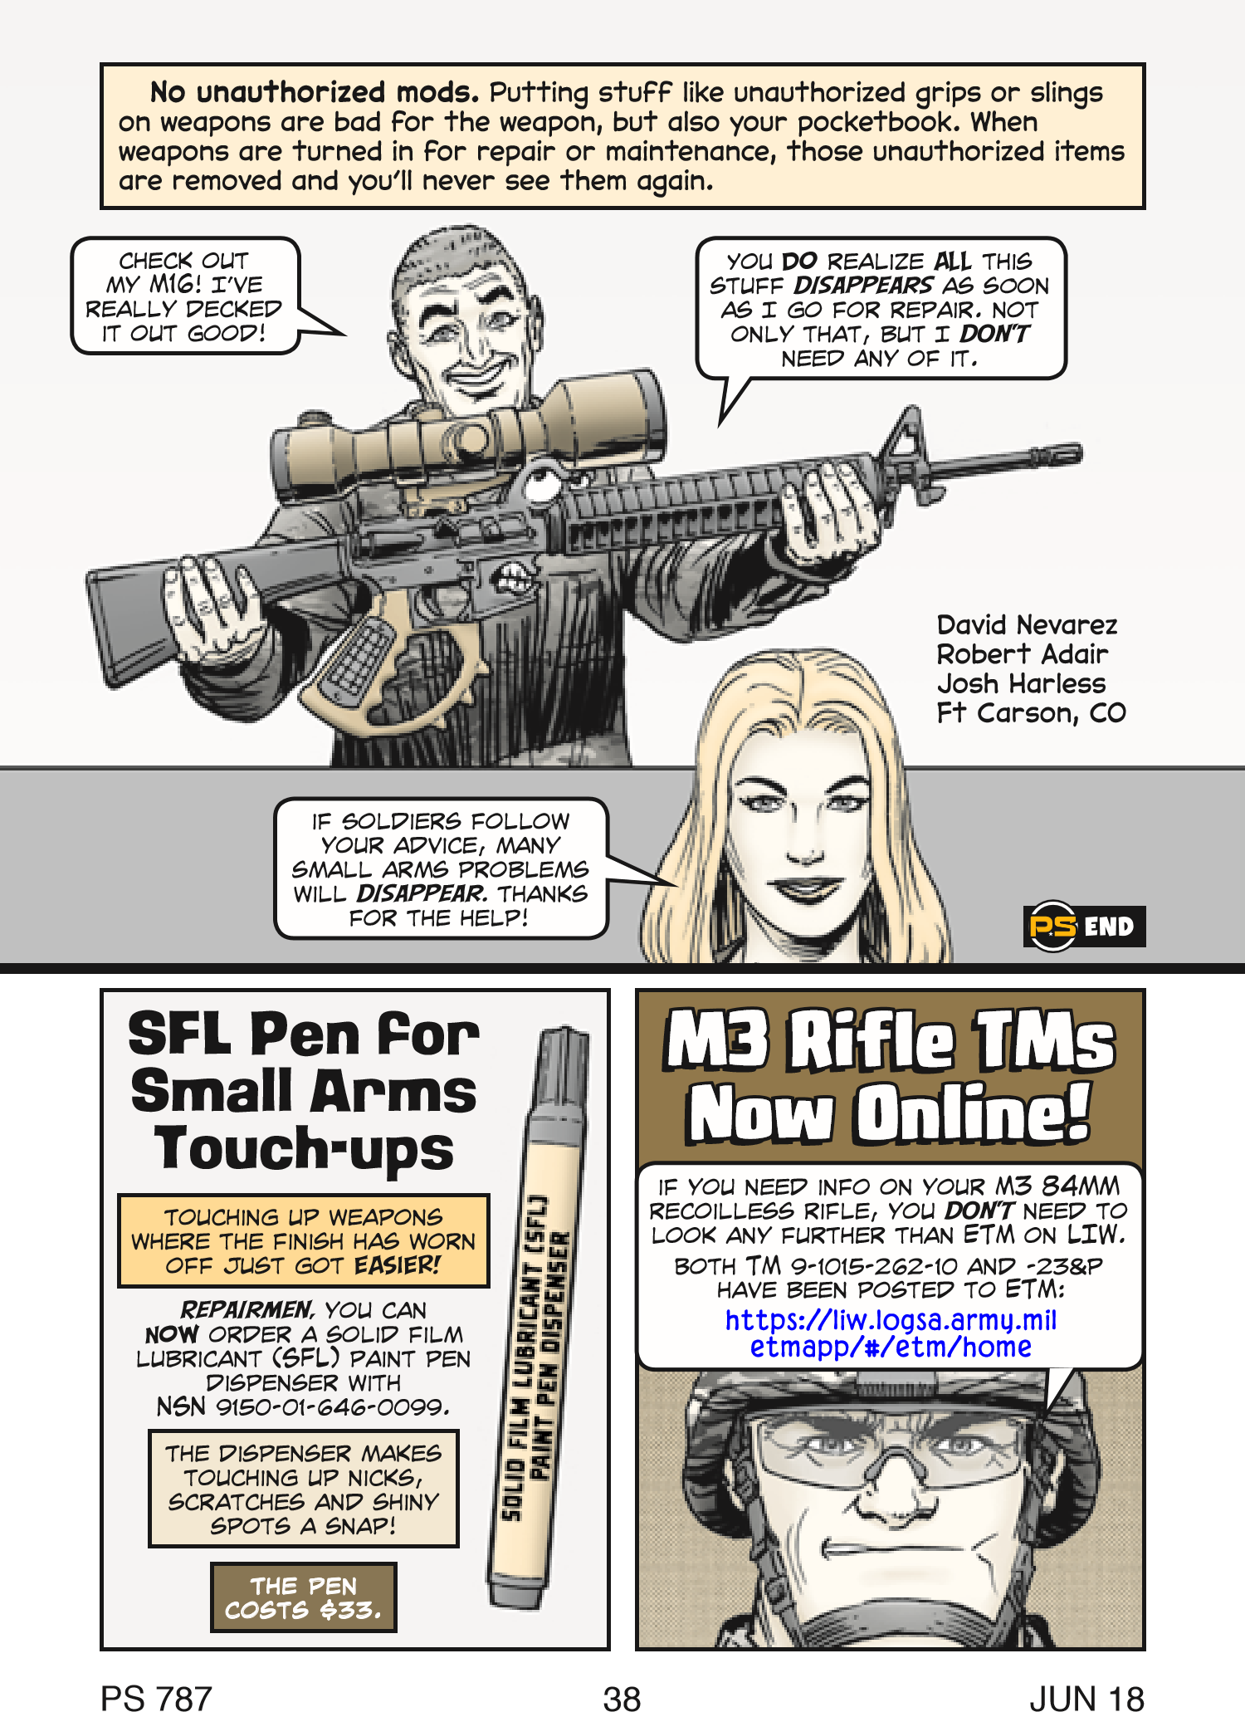
Reference: PS Magazine Issue 787, Dated June 2018

Slide 10
MIL-PRF-680 Type II
Dry Cleaning Compound Solvent
No Photo Available
Replaces P-D-680 dry cleaning solvent as of July 2005
Recommended for use in solvent tanks
Must be followed by lubricant
1gal 6850-01-474-2319
5gal 6850-01-474-2317
15gal 6850-01-378-0698
55gal 6850-01-474-2316

Slide 11
DON’T:
Use oven and carburetor cleaner: Strips off protective finish, leads to corrosion
Use cleaning pads (Green scratch pads): Strips off protective finish, leads to corrosion
Use shaving cream or Simple Green: Removes all lubrication, leads to corrosion
Use lightweight oils (WD40, etc): Evaporates quickly, low flash point

Slide 12
DON’T
Use cotton tips or swabs: Cotton plugs small areas such as gas ports. Use swabs only in weapon barrels.
Use chamber brush attached to a drill: Grinds off metal
Use homemade cleaning tools (coat hangers): Scratches metal/protective finish
Use paper towels and rags: Clogs areas like buffer tubes

Slide 13
DON’T
Use JP-8: Causes worse carbon build-up, difficult to remove
Use motor oil: Hardens, heavy carbon build-up
Use graphite-based lubricants: Eats and destroys aluminum and other alloys
Use sandpaper: Scratches metal/Protective finish

Slide 14
For NSN’s and more information on lubrication
Expendable and Durable Items List in the TM -23&P
https://www.logsa.army.mil/psmag/archives/PS2008/671/671-23.pdf
TACOM Ground Precautionary Message 07-003

