Slide 1
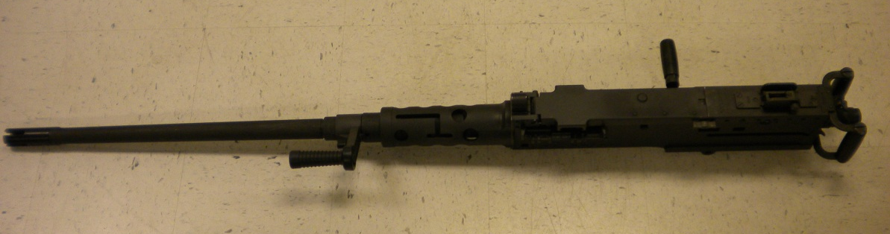
MACHINE GUN, CALIBER .50 M2A1

Slide 2
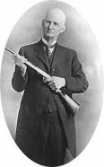
John Moses Browning
1855 - 1926

Slide 3
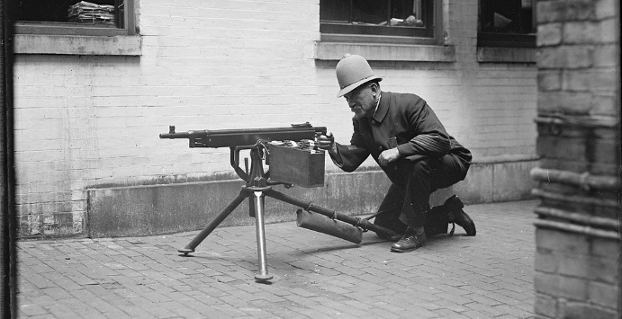
M1895
6mm Lee Navy, .30 Army in 1899
400 rds/min

Slide 4
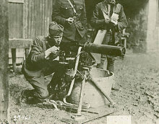
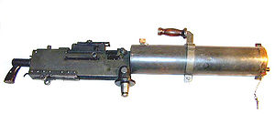
M1917
.30-06
450 rds/min
M1917A1 600 rds/min

Slide 5
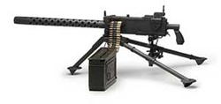
M1919 (A1-A6)
.30-06 & 7.62
400-600 rds/min

Slide 6
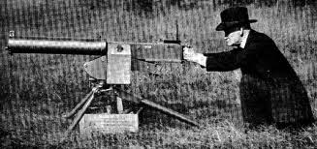
M1921
CIRCA 1919
450-600 rds/min

Slide 7
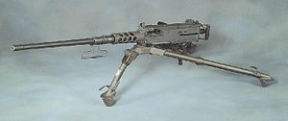
CAL .50, M2, HB
1933 –Present
450-635 rds/min

Slide 8
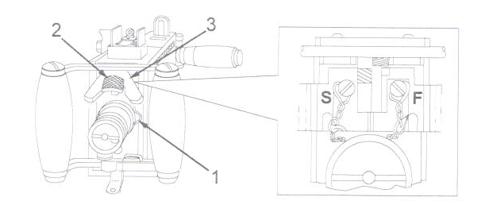
5
6
4
Bolt Latch Release Lock 5. Backplate Latch Lock
Bolt Latch Release 6. Backplate Latch
Trigger
Trigger Block (Safety)

Slide 9
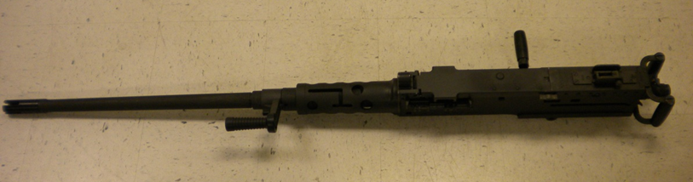
M2A1
DISASSEMBLY

Slide 10
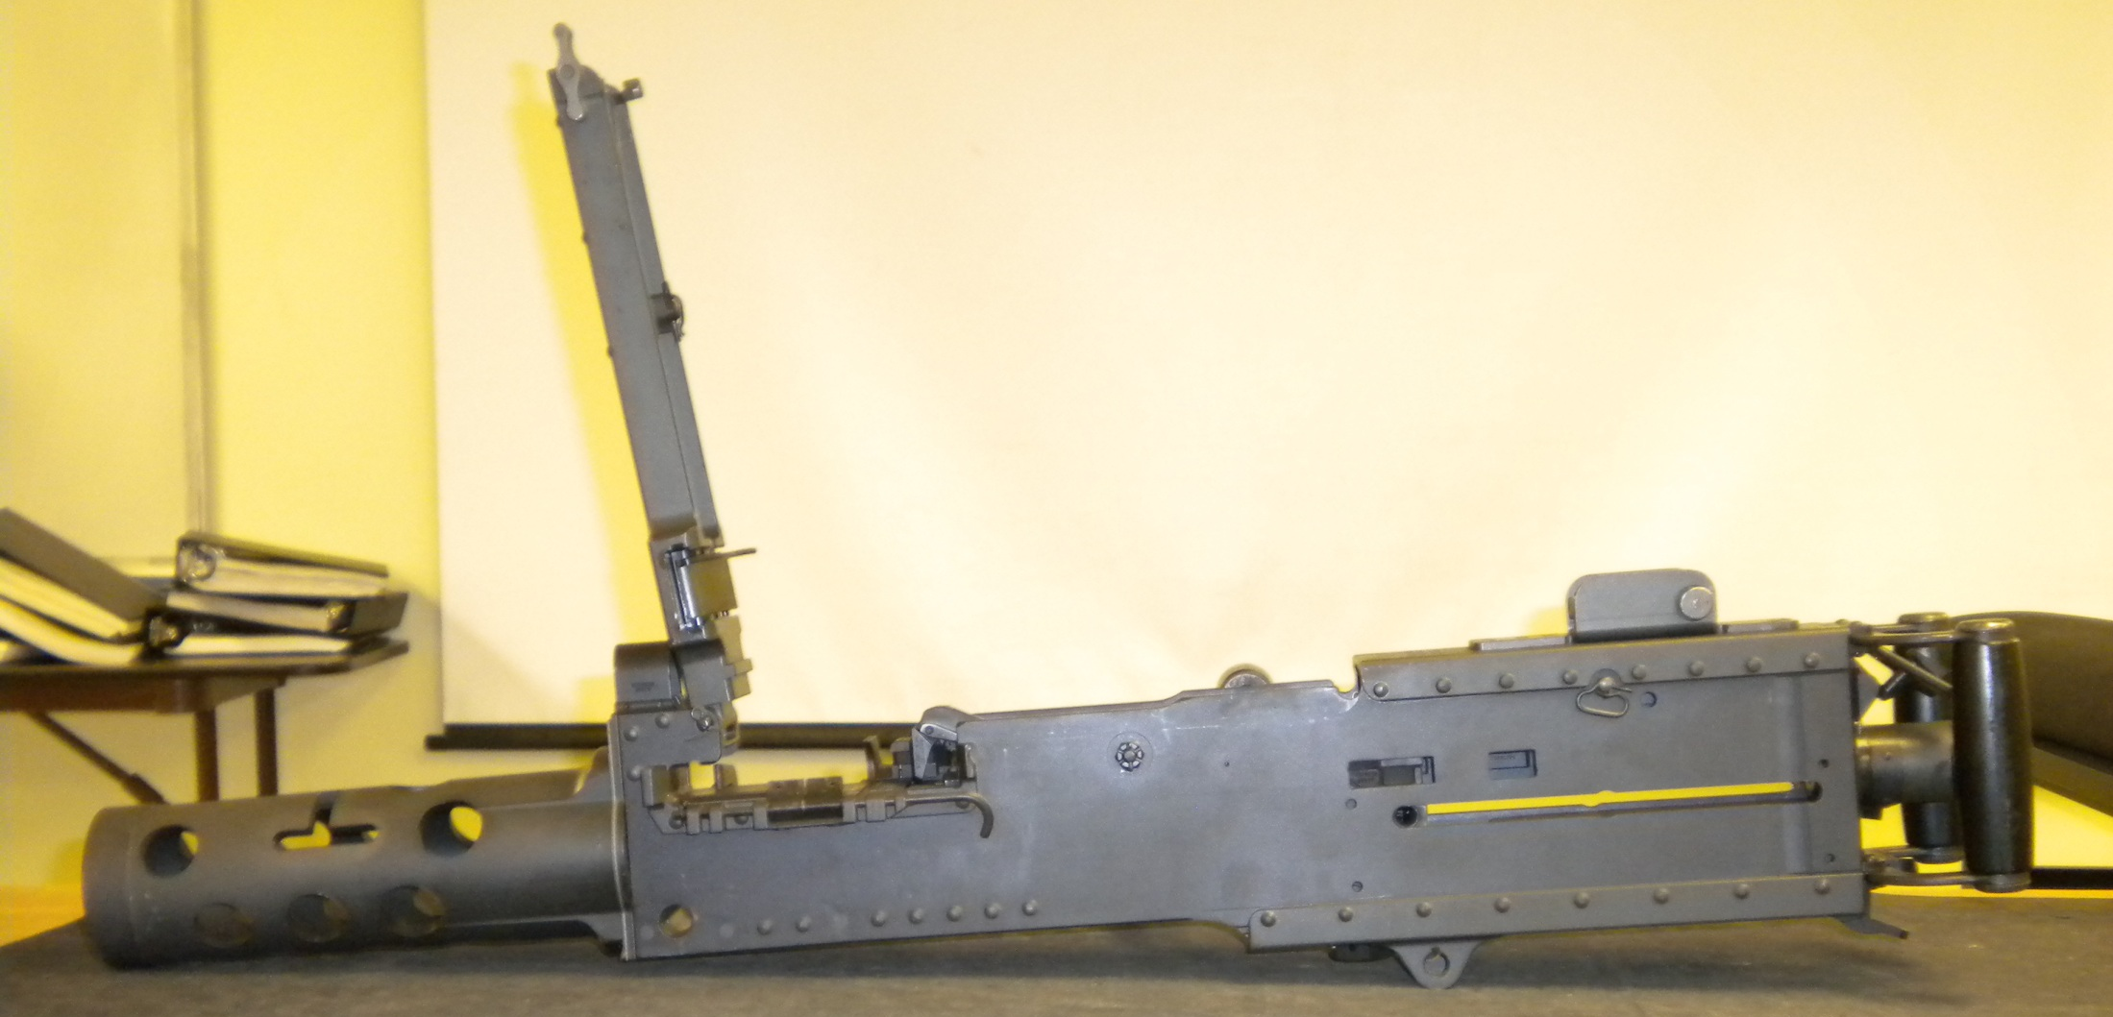
Clear the Weapon
Raise Cover
Observe Chamber
Ensure Bolt is Forward

Slide 11
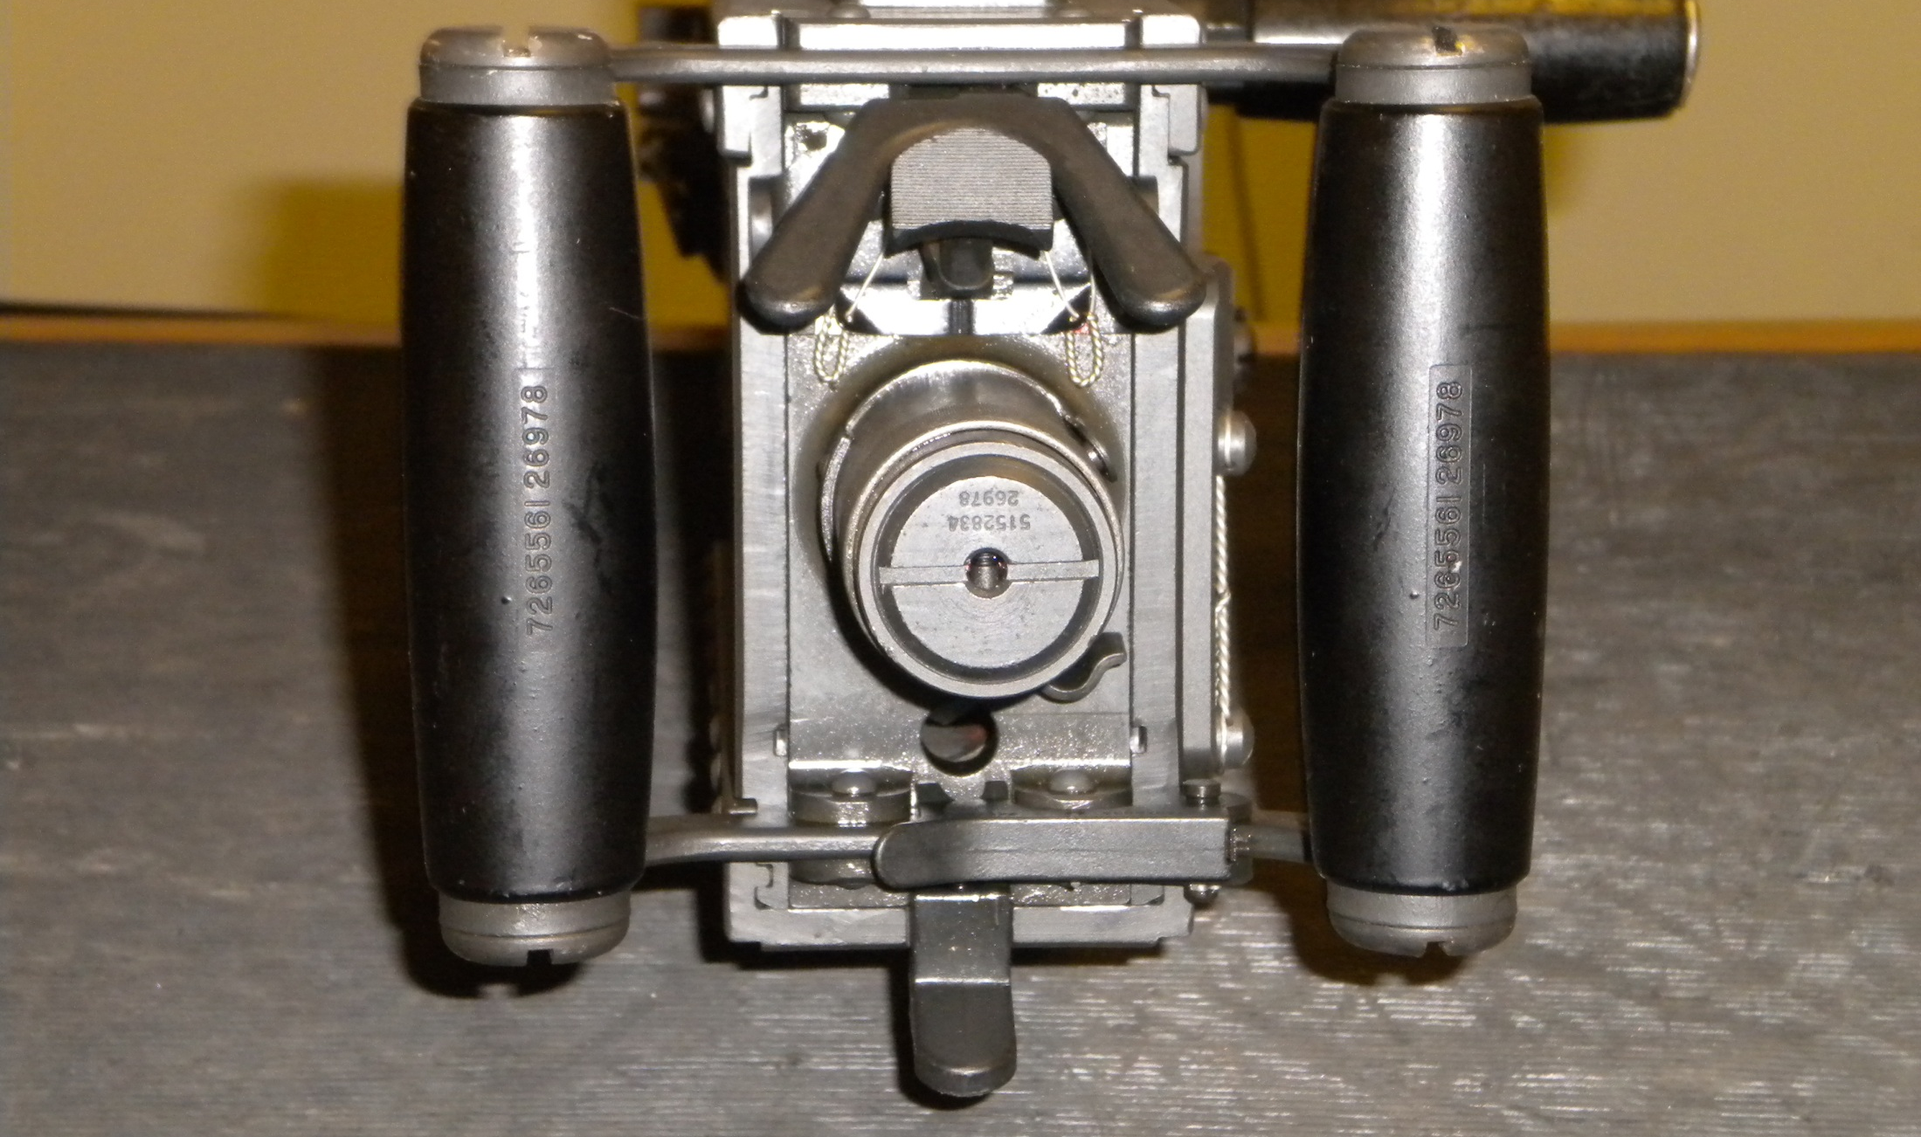

Pull out on Backplate Latch Lock
Pull up on Backplate Latch
1
2

Slide 12
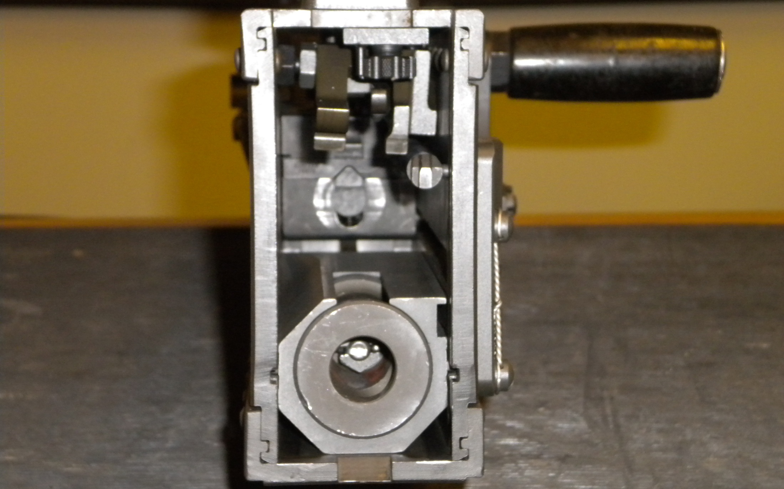

Remove Driving Spring Rod Assembly

Slide 13
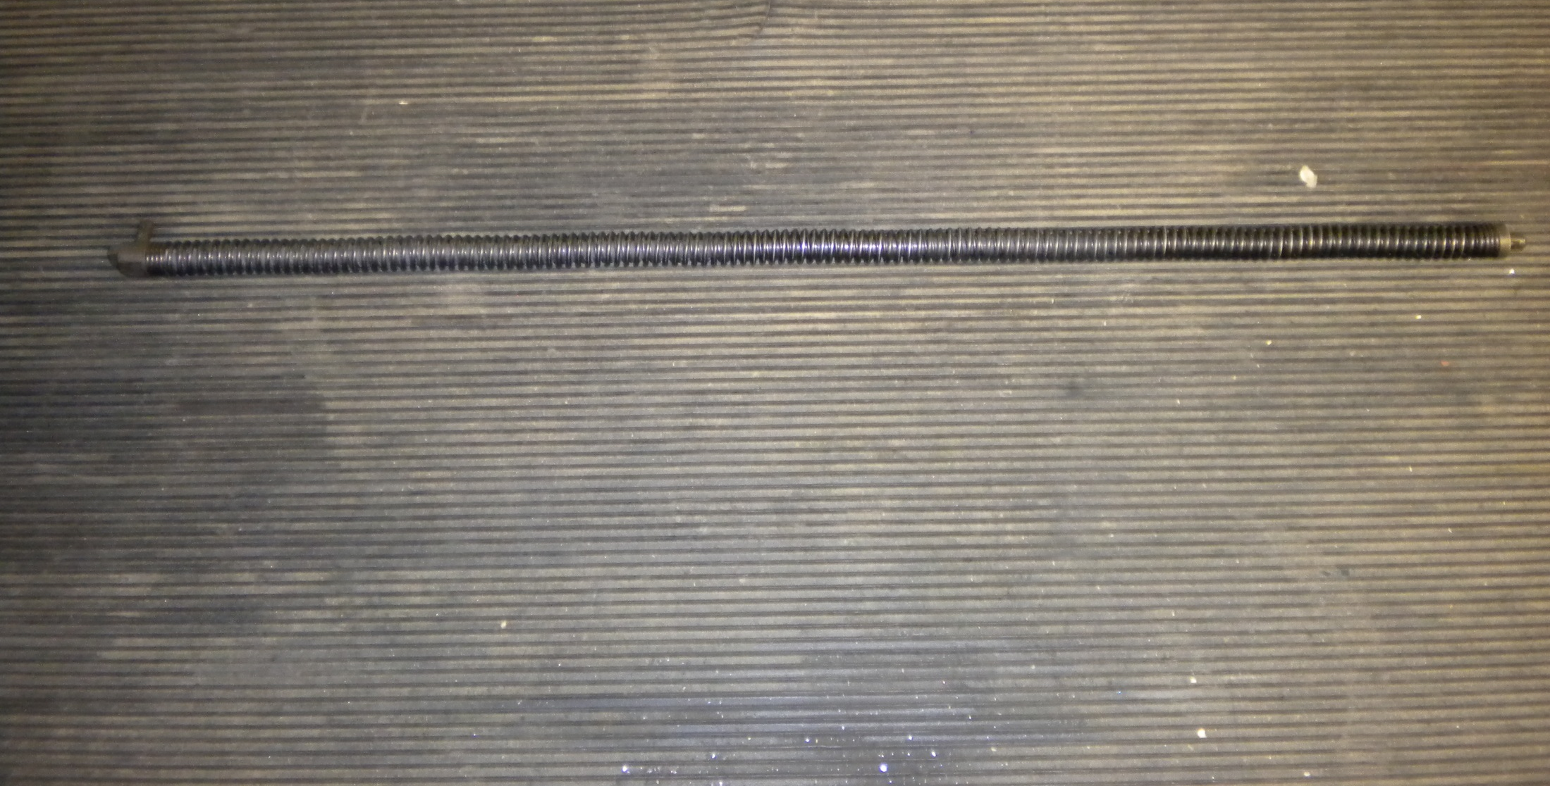
Driving Spring Rod Assembly

Slide 14
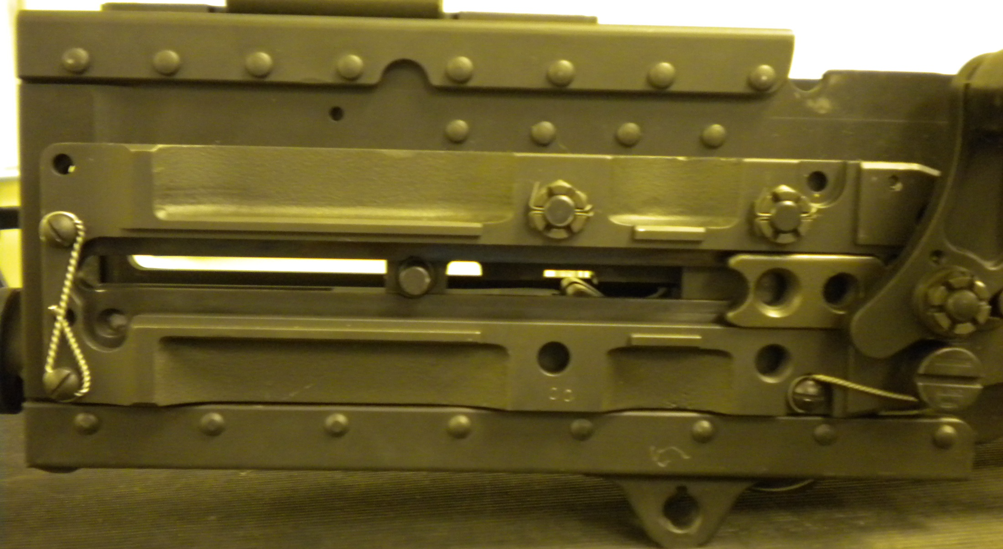

Remove Bolt Stud

Slide 15
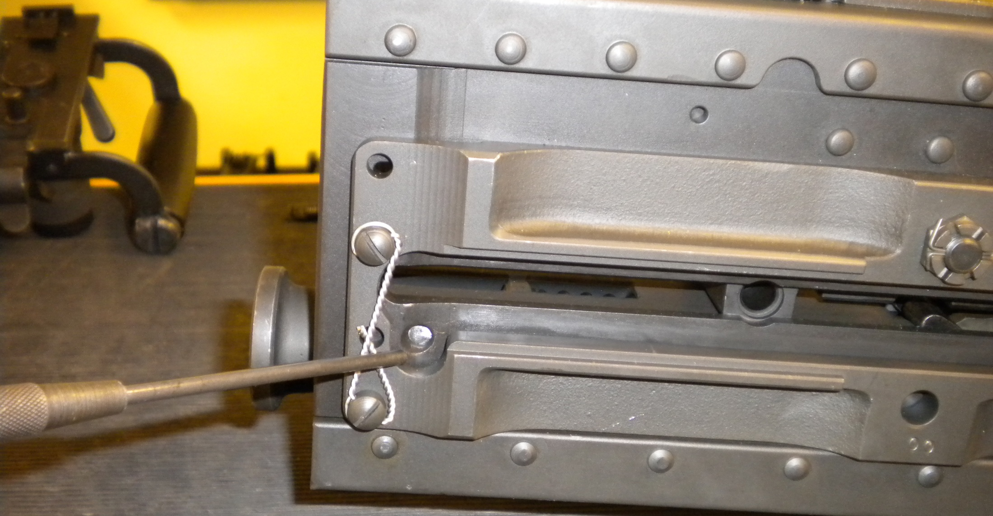

Depress Buffer Body Lock

Slide 16

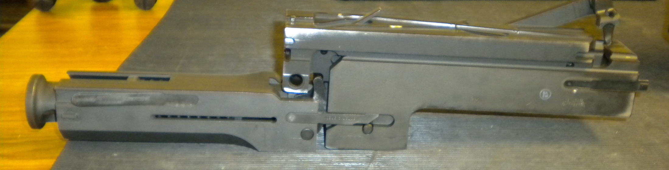
Bolt Assembly
Barrel Buffer Assembly
Barrel Extension Assembly
2
1
3

Slide 17
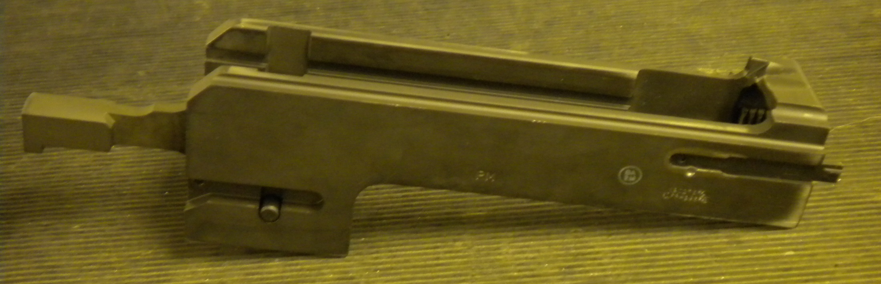
Barrel Extension Assembly

Slide 18
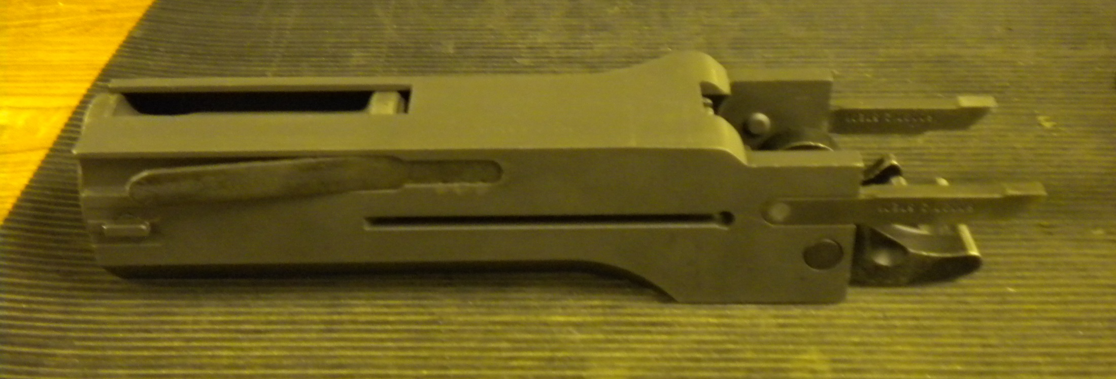
Barrel Buffer Assembly

Slide 19
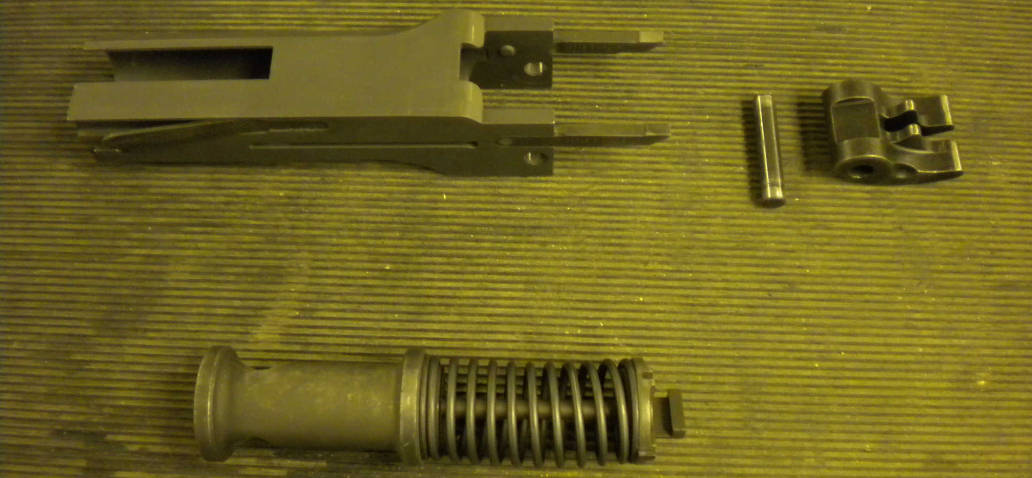

Barrel Buffer Body
Buffer Accelerator and Pin
Buffer Assembly
1
2
3

Slide 20
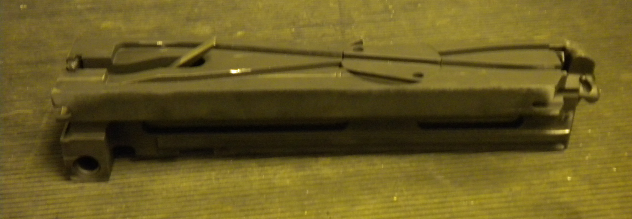
Bolt Assembly

Slide 21
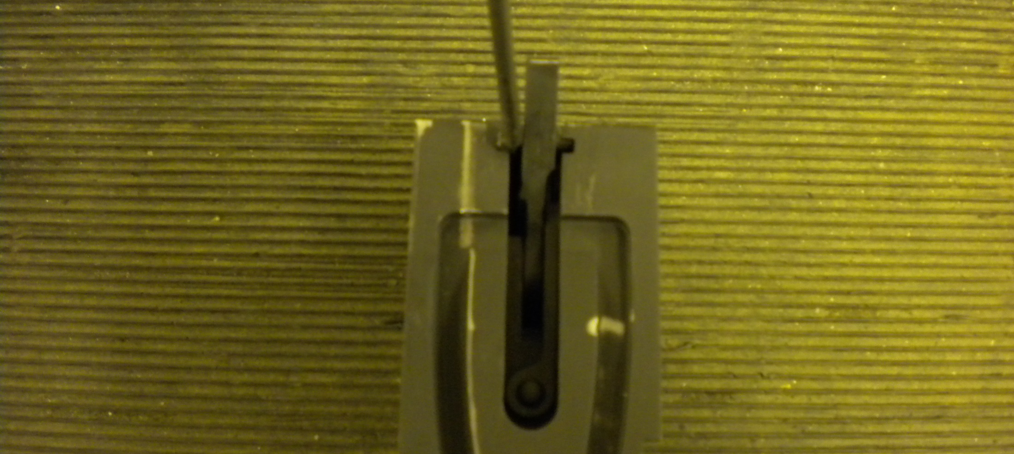
Fire the Bolt

Slide 22
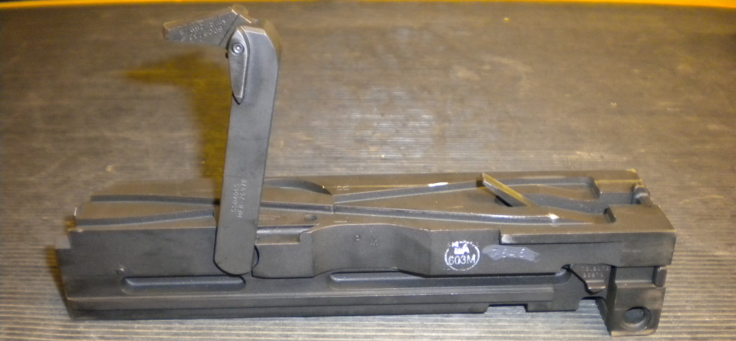

Cartridge Extractor

Slide 23
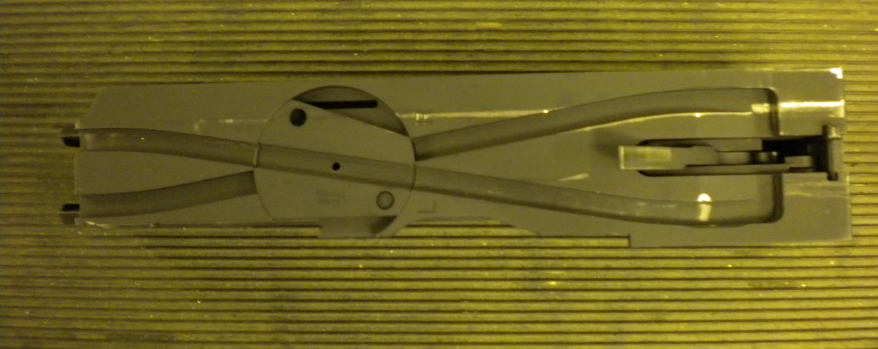



Bolt Switch
Cocking Lever
Cocking Lever Pin
1
2
3

Slide 24
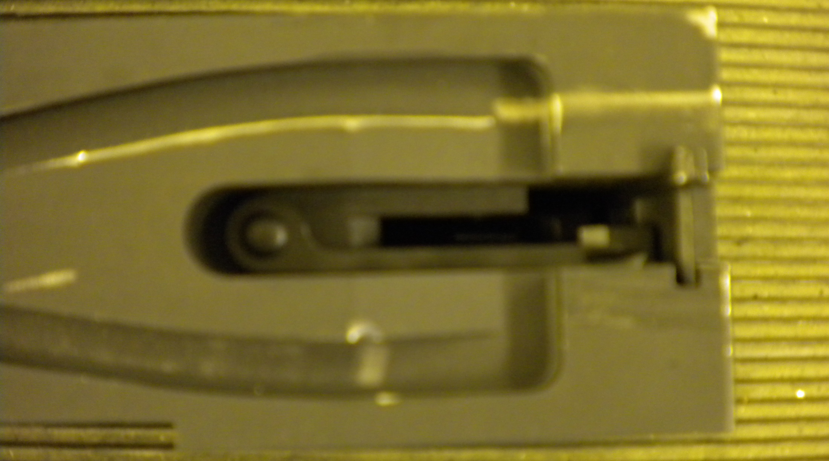
Sear Stop and Pin

Slide 25
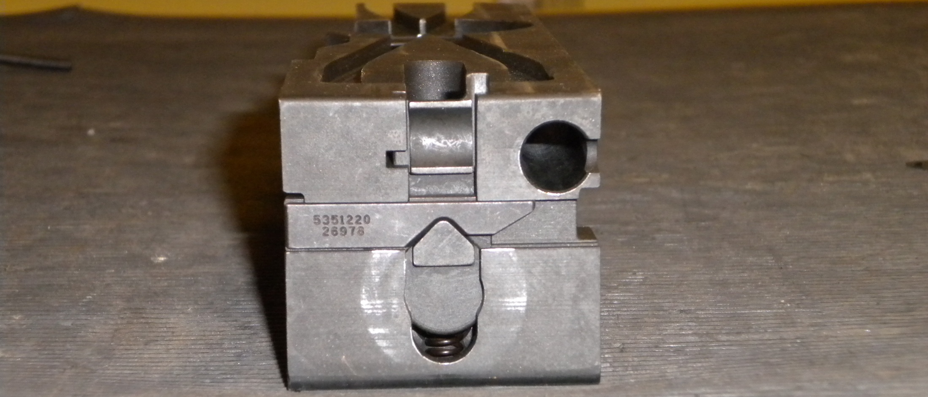

Sear Slide
Sear
Sear Spring
1
2
3

Slide 26
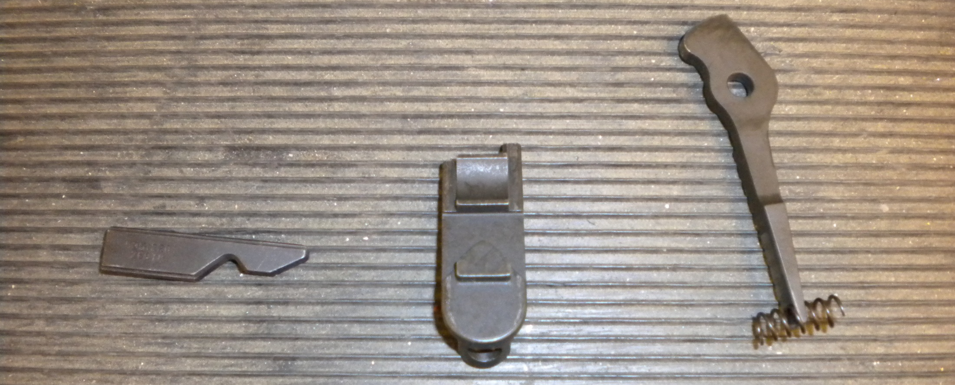

Sear Slide
Sear
Sear Spring
2
1
3

Slide 27
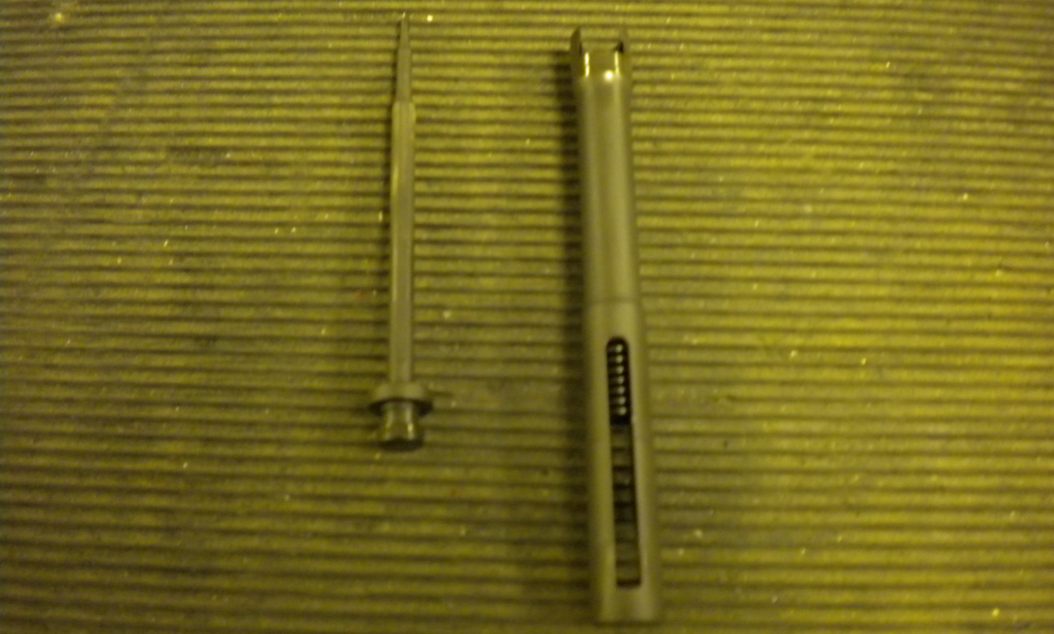
Firing Pin
Firing Pin Extension
1
2

Slide 28
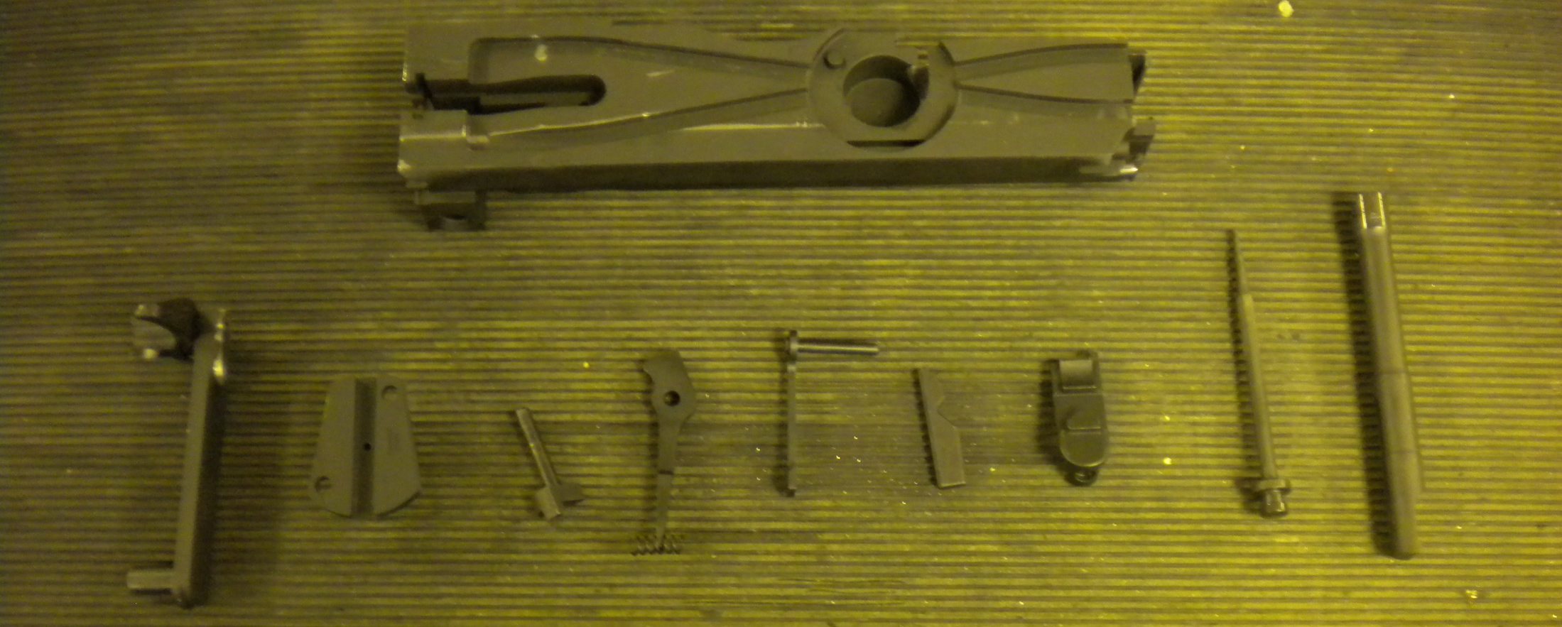
Disassembled Bolt Assembly

