Slide 1
To ensure Compliance & Basic Knowledge of understanding of all radioactive equipment, awareness training, survey/wipe tests, and waste shipment on Fort Riley.
PURPOSE

Slide 2
SYSTEMIC PROBLEMS
Units not conducting user-level, awareness training in the aspects of radioactive commodity use or ensures users receive required training. (Technical Manuals, DA PAM 385-24, page 6, para 1-4 r, 2).

Slide 3
TRITIUM
Exposure to tritium increases the risk of developing cancer
Tritium exposure can pose a health risk if it is ingested through drinking water or food, inhaled or absorbed through the skin in large quantities
Urinalysis is the easiest bioassay method for determining exposure to tritium

Slide 4
ROUTES OF ENTRY
INHALATION
INGESTION
ABSORPTION
INJECTION
Notes:
*Ingestion- eat or drink it
*Inhalation- breathe it in
*Absorption- Does it pass through the skin, eyes or other membranes?
*Injection – Does it enter through a puncture or cut?

Slide 5
BIOLOGICAL EFFECTS
Radiation may…
  Deposit Energy in Body
  Cause DNA Damage
  Create Ionizations in Body
    Leading to Free Radicals
Which may lead to biological damage

Slide 6

ADVANCED COMBAT OPTICAL GUNSIGHT (ACOG)
NSN: 1240-01-557-1897
M150 Rifle Combat Optic (RCO), Advanced Combat Optical Gun sight (ACOG) designed for the US Army's M4 weapon system.
Tritium 0.1 curie
It incorporates dual illumination technology using a combination of fiber optics and self- luminous tritium. This allows the aiming point to always be illuminated without the use of batteries.

Slide 7
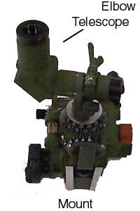
M67 SIGHT UNIT
*The M67A1 has several locations with tritium sources.

Slide 8
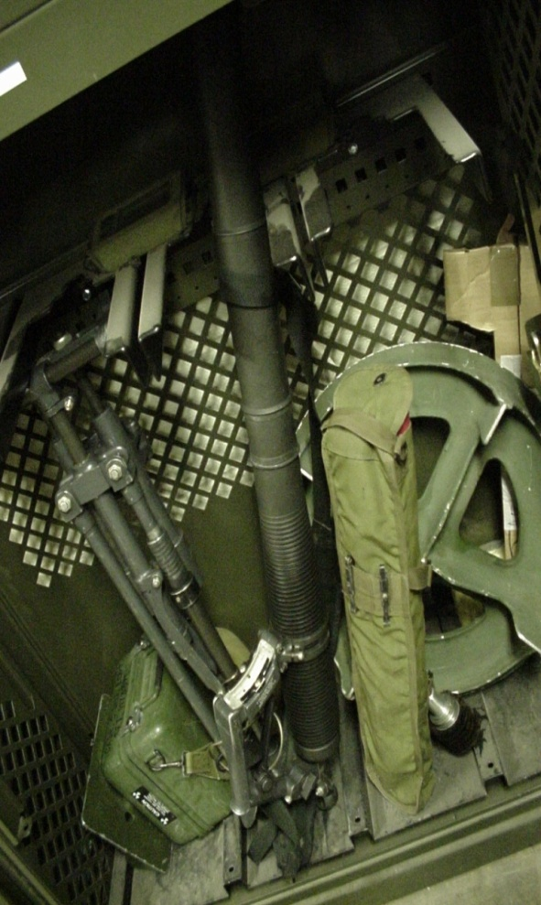
RANGE INDICATOR
NSN: 5840-01-458-6159
P/N: 9360374
The Range Indicator, housed in the mortar handle, is used with the Handle & Firing Mechanism when firing the mortar in its alternative handheld mode.
The Range Indicator uses radioluminous tritium (H³) gas to illuminate the scales in night and low light operation conditions.
The Range Indicator is used to estimate the correct weapon elevation corresponding to the range to the target being engaged.
The Range Indicator is used with the M224 (60mm) Mortar.

Slide 9
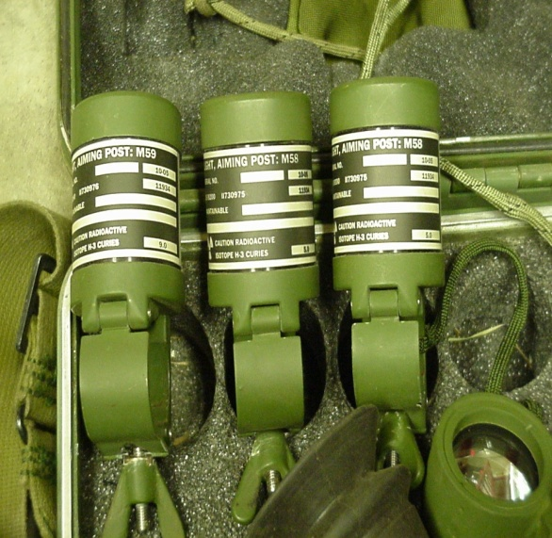
M58 & M59
AIMING POST LIGHTS
NSN: 1290-00-169-1934
P/N: 11739179-1
The M58 Aiming Post Light is illuminated by orange tritium (H³) gas.
Tritium 5.0 curie
NSN: 1290-00-169-1935
P/N: 11739179-2
The M59 Aiming Post Light is illuminated by green tritium (H³) gas.
Tritium 9.0 curie
*The M58 and M59 Aiming Post Lights are typically ordered as an Aiming Post Light Kit which consists of (2) – M58 (green) and (1) – M59 (orange).

Slide 10
Work Practices
WORK PRACTICES
Maintenance on devices containing radioactive material can not be performed with a “Shade Tree Mechanic” attitude.
Maintenance personnel must be familiar with the TM for the equipment and follow the instructions precisely.

Slide 11
WORK PRACTICES
Illumination Checks
Washing Hands
Isolation
Ventilation

Slide 12
INCIDENT PROCEDURES
Notify all personnel to vacate area & restrict access
Turn off central air conditioning
Open all windows to the outside
Turn on any exhaust fans leads outside

Slide 13
INCIDENT PROCEDURES
Place the device in a dark place for
a minimum of 2 hours to ensure phosphor is not being activated by an outside light.
View device in low light – If there is no evidence of illumination or the illumination appears diminished, consider the light source to be broken , double bag it and turn it in to the RSO for disposition.

Slide 14
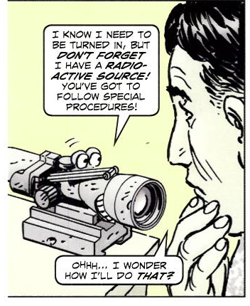
ADVANCED COMBAT OPTICAL GUNSIGHT
Returning damaged (ACOG’s)
Contact htttp://www.trijicon.com or 1-800-338-0563
  Click Support
    Return Authorization (RA)
      Read & click acknowledge
        Enter unit POC & ph #
          Date of purchase (UNK)
            List all serial numbers
              Submit information
                Contact IRSO once RA has been obtained
walter.l.hill10.civ@mail.mil/GSO/239-0517

Slide 15

Radioactive material MUST BE secured at all times, when not in use.

Slide 16
REGULATIONS
AR 385-10, The Army Safety Program
DA Pam 385-24, The Army Radiation Safety Program
DA Pam 385-25, Occupational Dosimetry & Dose Recording
FORSCOM Regulation 385-1, FORSCOM Safety
Fort Riley Regulation 385-24, Radiation Safety Program
Unit Radiation SOP
Technical Manuals
Notes:
Report ALL incidents/accidents to the Installation Radiation Safety Officer within 24-hours, that involves radioactive equipment.

Slide 17
RADIATION SAFETY OFFICER
Installation RSO (IRSO)
Mr. Walter L. Hill
785-239-0517
walter.hill10.civ@mail.mil
Unit RSO/
CBRN
BDE RSO/
Safety Officer
All incidents, damaged or missing radioactive item’s are required to be reported within 24 hours, to the IRSO.
Notes:
Report ALL incidents/accidents to the Installation Radiation Safety Officer within 24-hours, that involves radioactive equipment.

