Slide 1
Session Objectives
Session Objectives
Detail the current procedure for reporting course assessment data
Describe the purpose of course assessment reporting at Barton
Differentiate between the two course assessment data products
Explain how course assessment data are used
Recognize best practices to identify competencies to report on each semester
Notes:
https://bartonccc.edu/assessments/student-learning

Slide 2
Semi-Annual Course Assessment Report
Process overview
Course assessment reports are required for all instructors listed in the Fall and Spring scheduling matrices each semester
We actively solicit responses the last two weeks of each Spring and Fall semester
Last chance/late submissions are still accepted in August (Spring) and January (Fall)
Faculty report on one competency from one course of their choice

Slide 3
Semi-Annual Course Assessment Process – What We Collect
Course data
Instructor Information
Course Characteristics
Course Adjustments
Categories of Adjustments
Open-ended description
Assessment Tool
Categories of Assessment types
Open-ended description
Course Competency
Bloom’s Level
Empircal Data

Slide 4
Current Procedure
Course Assessment Annual Report
Data are downloaded into an Excel sheet each semester, cleaned, de-duped, and analyzed
All reports are available on the Barton Assessment page (https://www.bartonccc.edu/assessments/student-learning/evidence)
Draft Report is reviewed and approved by the Course Assessment Committee
A report is prepared based on these data every Fall for the prior academic year.
Finalized Report is then submitted to Jo Harrington and made available to anyone (usually October/November each year)

Slide 5
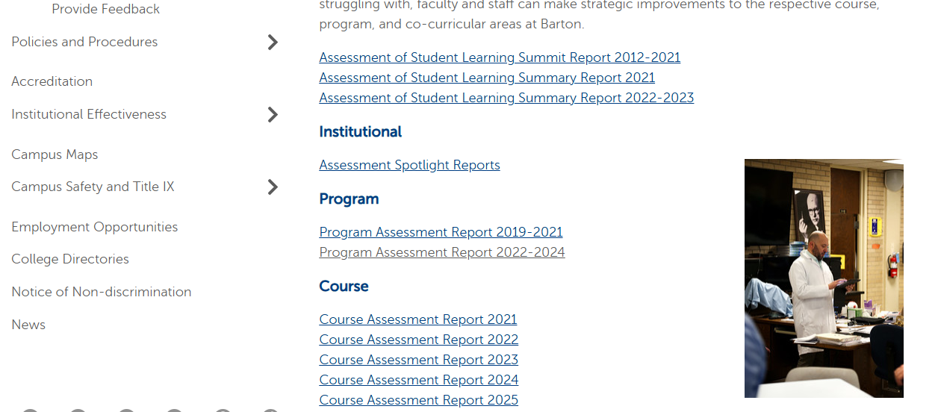
Assessment of Student Learning
Notes:
https://www.bartonccc.edu/assessments/student-learning/evidence

Slide 6
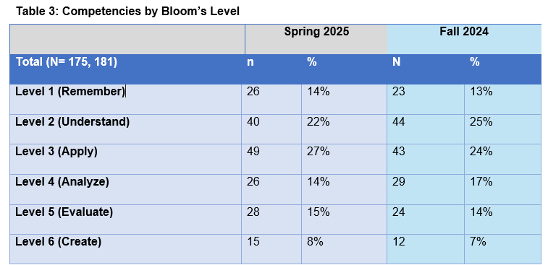
Report Sample

Slide 7
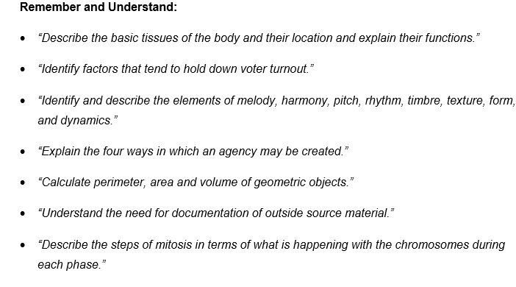
Report Sample

Slide 8
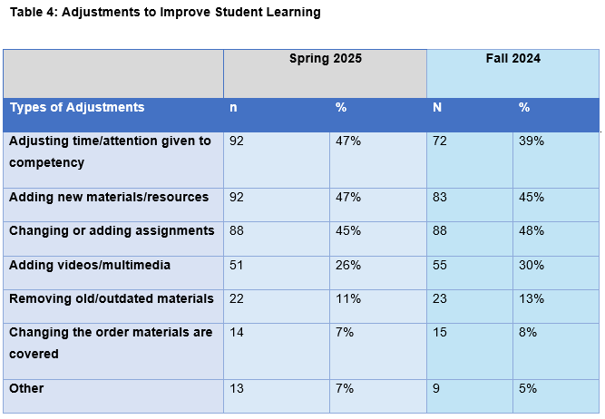
Report Sample

Slide 9
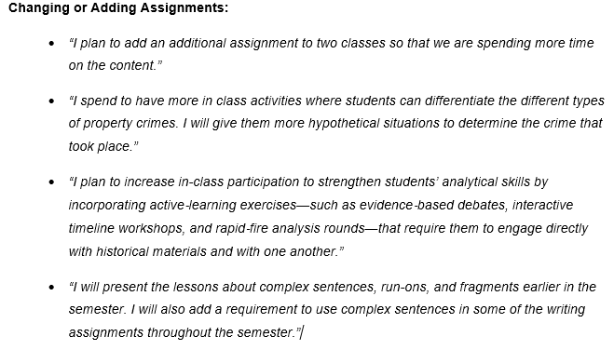
Report Sample

Slide 10
Current Procedure
Why do we collect these data?
The committee was created to build out a culture of assessment across all levels of assessment
CATs or Classroom assessment was well established here, but Course level assessment was not
Creation of the Course Committee and data reporting requirement closed a critical blind spot
Course allows as to examine changes made from April to October as opposed to Monday to Wednesday

Slide 11
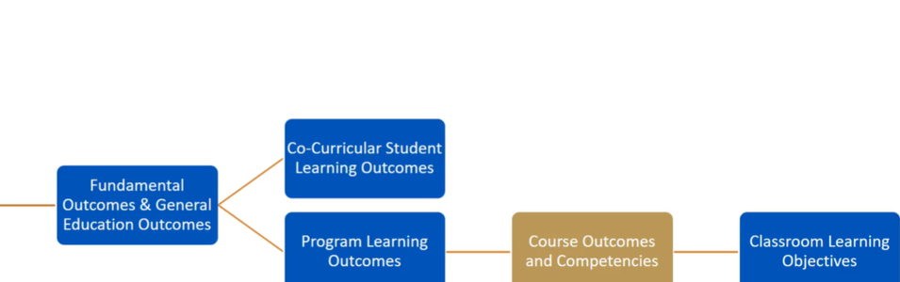
Current Procedure
Assessment in the Bigger Picture

Slide 12
Course Assessment - Testimonials
Course Testimonial Project
This is a new data product is more open-ended and not confined to a single course or competency
Participation is entirely optional; but it is an ‘assignment’ as part of the Assessment Institute each spring beginning this year (2026)
Gives the committee a 40,000-foot data view to go with our 4,000-foot view we already have

Slide 13
Current Procedure
Testimonial Reporting
Open, unstructured format allows for a fuller exploration of how faculty use course assessment at a meta-level
Any faculty member can submit a report, but is not required, nor is it recurring
The addition of this level of data will allow us to better demonstrate our culture of assessment and meet our HLC requirements

Slide 14
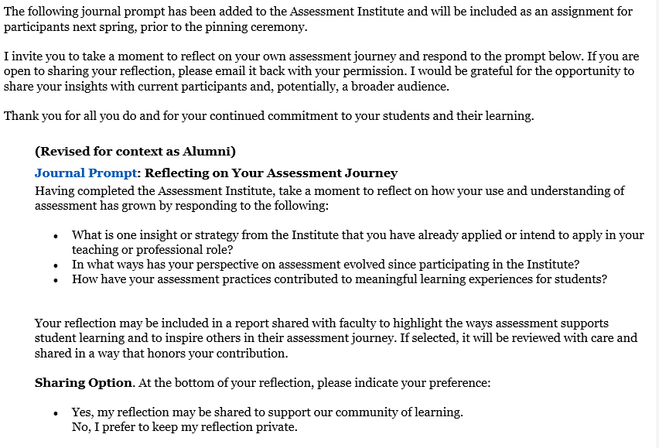
Testimonial Prompt

Slide 15
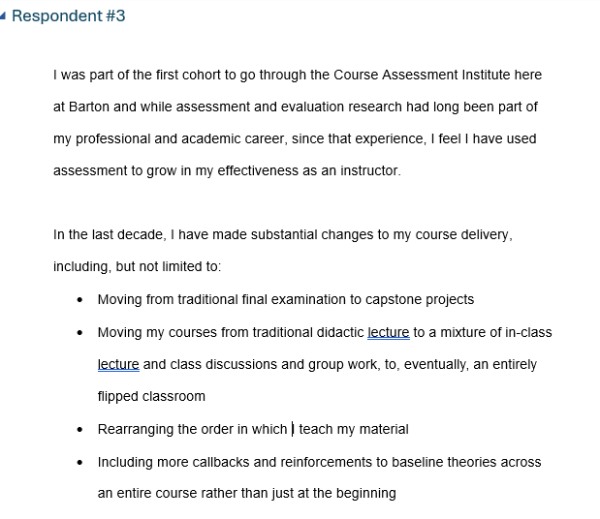
Testimonial Sample

Slide 16
Current Procedure
Why Do We collect Course Assessment Data?
Gives us another data point about how instructors focus on improving student learning
Report will eventually be used to identify best practices to help all faculty improve student learning
Provide the framework to stop and reflect each semester
Repeated data collection allows us to track changes over time
Course Assessment Testimonials
Semester-based Course Assessment
HLC Criterion 4B-2
The institution uses the information gained from assessment to improve student learning

Slide 17
Session Objectives
Which Competency?
Best Practices
Empirical
Team/Departmental
Instructional Goals
Program Assessment
Notes:
https://bartonccc.edu/assessments/student-learning

Slide 18
1. Empirical Data
If your assessment tool (most commonly an exam of some type) gives you quantitative data, you can use this
Identify competencies that have low rates (70% or below)
Identify a change you can make to improve that next semester
If you already report quantitative assessment data (numerical data) at the end of each semester to Jo Harrington, you can use this

Slide 19
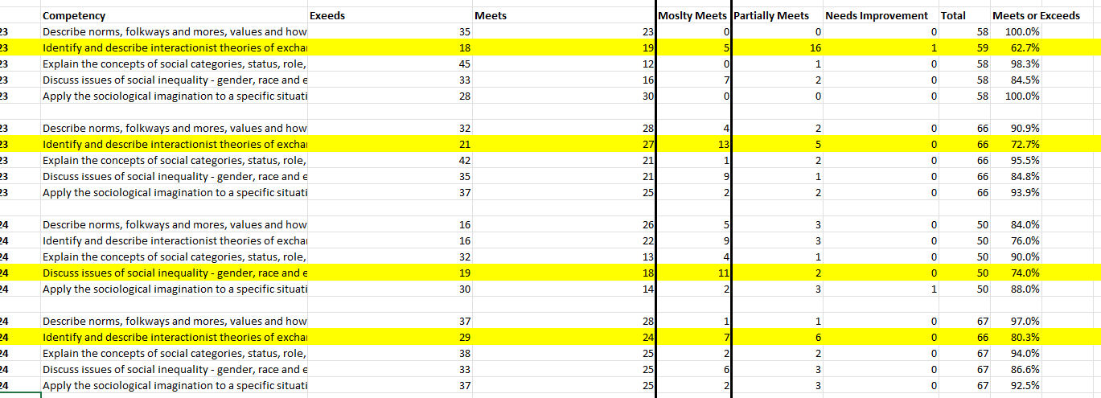
Using Your Own Empirical Data

Slide 20
2. Team or Departmental Priorities
All instructors of a given course (e.g. SOCI1100) agree to focus on a single competency
Can happen as part of formalized goal – or an ad hoc discussion in August. - The “why” doesn’t matter
Planning ideally occurs between semesters – “We’re going to work on X this Fall”
Ideal after something like a textbook change, competency updates after KBOR – some kind of logical impetus

Slide 21
3. Program Assessment
Feed Two Birds With One Seed
It’s perfectly acceptable to use the same competency for program assessment reporting and the course assessment report
Key difference is to add the improvement/change piece*
* (If your program assessment data is very high already (e.g. 95%), then this may not work
You likely have to report on a handful of competencies as part of your program assessment

Slide 22
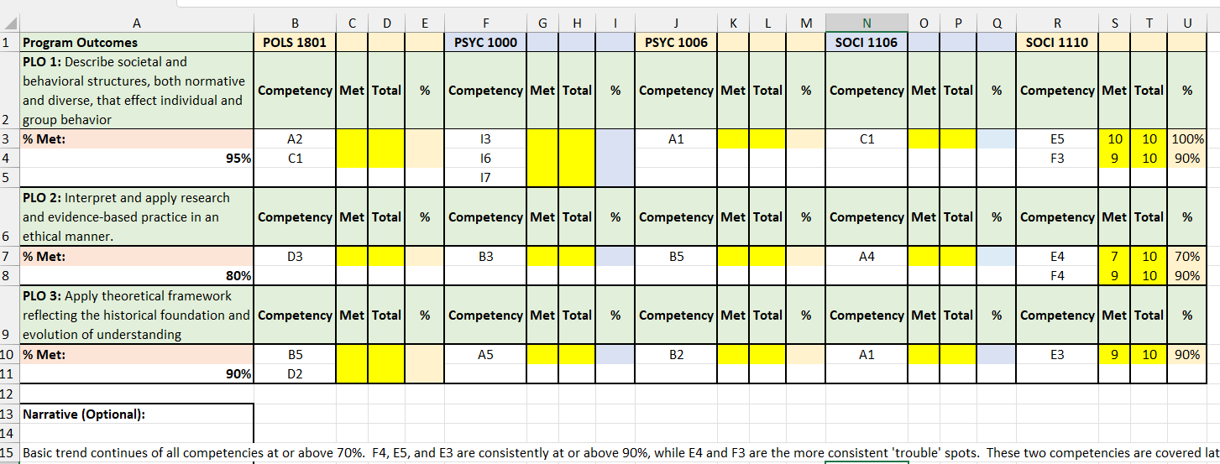
Program Assessment

Slide 23
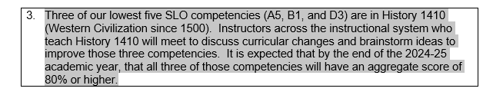
4. Instructional Review Goals
Check your current instructional review goals – at least one of those goals should support improving student learning
If that goals refers to specific competencies, consider using that data for your Fall 2024 Course Assessment reporting

Slide 24
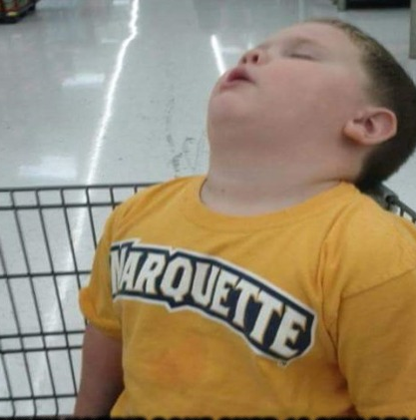
Questions??

