Slide 1
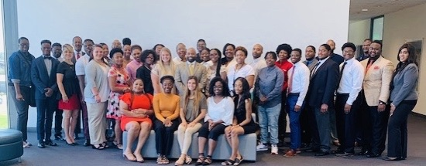


Leadership Development Academy

Slide 2
INTRODUCTION
This presentation shows how to create a Leadership Academy based on the Leadership Development Academy (LDA) at Baton Rouge Community College. What is LDA?
Leadership Development Academy (LDA) is a student program designed to: educate, engage, empower , encourage and to create networking opportunities for students.

Slide 3
CONTENT
LDA content focuses on leadership skills; personal development; teambuilding skills; exposure to city and state governmental agencies, social concerns, non-profit organizations, higher education and the criminal justice system.

Slide 4
LDA LEARNING OBJECTIVES
Students learn their individual thinking and behavioral preferences and
how they perform in teams
Students gain knowledge, confidence and inspiration by visiting state and local government
agencies and hearing from prominent community leaders
Students are afforded networking opportunities to develop support groups,
business affiliations and friendships while in college and beyond.

Slide 5
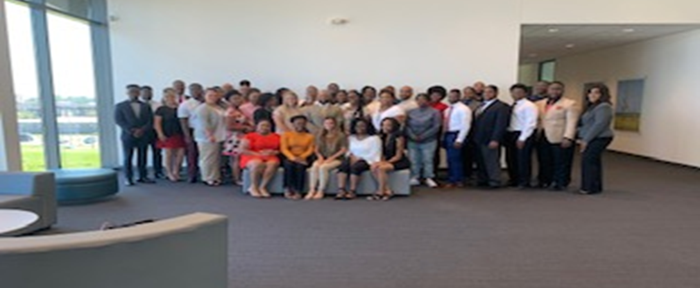
ULTIMATE GOAL
That through these experiences, students will be inspired and empowered to become
better leaders, better citizens, better students, better team members
and ultimately have an overall better quality of life.

Slide 6
We all want to be inspired!!!
“If your actions inspire others to dream more, learn more, do more and become more, you are a leader.”- John Quincy Adams

Slide 7


Slide 8
LDA is a replica of the local chamber of commerce Leadership Academy, one that inspired us.
That inspiration, fueled this vision. Inspiring colleagues was the catalyst to make the vision a reality.
FACT

Slide 9
“Leadership is about vision and responsibility, not power.” Seth Berkley

Slide 10
THE STAGE HAS BEEN SET
these are the 5 LDA strategies (to INSPIRE!)
1
2
3
4
5
Educate students about governmental departments, agencies and social concerns that contribute to the overall success of society
Empower students by creating opportunities for them to visit and meet with various community leaders and agency representatives;
Engage students by having them participate in hands-on leadership and teambuilding exercises and a community project;
Encourage them to take on leadership roles at the college, in their communities and beyond
Create a networking opportunities for students to develop support groups and friendships while in college and beyond.
Reference : The basics you can find anywhere 5 Steps To Successful Storytelling Published on April 5, 2014 Featured in: Marketing & Advertising

Slide 11
“A leader is a dealer in hope.” – Napoleon Bonaparte

Slide 12
Logistics
Academy Logistics
Student Cost: There is no cost to the student for the academy. All costs associated with LDA: transportation, meals and snacks, field trips, retreats, and graduation and other meetings are paid for by federal grants and/or private donations.
Transportation: Luxury motor coach transportation will be provided for group field trips. Students meet at the college for pick-up and drop-off.
Meals: Breakfast, lunch and other refreshments will be provided for field trips and day-long activities.
Nominee Recruitment Period: June 3, 2019 – August 10, 2019
Target Audiences: Faculty/staff nominations of students exhibiting leadership qualities (including Student Life, Clubs, Peer Mentors, College Work Study)
Maximum number of Students: 40
Application Deadline: August 15, 2019

Slide 13
Logistics
Field Trip/Session Itinerary
LDA SESSION(s) OVERVIEW
Transportation: Motor Coach
Provide lunch and snacks
Obtain funding through sponsorships and private donations
Secure dynamic speakers/presenters – provide speaking points
Secure locations for meetings related to topics
Provide information about topic and presenter to students prior to each event

Slide 14


Slide 15
Itinerary
LDA Schedule of Activities
Students complete Emergenetics Profile
Inaugural Breakfast: Date: August 30 Bus Trip: The Water Campus Agenda: Welcome and Purpose, Keynote Speaker, Participant Roll Call and Induction
Opening Retreat: Self Awareness, Teambuilding, Leadership: Date: September 3 Location: LCTCS SIS Training Room Agenda: Emergenetics Workshop
Topic 1: Higher Education / Philanthropy Date: September 30 Bus Trip: Board of Regents, LCTCS, BRAF, BRAC
Topic 2: City and State Government Date: October 24 Bus Trip: City Council, Mayor’s Office, La State Museum, State Capitol-Lunch With Black Caucus, Governor’s Mansion
Topic 3: Criminal Justice and Social Concerns Date: November 22 Bus Trip: Judge Johnson Chambers, United Way, La Promise, St. Vincent Shelter, Youth and Family Services
Closing Retreat: LSU Team-Building Ropes Course Date: December 6 Bus Trip: LSU – Recreational Building
Graduation Dinner: Date: January 6, Location: BRCC Keynote Speaker

Slide 16
“Leadership is a choice, not a position.” —Stephen Covey

Slide 17
Budget
Sample Budget/Funding Sources
Sample Budget: Roughly $20,000
$11,000- Emergentics Presenter and Student Profiles (to have an employee become certified is a (1 time fee) and to purchase student profiles)
$5000 - Motor Coach Rental Total
$1000 - Induction Ceremony Venue Rental
$1000 -ROPES COURSE:
$1600 – Lunch and snacks total
$500 -Graduation Certificates/Decorations/Swag
FUNDING SOURCES:
Federal Grants (Perkins, PBI etc.)
SGA Funds
Foundation
Departmental Grants
Community Grants
Private Donations

Slide 18
“Obstacles are those frightful things you see when you take your eyes off your goal.” – Henry Ford.

Slide 19


Slide 20

Self-Awareness
Emergentics
Utilizes psychometric tools that measure seven Thinking and Behavioral Attributes, forming the basis of understanding self and others at a personal and professional level.

Slide 21
Reliable and valid assessment
Measures seven Thinking and Behavioral preferences in an easily understood report
Uses positive language
Increases effective communication
Builds strong teams
Notes:
If desired, place your logo in the bottom left-hand corner of the presentation.
Sample script
Compared with other assessments on the market, we are particularly proud of these five differentiators:
Our assessment is backed by significant research and has been regularly revalidated over the past 30 years to ensure accuracy and reflect the global population-at-large. Participants can feel confident that the insights they receive truly reflect who they are and can be used to support global connections.
With just seven Attributes, a person can easily remember their Profile. All people possess some degree of each Attribute, so individuals can readily compare their preferences to others, enabling employees, teams and managers to recognize how to work together, adapt to meet others’ preferences and lean on each other’s strengths.
Emergenetics programs use positive psychology and affirming language to motivate participants and reduce bias by revealing the brilliance of every Attribute and approach.
Because it is important for every staff member to understand how to communicate and collaborate productively, our programs, industry-leading mobile app and resources are built for all levels of staff.
Inclusion initiatives are becoming more commonplace, and diversity of thought plays a critical role in these conversations. Emergenetics recognizes and promotes the value of cognitive diversity. Our programs support inclusion by building common understanding and empower groups to utilize cognitive diversity to drive business success.

Slide 22
“A picture is worth 1000 words.”

Slide 23
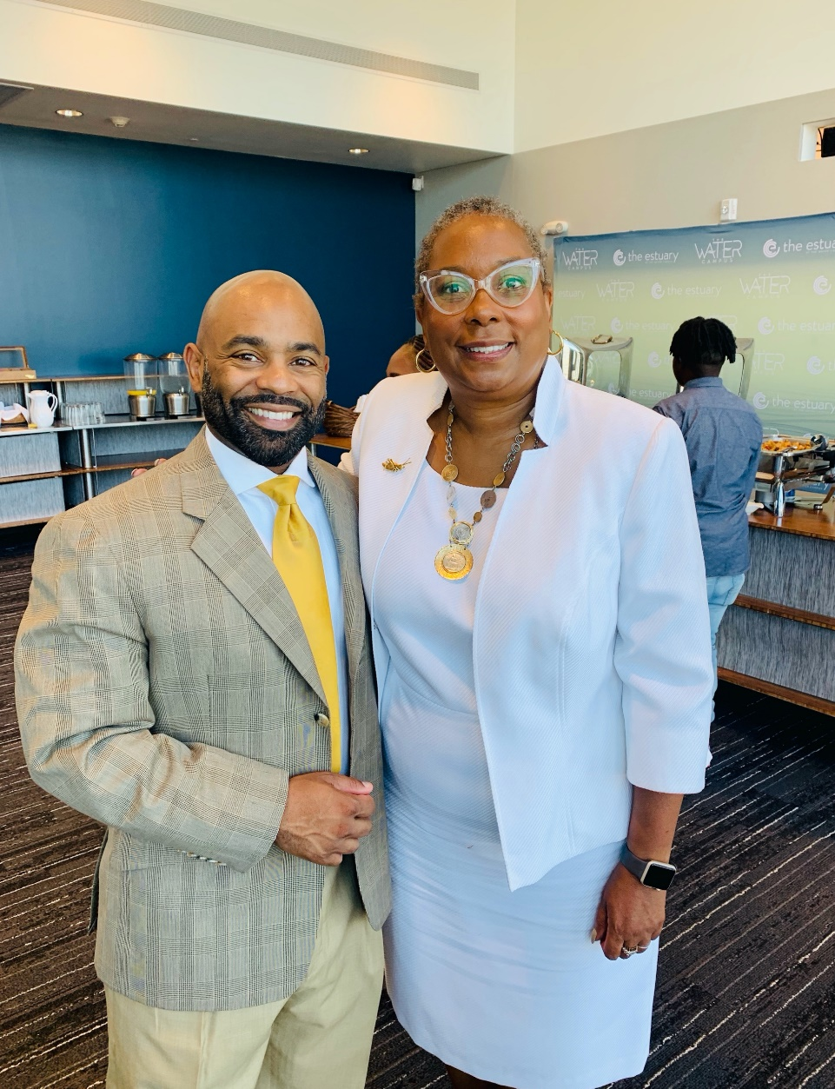
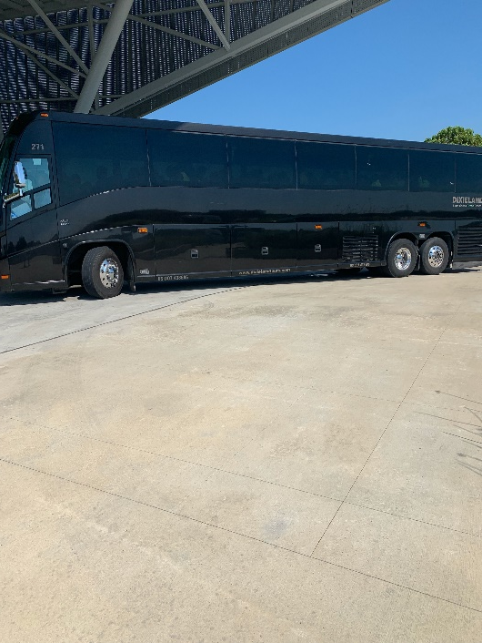
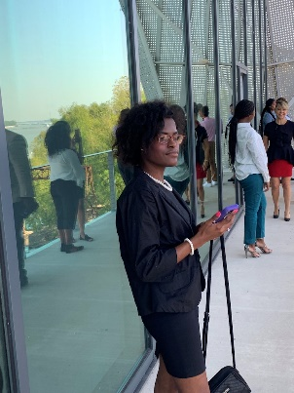
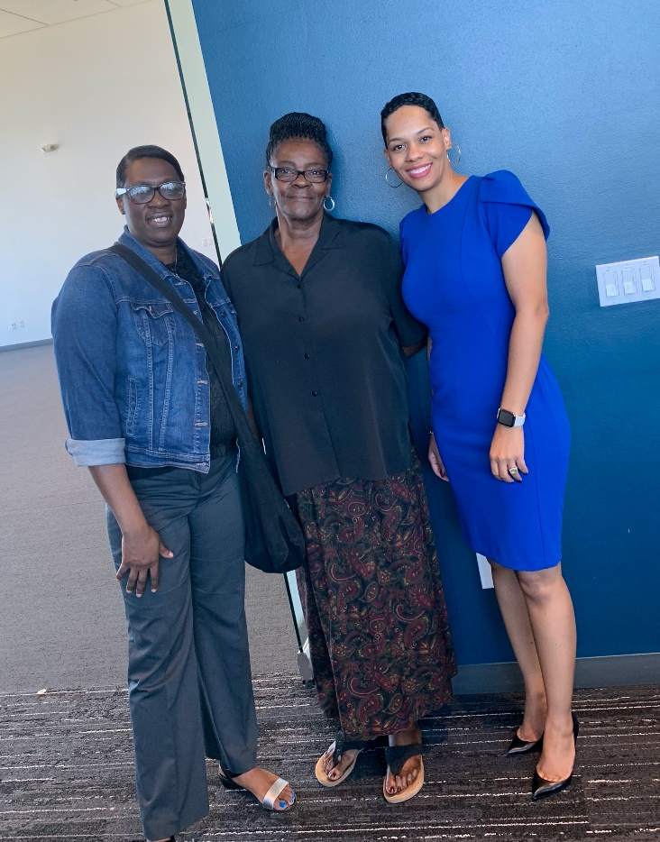
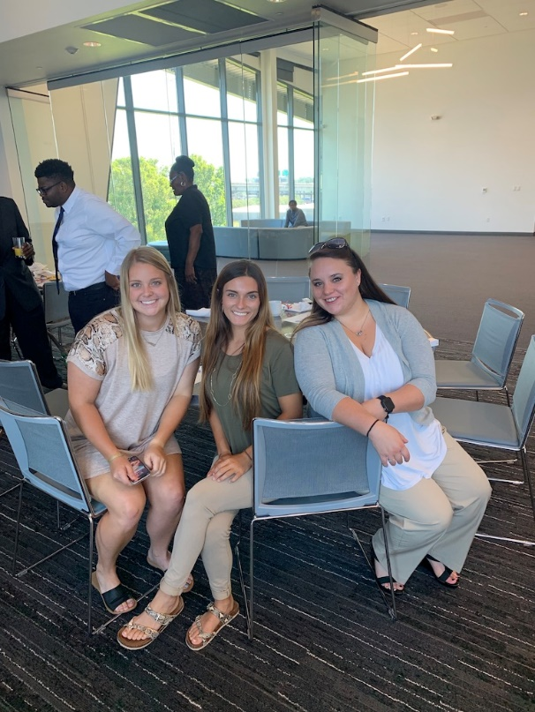
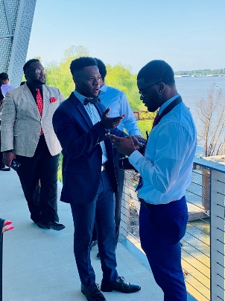
LDA Inaugural Induction Breakfast

Slide 24
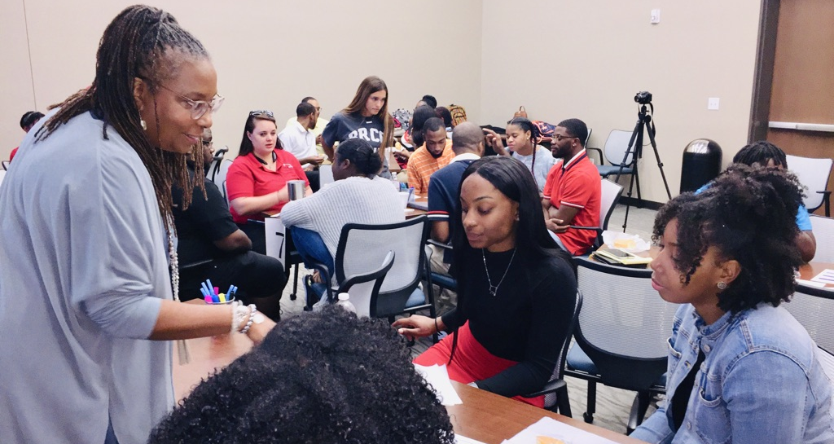
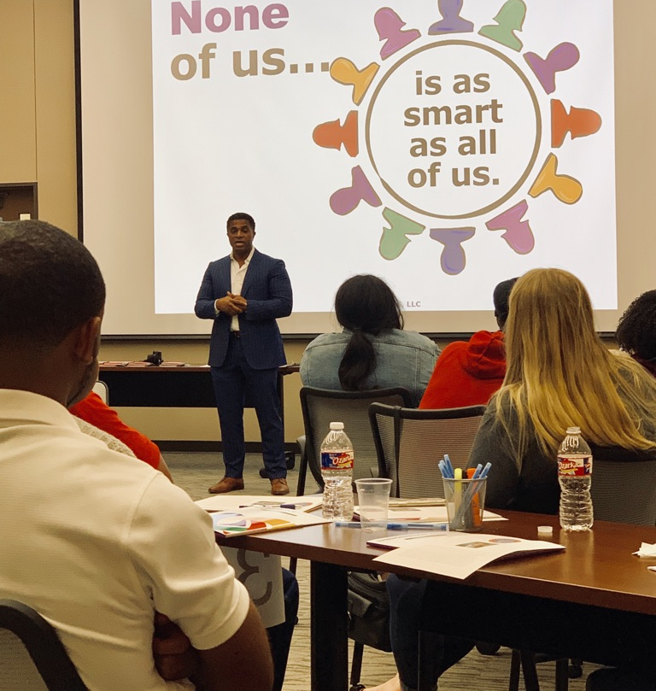
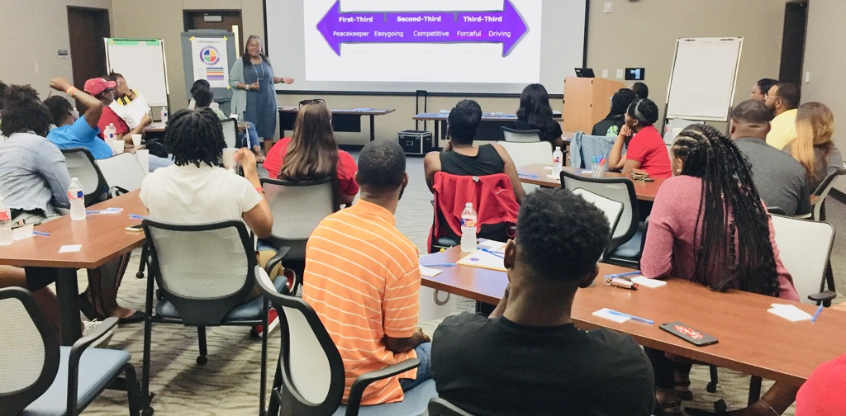

Slide 25
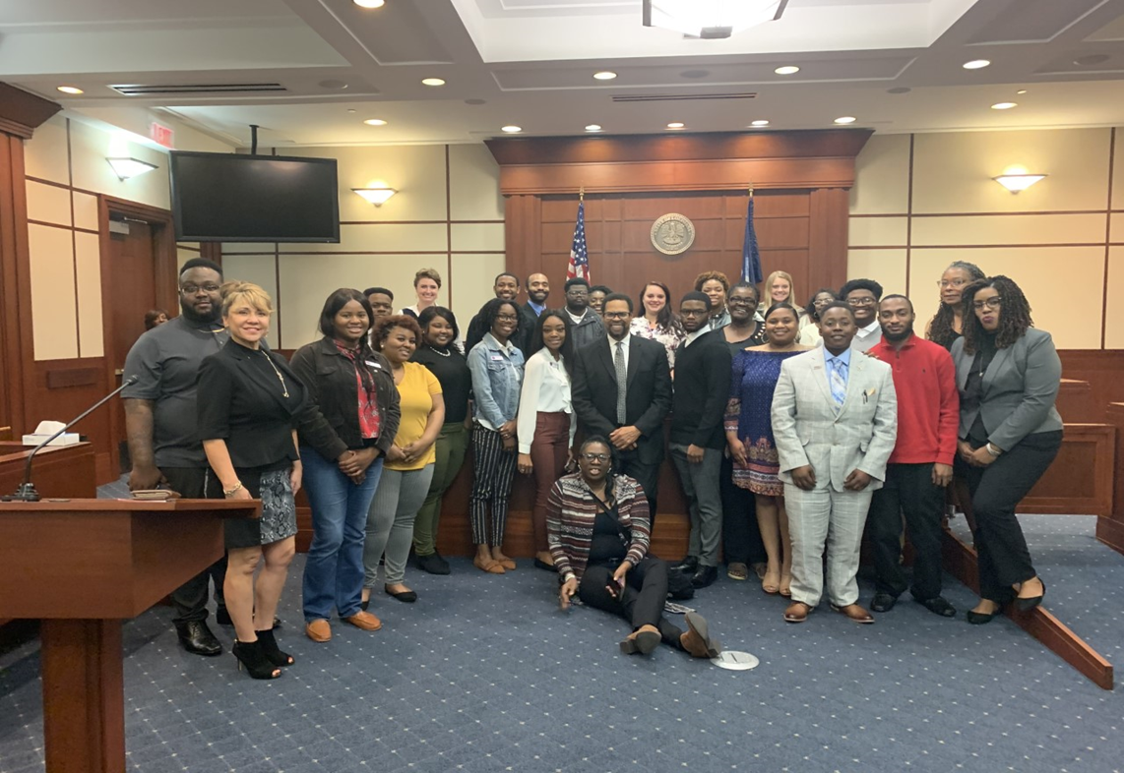
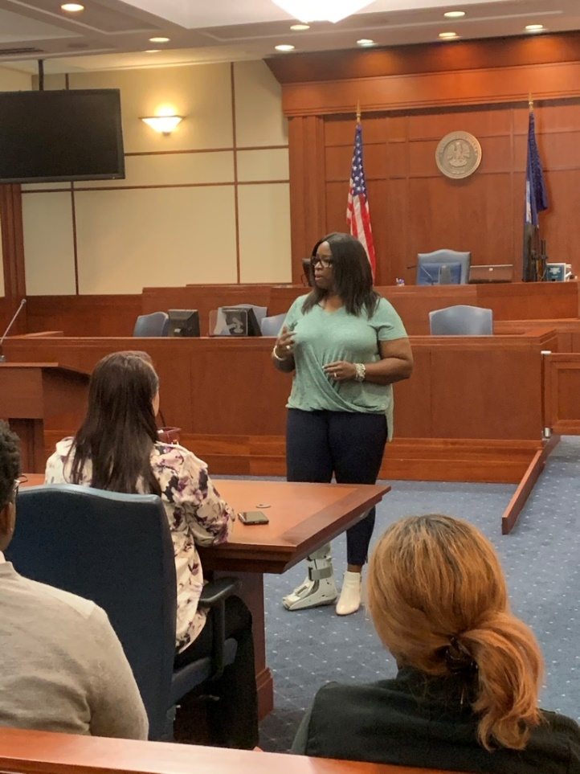
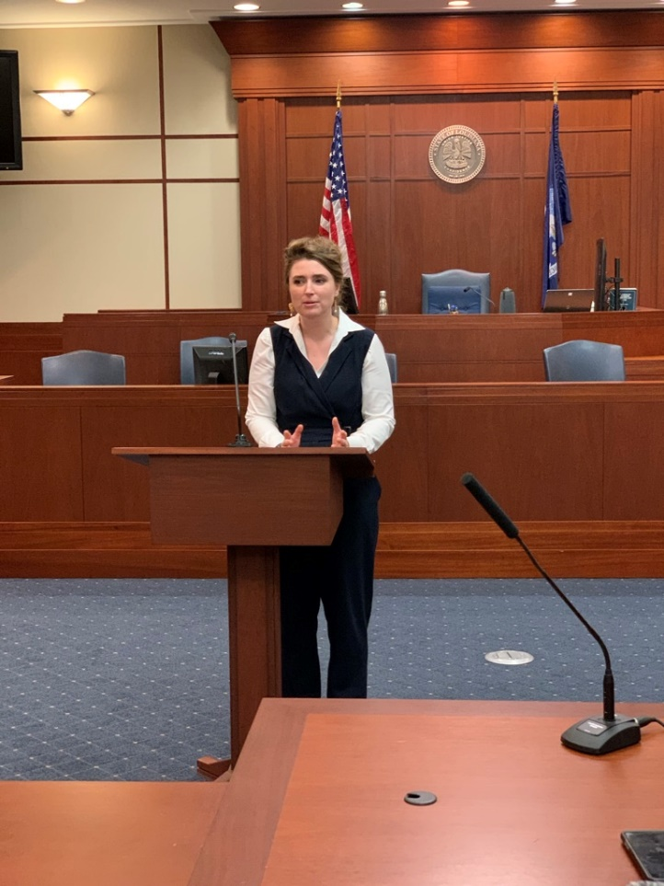
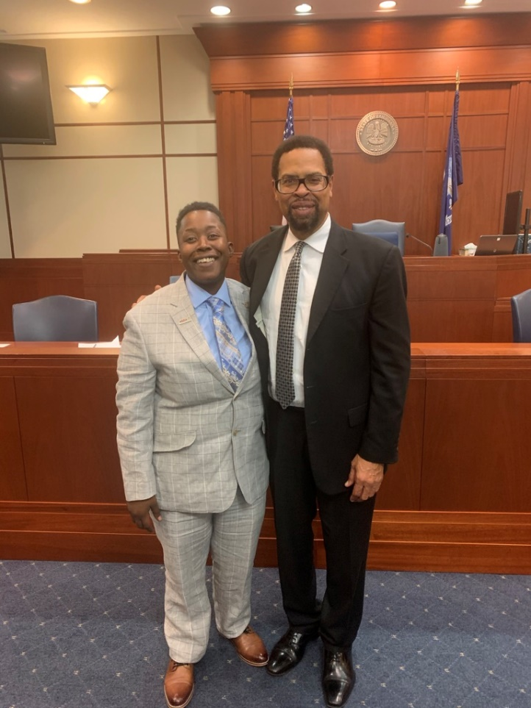
Honorable Judge Don Johnson
Judge’s Chambers
Criminal Court
Honorable Judge Don Johnson
Judge’s Chambers
Criminal Court

Slide 26
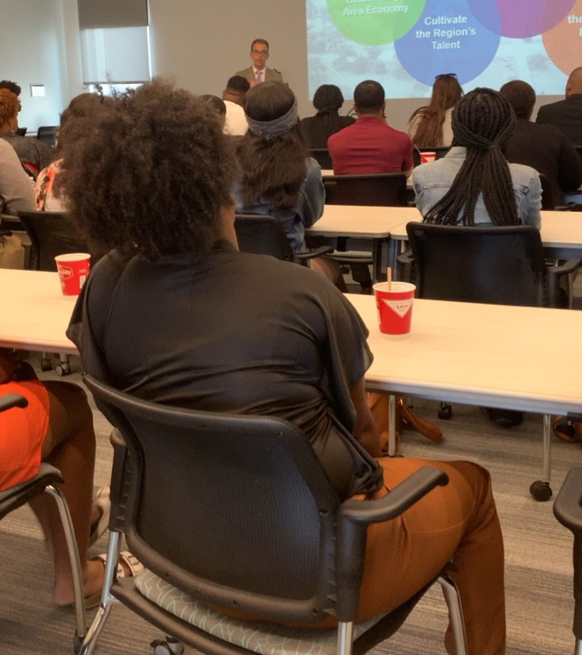
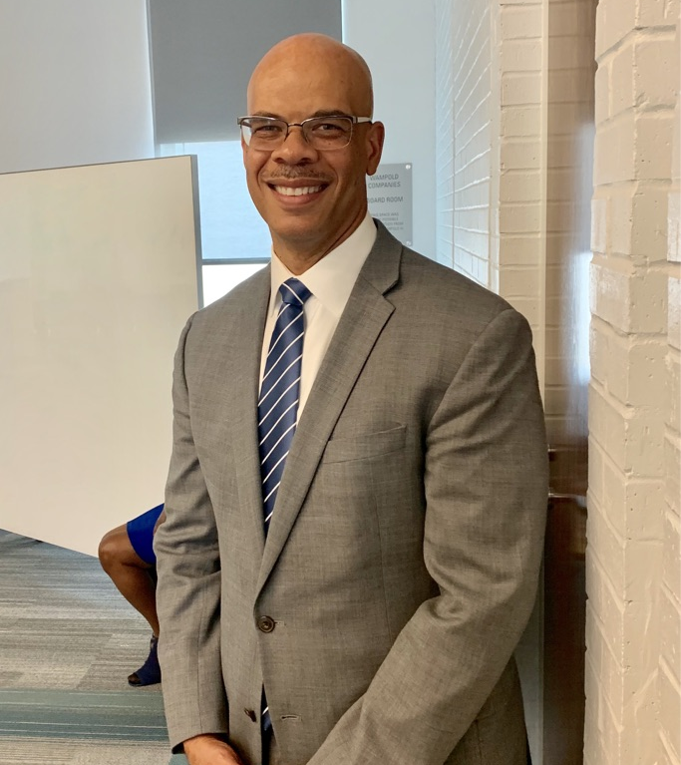
Greater Baton Rouge Area Chamber of Commerce

Slide 27
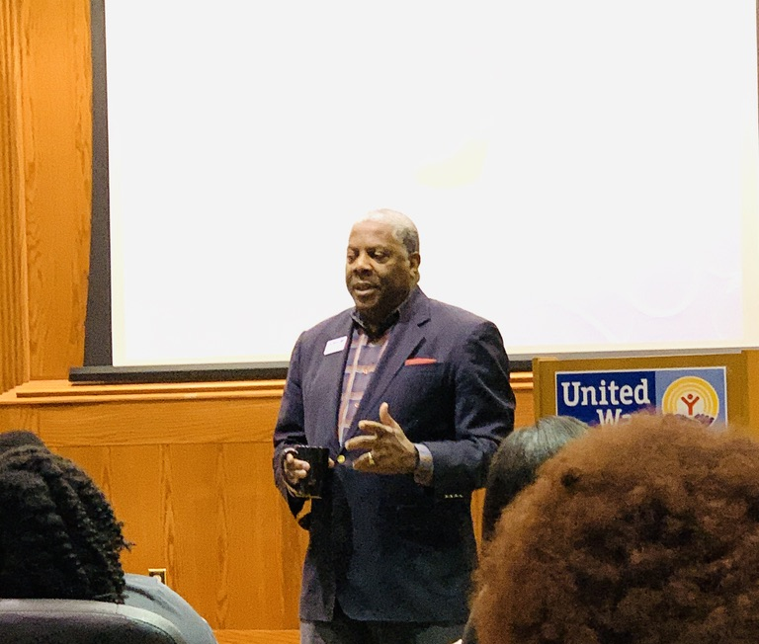
Capital Area United Way
CEO, George Bell

Slide 28
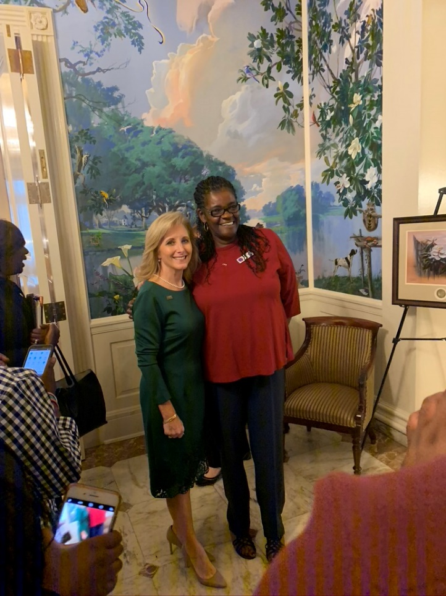
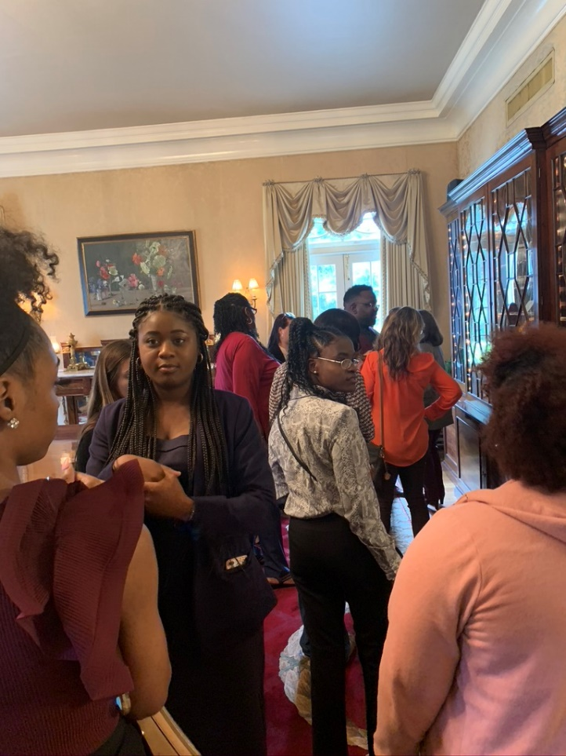
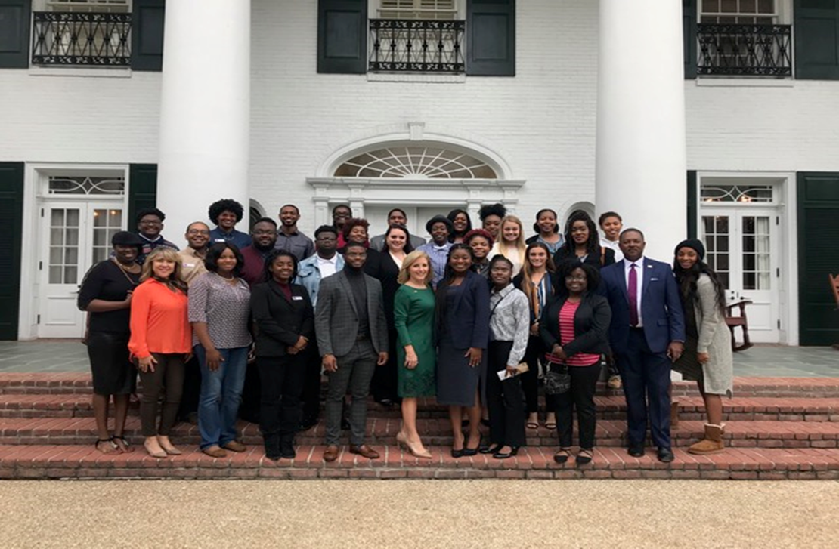
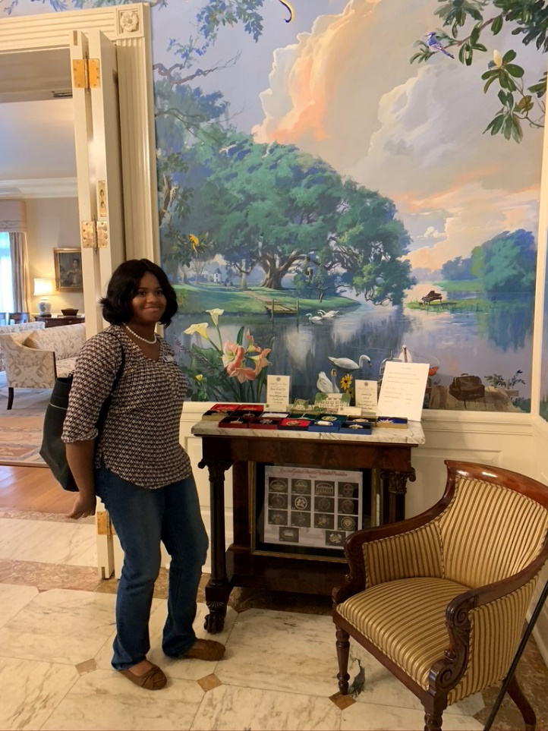
Louisiana Governor’s Mansion with the State First Lady

Slide 29
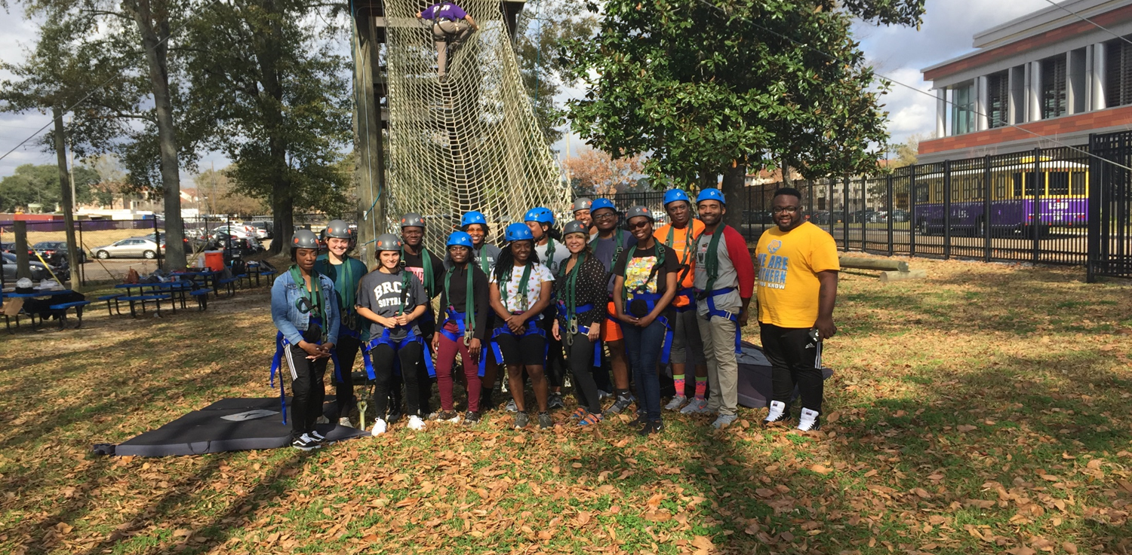
LSU-Team-Building Ropes Challenge

Slide 30
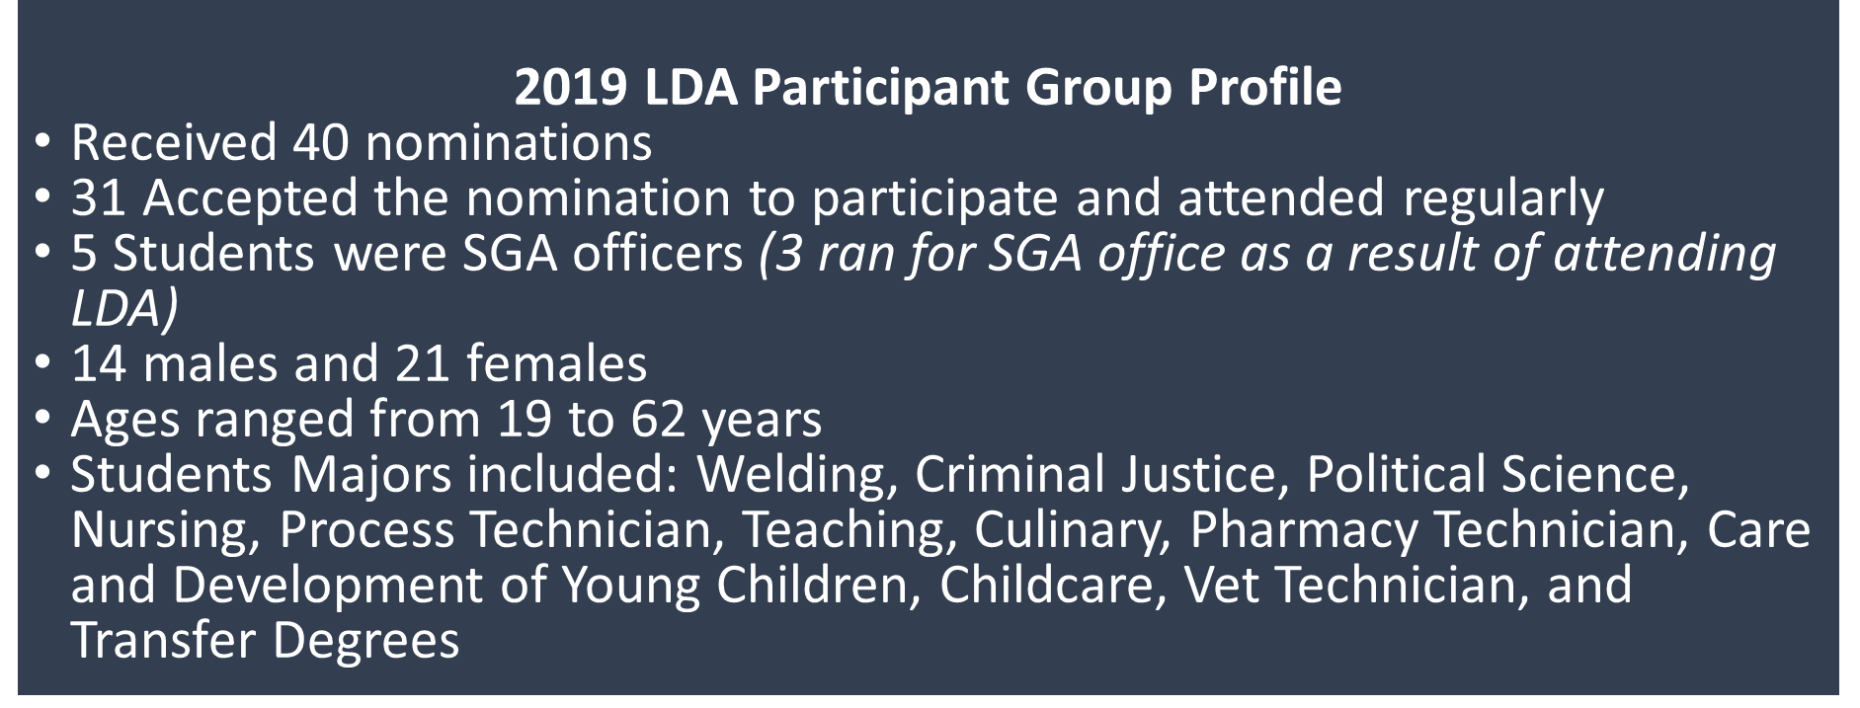
Evaluations LDA Participants
As the result of participating in this academy:​
100% of the participants say they have a better understanding of themselves and group dynamics​
100% of participants said that they learned new facts as it pertains to local and state government​, non-profit agencies
100% of participants say the learned new facts about higher educational and the Criminal Justice system ​
100% of participants have gained additional confidence and motivation after participating in this academy
100% of participants said that they have made new friends/contacts as a result of the academy​
STATS

Slide 31
“Leadership is a matter of how to be- not how to do it.” – Frances Hesselbein

Slide 32
Parting Words:
“You can do this at your site. Be creative. Make it your own. Let your desire to positively impact the students we serve drive the mission. Your belief in a program will bring forth the collaborators, the finances and most importantly, the wonder of inspiration.”– US ☺
STUDENTS ARE WAITING ON YOU!

Slide 33
Questions?
Tammy Brown, BRCC Campus Administrator brownt4@mybrcc.edu
Gerri Hobdy, BRCC Director of Community Outreach hobdyg@mybrcc.edu
?

