Slide 1
Human Cannonballs and Evil Geniuses: Boosting Performance in Online Discussions
Lea Rosenberry, IT Training Specialist, lea@psu.edu
Tami Tacker, Professor, ttacker@purdueglobal.edu

Slide 2
Demographics
30% Military
52% First in Family to Graduate
63% At Least One Dependent
Vandenbosch, B. (2019, May). Purdue Global Commencement, Indianapolis, IN.

Slide 3
Course Revision
Real-life Examples
Humor
Guided Peer Replies

Slide 4
Objectives
Rational Equations
Quadratic Equations
Radical Equations
Exponential Equations

Slide 5
Objectives
Evil Geniuses
Human Cannonballs
Trapeze Artists
Caffeine

Slide 6
The Evil Genius!
An evil genius was present at your birth. You were injected with 100 cc’s of a docile radioactive material. You craftily figure out the formula for deterioration of the substance and are ready for some answers.

Slide 7
The Evil Genius!
First Response to a Classmate
Calculate the amount of the docile radioactive material in a classmate’s body two years from today.
Second Response to a Classmate
Share any appropriate and interesting scenario that may explain the injection!

Slide 9
Why Include Humor?
Appleby (2018)
"Teachers do not have to be serious to be effective.”
Appleby, D. C. (2018, February). Using humor in the college classroom: The pros and the cons. Retrieved from https://www.apa.org/ed/precollege/ptn/2018/02/humor-college-classroom.

Slide 10
Why Include Humor?
Appleby (2018)
Increases in learning, self-motivation, class attendance, test performance.
Appleby, D. C. (2018, February). Using humor in the college classroom: The pros and the cons. Retrieved from https://www.apa.org/ed/precollege/ptn/2018/02/humor-college-classroom.

Slide 11
Why Include Humor?
Appleby (2018)
The creation of a positive social and emotional learning environment.
Appleby, D. C. (2018, February). Using humor in the college classroom: The pros and the cons. Retrieved from https://www.apa.org/ed/precollege/ptn/2018/02/humor-college-classroom.

Slide 12
Why Include Humor?
Appleby (2018)
A reduction of anxiety and stress in dealing with difficult material.
Appleby, D. C. (2018, February). Using humor in the college classroom: The pros and the cons. Retrieved from https://www.apa.org/ed/precollege/ptn/2018/02/humor-college-classroom.

Slide 13
Why Include Humor?
McCabe, Sprute & Underdown (2017)
Students perceive their success, even in difficult classes, based on their interactions with instructors.
McCabe, C., Sprute, K., & Underdown, K. (2017). Laughter to Learning: How Humor Can Build Relationships and Increase Learning in the Online Classroom. Journal of Instructional Research, 6, 4-7.
Notes:
Std

Slide 14
Why Include Humor?
McCabe, Sprute & Underdown (2017)
Using humor to make connections with online students resulted in higher success rates and levels of engagement.
McCabe, C., Sprute, K., & Underdown, K. (2017). Laughter to Learning: How Humor Can Build Relationships and Increase Learning in the Online Classroom. Journal of Instructional Research, 6, 4-7.
Notes:
Std

Slide 15
Quadratic Equations
Which method of solving quadratics is your favorite: factoring, completing the square, or the quadratic formula? Why?
Choose a quadratic equation from the list and solve it using your preferred method.
First Response to a Classmate: Choose a classmate’s problem and solve their quadratic using a different method.
Second Response to a Classmate: Choose a different classmate and check their problem.

Slide 16
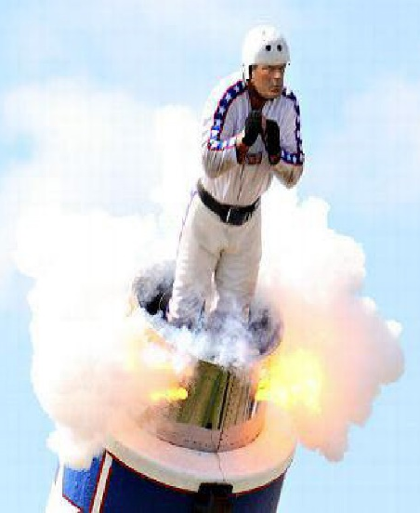
Human Cannonball
You are being shot out of a cannon. Use the equation to determine how many seconds it will take for you to hit the ground.
Since we want the time required for
you to land (safely!) on the ground,
let Y = 0.

Slide 17
Guided Peer Replies
Find the height of the human cannonball in 1, 5 and 10 seconds.
Check a classmate’s solutions
OR
Create a scenario explaining why
your classmate was shot out of a
cannon.

Slide 18
Why Use Guided Peer Replies?
DeCristofaro, Murphy, Herron, & Klein (2014).
Online conversations that more closely resembled an in-class discussion.
DeCristofaro, C., Murphy, P. F., Herron, T., & Klein, E. (2014). Using guided response to stimulate student engagement in the online asynchronous discussion board. International Journal of Arts & Sciences, 7(3), 45.
Notes:
Std

Slide 19
Why Use Guided Peer Replies?
DeCristofaro, Murphy, Herron, & Klein (2014).
Greater elaboration of content with challenging topics more fully analyzed.
DeCristofaro, C., Murphy, P. F., Herron, T., & Klein, E. (2014). Using guided response to stimulate student engagement in the online asynchronous discussion board. International Journal of Arts & Sciences, 7(3), 45.
Notes:
Std

Slide 21
Trapeze Artist
A circus trapeze can be thought of as a pendulum. The time it takes for a pendulum, or trapeze artist, to make one full swing (a period) can be calculated using the following formula:

Slide 22
Trapeze Artist
If another member of the circus lengthened the trapeze by one foot, how long would it take the trapeze artist to complete one full swing with their new length?
Share any appropriate and interesting scenarios that may explain the change in length of the trapeze.

Slide 23
Caffeine
The half-life of caffeine is found using the formula:
Share the name of your favorite caffeinated beverage, the amount of caffeine in the beverage, and your calculations for how much caffeine will be left in your system after 2 hours.

Slide 24
Caffeine
How much caffeine would be left in their system after 2 hours if they completely drank 3 beverages in one sitting?
Share any appropriate and interesting scenarios that may explain the decision to triple the caffeine intake.

Slide 25
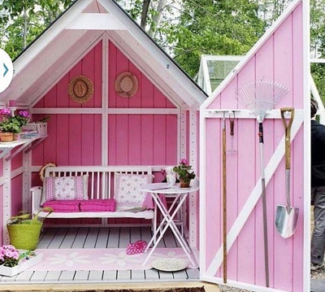
Man Cave / She Shed
Your favorite building supply store is having a contest and will build a man cave or she shed for the lucky winner.
To enter, you design and submit the plans. The store chooses the winning design and builds it for the winner free of charge.
Figure 1. She-shed pink. By Lewis, 2015, retrieved from https://www.flickr.com/photos/99781513@N04/20950322125/. CC BY 2.0.

Slide 26
Budget
Do an internet search and find the starting salary for the job you hope to get with your degree.
Create a budget. Estimate what percentages you will need to spend on the following categories:
Housing, Insurance, Food, Utilities,
Transportation, Giving/Saving,
and Personal.

Slide 28
Best Practices
Use humor to support course material
Content comes first
Integrate humor with the content - if possible
Find an application for the material
Incorporate humor using a scenario
Find ways for students to use humor
Allow creativity via explanations for situation
Permit video/picture responses

Slide 29
Best Practices
Be specific in instructions
Identify things that must be done
Provide an example and a rubric
Ask colleagues for help
Let friends and coworkers review the directions and develop an answer
Be flexible
Allow for creativity and critical thinking

Slide 30
Your Turn!
Find a buddy in a similar subject area.
Choose a common topic of study.
Create a super-cool discussion question to share with the group.
Construct at least one guided peer reply.

Slide 31
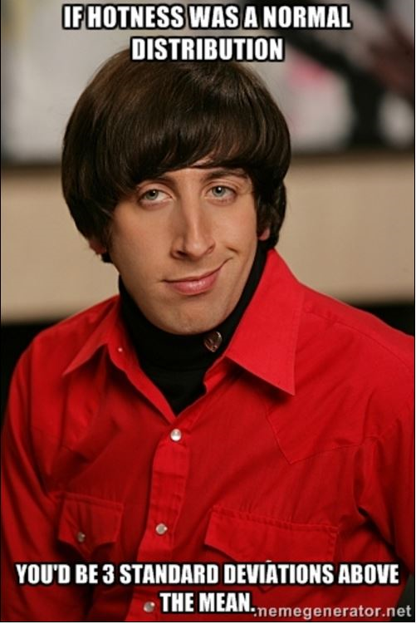

Slide 32
Questions?
Tami Tacker
ttacker@purdueglobal.edu
Lea Rosenberry
lea@psu.edu

Slide 33
References
Appleby, D. C. (2018, February). Using humor in the college classroom: The pros and the cons. Retrieved from https://www.apa.org/ed/precollege/ptn/2018/02/humor-college-classroom.
DeCristofaro, C., Murphy, P. F., Herron, T., & Klein, E. (2014). Using guided response to stimulate student engagement in the online asynchronous discussion board. International Journal of Arts & Sciences, 7(3), 45.
McCabe, C., Sprute, K., & Underdown, K. (2017). Laughter to Learning: How Humor Can Build Relationships and Increase Learning in the Online Classroom. Journal of Instructional Research, 6, 4-7.
Vandenbosch, B. (2019, May). Purdue University Global Commencement, Indianapolis, IN.

