Slide 1


Kansas Community College Corequisite Symposium
Pre-Game Welcome!

Slide 2
Kansas Community College Corequisite Symposium
We are a part of movement in Higher Education
We care about our students and their academic success

Slide 3
Kansas Community College Corequisite Symposium
Shift our Focus:
    Individual Course Success Rates
    vs
    Throughput

Slide 4
Kansas Community College Corequisite Symposium
Logistics:
    Welcome Packet
    Session Format
    Evening Zoom

Slide 5
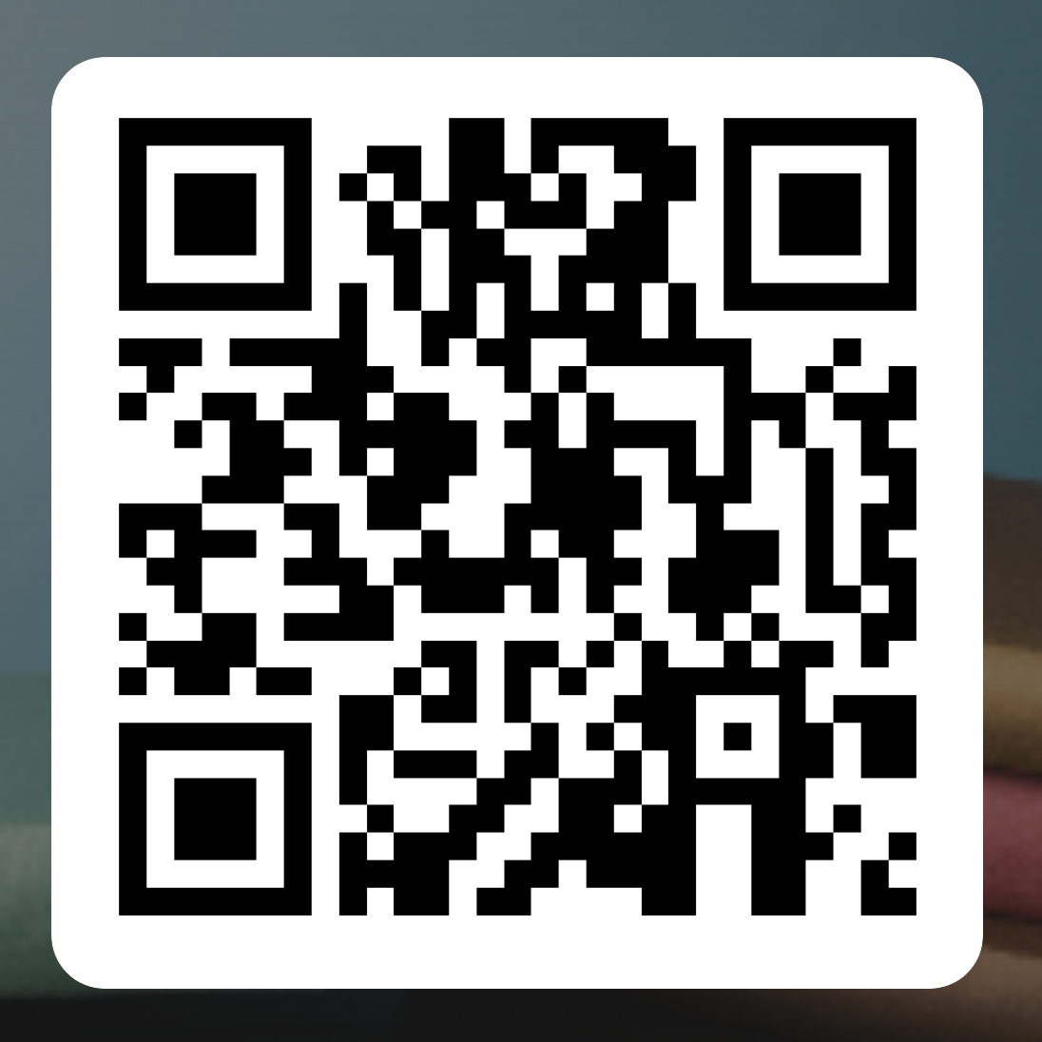
Kansas Community College Corequisite Symposium
https://forms.office.com/r/KEH2ECXQDN
Building the Playbook

