Slide 1
Strategic Planning Made Easy
Dr. Penny Quinn, VP
Barton Community College
NISOD 2013

Slide 2
Brief Experience with Strategic Planning
Involved with redesign of college strategic plan
3 institutions in 3 states
Employment
In HE 23 years
Predominantly in public community colleges
Positions
Faculty Member, Department Chair, Program Director, Dean, & VP

Slide 3
Understanding Terminology
 | Operational Planning | Strategic Planning
 | Short Range Plans & Policies (often annual) | Long Range Plans & Policies (3-5 years)
Focus | Routine Activities | Achieving Goals
Purpose | To Achieve the Best Use of Resources | To Plan the Best Action
Rewards | Efficiency & Stability | Effectiveness & Impact
Information | Present Situation (assumes continued stability) | Future Opportunities (recognizes a dynamic environment)
Organization | Bureaucratic & Stable | Entrepreneurial & Flexible
Problem Solving | Bases Decisions on Past Experiences | Identifies New Methods & Alternatives
Risks | Lower | Higher
Notes:
“Strategic Planning” terminology is used by many, but may or may not be accurate.
Important to recognize that with Strategic Planning:
Focus on achieving goals - - not routine activities
Based upon future opportunities - - not present situation
Holds potential for higher risks

Slide 4
Strategic Planning: Simplicity
Consideration
Information
Implementation
Evaluation
Preparation

Slide 5
Considerations: Why?
Some Institutional Benefits:
Effectiveness
Set institutional priorities
Communication
Promote internal stakeholder dialogue
Present the college to external stakeholders successfully
Efficiency
Enhance effective use of college resources (Fiscal, Physical, & Personnel)

Slide 6
Considerations: Leadership & Buy-in
Who will chair the SP initiative?
Who will serve on the SP committee?
Broad representation is best
Announce the SP initiation in advance
Reassure employees that SP is not being done to provide justification for RIFs
If personnel cuts are on the horizon, conduct prior to beginning SP process
If major leadership changes are likely, delay the SP until better stability exists
Engage as many individuals in the process as possible

Slide 7
Considerations: Existing College Docs
Review college planning documents to ensure Vision, Mission, & Values (etc.) truly represent the college
All must be clear and accurately reflect the institution as they will serve to guide college direction
‘Core Values’
‘Vision’
‘Mission’

Slide 8
Core Values
5-10 (or so) essential beliefs regarding the organization
High Quality
Access
Student Success
Leadership & service
Integrity
Respect
Loyalty

Slide 9
Vision Statement
Identifies what the college aspires to become
What is the ideal future state of the organization?
Based on the Core Values
Often include “Will be…” or “Aspires to…” phrasing

Slide 10
Mission Statement
Summarizing statement of the general principles guiding the organization
Who are we?
What is our purpose?
What is our philosophy?
How do we meet stakeholder expectations?
What makes us unique?

Slide 11
Considerations: Phases Timeline
Consideration (1-2 months)
Information
(4-6 months)
Implementation
(Year)
Evaluation
(Annually)
Preparation
(3-4 months)

Slide 12
Preparation: Consultants?
Do you plan to use an outside party (consultant) to facilitate?
Pros
Can identify processes/concepts not considered by the College SP team
Can create atmosphere of expertise (anyone more than 60 miles away is “an expert”)
Can provide momentum to keep process moving forward
Cons
Cost
Assumption of time savings is false as college personnel must provide the college information for consultant utilization

Slide 13
Preparation: External Expectations
Identify and compile external requirements
Regional School Accrediting Body
HLC, etc.
State & Regional Program Accrediting Groups
National League of Nursing Accrediting Commission (NLNAC), Automotive Service Excellence (ASE), Commission on Accreditation of Ambulance Service (CAAS), etc.
State Governing/Coordinating Agencies
Board of Regents, etc.
Federal Grants
Notes:
College Board of Trustees
Policy Governance
College
Annual Departmental & Divisional Plans
Kansas Board of Regents
Foresight 2020 Goals
Technical Education Authority
Performance Agreements
Accreditation
HLC AQIP Initiatives

Slide 14
Information: Gathering & Comparing
Environmental Scan
Monitoring internal and external environments to detect trends which could impact a business
SWOT or SOAR Analysis
Labor Market Projections
Gap Analysis
Defining difference between the current position and the desired one
Benchmarking
Systematized comparing against others; often a selected, representative cohort based upon comparable aspects (location, size, services, etc.)
Notes:
S.O.A.R. – Strength Opportunity Aspiration Results

Slide 15
Information: Focus Group
To gather in-depth info from a large population
Select 6-12 individuals with common characteristics
Define questions to be used for all groups
Facilitator led, with scribe (doesn’t interact with group)
60-90 minutes in length
Pros
Quick & relatively easy
Group dynamic can provide more quality info
Cons
Facilitator bias possible
Conversation can be biased by strong personalities
Data analysis can be time consuming
Info collected not representative of other groups

Slide 16
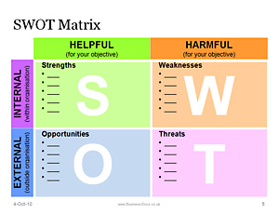
Information: Environmental Scan - SWOT
Analyzes both internal and external factors
Internal
Strengths
Weaknesses
External
Opportunities
Threats

Slide 17
Information: Environmental Scan - SOAR
Appreciative Inquiry Model – orients focus on the positive and minimizes getting bogged down in belaboring issues that are not likely to be modified (i.e. ‘campus is too far from town’)
Strengths
What are the greatest assets?
Opportunities
What are the best possible outcomes?
Aspirations
Who do we want to be; what does our future look like?
Results Desired
What measureable results are desired?

Slide 18
Information: Environmental Scan - Labor Projections
All States Labor Market pages
http://www.bls.gov/ooh/about/sources-of-career-information.htm
Sometimes state labor market info is great!
Sometimes… not so much…

Slide 19
Information: Environmental Scan - Gap
Identify Gaps (existing & potential)
Are the gaps positive (to our benefit) or negative (worsen our position)?
Can the gap be mediated or is it unrealistic to overcome?
Gap Type
Personnel
Costs: Annual Wage/Salary + Benefit Package
Options: Has overtime/stipend been considered?
Facilities
Existing: viability for new use, availability, capacity, etc.
New: added utilities, maintenance, supervision, etc.
Other Expenses
Insurance, Legal Fees, Equipment, Supplies, etc.
Remember some expenses are not one time only
Notes:
Mediated through a partnership, a grant, redistribution of personnel or reconsideraton of facilities utilization, etc.

Slide 20
Information: Environmental Scan - Benchmarking
Why?
Know the standard to work toward
Know what the competition is doing
What?
Determine what is to be benchmarked
Retention rate
FT to PT faculty ratio, etc.
What & How?
Determine what is to be benchmarked and where the data can be gathered - NCCBP

Slide 21
Information: Environmental Scan - NCCBP
Benchmarks
Completion Rates
Transfer Rates
Performance at Transfer institutions
Retention/Persistence
Student Success Rate
Distance Learning Outcomes
CTE Completer Employment Status
Employer Ratings
Class size
Cost (by credit hour & FTE)
HS enrollment rate
HR Stats
Faculty Load
Minority Participation Rates
Student Faculty Ratio
272 schools participated in 2012
<$1,500 annual participation fee

Slide 22
Implementation: SP Creation
Goals
Matters necessary to address in order to achieve the identified mission
Ex. Outstanding stewardship of resources
Strategies
Desired change to impact the issue
Ex. Development of a financial plan which supports the SP
Actions
Steps to reach the identified strategies
Ex. Management team will define priorities for five colleges areas including facilities, personnel, & programing (areas: Instructional Divisions, Student Services, Athletics, IT, PR, and Administrative Services)

Slide 23
Implementation: Final Stage
The Strategic Plan serves as the foundation upon which the budget is developed to meet the identified expectations as efficiently as possible
Publication of the SP
Identification of the key internal leaders for the various initiative identified
Determination of the communication methods and plans which will be utilized

Slide 24
Evaluation
Recognition that SP must remain flexible – it is a conceptual framework not a rigid hierarchy
Consistent results tracking
Annual review
Modification of strategies as necessary
Recognition of emergent strategies
Consistent communication regarding strategic actions and results
Presidents Council and other campus committees
Presidential Email
College Newsletter
Webpage Notification

Slide 25
Resources
NCCBP – National Community College Benchmarking Project
www.nccbp.org
Occupational Outlook Handbook
http://www.bls.gov/ooh/About/Projections-Overview.htm
Projections Central (State Occupational Projections)
http://www.projectionscentral.com/
Career One Stop
http://www.careerinfonet.org/Occ_Intro.asp?id=1,&nodeid=1

Slide 26
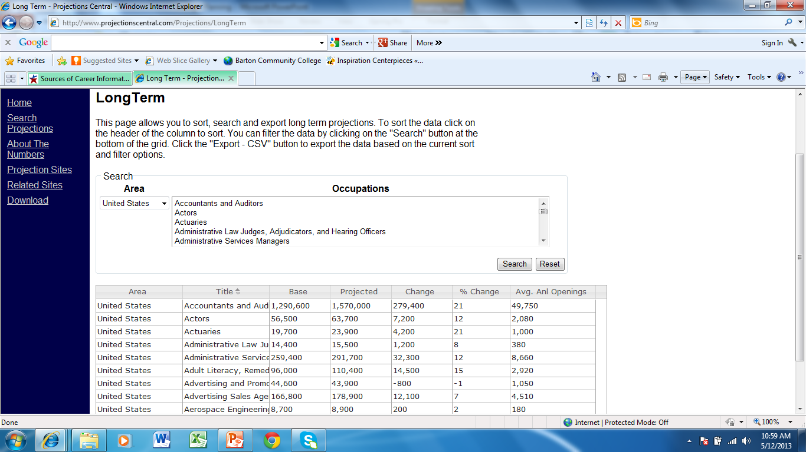
State Occupational Projections

Slide 27
Career One Stop

Slide 28
Questions?
Dr. Penny Quinn
Vice President
Barton Community College
QuinnP@BartonCCC.edu
Office #620-792-9303
PowerPoint Available:
http://bartonccc.edu/administration/is/staff/perkinsc/quinnnisod.html

